Slide 1
A Solution for the Automated Detection of Clickjacking Attacks

Slide 2
Contents
Background
Related Work
Clickjacking Detection
Evaluation
Discussion

Slide 3
Background
Clickjacking: steal user's click
  Expose confidential information
  Give away authority
Typically overlaying the web page with transparent iframe
SOP is not violated
Not a bug

Slide 4
Background
Web sites may not be taking this vulnerability seriously
  About 14 percent of the Alexa Top 500 protect their sites from clickjacking
Hard to manipulate
Countermeasures for clickjacking are not reliable
Lack of awareness

Slide 5
Related Work
HTTP header X-FRAME-OPTIONS
Browser willl prevent loading page in iframe
  Deny
  SAMEORIGIN
  ALLOW-FROM uri

Slide 6
Related Work
Framebuster
JavaScript code prevent web page from being rendered in inframe
<script type="text/javascript">
if ( top.location != self.location )
top.location.replace(self.location.href);
</script>

Slide 7
Related Work
Framebuster-buster
Onbeforeunload
<script>
window.onbeforeunload = function ( )
{
return "Do you really want to exit Paypal?";
}
</script>
<iframe src=" http://www.paypal.com">

Slide 8
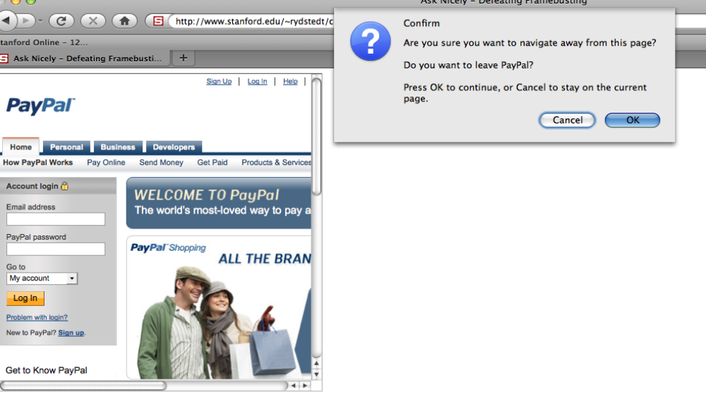
Related Work
Framebuster-buster
Onbeforeunload
<script>
window.onbeforeunload = function ( )
{
return "Do you really want to exit Paypal?";
}
</script>
<iframe src=" http://www.paypal.com">

Slide 9
Related Work
Framebuster-buster
204 flushing
<script type="text/javascript">
var prevent_bust = 0
window.onbeforeunload = function() { prevent_bust++ }
setInterval(function() {
if (prevent_bust > 0) {
prevent_bust -= 2
window.top.location = 'http://example.org/page-which-responds-with-204'
}
}, 1)
</script>

Slide 10
Related Work
NoScript/ClearClick
Prevent clicks on invisible, or partially obstructed cross-domain element
Frame, object or embed element overlaps with elements that could potentially receive mouse or keyboard events
Opacity of the frame, object or embed element reaches a value below 0.3

Slide 11
Related Work
ClearClick
  1. Listener registration
  2. Fast-track bypass
  3. Parent chain check
  4. Rapid fire check
  5. Cursor sanity check
  6. Obstruction check
  7. User notification
  8. Interaction cancellation

Slide 12
Detection
Testing Unit
Detecting Unit
Extractor
ClickIDS
Xclick
NoScript

Slide 13
Detecting Unit
ClickIDS
  Report when detecting overlapping clickable elements: links, buttons, input, flash
  But not able to detect partially obstructed pages
Modified NoScrpit:
  Analyze click's neighborhood region to detect overlap and partially obstruction
  log the alert

Slide 14
Detecting Unit
ClickIDS
  1. Page-handler handles new pages
  2. Click-handler intercepts clicks
  3. Detect If the clicked element is clickable
  4. Scan the page and iframes
  5. If clickable elements at the same position
  6. Drop the click event

Slide 15
Testing Unit
Xclick
  Load pages
  Move the mouse
  Simulating users' clicks
  For large elements, multiple clicks
Element Extractor
  analyze DOM
  registered to the page-open event

Slide 16
Xclick
start browser
for url in input:
check the browser functionalities, else:
restart it
feed the browser with the url and instruct it to load the page
wait for the page to be loaded
if a timeout occurs:
continue
check the elements extractor’s logfile, else:
continue
parse the logfile for the list_of_elements and the page statistics
record the page statistics in the database

Slide 17
Xclick
for element in list_of_elements:
if element > 50x50px:
crop it (multi click)
if element.coordinates are in the next page:
scroll the browser page
check the element.coordinates validity else:
continue
move the mouse on the element.coordinates
click
if element.type == select:
press ’esc’ to close the menu

Slide 18
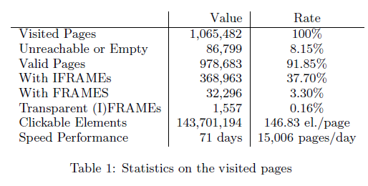
Evaluation
1,065,482 pages on 830,000 unique domains

Slide 19
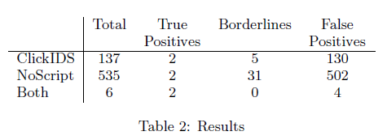
Evaluation
672 alerts
Combine them

Slide 20
Evaluation
False Positive
  dynamic pop-ups
  IFRAMEs overlaps the page content in proximity

Slide 21
Discussion
Only can detect clickjacking on clickable elements
High false rate

