Slide 1
FlowFox
A Web browser with flexible and precise information control
Notes:
Flowfox is a fully functional borwser it implements a sound precise mechnism information flow control mechnim, called secure multi execution

Slide 2
ROADMAP
Background
Threat Model
Design
Security Policies
Implementation
Evaluation

Slide 3

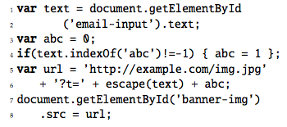
Background
same-origin-policy (SOP) has holes
Examples to bypass SOP
More powerful security enforcement mechanisms are required.
XMLHTTPRequest？
Notes:
Same origin policy is perhaps the most important denfence mechinism adopted by all the browsers, but it is not enough.
Now it seems that the most straightforward way is to use (AJAX) ( XMLHTTPRequest ) to send this private information to attacker’s website. But due to same-origine-policy, XMLHTTPRequest can only send
There are many ways to bypass this restriction
Here is another more serious case, with the similar scenario
Information flow control is a genral and powerful way to adress these attacks

Slide 4
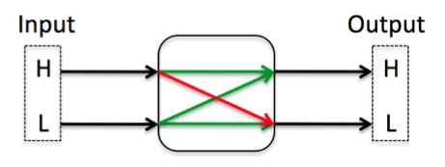
Background
Information flow control
Any program can be seen as a machine with inputs and outputs. Inputs can be classified high credential input and low credential input. The same for output.
Notes:
Low credential level

Slide 5
Background
Example for Information flow analysis
High Input:
document.getElementById(‘email.input’).text
Low Output:
*.src=*
Notes:
setting the src property of an img element will trigger an HTTP request to the url set

Slide 6
Background
Noninterference
A program is defined to be noninterferent if its outputs cannot be influenced by inputs at a higher security level than their own.
Termination-insensitive noninterference
A version of Noninterference.
Under the assumption that a program always terminates normally, information is only disclosed by the program when it terminates.
Many existing tools can effectively determine a program as long as the assumption holds
Notes:
Noninterference program is safe.
If a program is not noninterference, there must exist some channels that may be utilized by attaks
Under this version of noninterference, information leaks are permitted if they are transmitted purely by the program’s termination behavior (i.e., whether it terminates or not).
A termination-insensitive model ignores the possibility of non-termination or of abnormal termination due to unchecked exceptions such as out-of-memory errors. This model only makes security guarantees under the assumption that a program always terminates normally.
Under the assumption of Termination-insensitive noninterference, existing works can detect whether a program is noninterference (whether exists information leaks)

Slide 7

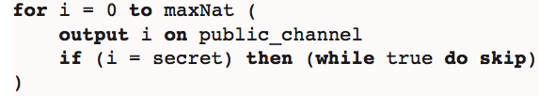
Background
Termination-insensitive noninterference Vs. Termination-sensitive noninterference
Notes:
The programs 1 and 1a, for example, would be rejected as insecure because they contain a “high” loop (a loop depending of the value of a secret) which assigns to a “low” variable (a public channel) causing an implicit information flow from secret to public.
Fall into an infinite loop
In conclusion, existing tools exist to detect

Slide 8

Background
In Context of web security
Many state-of-art information flow systems can detect information leak for this case
Notes:
Because it satisfies the termination insensitive assumption

Slide 9
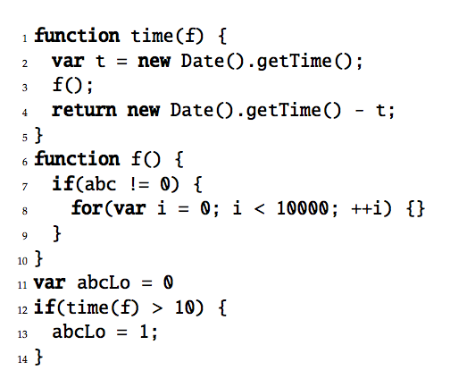
Background
Timing-insensitive noninterference
Assumption: the execution result has nothing to do with the execution time
Notes:
Low variable abclo’s value depends the exuection time of the function f. function f’s execution time depends on the high variable abc. So low vairbale abclo’s value can leak private information.

Slide 10
Background
Secure Multi-Execution ([18])
An information flow control enforcement mechanism
As its name suggests, secure multi-execution will execute a program multiple times, once for each security level.
SME regime will guarantee non-interference
FlowFox implements SME

Slide 11
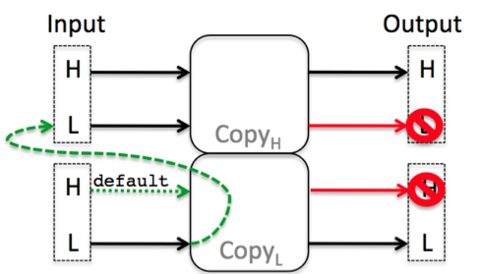
Background
Secure Multi-Execution Rule
Image.src
Document.
cookie
Image.width
Notes:
I/O operations are executed only in the executions at the same security level as the operation. (although scripts will be executed twice, domain.cookie can only be executed in high level)
Output operations at other levels are suppressed.
High input operations in the low executions:
Input operation is skipped
Input operation returns a default value
Low input operations in the high executions:
Wait for the low execution to perform this input

Slide 12
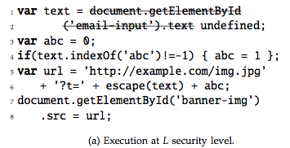
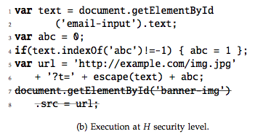
Background
Example of Secure Multi-Execution

Slide 13
Background
Secure Multi-Execution
Pros:
1. Secure multi-execution is sound:
2. Secure multi-execution is precise
Cons:
1. Cost in CPU time and memory use
Notes:
1. Secure multi-execution is sound: any program is noninterferent under secure multi-execution. (draw picture
More interesting, not easy to see but has been mathmatically proved 2. Secure multi-execution is precise: if a program is (termination-sensitively) noninterferent under normal execution, then its behavior under a terminating normal execution and under secure multi-execution are the same.

Slide 14
Threat Model
Examples
Session Hijacking
Malicious Advertisements (Plugins)
History Sniffing and Behavior Tracking
Notes:
Based on the gadget

Slide 15
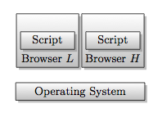
FlowFox Design
Two Design Alternatives
Multi-execute entire browser:
Easy to implement
Too Coarse grained and imprecise
Notes:
Label inputs and outputs at the abstraction level provided by OS.
Policy can talk about I/O to files, networking, mouse events…
Policy can NOT distinguish individual HTML elements

Slide 16
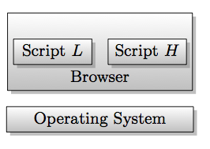
FlowFox Design
Two Design Alternatives
2. Multi-execute the web scripts (FlowFox)
Treat all interactions with the browser API as inputs and outputs
Fine grained
Hard to implement

Slide 17
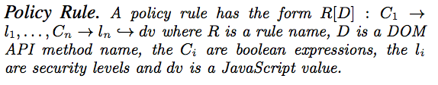
Security Policies
DOM API will be specified policy
FlowFox policy specifies two things
Security levels to DOM APIs
Default value to each DOM API call
Policy Rule

Slide 18


Security Policies
4. Examples

Slide 19
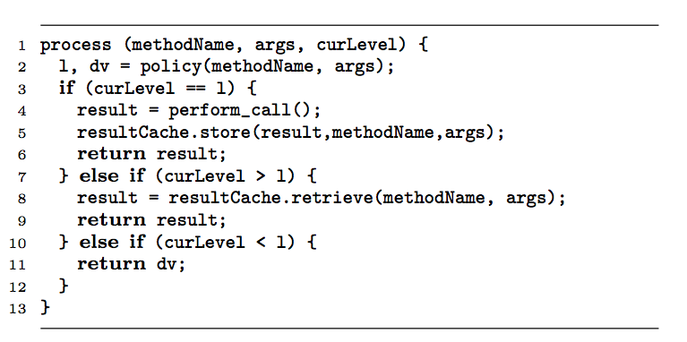
Implementation
Implemented on top of Mozilla Firefox and consists of about 1400 new lines of C/C++ code
SME-aware JavaScript Engine
JSContext has a security level field
Each property of JSObject has a security level field
Only properties with the same security level as the coordinating JSContext are visible
SME/IO Process
Event Handling
Low events will be handled by both the low and high executions
High events will only be handled by the high execution.

Slide 20
Evaluation
Security
Is FlowFox Non-interferent
Two reasons FlowFox could fail to be non-interferent
Violate the assumptions underlying the soundness proof
Exist implementation level vulnerabilities
Hard to guarantee.
Notes:
I have said that secure multi execution is non-interferent

Slide 21

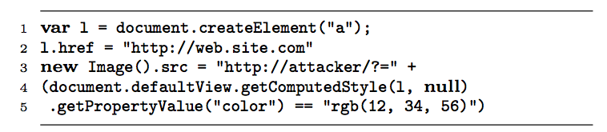
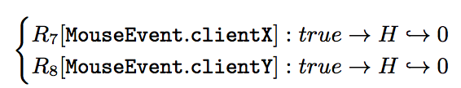
Evaluation
Security
Examples of mitigating threats
Leaking Session Cookies
History Sniffing
Tracking Libraries

Slide 22
Evaluation
Compatibility
Two regular FireFox browsers and one FlowFox browser
A simple policy that makes reading document.cookie high
Crawler dumps a screenshot of each of the three browsers to a bitmap
First, compare the bitmaps belonging to two FireFox browsers and find the same area (unmasked area).
Second, compare the unmasked areas for bitmaps belonging to FireFox and FlowFox browsers.

Slide 23
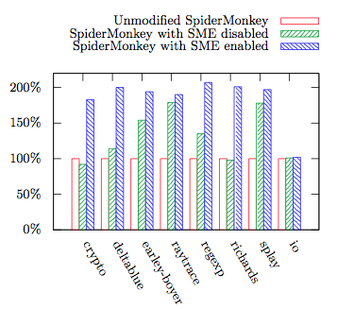
Evaluation
Micro Benchmark
Measure the overhead of executing pure JavaScript.
Measure the overhead for I/O intensive applications.
Executing pure JavaScript incurs large overhead
IO test shows only a negligible impact overhead

Slide 24
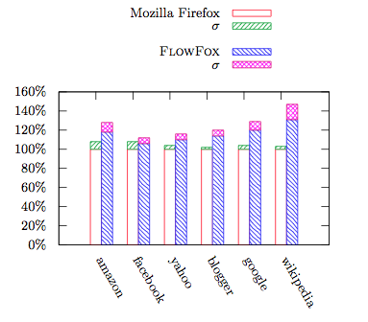
Evaluation
Macro Benchmark
Measure the impact on the latency perceived by a browser user
The results show that the user-perceived latency for real-life web applications is acceptable
Notes:
Use web application testing application to record and replay six scenarios.

Slide 25
Evaluation
Memory Benchmark
Measuring 500 different websites
FlowFox incurred a memory overhead of 88%

