Slide 1
Gazelle
The multi-principal os construction of the gazelle web browser

Slide 2
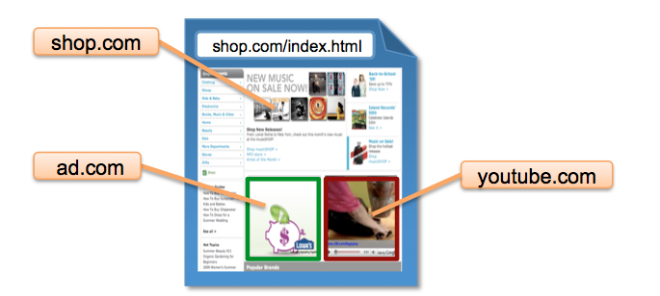
Background
Browser has evolved into Multi-principle operation environment
Notes:
1.Browser has Evolved into a multi-princple operation evrinment where a principle is a site
2. Browser has already been the first target for attackers and cross0site interations always led to many vulnerabilities
A new design of beowser is requied

Slide 3
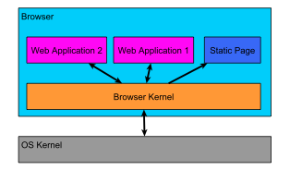
Background
Browser design requires OS thinking
An operating system!
Multitasking
Inter-process communication
Resources management
A browser OS structure has several major advantages
Cross-principle protection
Fair sharing of all system resources
Notes:
Based on the fact that browser is quiet silimar to OS
The compromise or failure of a principal affects that principal alone, leaving other principles and browser kernel unaffected
This main concern regarding resource protection is the SOP (same-origin policy)
An origin or (principal) is defined as <protocol, domain-name, port> Different origins should be in different browser OS “processes” Note that news.google.com is a different origin than google.com

Slide 4
Background
Existing Browsers
Example Google Chrome Browser
Its origin policy is more lax, i.e. an origin is defined in terms of the top-level domain
It has a per-site-instance process model
All plugins (regardless of origin) are in a single process
The rendering process (rather than a centralized kernel) is responsible for some of the origin policy enforcement
Notes:
attacker.example.com and benign.example.com belong to one principle
2. , i.e. each site being browsed corresponds to exactly one process, regardless of embedded cross-site iframes （same adress sapce)
3. But are placed into different protection domain
4. Meaning that cross principle protection take place in its rendering process and plugin process

Slide 5
Security Model
Security models of popular browsers
The SOP is usually enforced in regards to scripts
Cookies have a path-based security policy, but scripts can supersede this and access all cookies for a given domain
Plugins are not usually regulated by any browser security policies
Gazelle security model
Enforce the SOP in all cases (scripts, cookies, plugins)
A more flexible definition of “origin” could be adopted (e.g. to include paths), but this could cause compatibility problems with existing websites
Notes:
1.2. Programmer can make cookie less restrictive by setting a cookie’s domain attribute to a postfix domain or the path name to be a prefix path
1.3 It is possible for a third party plugin access a domain’s cookie and send it to attakcers

Slide 6
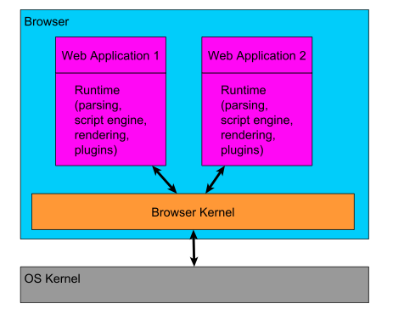
Architecture
Web applications communicate with each other (and/or the system) only through “system calls” to the browser kernel

Slide 7
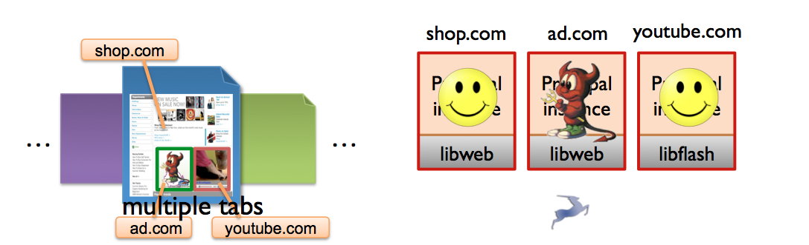
Architecture
This architecture provides a good combination of features...
Efficiency – a dedicated runtime instance (with parsing, rendering, etc.) is spawned for each web application, which is faster than approaches having separate modules for these functions
Security – since the web applications exist in separate processes owned by the browser kernel, they are prohibited from communicating with each other, except through the browser kernel
Robustness – if one web application encounters an error, that process can be safely terminated without effecting the rest of the browser
Notes:
2, Plugins are unable to interact with the OS and is only provided access to system resources subject to the browser kernel allowing that access

Slide 8
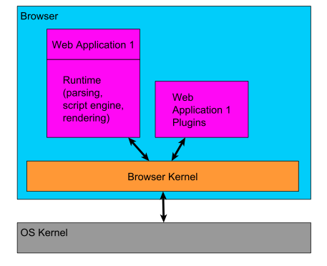
Architecture
One slight modification, for the sake of legacy script protection...
Based on the fact that plugins are less reliable than browsers.
Notes:
In each principal, plugins and brwoser code in different processes. Browser code retrive cross site scripts for plugins

Slide 9
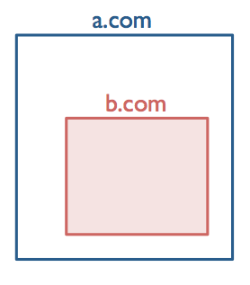
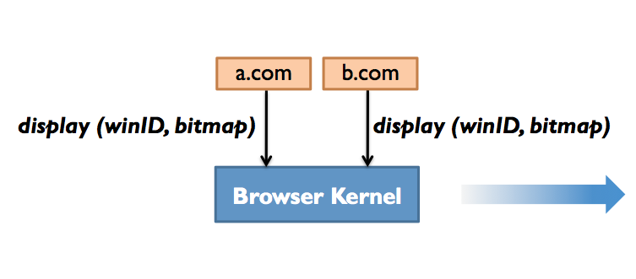
Cross-origin DISPLAY Protection
Display Ownership and Access Control
Browser kernel manages/composes the display
browser kernel doesn’t know content semantics
• Principal instances render the content
Notes:
a window is created by a landlord and occupied by a tenant, the browser kernel must allow reasonable window interactions from both princopal instances without losing protection

Slide 10
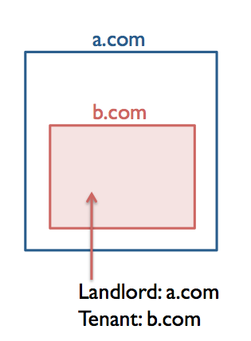
Cross-origin Display Protection
Dual ownership of a window
Window: unit of display delegation
A window has two owners:
landlord: creator principal
tenant: resident principal
landlord can delegate screen area to tenant
delegate() system call
Window’s resources:
position, dimensions, content (pixels), URL location

Slide 11
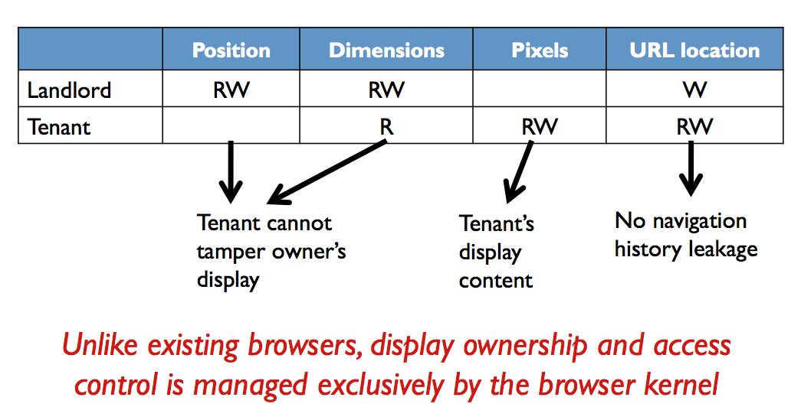
Cross-origin Display Protection
Display Access Control
Notes:
Such policies vaguely exist in exisitng browsers, but they are implemented in the same protection domain, despite their domains
Has led to a numerous velnerabilities.

Slide 12
Cross-origin Events Protection
Browser Kernel must dispatch users’ events to the right principle instance
Challenge: cross-principal content overlaying
frames can be transparent
overlapping
Threats:
things like stacked transparent windows can be used to trick the user into interacting with the wrong site
Layout policy
win1 can overlay on win2 iff
(Tenant_{win1}==Tenant_{win2})||
(Tenant_{win1}!=Tenant_{win2}&& is opaque)
Notes:
2.2 mix content from different origins along the z-axis

Slide 13
Comparison with FlowFox
Both these two papers provide protection mechanism on browser level
They focus on different problems and can’t replace each other
FlowFox: Information leak
Gazelle: Cross-site interactions
Both have compatibility issues. A common weakness for browser-based protection.
Notes:
Many security issues can arise from cross-site interactions
Gazelle is structured as an OS whose “applications” are the web sites being browsed

