Slide 1
A Quantitative Analysis of the Insecurity of Embedded Network Devices: Results of a Wide-Area Scan
Ang Cui and Salvatore J. Stolfo
Department of Computer Science, Columbia University
{ang,sal}@cs.columbia.edu

Slide 2
Motivation
Embedded network devices have become an ubiquitous fixture in the modern home, office as well as in the global communication infrastructure

Slide 3
Widely deployed and often misconfigured, embedded network devices constitute highly attractive targets for exploitation

Slide 4
Questions
How have embedded devices been exploited in the past?
How feasible is large scale exploitation of embedded devices?

Slide 5
Questions
How can we quantitatively measure the level of embedded device insecurity on a global scale?

Slide 6
Questions
How can compromised embedded devices be used to benefit malicious attackers?

Slide 7
How many vulnerable embedded devices are there in the world?
What are they?
Where are they?

Slide 8
What are the most efficient methods of securing vulnerable embedded devices?

Slide 9
Technique
Scan the entire internet
First, nmap is used to scan large portions of the internet for open TCP ports 23 and 80. The results of scan is stored in a SQL database.
Identify device type.

Slide 10
Use default passwords to try to log into embedded devices by verification profile
Gain root access

Slide 11
Each scan takes approximately four weeks and involves two or three sweeps of the entire monitored IP space
Increase likelihood of getting connection
Allow for comparison over time

Slide 12
Ethical Concerns
Make sure we are not overloading networks
Make it easy to opt out of research
Have secondary checks (Columbia University NOC)
Rigid security policies for protecting data

Slide 13
Sensitive experimental data is purged from the production database regularly
Transferred to an IronKey [4] USB stick for encrypted offline storage

Slide 14
Results
Identified approximately 1.1 million vulnerable devices. (as of now the paper cites 540,000)
Over 96% of such accessible devices remain vulnerable after a 4-month period

Slide 15
300,000 vulnerable embedded devices within two ISP networks in Asia.
Residential ISPs constitute over 68% of the entire vulnerable population.

Slide 16
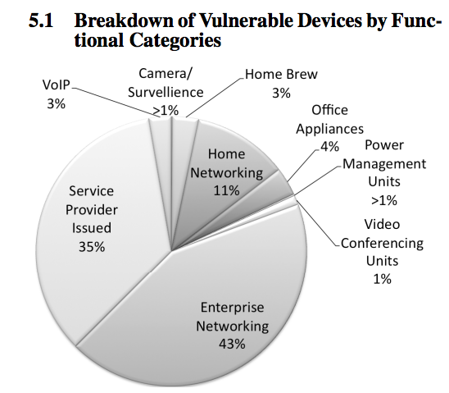

Slide 17
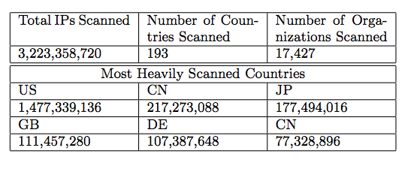

Slide 18
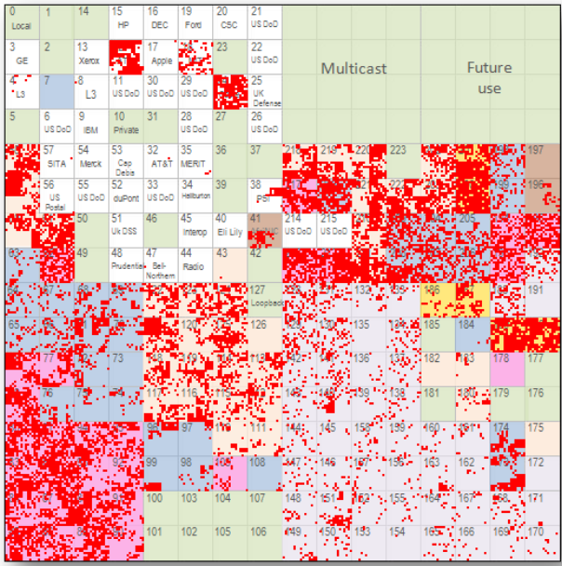

Slide 19
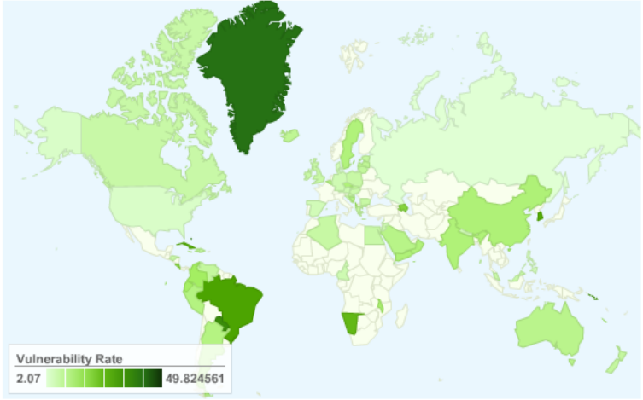

Slide 20
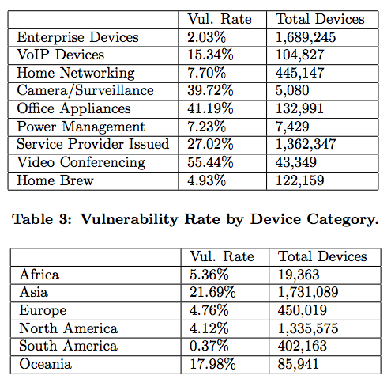

Slide 21
DDOS
3 types of devices are 55% of vulnerable
This could be used for massive DDOS attack

Slide 22
Office Espionage
HP JetDirect Printer Servers represent 44,000 of vulnerable devices
Located in 2505 unique organizations
This allows hackers to see data and dataflow

Slide 23
END

Slide 24
They Can Hear Your Heartbeats: Non-Invasive Security for Implantable Medical Devices
Shyamnath Gollakota, Haitham Hassanieh, Benjamin Ransford, Dina Katabi, and Kevin Fu ACM SIGCOMM 2011

Slide 25
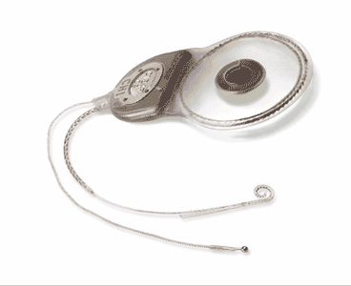
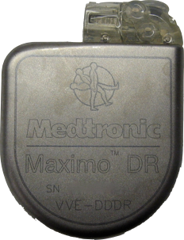
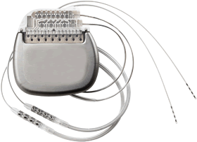
Implantable Medical Devices (IMD)
Neurostimulators
Cardiac
Defibrillators
Cochlear Implants

Slide 26

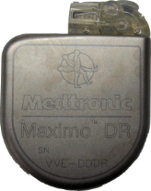

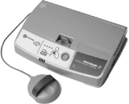
Wireless Interaction in IMD
Notes:
Having wireless in these devices has multiple benefits.
First, it makes it easier to communicate with the implant itself.
More importantly, it enables remote monitoring of the patient’s status.
The patient can be in her home; she would have an implant reader that periodically queries the implant for patient’s vital signals. The reader then forwards this information to the medical professionals over the internet.

Slide 27
Wireless Interaction in IMD
Pro: Safety and Cost
Con: Security and Privacy
Easier communication with implant
Remote monitoring
Reduces hospital visits by 40% and cost per visit by $1800 [Journal of the American College of Cardiology, 2011]
Passive attack: Eavesdrop on private data
Active attack: Send unauthorized commands

Slide 28
Possible Security Measurements
Cryptography?
Problems 1) In emergencies, patient may be taken to a foreign hospital where doctors do not have the secret key 2) Millions of patients already have implants with no crypto; would require surgery to replace

Slide 29
Ideal Solution
Cryptography? => The “Shield”
Problems 1) In emergencies, patient may be taken to a foreign hospital where doctors do not have the secret key => can be non-intrusively disable 2) Millions of patients already have implants with no crypto; would require surgery to replace => external security module

Slide 30
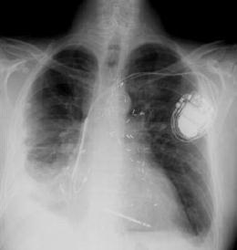

Traditional System

Slide 31

Shield: Secure Legal Communication
Use encryption
Doctor configures the shield with a secret key
Shield encrypts the implant data and forwards it to doctor
→ Shield acts as proxy

Slide 32

Shield: Jam Illegal Communication
Turn off therapy
Implant ID
Shield listens on medium
Shield jams unauthorized commands
➔ Implants can’t decode or react to illegal commands

Slide 33
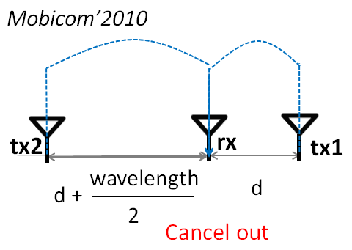
Technical Issue
Needs to be able to Tx (jam) and Rx at the same time.
Needs to be small enough to be portable.
wavelength
≈ 40 cm
2

Slide 34
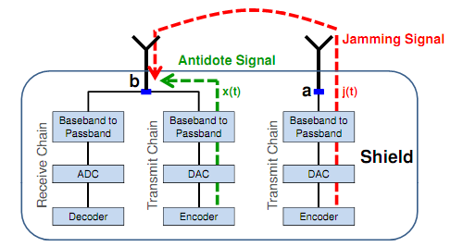
Solution
The “Antidote”
w/o antidote: 50% BER
w/ antidote: 0.2% packet loss

Slide 35
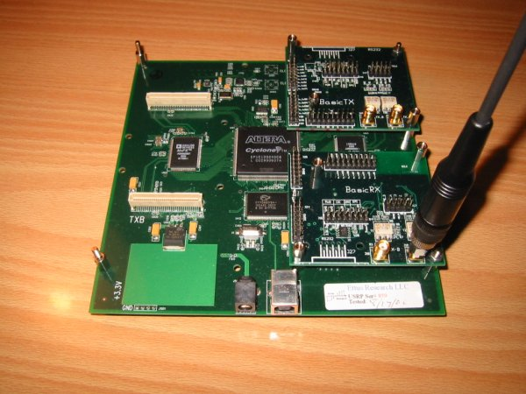
Implementation
USRP2 (Universal Software Radio Peripheral)
Antenna *2
FPGA
Ethernet interface
SD card reader

Slide 36

Evaluation
IMD: MedtronicTM cardiac implants
Legal user: MedtronicTM IMD programmer
Attacker: USRP2
Shield: USRP2
Human body: bacon & beef

Slide 37
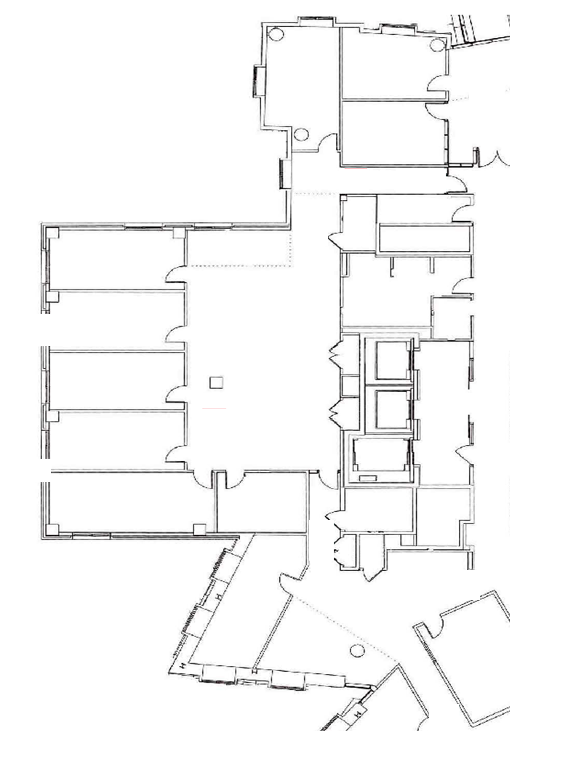


Test Bed
IMD & Shield fixed in one place
20 locations for attacker to test
20cm
30 m

Slide 38
Phase1: Passive Eavesdrop
Worst case scenario
Attacker is only 20cm away from IMD
Average loss rate
0.2%

Slide 39
Phase2: Active Attack
Simulating two kinds of attackers 1) Off-the-shelf IMD programmer 2) Self-modified programmer with x100 transmission power

Slide 40
Phase2-1: Off-the-shelf Attacker
w/o Shield
w/ Shield
Less than 14 meters

Slide 41

Any attack successful
Without the Shield
No attack successful
14 m
Notes:
Here are the results without the shield. As we can the attacker is successful as far 14 meters away and in non-line-of-sight configuration. Thus, an attacker can be in a different room and still mount this attack on an unsuspecting target.

Slide 42

Any attack successful
With the Shield
No attack successful
20 cm
Notes:
Next, here are the results in the presence of a shield.
As we can see, even at the closest attacker location which is about 20 cm away from the implant, the adversary is unsuccessfully in mount the attack.
Thus, we conclude that independent of the location, the shield protects from an adversary mounting active attacks using off-the-shield programmers.

Slide 43
Phase2-2: x100 Power Attacker
Too powerful, cannot jam it due to limited battery power of Shield
However, can warn the wearer by beeping and/or vibration to leave the location

Slide 44
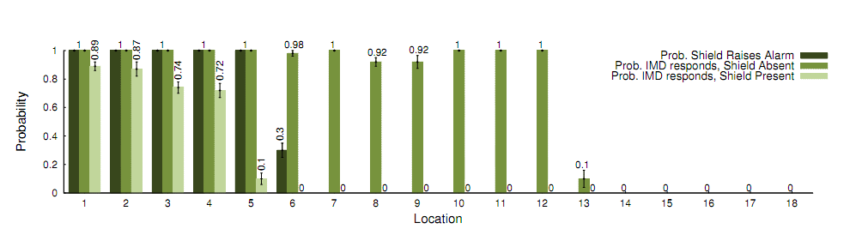
Phase2-2: x100 Power Attacker

Slide 45
Any attack successful
Without the Shield
No attack successful
27 m
Notes:
First lets look at the result when there is no shield. Now the attack can be mount from farther locations which are as far as 27 meters away. This is expected because the adversary uses much higher power and hence can reach longer distances.
Now lets look at the results in the presence of the shield.

Slide 46
Any attack successful
With the Shield
No attack successful
Notes:
Here are the result.
We can see that the attacker is successful only from nearby locations.
Thus, although the shield cannot protect from all high power attacks, now the attacker has to get much closer to the patient to successfully mount its attack.
thus, It has significantly raised the bar on the attacker.
But, once the attacker gets close enough, it can overwhelm the jamming power and reach the implant.
This is a intrinsic limitation of jamming where the shield is constrained by the FCC limitations, while the attacker is not.

Slide 47
Phase2-2: x100 Power Attacker
Cannot totally eliminate the hazard
But,
Raise the bar of active attack
Provide detection of hazard

Slide 48
Conclusion
First to secure medical implants without modifying them
Other applications in RFIDs, small low-power sensors, legacy devices
Convergence of wireless and medical devices open up new research problems

Slide 49
Few Comments (kcir)
Meticulous foot notes
Kind of verbose/repetitive
DoS -> wears out the battery
Technical invention in disguise of an application work, incurs more attention

