Slide 1
An Overview of Software-Defined Network
Presenter: Xitao Wen

Slide 2
Review: How a Router Works
routing algorithm
local forwarding table
header value
output link
0100
0101
0111
1001
3
2
2
1
value in arriving
packet’s header
0111
1
3
2
* Copied from slides of EECS 340

Slide 3
Inside a Router
General-purpose CPU
Routing Engine
Input Ports
Packet Forwarding Fabric
Output Ports
ASIC, or specialized chips

Slide 4
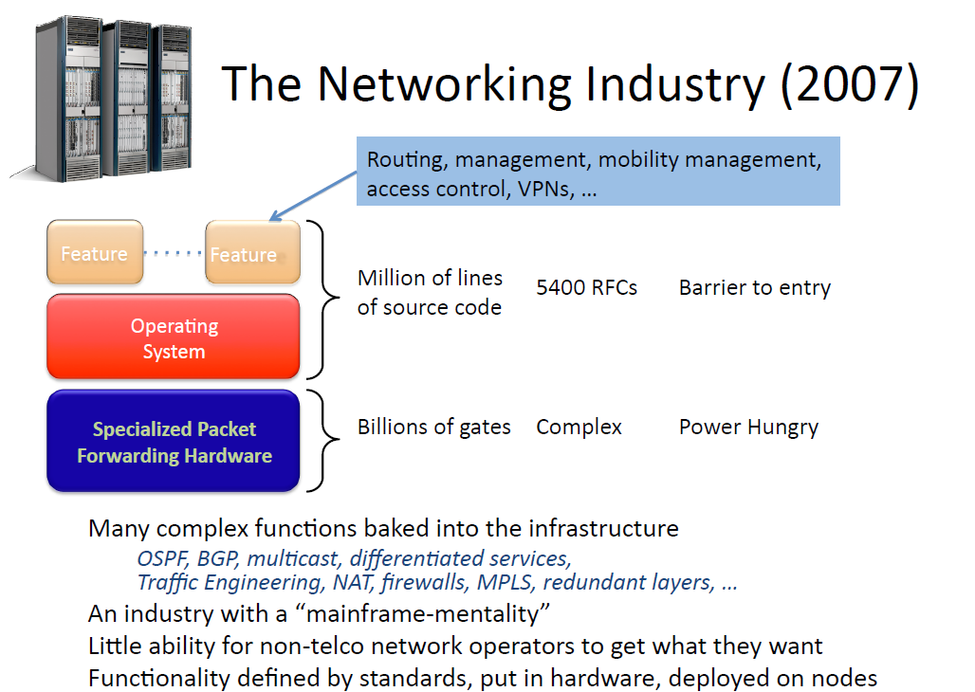

Slide 5
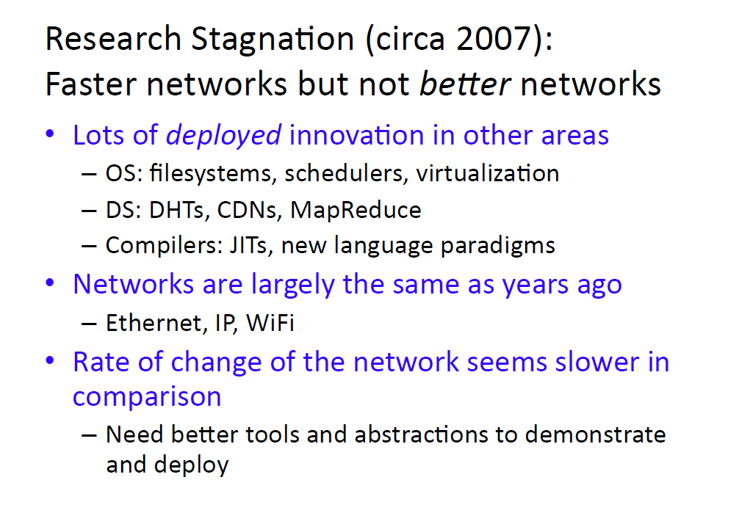

Slide 6
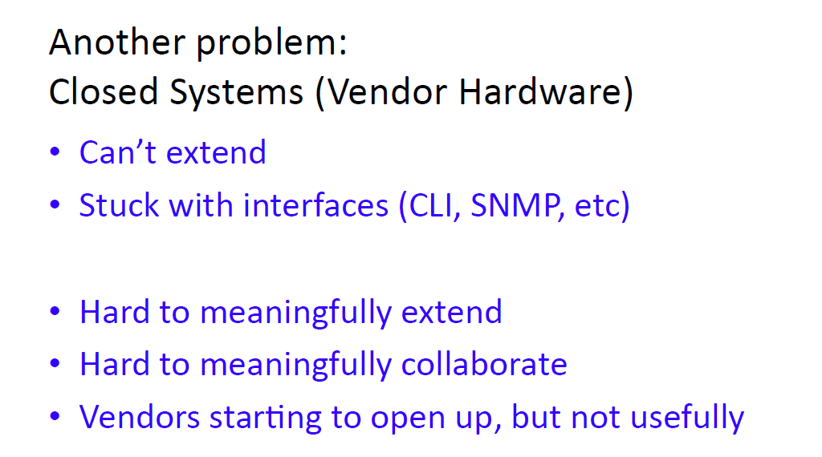

Slide 7
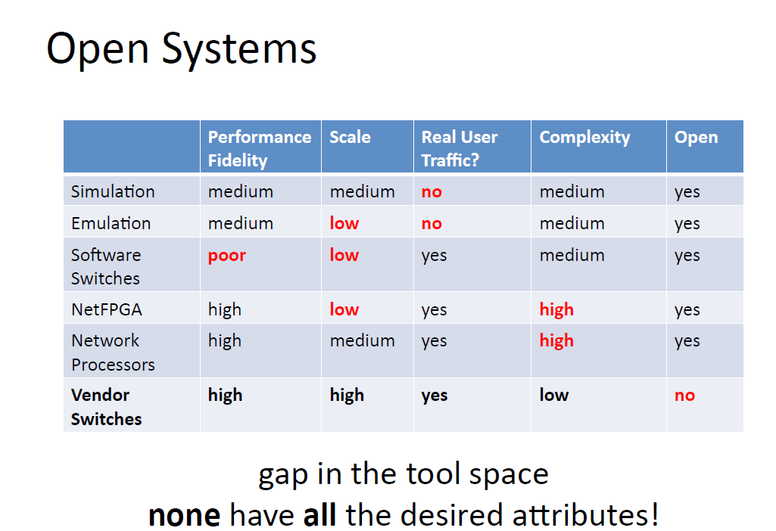

Slide 8

Experimenter’s Dream (Vendor’s Nightmare)
Standard
Network
Processing
User-
defined
Processing
sw
Experimenter writes experimental code on switch/router
hw

Slide 9
Furthermore, we want…
Isolation: Regular production traffic untouched
Virtualized and programmable: Different flows processed in different ways
Equipment we can trust in our wiring closet
Open development environment for all researchers (e.g. Linux, Verilog, etc).
Flexible definitions of a flow
Individual application traffic
Aggregated flows
Alternatives to IP running side-by-side
…

Slide 10
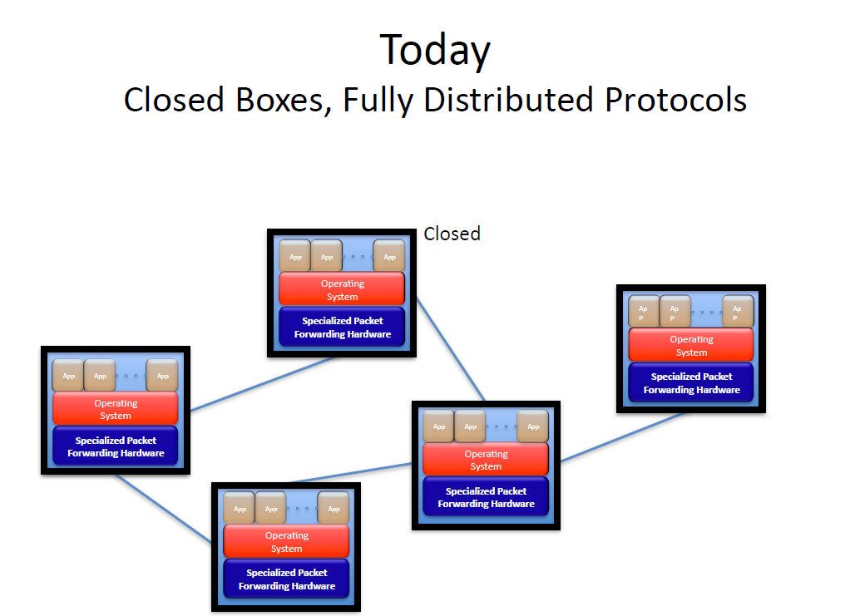

Slide 11
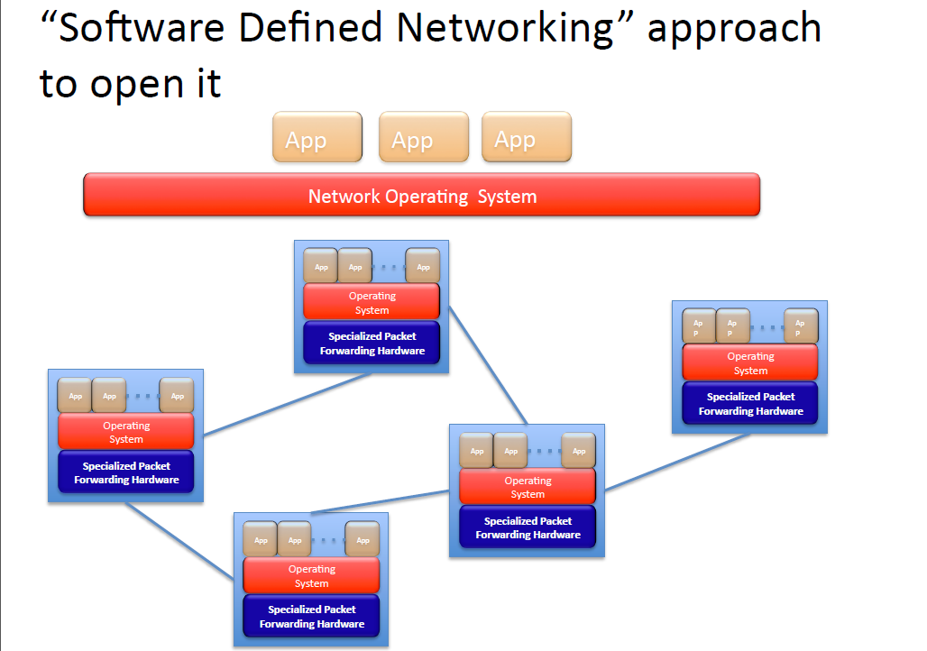

Slide 12
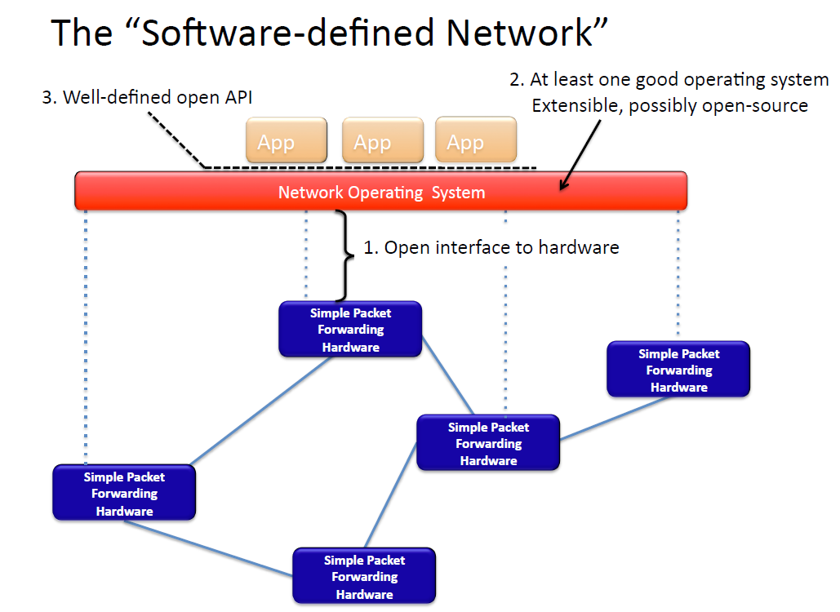

Slide 13
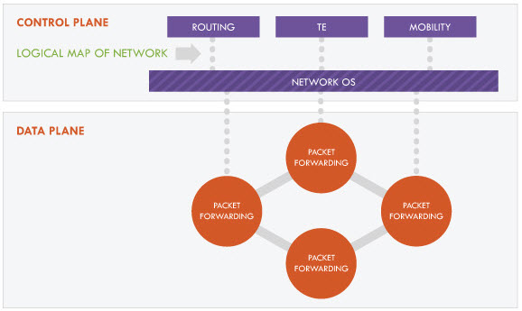
Software-Defined Network

Slide 14
OpenFlow Architecture
Routing Engine
Controller
Network Protocol over SSL
Input Ports
Packet Forwarding Fabric
Output Ports
Switch

Slide 15
Roadmap
Overview
Switch Model
OpenFlow Protocol
Controller
Controller
OpenFlow Protocol
Switch
Switch
Switch
Switch

Slide 16
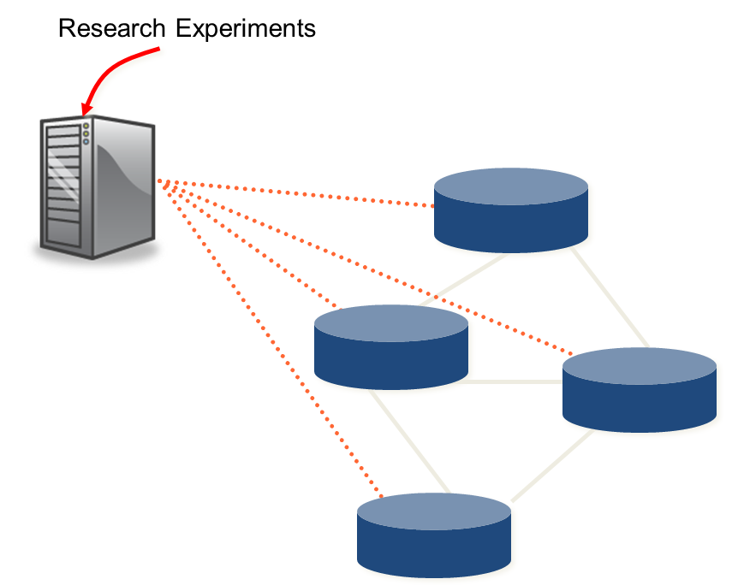
Step 1: Separate Control from Datapath

Slide 17
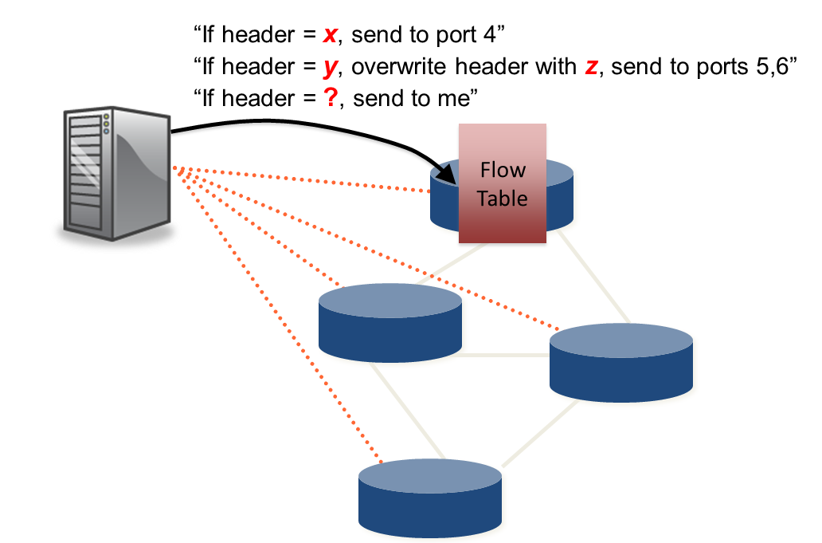
Step 2: Cache flow decisions in datapath

Slide 18
Roadmap
Overview
Switch Model
OpenFlow Protocol
Controller
Controller
OpenFlow Protocol
Switch
Switch
Switch
Switch

Slide 19

OpenFlow Switch Model
Controller
OpenFlow Switch
OpenFlow Switch specification
OpenFlow
Protocol
PC
SSL
Secure
Channel
sw
Flow
Table
hw

Slide 20
OpenFlow Switch Model
Hardware
One or more flow tables
Group table (since Spec 1.1)
Software
Secure Channel

Slide 21
Flow Table Entry
Matcher
Action
Counters
Packet + byte counters
Forward packet to port(s)
Encapsulate and forward to controller
Drop packet
Rewrite headers
Map to queue
Switch
Port
MAC
src
MAC
dst
Eth
type
VLAN
ID
IP
Src
IP
Dst
IP
Prot
TCP
sport
TCP
dport
+ mask

Slide 22
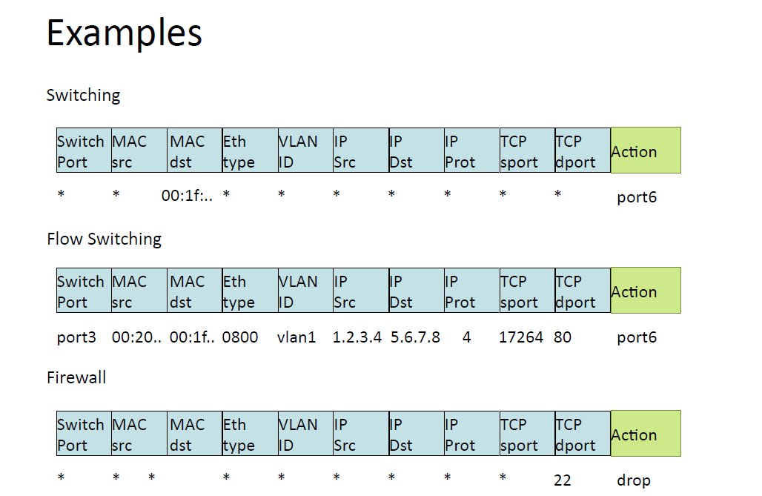

Slide 23
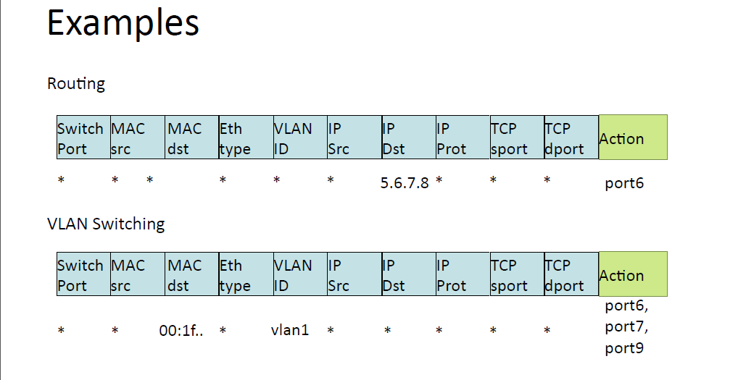

Slide 24
Secure Channel
SSL Connection, site-specific key
Controller discovery protocol
Encapsulate packets for controller
Send link/port state to controller

Slide 25
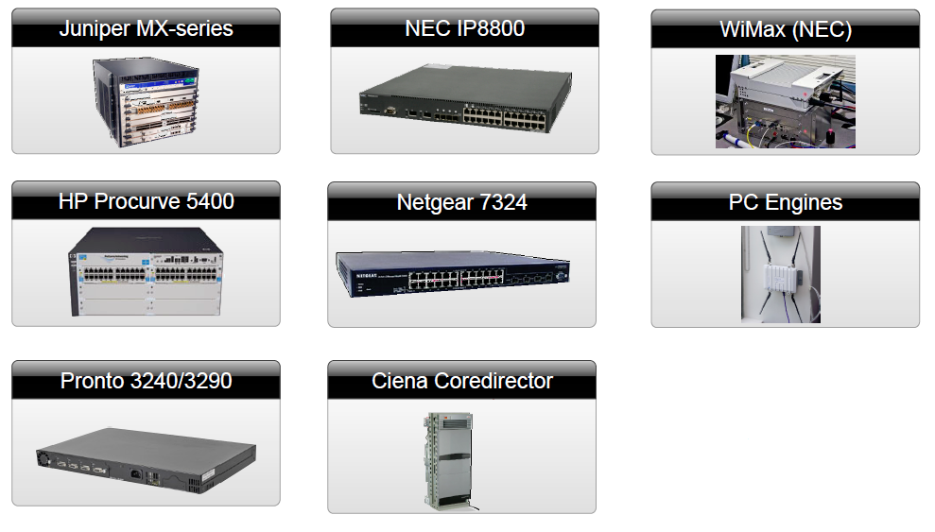
Current OpenFlow Hardware

Slide 26
Roadmap
Overview
Switch Model
OpenFlow Protocol
Controller
Controller
OpenFlow Protocol
Switch
Switch
Switch
Switch

Slide 27
OpenFlow Protocol
Connection
Hello, Echo, Feature, Config…
Read-State
Statistics, Port-status, Error
Modify-State
Flow, Group, Config
Packet-in/Packet-out
Barrier

Slide 28
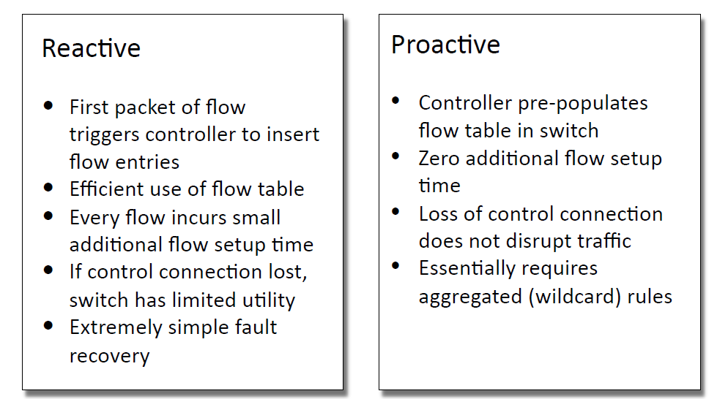
Reactive vs. Proactive (pre-populated)

Slide 29
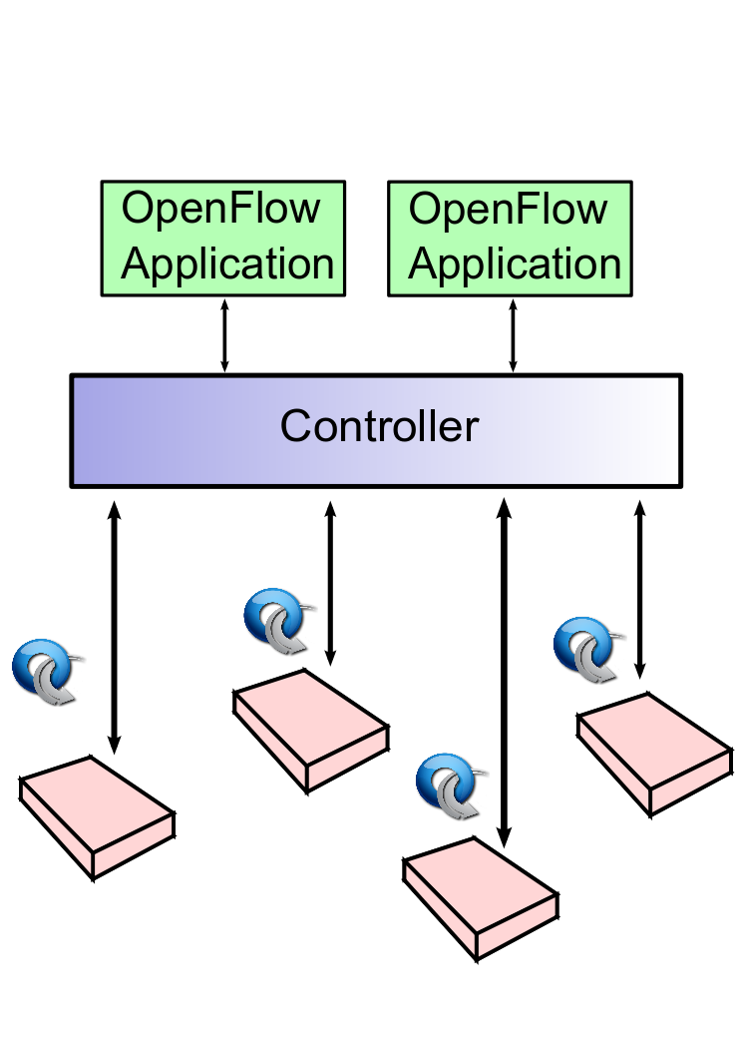
Reactive Flow-Push

Slide 30
Proactive Flow-Push

Slide 31
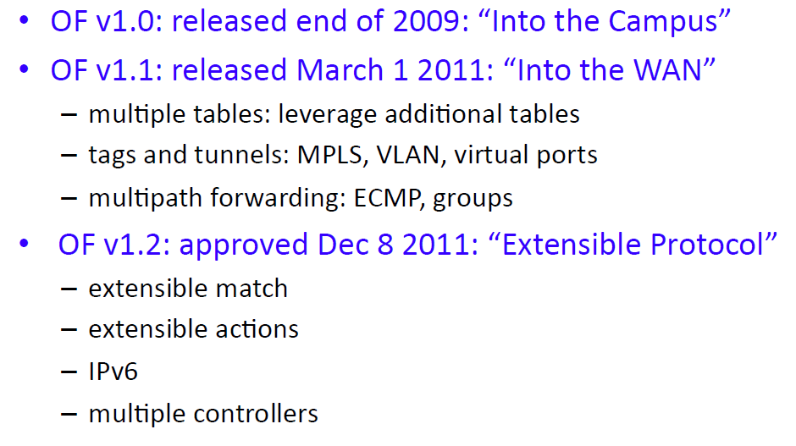
Evolving Protocol

Slide 32
Roadmap
Overview
Switch Model
OpenFlow Protocol
Controller
Controller
OpenFlow Protocol
Switch
Switch
Switch
Switch

Slide 33

Key Task of OF Controller
OpenFlow protocol is largely deltas:
Switch-to-Controller: changes of network state
Controller-to-Switch: changes of configuration
It is a natural way to write control logic

Slide 34
Architectural View: Network OS
App
App
App
App
OF Controller
Operating System
Switch
Switch
Switch

Slide 35
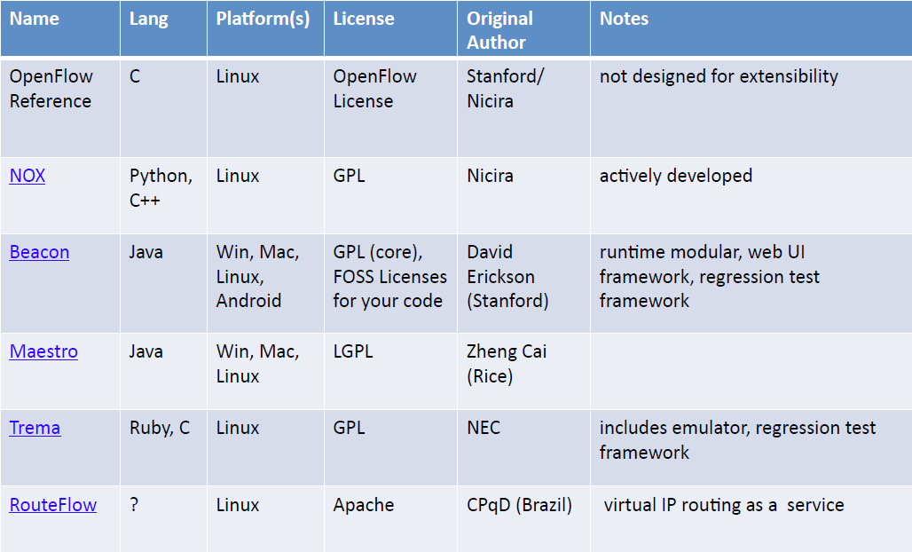
Open Controllers

Slide 36
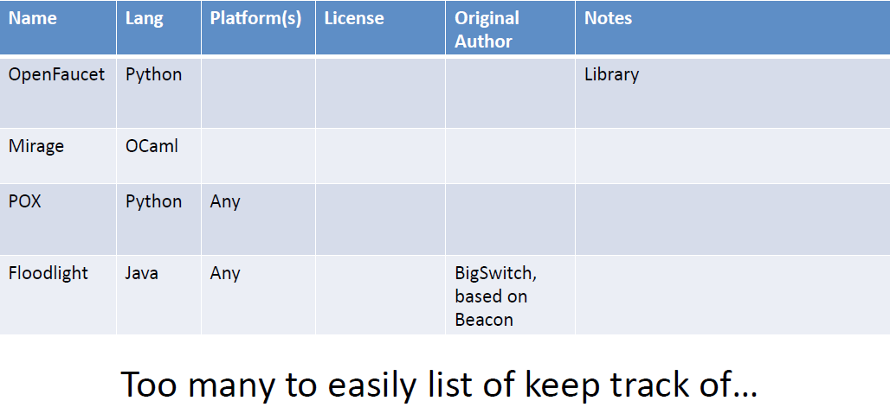
Open Controllers (2)

Slide 37
NOX: A Bit of History
NOX was the first SDN controller
Released under GPL in 2008
Extensively used in research
Now maintained by research community

Slide 38
NOX Highlights
Linux
C++ and Python
Component system
Event-based programming model
Applications:
Forwarding (reactive), topology discovery, host tracking, …

Slide 39
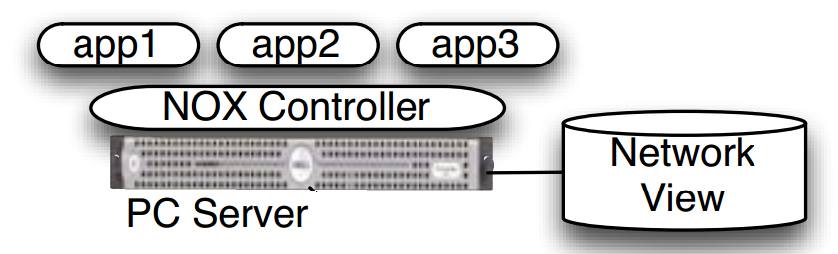
NOX
Centralized programming model
High-level abstraction

Slide 40
Programming Interface
Events
Namespace
Libraries
Routing
Packet classification
DNS
Network filtering

Slide 41
POX
A new platform in pure Python
Clean dependencies
Take good things from NOX
Target Linux, Mac OS, and Windows
Goal: Good for research
Non-goal: Performance

Slide 42
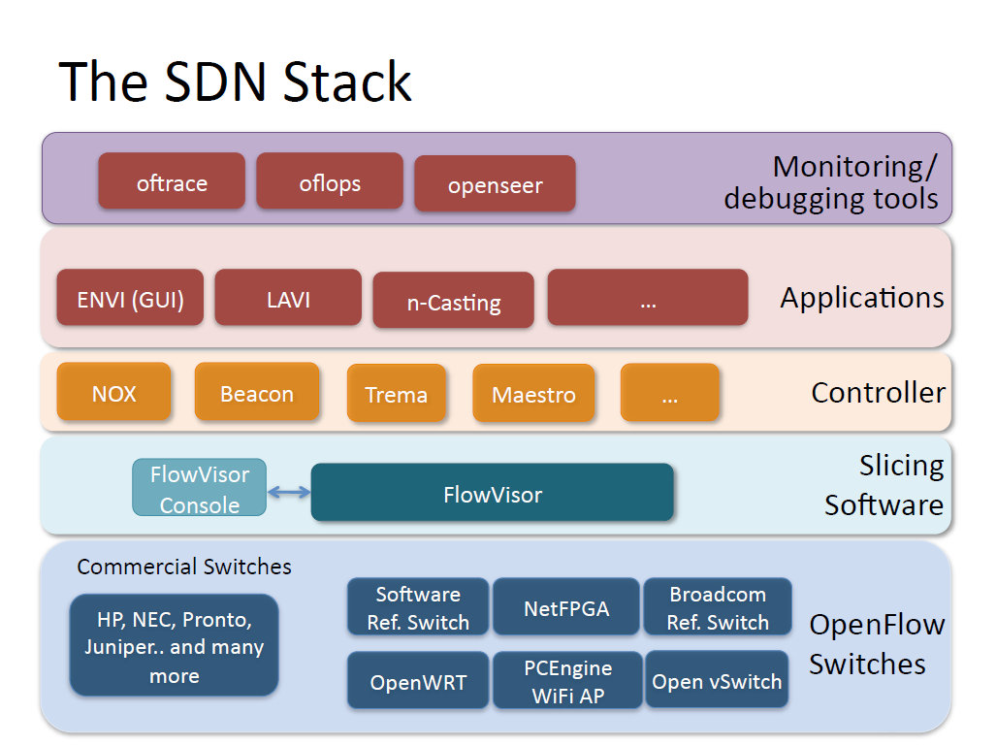

Slide 44
