Slide 1
PScout: Analyzing the Android Permission Specification

Slide 2
Outline
Key questions
Android permission system
PScout design and implementation
Answer to key questions

Slide 3
Key Questions
Are there any redundant permissions?
Are undocumented APIs used?
Undocumented APIs are APIs that are not listed in the Android API reference
How complex is the Android specification?
How are permission mappings interconnected?
How has it evolved over time?
Notes:
They developed a tool called pscout which extracts the permissions specification from the android OS source code, by using the tool they try to answering these questions. Because the documentation of android’s permission system is incomplete and complete mapping not available due to incomplete documentation.
An intent is exactly what it describes. It’s an “intention” to do an action.
An intent is basically a message to say you did or want something to happened. Depending on the intent apps or the OS might be listening for it and will react accordingly. For example, you send a email to bunch of friends, in which you tell your friend John to do something, the other people will ignore the email, but John will react to it.
One android process can call a routine in another android process, using binder to indentify the method to invoke and pass the arguments between processes.

Slide 4
Outline
Key questions
Android permission system
PScout design and implementation
Answer to key questions

Slide 5
Android Permission System
API to permission mapping:
Android.net.wifi.WifiManager.reassociate();
CHANGE_WIFI_STATE
Android.telephony.TelephonyManager.getDeviceId();
READ_PHONE_STATE
Complete mapping NOT available due to incomplete documentation

Slide 6
Outline
Key questions
Android permission system
PScout design and implementation
Answer to key questions

Slide 7
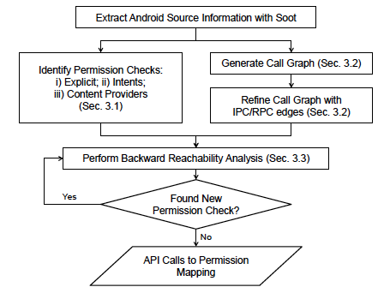
PScout Design and Implementation
PScout produces a permission specification
Set of mapping (set of API calls and set of permissions)
Three Phases
Permission Check Identification
Call graph Generation
Reachability Analysis
Notes:
Pscout produces a permission specification that is a set of mappings between elements in the set of API calls and the set of permissions that third party applications may request.
The extraction of the permission specification from the android framework has three phases.
First, Pscout identifies all the permission checks in the android framework and label them with the permission that is being checked. Then, it builds a call graph over the entire android framework including IPC and RPC. Finally, it performs a backwards reachability traversal over the graph to identify all API calls that could reach a particular permission check. In some case the reachability traversal may find additional permission checks that were missed in the first phase. As a result, the reachability analysis is repeated until the number of permission checks converges.

Slide 8
Permission Check Identification (1)
Explicit Call
Permission strings and App’s User ID -> checkPermission
Intents
Permission (send/receive) in AndroidManifest
Permission (send/receive) expressed programmatically
E.g. sendBroadcast
E.g. registerReceiver
Content Provider
Parse the manifest file
Notes:
Android has three types of operations that will succeed or fail depending on the permissions held by an application, 1) an explicit call to checkPermission function that checks for the presence of a permission, 2) methods involving Intents and 3) methods involving content providers. They abstract each of these into a permission check that indicates that a certain permission must be held at that point by the application.
Permissions in Android appear as string literals in the framework source code and values of the permissions strings are documented by Google. The strings are passed to the checkPermission function along with the application’s user ID(UID) and the function checks if an application with the UID holds the specified permission. The first step of identifying this type of permission check is to find all instances of permission string literals in the framework source. These permission string literals are passed directly to checkpermission function, which Pscout then abstracts as a permission check.
Sending and receiving of Intents may require permissions. This requirement can be expressed ways. First, a requirement to hold a permission to send or receive an Intent can be specified in the Manifest file. Second, permission to send or receive an intent can be expressed programmatically when the method to send or receive an intent is called. For example, to send an intent, an application may call sendBroadcast with an optional permission string that specifies that the receiver of the intent must hold that permission. Similarly, to receive intents, an application may call registerReceiver with an optional permission string that specifies that the sender of the intent must hold that permission. By extracting information from the manifest file and invocations of sendBroadcast and registerReceiver, Pscout builds a global mapping between permissions and the Intent action strings. Since this mapping tells Pscout which Intent actions strings require permissions to send or receive, pscout abstracts any send or receive such an intent as a permission check. (the type of permission that is being checked is computed by translating the action string of the Intent being sent or received into android permission.)
Methods that implicitly access a content provider protected by a permission are categorized as content provider permission checks. To access a content provider, an URI object designating the recipient content provider is passed to contentResolver class, which then provides a reference to the content provider targeted by the URI object. Each content provider declares the permissions required to read and write to it in its manifest file. So Pscout parse the manifest file to extract this information. Pscout constructs a mapping of content provider URIs to permissions.

Slide 9
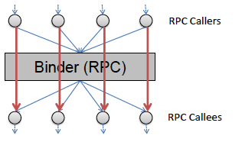
Call Graph Generation (2)
Call Graph Generation
Entire Android framework
Refined with RPC/IPC information
Notes:
RPC (remote procedure call) is an inter-process communication that allows a computer program to cause a subroutine or procedure to execute in another process without the programmer explicitly coding the detail for this remote interaction.

Slide 10
Reachability: Starting Points
Permission check definition:
An execution point in the OS after which the calling application must have the required permission
Three Type
Explicit calls to checkPermission functions
Sending/receiving of specific intents
Accesses to specific content providers
Notes:
Finally, pscout performs a backward reachability analysis starting from the permission checks. Pscout creates a mapping for every method that can be reached via a path from a permission check. However, not every method is an API that can be called by a third party application, because permission protected resources typically reside in system services, which can only be reached by third party applications via an RPC or through IPCs using intents. Thus any path from a permission check that does not cross a process boundary is filtered from pscout’s specification.
The backward reachability analysis continues until one of three stopping conditions is met.

Slide 11
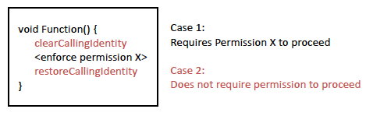
Reachability: Stopping Conditions
Method caller ID is temporary cleared
Permission enforcement always pass when caller ID is cleared in system processes
Notes:
First, any calls to checkpermission and its wrappers always succeed if they are between calls to clearCallingIdentity and restorecallingidentity, because these functions temporarily set the UID to the system services. As a result, any call path that passes through a function called between these two functions will always pass a permission check. Thus it is not necessary to perform any reachability analysis beyond one of these points and any method called between the clearcallingidentity and restorecallingidentity function is a stopping point.

Slide 12
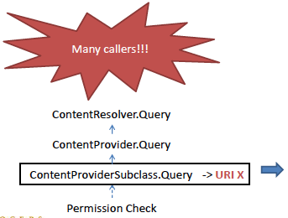
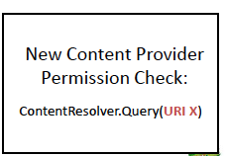
Reachability: Stopping Condition
Reached content provider subclasses
Notes:
Second access to a content provider is made with a virtual call to the generic(类的) class. Pscout stops reachability traversal when it reaches a class or subclass of contentprovider. At this point, pscout infers the URI string of the content provider and associates that URI with the permission of permission check where the reachability analysis started. Thus access to the contentprovider found on the reachability path is abstracted to a content provider permission check and pscout iterates the reachability analysis until it converges.

Slide 13
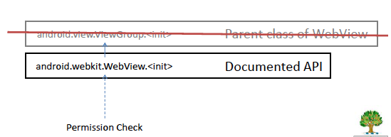
Reachability: Stopping Conditions
Reached generic parent classes of documented APIs
Notes:
Finally, documented APIs often have a generic parent class that is called by many other methods, as a result, once a documented API is reached, calls to its parent class methods are excluded from the analysis.

Slide 14
PScout Design and Implementation
Time (33 hours)
Environment
Android 4.0 framework
Intel Core 2 Duo 2.53 GHz CPU
4 GB memory
Notes:
Pscout extracts a permission specification from the Andorid 4.0 Framework on an Intel Core 2 Duo 2.53 GHz CPU with 4 GB memory in 33 hours. The vast majority of time is spent in two iterations of using Soot to extract information needed by Pscout from the bytecode. Since each bytecode file is analyzed independently, the total soot analysis time scales linearly with the number of classes and each file takes about 4 seconds to process. The rest of Pscount’s analysis completes within 30 minutes.

Slide 15
Outline
Key questions
Android permission system
PScout design and implementation
Answer to key questions
Conclusion

Slide 16
Key Questions
Are there any redundant permissions?
Are undocumented APIs used?
Undocumented APIs are APIs that are not listed in the Android API reference.
How complex is the Android specification?
How has it evolved over time?
Notes:
They run pscout on four version of andorid and summarized the results of the extracted permission specifications. They analyze the extracted specifications to try and answer the four main questions.

Slide 17
Q1: Redundancy in Permissions?
Conditional Probability
P(Y|X) = ?
Given an API that checks for permission X, what is the probability that the same API also check for Permission Y?
79 permissions (Andorid 4.0) -> 6162 pairs of permissions
Notes:
To answer whether the permission are redundancy, they compute the conditional probability of all pairs of android permissions across their API mappings.

Slide 18
Q1: Redundancy in Permissions?
Redundant Relationship
Both permissions are always checked together
P(Y|X) = 100% and P(X|Y) = 100%
Only 1 pair found:
KILL_BACKGROUND_PROCESSES and RESTART_PACKAGES
RESTART_PACKAGES is a deprecated permission
Notes:
Only one of the permission pairs, kill_background_processes and restart_packages is truly redundant. Both permissions are checked by the same set of APIs.
Which means that we can just request one permission, instead of two permissions.
The android documentation indicates that the API requiring restart_packages has been deprecated and replaced with an API that requires kill_background_process.

Slide 19
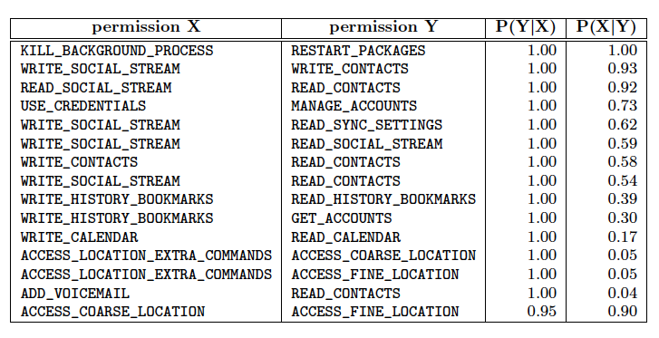

Slide 20
Q1: Redundancy in Permissions?
Implicative Relationship
All APIs that check for permission X also checks for Permission Y
P(Y|X) = 100% and P(X|Y) = ?
Found 13 pairs
Many write permissions imply read permissions for content providers
E.g. WRITE_CONTACTS implies READ_CONTACTS
Notes:
They define two types of correlations between permissions: first one is implicative relationship that all APIs that check for permission X also check for the permission Y

Slide 21
Q1: Redundancy in Permissions?
Reciprocative Relationship
The checking of either permission by an API means the other permission is also likely checked
P(Y|X)>90% and P(X|Y) >90%
Found 1 pair:
ACCESS_COARSE_LOCATION vs. ACCESS_FINE_LOCATION
Notes:
Another correlation between permissions is reciprocate relationship that the checking of either permission by an API means that the other permission will also be checked with a probability higher than 90%).

Slide 22
Q1: Redundancy in Permissions?
15/6162 all possible pairs of permission demonstrates to have close correlation.
There is little redundancy in the Android permission system.

Slide 23
Q2: Undocumented API usage?
22-26% of the declared permissions are only checked through undocumented APIs
Can be hidden from most developers
E.g. SET_ALWAYS_FINISH, SET_DEBUG_APP are moved to system level permission in Android 4.1
3.7% applications use undocumented APIs
Undocumented APIs are rarely used in real applications, some permissions can be hidden.

Slide 24
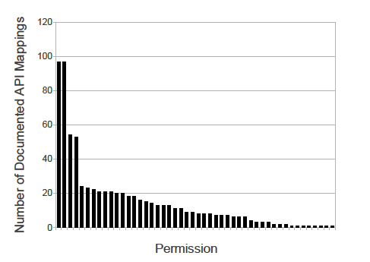
Q3: Specification complexity
75% of permission map to <20 API calls
Permissions guards specific functionalities

Slide 25
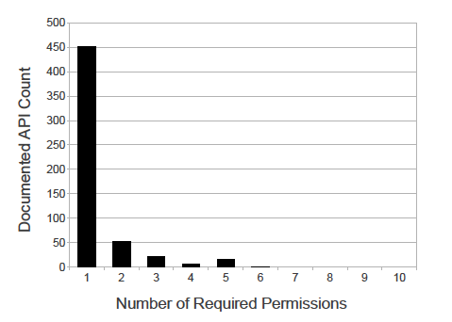
Q3: Specification complexity
>80% APIs require only 1 permission, few need more than 3
Sensitive APIs have relatively distinct functionality

Slide 26
Q3: Specification complexity
Few overlaps in the permission mapping
Android permission specification is simple.

Slide 27
Q4: Changes over time
Permission checks grew proportionally with code size between 2.2 and 4.0
More sensitive functionality are exposed through documented APIs over time
New APIs introduced with permissions
Undocumented -> documented API mapping
Existing APIs + new permission requirements

Slide 28
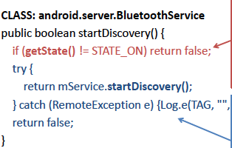
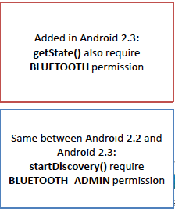
Q4: Changes over time
Small changes can lead to permission changes
No fundamental changes in API functionality

Slide 29
Q4: Changes over time
Tradeoff between fine-grain permission and permission specification stability
E.g. combining the BLUETOOTH and BLUETOOTH_ADMIN permission can prevent the permission change between 2.2 and 2.3 but reduces the least-privilege protection

Slide 30
Outline
Key questions
Android permission system
PScout design and implementation
Answer to key questions
Conclusion

Slide 31
Conclusion
PScout extracts the Android permission specifications of multiple Android versions using static analysis.
Results show that the extracted specification is more complete than existing mappings
Error from static analysis imprecision is small
There is little redundancy in the Android permission systems.
Few application developer use undocumented APIs which some permissions are only required through undocumented APIs.
There is a tradeoff between fine-grain permission and permission specification stability.

Slide 32
Question?

