Slide 1
Node Add-ons
Adding on to Node because Node can be added on to by creating add-ons for Node

Slide 2
What are they?
Create native modules for use in Node
Written in C++
Uses node-gyp for building

Slide 3
GYP (Generate Your Projects)
Tool for generating project and build files in a platform-independent way
Created by Google and used for Chromium
Python dictionary – basically JSON, with a few small differences
Uses # for comments
Allows commas after last item in arrays and objects
https://code.google.com/p/gyp/

Slide 4
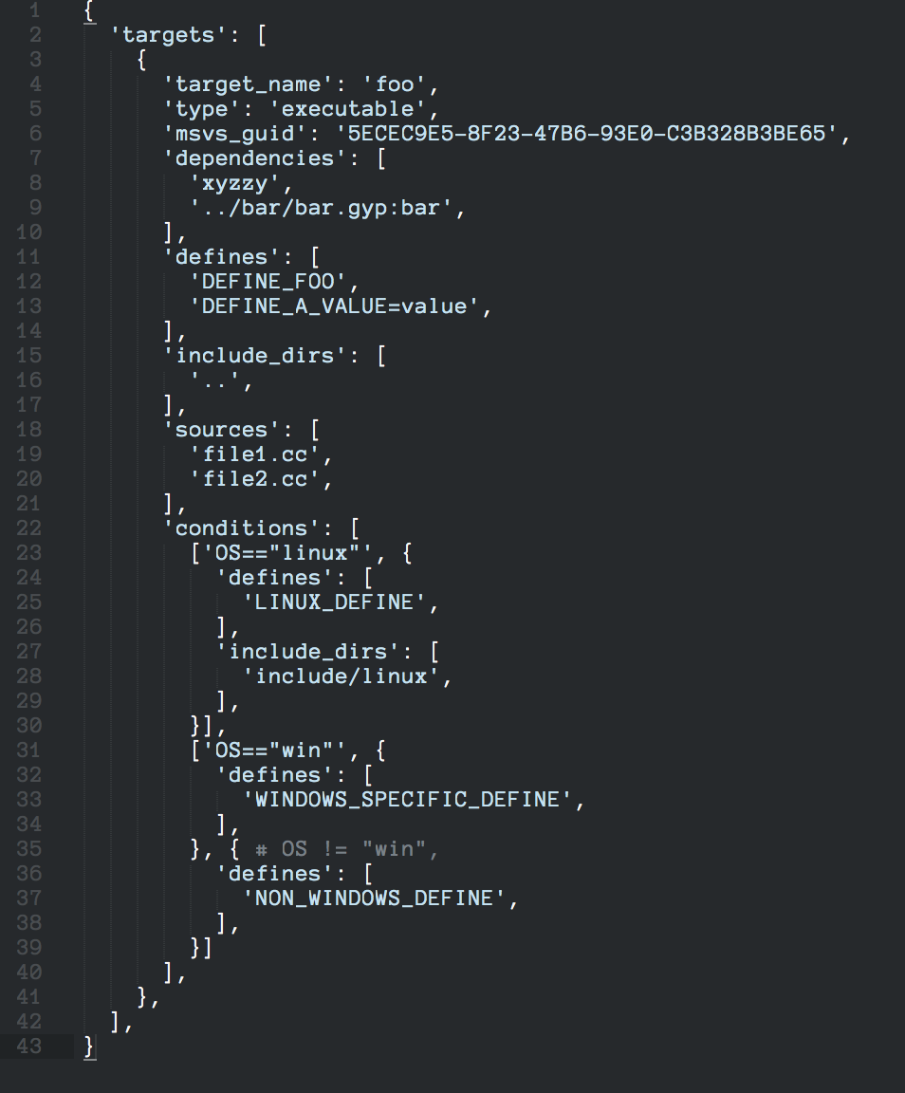
GYP sample

Slide 5
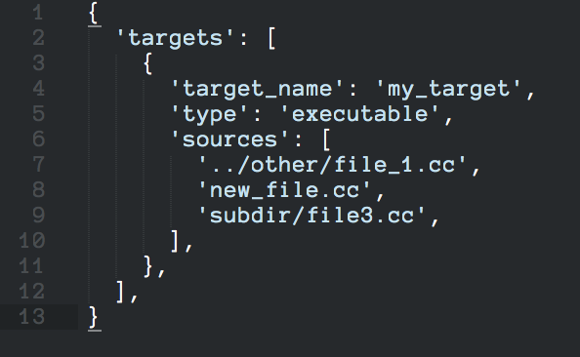
GYP sample (more common)

Slide 6
node-gyp
Based on GYP – written specifically for Node
Provides extra functionality to support building native Node add-ons
https://github.com/TooTallNate/node-gyp

Slide 7
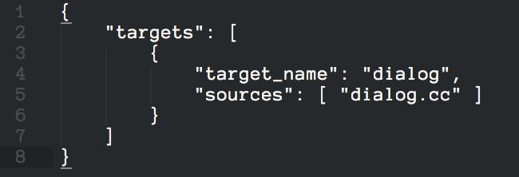
node-gyp sample

Slide 8
V8
Open source JavaScript engine that implements ECMA-262 5th Edition
Created by Google
Written in C++
Can be run standalone or embedded in a C++ application
https://code.google.com/p/v8/

Slide 9
Hello World!
Simple example
Goals:
Create a simple module with one method, which returns the word “world”
Showcase basic add-on building and how to build with node-gyp

Slide 10
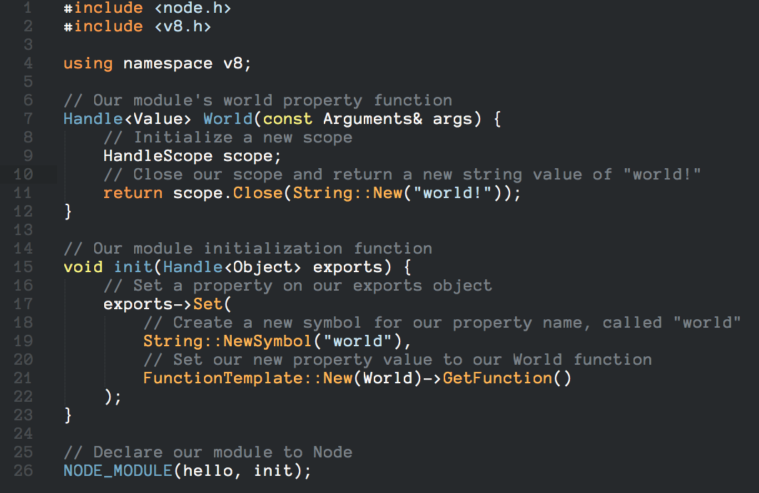
Hello World! (hello.cc)

Slide 11
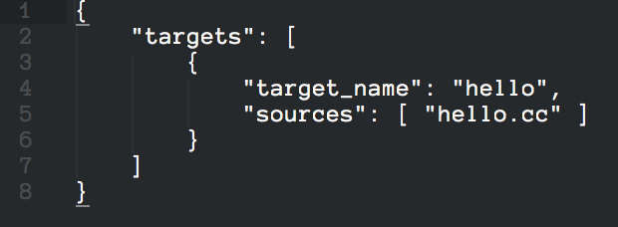
Hello World! (binding.gyp)

Slide 12
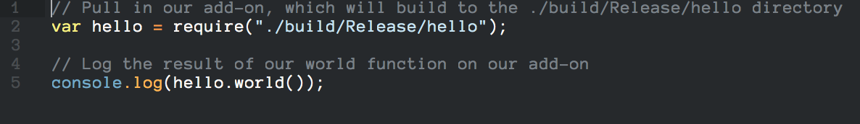
Hello World! (app.js)

Slide 13
Fun With Dialogs
More realistic example
Goals:
Create a module that allows us to display native dialogs from Node

Slide 14
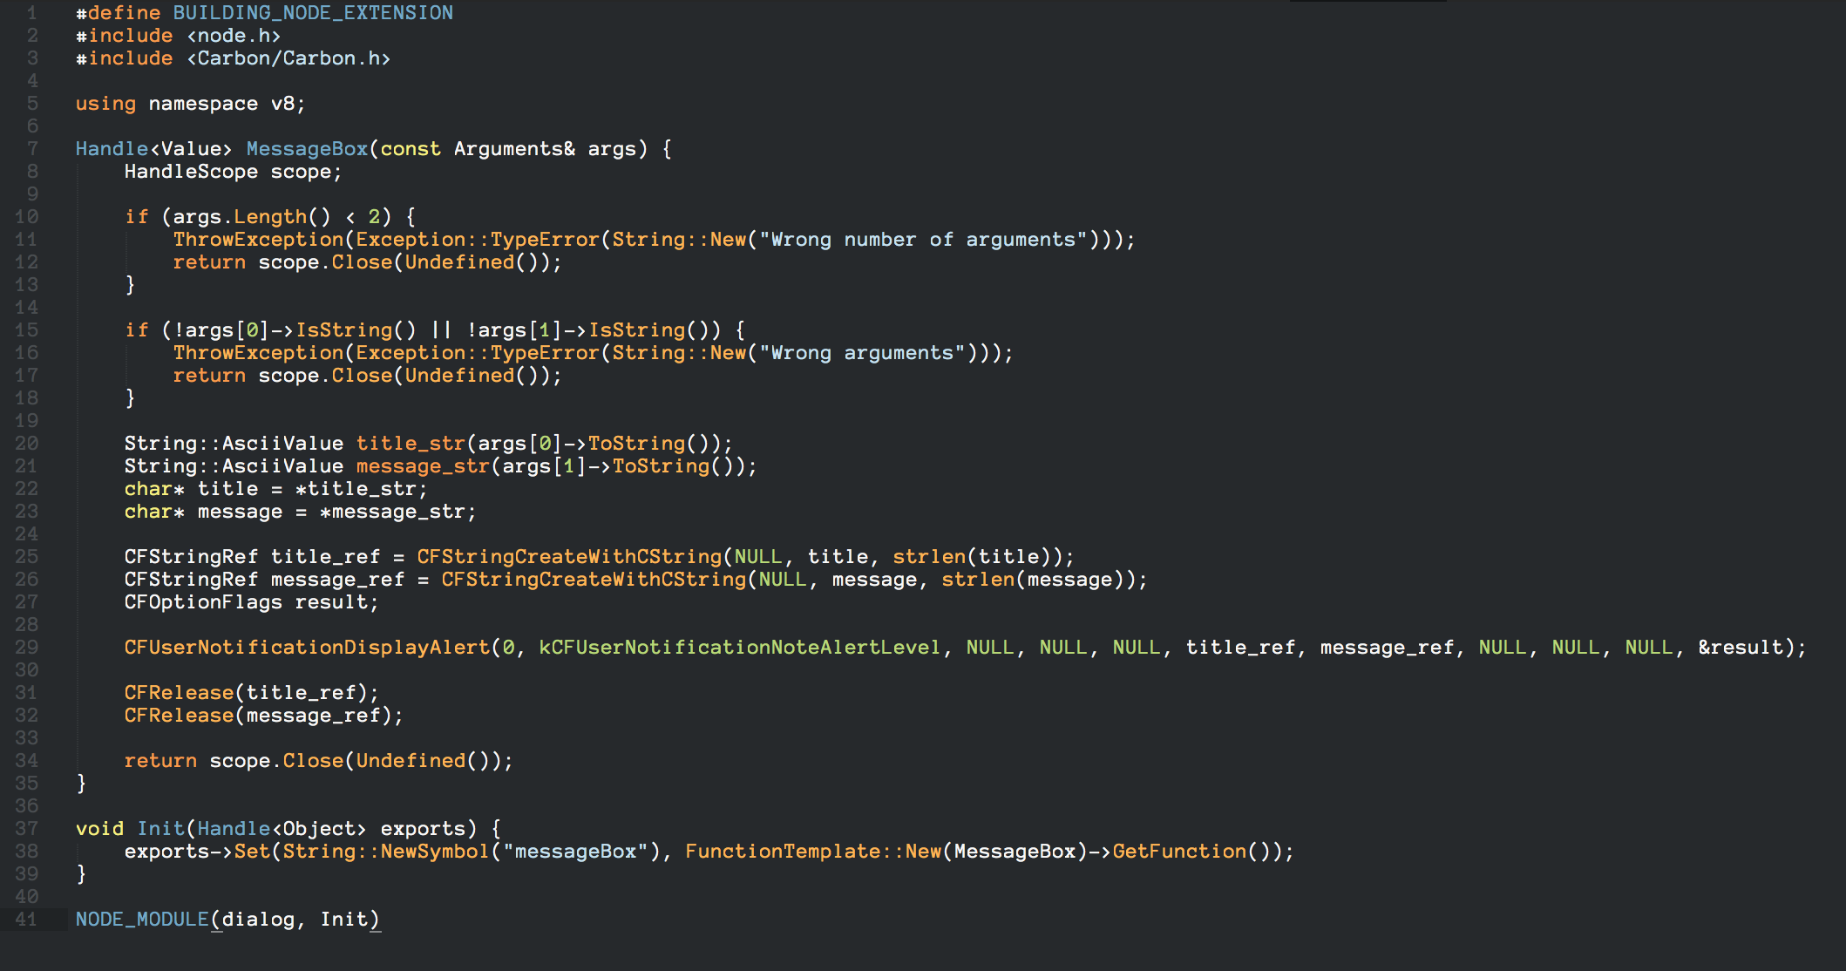
Fun With Dialogs (dialog.cc)

Slide 15
Fun With Dialogs (binding.gyp)

Slide 16
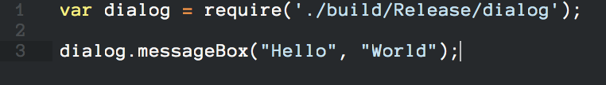
Fun With Dialogs (app.js)

Slide 17
Fun With Dialogs
Areas to improve:
Add options for various buttons and dialog settings
Return dialog result
Use libuv and a callback to make dialogs asynchronous
Add other types of dialogs

Slide 18
Resources
Node add-on documentation
http://nodejs.org/api/addons.html
GYP documentation
https://code.google.com/p/gyp/wiki/GypUserDocumentation
node-gyp documentation
https://github.com/TooTallNate/node-gyp
V8 documenation
http://izs.me/v8-docs/
Examples
https://github.com/flapitz/node-addon-examples

Slide 19
Questions?

