Slide 1
Artifical Stock Broker
Alwin, Akashdeep, Ashray, Atul

Slide 2
Introduction
25 % of Millennials (i.e. people between the ages of 18 and 35) don’t invest their money due to lack of understanding of the stock market
60% of people do not own any stocks
Median Balance of 401(k) accounts: $31,396
Recommended Balance: $218,000- $350,000
Main Goal: to let more people comprehend the stock market and include more people financially.

Slide 3
Main Idea:
To motivate naive users to invest in stock markets.
To eleminate the bias caused due to stock brokers.

Slide 4
Algorithm Design
Sentiment Analyser (From twitter’s feed)
From user’s data background
RNN using LSTM model to predict tomorrow’s stock price from today’s one

Slide 5
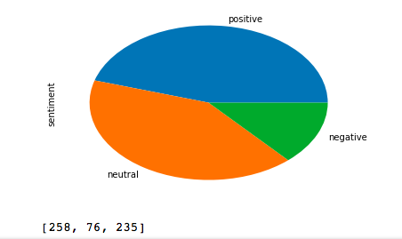
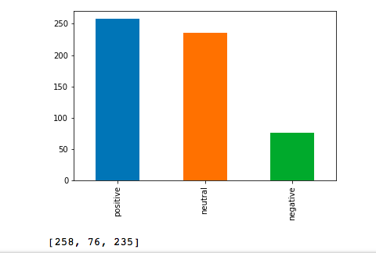
Result of Sentiment Analyser for 500 latest tweets with phrase “$KO” ie Coca Cola Stocks

Slide 6
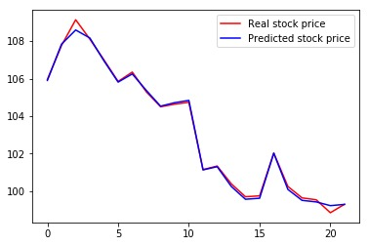
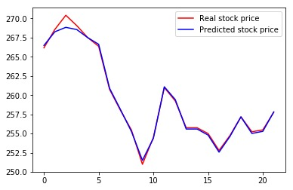
Sample Result: Coca Cola , Walmart

Slide 7
Market and Business Model
We can integrate a payement gateway in our model, so that users can directly buy stocks from our interface.

Slide 8
Conclusion
Based on various deep learning techniques we are able to suggest a good investment oppurtunity to naive users thereby increasing our user base and hence increasing the spectrum of people investing into stocks.

