Slide 1
Foundations for a realist ontology of mental disease
Reviewed by Yangfan Sun
Dept of Computer Science & Electrical Engineering
University of Missouri, Kansas City
Email: ysb5b@mail.umkc.edu

Slide 2
Introduction
Motivation: The classifications of mental disorders have existed for over one hundred years and still remains unspecified what terms such as mental disorder, disease and illness.
Solution: Ontologies can address this shortfall to provide a formal description of the structure of some pre-existing terminology or classification, rather than of the corresponding structures and processes on the side of the patient.
Contribution: The key contributions lie in the identification of confusions in the existing terminology of mental disease and in providing clear and unambiguous reference to entities on the side of the patient.

Slide 3
Basic Formal Ontology (BFO)
BFO is an upper-level ontology framework encapsulating best practices in the development of ontologies to serve scientific research, especially at the creation of high-quality shared ontologies (biomedical research domains).
BFO is a realist ontology, which mean that representations faithful to BFO can acknowledge only those entities which exist in reality, reject all those types of putative negative entities.
Notes:
- lacks, absences, non-existents, and the like - which are sometimes postulated as artifacts of specific terminologies or of associated logical or computational frameworks.

Slide 4
Basic Formal Ontology (BFO)
BFO captures a small number of basic categories into which reality is divided:
First, it distinguishes particulars from universals (particulars are specific entities and universals are repeatable entities)
Second, it distinguishes within the realm of particulars between continuants and occurrents. Entities endure continuously through time as continuants, while time span discretely as occurrents.
Third, it distinguishes between dependent and independent entities.
More than that, three major families of relations between entities in the categories just distinguished:
<p, p>-relations
<p, u>-relations
<u, u>-relations
Notes:
First, it distinguishes particulars from universals, particulars are entities such as John, or the specific depression from which John, universals are repeatable entities, such as Human Being and Depression, which have particulars as their instances.
Second, distinguishes within the realm of particulars between continuants and occurrents. Continuants are entities - such as John, his brain, his brain cells - that endure continuously through time while undergoing changes of various sorts. The domain of occurrents is made up of processes, entities which unfold over a certain time span through successive temporal parts or phases, including entities such as actions, and of the instantaneous boundaries of processes (beginnings and endings).
Third, distinction between dependent and independent entities, the for- mer being such that they cannot exist without some instance of the latter: John’s height or weight, for example, cannot exist without John himself, and neither can his depression, or his feelings of remorse, or his bouts of anger.
•distinguishes three major families of relations (depicted in bold italic face) between entities in the categories just distinguished: (1) <p, p>-relations: from particu- lar to particular (for example: part of between John’s brain and John; member of between Dr McX and the clinical staff of hospital Y; participant_of between Jim and his life); (2) <p, u>-relations: from particular to universal (for example: instance_of between John and the universal Human Being); and (3) <u, u>-relations: from univer- sal to universal (for example: subkind_of between Mouseand Organism) [19].

Slide 5
Ontology of General Medical Science (OGMS)
The Ontology of General Medical Science (OGMS) is an ongoing endeavor to facilitate inference across the boundaries of domain ontologies.
It comprises representations of highly general universals in the domains of anatomy, physiology and pathology, of diagnosis and treatment, and of information artifacts such as clinical histories and lab test results.
It follows the principles of the Open Biomedical Ontologies (OBO) Foundry,
Avoid redundancy
Exploit compositionality
Common architecture
Notes:
•1. avoid redundancy: terms already included in existing ontologies should be imported where necessary in order to ensure that for each domain there should be convergence upon exactly one Foundry ontology; [26]
2. exploit compositionality: terms and definitions should be built up compositionally out of component representations taken either from OGMS itself or from external ontologies; [11]
•3. common architecture: ontologies should use upper-level categories drawn from BFO together with relations unambiguously defined according to the pattern set forth in the OBO Relation Ontology; [19]

Slide 6
Ontology of General Medical Science (OGMS)
Granular Partition Theory is a framework for understanding the ways in which, when cataloguing, classifying, mapping or indeed diagnosing a certain portion of reality (POR), we divide up or partition this reality at one or more levels of granularity.
The paper proposed in a calculus for use in quality assurance of the complex representations:
Level L1: the level of reality, for example, in the medical domain, the reality of pains, wounds, bacteria, on the side of the patient).
Level L2: the level of cognitive representations of this reality, for example as embodied in observations and interpretations.
Level L3: the level of publicly accessible concretizations of L2 cognitive representations in information artifacts of various sorts.
Notes:
By distinguishing these three levels we are able, for instance, to differentiate clearly between disorders and diseases on the one hand and diagnoses on the other. Disorders and diseases are L1 entities - they exist in first-order reality, on the side of the patient. Diagnoses, in contrast, belong to either L2 or L3, depending on whether they are for- mulated in a clinician’s mind, or in an entry in an Electronic Health Record.

Slide 7
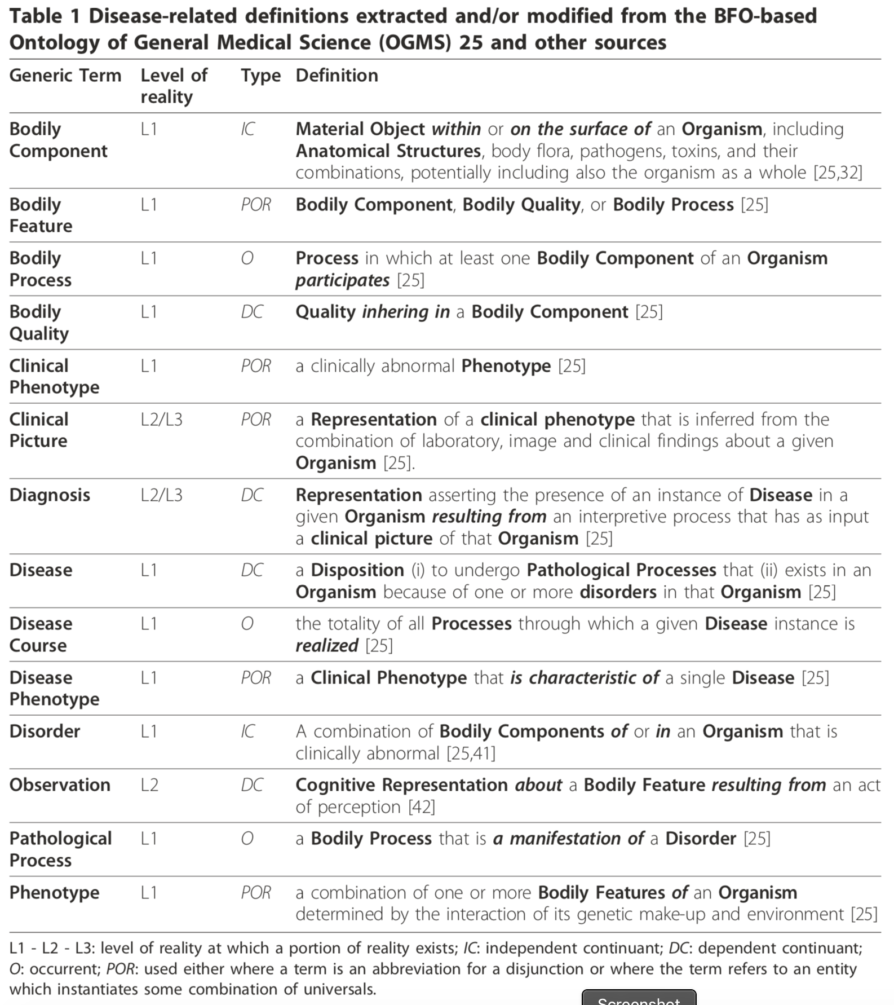
Notes:
It presents here a set of terms and definitions representing the core entities involved in the phenomenon of mental disease, building further on BFO and OGMS
By distinguishing these three levels we are able, for instance, to differentiate clearly between disorders and diseases on the one hand and diagnoses on the other.

Slide 8
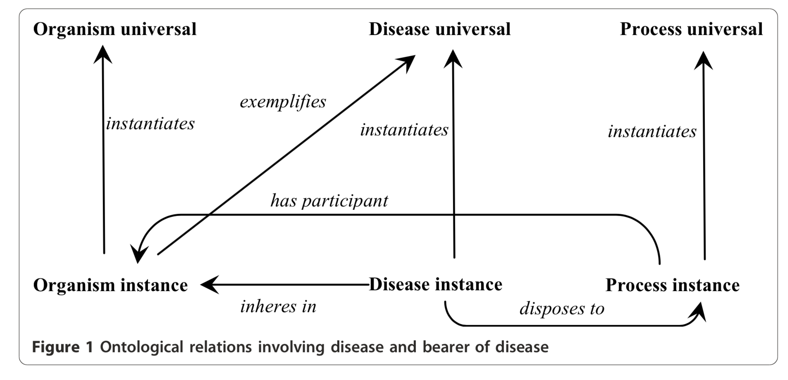
Methodology
BFO provides for the analysis an initial set of top-level representational units which are independent of any specific domain.
OGMS, using BFO as foundation, expands the range of representational units to embrace the terms of general medical science.
Then, assessed for each of the identified entities whether they belong to the portion of reality described by either BFO or OGMS or to the more specific portion of reality to be described in our proposed Ontology of Mental Disease (OMD).
Notes:
Figure 1. depicts in simple form the entities which exist on the side of a specific person when that person (an instance of Organism) has a disease.

Slide 9
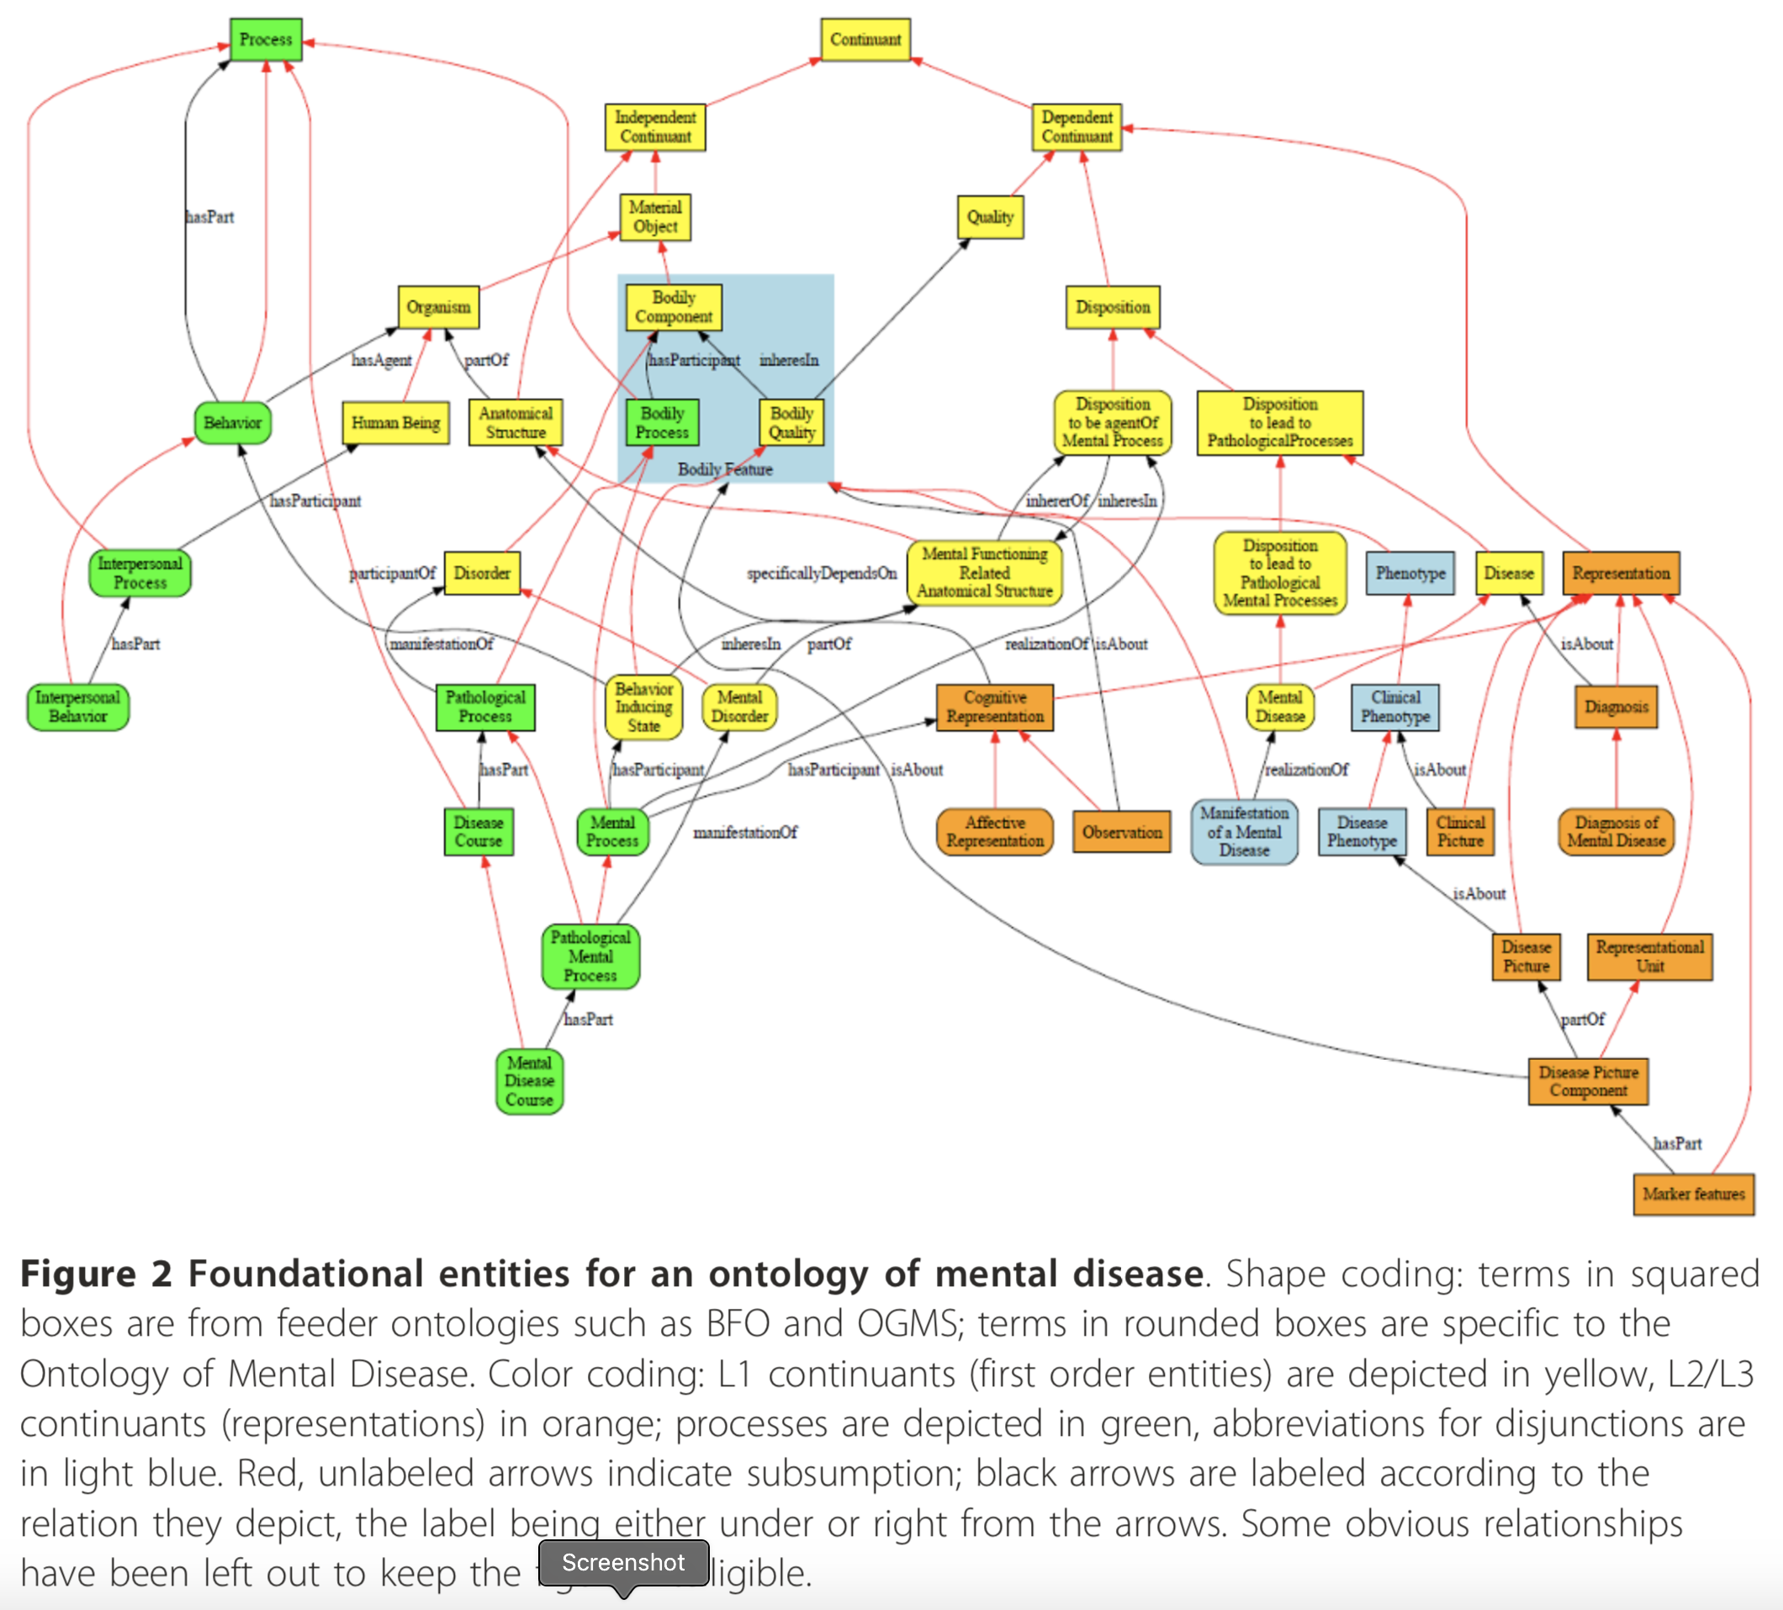
Result
Figure 2 contains an overview of the entities which we believe will need to play a foundational role in a future OMD alongside the entities already represented in BFO and OGMS.
Notes:
To say that the patient has a mental disease is to say that there is some Mental Dis- order instance in the patient. This is, in OGMS terms, the physical basis of the corre- sponding Disease instance. As a part of the organism it is, like the organism itself, an independent continuant (IC). This Disease instance is a certain disposition (DC), which inheres in the corresponding disorder in the patient, and is itself the potentiality for (and is realized in) instances of Pathological Mental Process (O) of certain pro- cess types, for example as manifested in the form of signs and symptoms. Typically, multiple patterns of such processes - multiple presentations, in other words, or what we shall officially call multiple Disease Courses (O) - will be associated with the same Disorder type, for example in reflection of the presence or absence of pharmaceutical or other interventions, of differences in environmental influence, and so forth.

Slide 10
Conclusion
By using the realism based approach the paper have been able to identify certain confusions in the clinical terminology around mental disease, disorder, and illness.
To bring clarity, the paper presented an ontology resting on the identification of mental diseases as dispositions which exist because of underlying disorders in mental functioning related anatomical structures.
Notes:
By being rooted in Basic Formal Ontology and in the Ontology of General Medical Science our ontology is fully compatible with other ontologies that adhere to the principles of the Open Biomedical Ontology Foundry.
Not based on any specific theory of mind, nor does it commit us to either the categorical or dimensional view on mental disease.

Slide 11
Thank you!

