Slide 1

Discover your catalysts from Open Catalysts dataset
Seoul National University
Materials Science and Engineering
Jaehyun Kim

Slide 2
Catalysts is important!

Slide 3
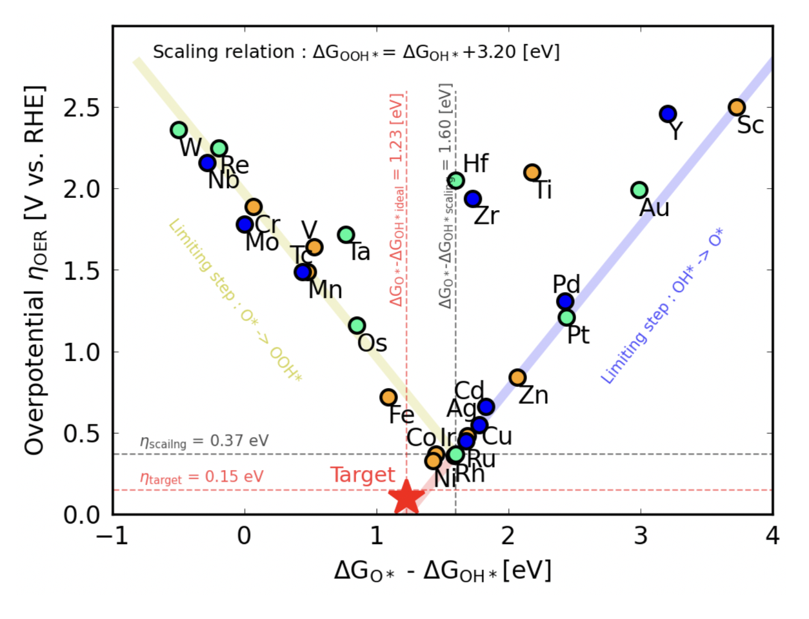
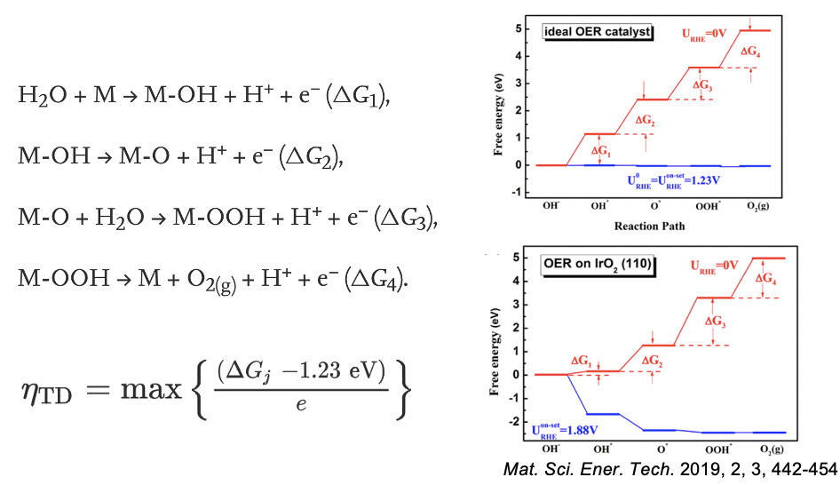
Discovering nice catalysts is hard.

Slide 4
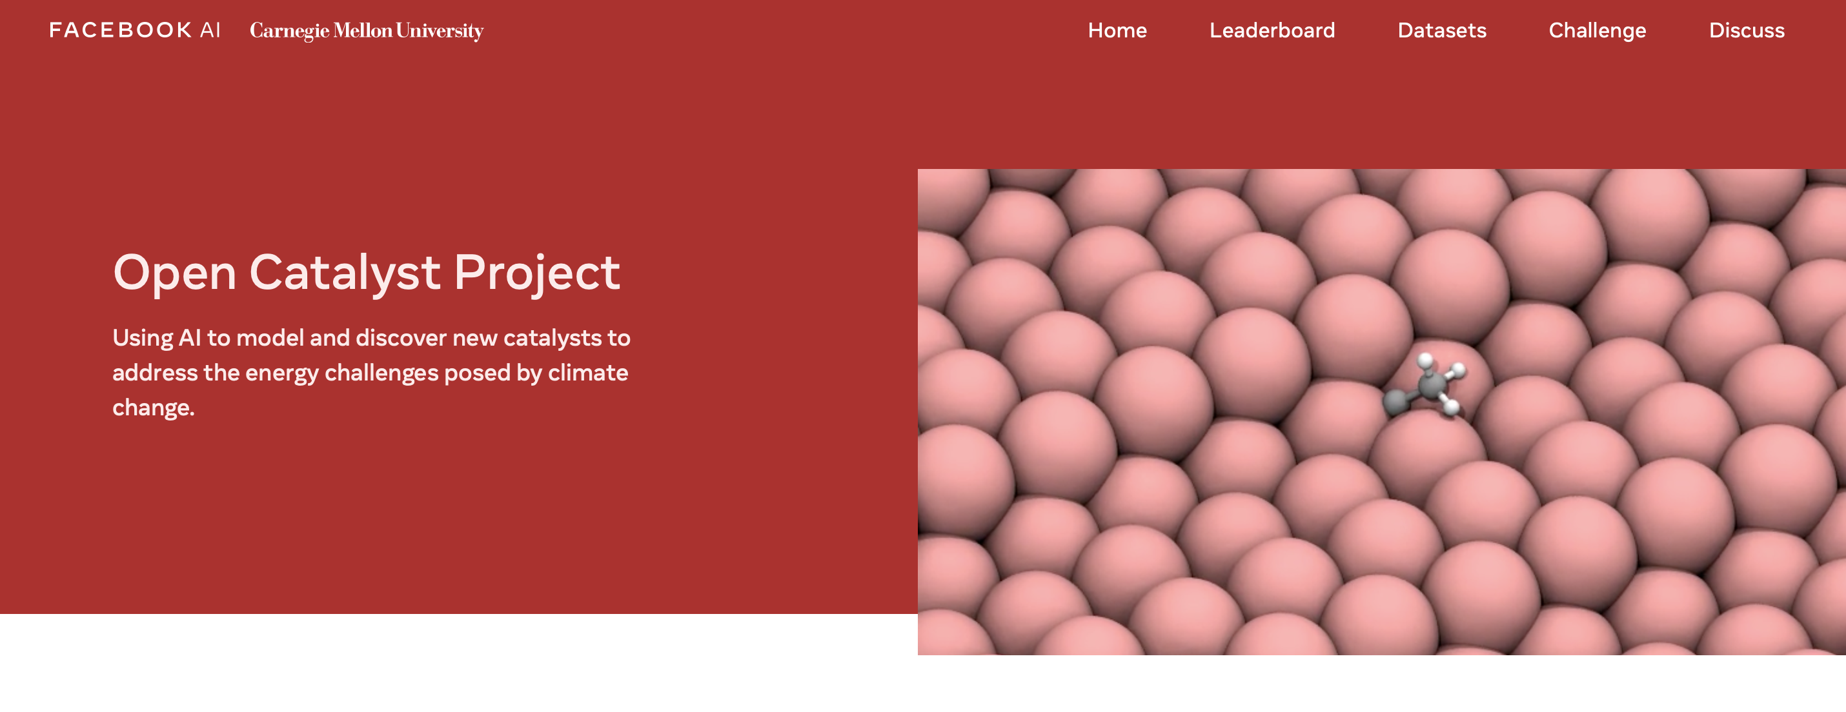
There is a good Open Source dataset.

Slide 5
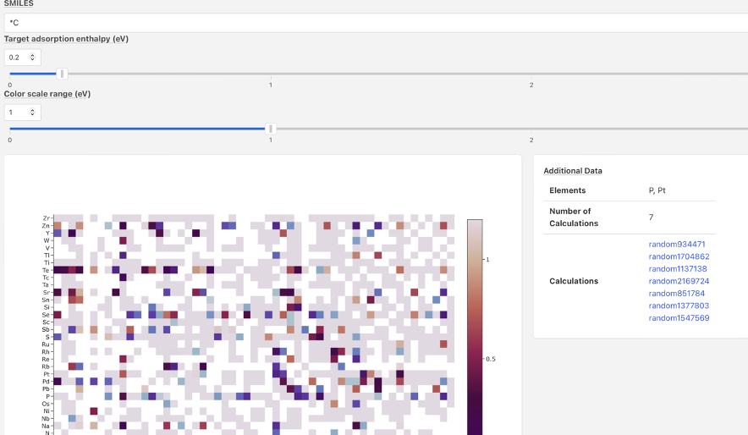
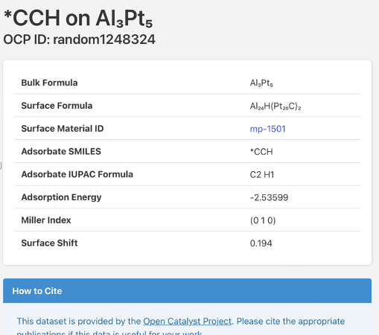
But It has some limitations in exploring.

Slide 6

Any other useful visualization solution?

