Slide 1
CHIME Instruction

Slide 2
Get Start (Tested in Mac OS)
Download demo.csv (a 200000x25 size random walk time series)
Run the script by
. demo.sh
The script will create:
getDim.m: Including all relevant dimensions information for detected subdimensional motif candidate
res.txt: Motif Candidate Information
Log file: recording execution run time result

Slide 3
Get Start (Tested in Mac OS)
Matlab Code for Visualization run:
TS=load('demo.csv')
load('res.txt')
getDim
[motif, dimension]=getmotif(dim,res); <- ranked motif
Try 1: visualization script, show Top20 motifs found that length >= 3000: plotmotif(TS,motif,dimension,motif(:,5)>=3000)
Try 2: visualization script, show Top20 motifs found that number of dimension >= 4: plotmotif(TS,motif,dimension,motif(:,7)>=4)
Try 3: visualization script, show Top20 motifs found that number of dimension >= 4 & length >= 1000: plotmotif(TS,motif,dimension,motif(:,5)>=3000 & motif(:,7)>=4)

Slide 4
How to Interpret The Output File

Slide 5
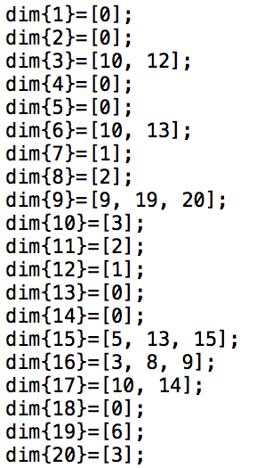
getDim.m
Each column indicated
a list of relevant dimension:
E.g. motif 9 has 3 relevant
Dimension (9,19,20)

Slide 6
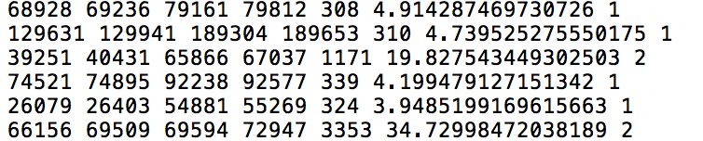
res.txt
Instance A
Instance B
Length
Distance
# of Relevant Dim
A list of motif intervals:

