Slide 1
Charito
Effective scholarly tools for layman biblical study
Peter Jackson Link, III
Sean Timothy Hayes
B.S. in Computer Science

Slide 2
The Problem
Scholarly tools for biblical research are typically gated behind expensive applications like Logos or Accordance.
The raw resources for those tools are typically public domain.

Slide 3
The Solution
Charito uses public domain resources to provide tools that enhance in-depth study of scripture.
Valuable documents are available from the millennia of church history.
It does so via a freely available web application.

Slide 4
The Resources
The Christian Classics Ethereal Library provides historical documents as XML files.
The CCEL provides these as PDF files but doesn’t put them into a comprehensive Bible application with the other sources I include.
Other sources provide Greek and Hebrew texts via XML.
Public-domain bibles like the KJV are also available as XML.

Slide 5
Constraints
It Must Be:
Stable
Efficient
Maintainable by single person

Slide 6
The Languages
Common Lisp: Powerful programming language for creating Domain Specific Languages
AP5: Advanced in-memory database represented by a logic-programming language.
Spinneret: Write HTML in Lisp
Parenscript: Write JavaScript in Lisp

Slide 7
Lisp vs Python/PHP/Ruby/Perl
Common Lisp | Scripting Language
Compiles to efficient machine code | Bytecode-interpreted or JIT
Strong type enforcement at compile time and run time | No compile-time or run-time type enforcement
Macros allow for easy creation of efficient DSLs by operating on the AST at compile-time | The compiler only compiles the base language with no comparable extension
Conditions & restarts for error-handling | Try/catch or function return value only

Slide 8
The Tools
SBCL Lisp Compiler: Stable and efficient
Plump: Lenient XML parser
Woo: Eitaro Fukamachi’s blazing-fast web server

Slide 9
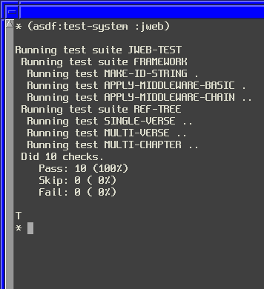
Testing

Slide 10
Demonstration
I shall now demonstrate how the application functions

Slide 11
Conclusion
This rapidly-evolving application will continue to integrate more resources into the database and create tools with those resources
Roadmap: After integrating lexicons, tools like flashcards and parsings will begin to be available. More ideas available as users request.

