Slide 1


Accessibility as a Service
(AaaS)
Shared accessibility infrastructure for public institutions
Team SUBARNAREKHA
Smart Odisha Hackathon '25
Theme: Accessibility · E-commerce & Cyber Security | Software · Odiapreneur track
Notes:
Namaskar. We are Team SUBARNAREKHA. Our project is Accessibility as a Service - shared infrastructure that makes any government or education website usable by every citizen, in their own language, including the blind, low-vision and dyslexic. One line for institutions to integrate; one extension for citizens to use it everywhere.

Slide 2
The Problem
▸ 26.8M+ Indians live with a disability (Census 2011) - yet most government and education sites are unusable with a screen reader.
▸ The web is English-first. Only about 1 in 10 Indians reads English comfortably - Odia-only citizens are shut out of digital services.
▸ Today's "fix" is an overlay sold to site owners. It ignores Indian languages, only works where installed, and is widely criticised for not actually fixing access.
▸ Every department builds accessibility alone. Slow, costly, inconsistent - and rarely WCAG / GIGW compliant.
A citizen who cannot read English or cannot see the screen simply cannot use the service.
Team SUBARNAREKHA · Smart Odisha Hackathon '25
02 / 16
Notes:
Frame the gap: disability + language + no shared solution. The punchline - existing overlays are English-centric band-aids. Public digital services exclude exactly the people who need them most.

Slide 3
Who gets left behind
The blind citizen
The Odia speaker
The exam candidate
A government notice or scholarship form they literally cannot read - no audio, no screen-reader support.
A farmer or student fluent in Odia, facing an English-only portal with no translation.
A student with dyslexia in an online test - no audio support, no extra time, no friendly fonts.
These are not edge cases - they are millions of citizens that public services are meant to serve.
Team SUBARNAREKHA · Smart Odisha Hackathon '25
03 / 16
Notes:
Put a human face on the stats. Three personas the judges can picture. End on scale: millions, not edge cases.

Slide 4
Our Solution: one shared platform
Accessibility as a Service - institutions plug in ONCE; citizens get it EVERYWHERE.
API + Widget
Browser Extension
On-device Indian AI
INTEGRATE ONCE
WORKS ON ANY SITE
PRIVATE & OFFLINE
One <script> line or a REST API turns any site accessible.
Citizens install it once - accessibility on every website, no site cooperation.
Neural Odia/Hindi/English voice & translation run in the browser.
Team SUBARNAREKHA · Smart Odisha Hackathon '25
04 / 16
Notes:
The one big idea: shared infrastructure, not another point tool. Two delivery modes (integrate vs extension) and the differentiator - Indian-language AI that runs on-device.

Slide 5
Two ways in - the same powers
Institutions integrate
Citizens install the extension
▸ Add one widget <script> line, or call the REST API.
▸ Their site gains read-aloud, translation, voice-to-fill forms and an accessible exam mode.
▸ Central control: API keys, usage metering, WCAG logging.
▸ One-time install in Chrome / Edge.
▸ Accessibility on ANY website - including legacy portals that will never be updated.
▸ Runs on-device: offline and even on strict-CSP sites.
Power with the user - not just the site owner.
Team SUBARNAREKHA · Smart Odisha Hackathon '25
05 / 16
Notes:
This slide pre-empts the overlay question. Overlays are site-owner-only. We add a citizen-controlled path so accessibility reaches sites that will never integrate.

Slide 6
Core architecture
two ways in -> one API gateway -> shared engines (also run on-device)
CLIENTS
API GATEWAY
ENGINES
Institution site / app
widget (1 line) + REST API
Accessibility API Gateway
Text-to-Speech + Screen Reader
Meta MMS-TTS · Odia/Hindi/English
X-API-Key · multi-tenant · CORS
POST /tts
POST /stt
Speech-to-Text
Whisper
Browser extension
any website, on-device
POST /translate
GET /widget.js
usage metering · rate limiting · WCAG logging
Translation
AI4Bharat IndicTrans2
Admin Dashboard
tenants · API keys · usage · WCAG
On-device option: the extension runs all three engines in the browser via WebAssembly - offline, and even on strict-CSP sites.
Team SUBARNAREKHA · Smart Odisha Hackathon '25
06 / 16
Notes:
Walk left to right. The gateway is the product: secure, multi-tenant, metered. The same engines run server-side OR on-device in the extension. Admin dashboard gives departments oversight and WCAG evidence.

Slide 7
How it works
Read aloud
Page text
IndicTrans2 (if needed)
MMS-TTS on-device
Odia voice plays
Translate page
Page text
IndicTrans2
Page rewritten in Odia
Speak to fill
Voice (mic)
Whisper on-device
Form field auto-filled
"On-device" = runs inside the browser via WebAssembly. No server needed, fully offline, and translation is skipped when the page is already in your language.
Team SUBARNAREKHA · Smart Odisha Hackathon '25
07 / 16
Notes:
Three everyday actions, each a small pipeline. Stress that the heavy AI runs on the user's device - so it works with no backend and respects privacy.

Slide 8
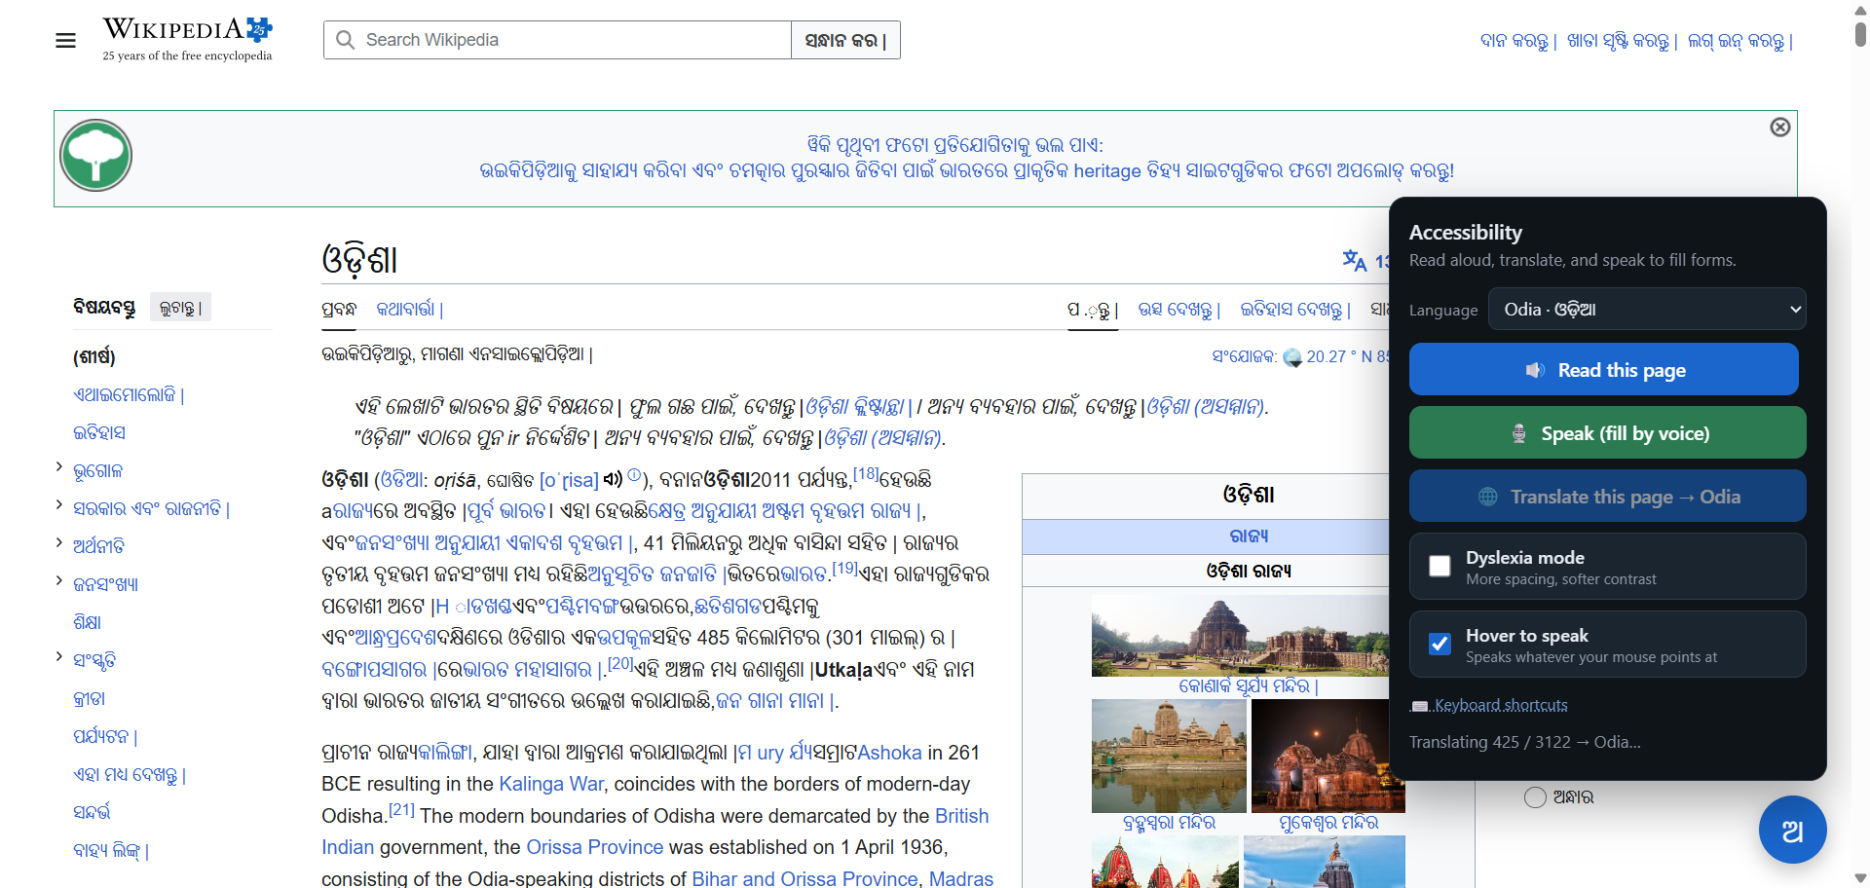
It already works - live, on any site
English Wikipedia -> Odia
Title and page flip to Odia in place, and the page reads aloud in a neural Odia voice.
No backend running.
Works despite Wikipedia's strict Content-Security-Policy - because translation goes through the extension and the voice runs on-device.
Team SUBARNAREKHA · Smart Odisha Hackathon '25
08 / 16
Notes:
This is a real screenshot, not a mockup. Wikipedia is a deliberately hard target (strict CSP). If it works here, it works on government portals. Offer to do it live.

Slide 9
One platform, six parts
1
Speech-to-Text
Voice input, dictation
2
Text-to-Speech + Screen Reader
Neural Odia/Hindi/English
3
Accessibility API Gateway
The plug-and-play surface
4
Translation - IndicTrans2
Indic-tuned, Odia-first
5
Accessible Exam module
Extra time, audio, dyslexia fonts
6
Admin Dashboard
Tenants, keys, usage, WCAG
Team SUBARNAREKHA · Smart Odisha Hackathon '25
09 / 16
Notes:
Maps directly to the problem statement's six modules. We didn't pick one piece - we built the whole accessibility platform, with the exam module and admin oversight as differentiators.

Slide 10
Built to run anywhere
▸ Browser extension (MV3): MAIN + isolated worlds, a Shadow-DOM widget that can't clash with any page.
▸ FastAPI gateway: multi-tenant, X-API-Key auth, CORS, usage metering, WCAG logging.
▸ Voices - Meta MMS-TTS: Odia, Hindi & English neural speech.
▸ Speech-to-Text - Whisper; Translation - AI4Bharat IndicTrans2.
▸ On-device runtime: transformers.js + ONNX / WebAssembly - inference in the browser.
▸ Portable bundle: the whole stack runs offline from a USB / folder (start.bat).
Why it matters
▸ Privacy: voice & text stay on the device.
▸ Offline: no connectivity required.
▸ Resilient: works on strict-CSP sites.
▸ Low cost: no per-call cloud AI bills.
Team SUBARNAREKHA · Smart Odisha Hackathon '25
10 / 16
Notes:
For technical judges. The headline engineering win is on-device inference: privacy, offline, resilience and cost - all at once. Mention the Shadow DOM isolation so the widget never breaks host pages.

Slide 11
Isn't this just another accessibility overlay?
 | Overlays (accessiBe / UserWay) | AaaS
Who controls it | Site owner installs & pays; one site only | User installs the extension -> works on ANY site
Language | English / Western-centric | Odia & Hindi first, via IndicTrans2
Data | Cloud SaaS; content sent to their servers | On-device & in-country; DPDP-friendly
Claim | "Auto-makes you compliant" (criticised) | Honest: assistive layer + API toolkit
Extras | Generic toolbar | Voice-to-fill, exam mode, admin & WCAG logs
We are not a compliance shortcut - we are accessibility infrastructure with first-class Indian-language access.
Team SUBARNAREKHA · Smart Odisha Hackathon '25
11 / 16
Notes:
The expected hard question - answer it head-on. Key lines: overlays are site-owner, English, cloud, and over-claim compliance. We are user-controlled, Indian-language, on-device, and honest about being an assistive layer + toolkit.

Slide 12
Why government should adopt AaaS
▸ Compliance, built in: helps meet the RPwD Act 2016, GIGW 3.0 and WCAG 2.1 - with WCAG result logging for evidence.
▸ Real inclusion: first-class Odia & Hindi reaches the citizens English-only tools miss.
▸ Data sovereignty: on-device & in-country processing - DPDP Act 2023 friendly; no citizen data sent to foreign clouds.
▸ Cost-efficient: one shared platform instead of every department reinventing it - and it works on existing legacy portals, no rebuild.
▸ Maximum reach: the extension covers sites that cannot be changed today, so impact is immediate.
Team SUBARNAREKHA · Smart Odisha Hackathon '25
12 / 16
Notes:
Speak the government's language: compliance (RPwD/GIGW/WCAG), sovereignty (DPDP, on-device), cost (shared infra, no rebuild) and reach (works on legacy sites now). These are procurement decision factors.

Slide 13
Impact & alignment
Outcomes
Aligns with national missions
▸ Any citizen can hear & read any public page in Odia.
▸ Exams become accessible for students with disabilities.
▸ Departments get measurable WCAG compliance.
▸ Accessibility delivered without rebuilding old sites.
▸ Digital India - inclusive e-governance.
▸ Sugamya Bharat (Accessible India Campaign).
▸ SDG 10 - reduced inequalities.
▸ SDG 4 - inclusive, quality education.
Team SUBARNAREKHA · Smart Odisha Hackathon '25
13 / 16
Notes:
Tie outcomes to flagship missions judges know. This signals the project isn't a toy - it advances policy goals the state already cares about.

Slide 14
Way forward
NOW - MVP
NEXT - 3-6 months
LATER - 6-12 months
▸ Extension + gateway live
▸ Odia / Hindi / English
▸ On-device TTS & STT
▸ Offline portable bundle
▸ More Indian languages
▸ Pilot with one govt dept
▸ Android / mobile
▸ Sign-language avatar (R&D)
▸ State-wide rollout
▸ WCAG compliance dashboard
▸ Developer SDKs & marketplace
▸ Certification programme
Team SUBARNAREKHA · Smart Odisha Hackathon '25
14 / 16
Notes:
Show momentum and a credible path. We already have a working MVP; the near-term ask is a real pilot; the long term is shared state infrastructure with certification.

Slide 15
The Ask
Give us one department's website - we'll make it usable by every citizen.
▸ A pilot: one Odisha government department or university portal to deploy on.
▸ Access & mentorship: real portals to test against, and guidance to harden for production.
▸ Support to scale: security hardening and infrastructure for a state-wide rollout.
Team SUBARNAREKHA · Smart Odisha Hackathon '25
15 / 16
Notes:
Make the ask concrete and small enough to say yes to: one pilot. Confidence line - hand us one site and we will prove it.

Slide 16
Thank you
Accessibility as a Service · Team SUBARNAREKHA
Smart Odisha Hackathon '25 · Accessibility for every citizen
Notes:
Close warm and confident. Restate the one-liner: accessibility for every citizen, in their own language, on any site. Invite the live demo.

