Slide 1
Species determination – what’s in my sample?

Slide 2
What is my sample?
When might you not know what your sample is?
One species
You have a malaria sample but don’t know which species
Misidentification or no identification from culture/MALDI-TOF
Metagenomic samples
Contamination

Slide 3
Taxonomic Classifiers
Compare sequence reads against a database and determine the species
BLAST works for a single sequence, too slow for a whole run
Classifiers use database indexing and k-mer searching
Similar accuracy to BLAST but much much faster

Slide 4
Kraken taxonomic classifier
Wood and Salzberg Genome Biology 2014 15:R46

Slide 5
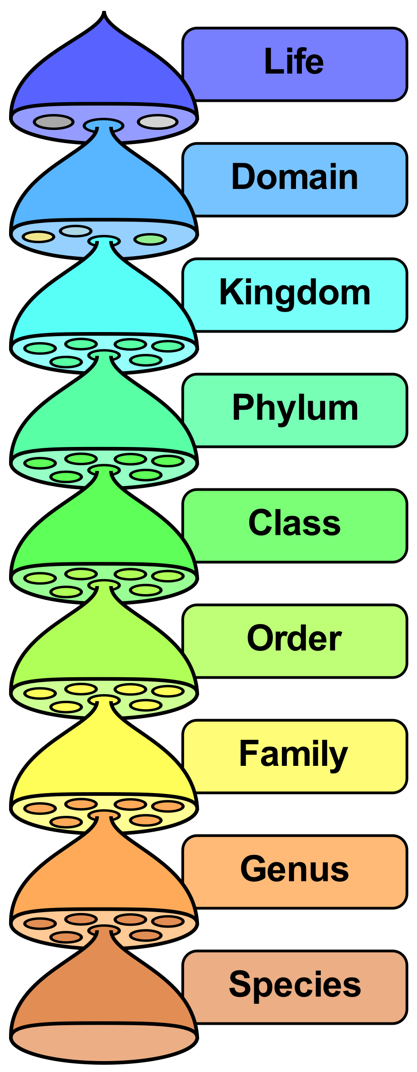
Bacteria
Proteobacteria
Gammaproteobacteria
Enterobacteriales
Enterobacteriaceae
Escherichia
Escherichia coli

Slide 6
0.24 8553 8553 U 0 unclassified
99.76 3553969 0 - 1 root
99.76 3553969 217 - 131567 cellular organisms
65.03 2316784 542 D 2 Bacteria
41.67 1484567 0 P 544448 Tenericutes
41.67 1484567 0 C 31969 Mollicutes
41.67 1484566 0 O 2085 Mycoplasmatales
41.67 1484566 0 F 2092 Mycoplasmataceae
41.67 1484566 822 G 2093 Mycoplasma
41.65 1483728 1434758 S 2100 Mycoplasma hyorhinis
0.52 18488 18488 - 936139 Mycoplasma hyorhinis MCLD
0.33 11708 11708 - 1118964 Mycoplasma hyorhinis SK76
0.25 9015 9015 - 872331 Mycoplasma hyorhinis HUB-1
0.20 6995 6995 - 1129369 Mycoplasma hyorhinis GDL-1
0.08 2764 2764 - 634997 Mycoplasma hyorhinis DBS 1050
22.81 812626 157 P 1224 Proteobacteria
22.73 809640 0 C 28216 Betaproteobacteria
22.73 809640 0 O 80840 Burkholderiales
22.73 809640 0 F 506 Alcaligenaceae
22.73 809640 0 G 222 Achromobacter
22.73 809640 0 S 85698 Achromobacter xylosoxidans
22.73 809640 809640 - 1216976 Achromobacter xylosoxidans ATCC 27061

Slide 7
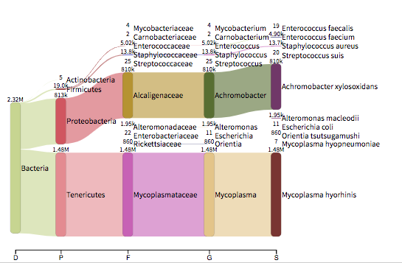
Visualisation
Breitwieser FP, Salzberg SL. Pavian: Interactive analysis of metagenomics data for microbiomics and pathogen identification. bioRxiv 2016: 084715.

Slide 8
Pavian demonstration

Slide 9
Pitfalls of classification
What is in your database?
Standard databases are bacterial and viral
More species, more sequences, bigger databases
How correct is your database? Draft genomes have contaminants
Confidence of classification
What if reads are not in the database?
Do you look at genus, species, or strain level?
How confident is each match? Tradeoff sensitivity vs specificity
Kraken confidence threshold moves up the tree until confidence is met

