Slide 1
Introduction to Basic Local Alignment Search Tool (BLAST)
Philip Ashton
OUCRU
Notes:
How many people have used BLAST?
How many of you know, roughly, how BLAST works?
If this was a molecular biology course, and you all ran PCR all day but didn’t know what taq polymerase was, that would be a problem.

Slide 2
Why is sequence similarity important?
DNA -> RNA -> Protein primary structure -> protein secondary structure -> protein tertiary structure
Protein tertiary structure is of fundamental importance to the function of proteins
If two proteins have similar sequences, they are likely to have similar structures
Therefore, we can make inferences about protein function purely from sequence similarity measures
Notes:
Blast is a tool for investigating sequence similarity. Why is this important?

Slide 3
Where does biological variation come from?
Biological sequences show complex patterns of similarity to each other
These patterns are often due to homology
Homologous sequences are those which share a common ancestor
Sequences evolve due to natural selection acting on random variation
Not all sequence changes we observe are due to natural selection, some are just due to genetic drift
BLAST; Korf, Bedell, Yandell; O’Reilly Media; 2003
Notes:
Pretty much every one of these statements is a massive field of biological research.

Slide 4
Smith-Waterman/Needleman-Wunsch
Needleman-Wunsch - global alignment, 1970
Smith-Waterman – local alignment, 1981
Guaranteed to find the best alignment (according to scoring criteria)
Scales quadratically (requires as many calculations as the query length multiplied by the subject length)
Too slow for many applications, but valuable if we want to be absolutely sure of the answer
Notes:
Put in a figure about hte difference between global and local
Write out hte n and m stuff a bit nicer
Maybe put in the growth of the sequence database

Slide 5

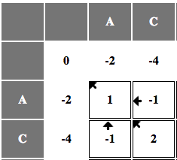
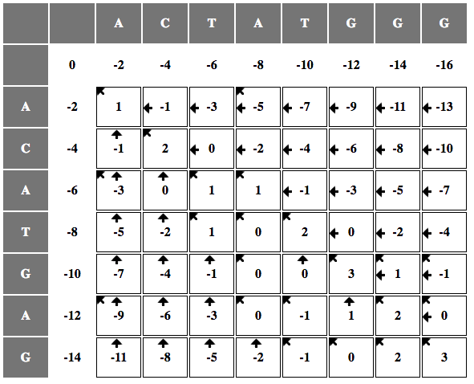
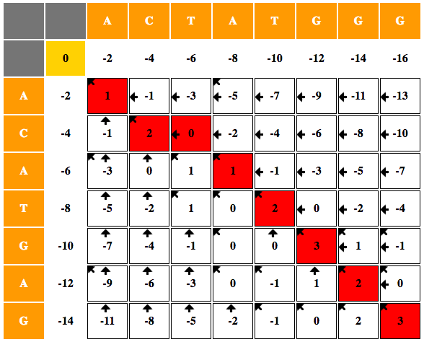

Needleman-Wunsch algorithm for global alignment:
Choose a scoring system
Fill in the table
Traceback from the cell on the bottom
http://experiments.mostafa.io/public/needleman-wunsch/
Notes:
Youtube video?

Slide 6
The better option – BLAST, Altschul et al., 1990
“Seed and extend”
Break the query into “words” – 3 AA, 11 nt
Look for exact matches between the words in the query and in each subject in the database.
For each query-subject match extend the alignment, calculating a score as you go.
Stop calculating for alignments where score goes below a certain threshold
Notes:
If you only remember one thing about BLAST – make it this; seed and extend. That’s the three line summary of how blast works.

Slide 7
How do we score?
Nucleotide
Amino acid
Match +1
Mismatch -1
Gap -1
BLOSUM amino acid substitution matrix
Notes:
For nucleotides, if the two sequences match the score increases, mismatches and gaps decrease the score. For proteins, it is more complex, as changes between amino acids have a range of consequences.

Slide 8
Putting sequence similarity on a firm statistical footing
BLAST provides an ‘E-score’ or ‘E-value’, E stands for Expectation
It is the number of times you would expect to see an alignment with a similar score by chance
Lower is better; 10^-30 is a frequently used threshold
E-value calculation depends on the size of the search space (the query and database size), and the score of the alignment
BLAST; Korf, Bedell, Yandell; O’Reilly Media; 2003

Slide 9
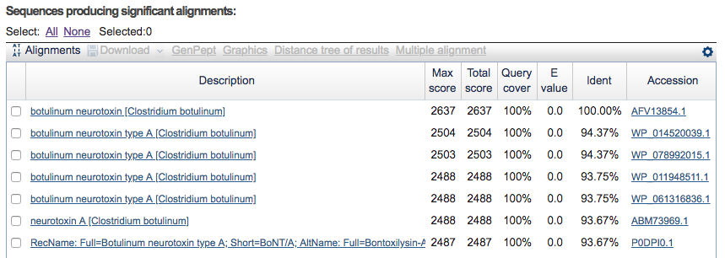
Example of BLAST output
Database is the complete non-redundant NCBI protein database

Slide 10
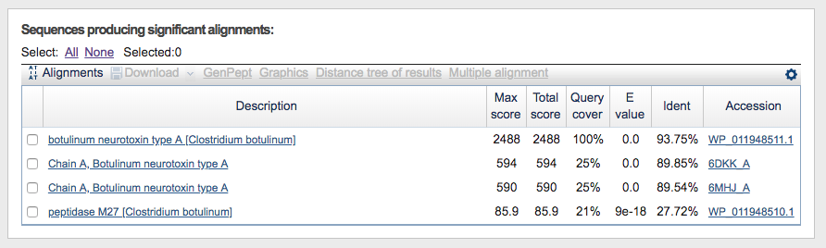
Example of hit with e-value and bit score etc.
Database is a single C. botulinum genome

Slide 11
BLAST is the most important piece of bioinformatics software*. Why?
The problem it solves, sequence similarity search, gives us a really powerful tool for identifying unknowns in the biological world
It is fast
It is reliable
It is flexible, can be used for many sequence analysis scenarios
It’s so widely used that most biologists understand it as a verb
* BLAST paper has > 70,000 citations
BLAST; Korf, Bedell, Yandell; O’Reilly Media; 2003
Notes:
Sequence similarity search is an enabling technology which touches every area of molecular biology (defined in the broadest sense).
It is fast in terms of comparing a single sequence against a large database. When we need to compared hundreds of thousands or millions of reads against a database, we need to use a mapper e.g. bwa, bowtie.
It’s reliable in terms of both reported statistics and in terms of software development (quite rare for bioinformatics)
It’s flexible – can be used for DNA or protein alignment, lots of

Slide 12
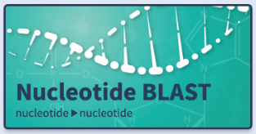
=
?

Slide 13
BLAST Glossary
Subject
Query – the sequence you are interested in
Subject – the specific sequence you are comparing against
Database – all the sequences you are comparing against
Query
Database

Slide 14
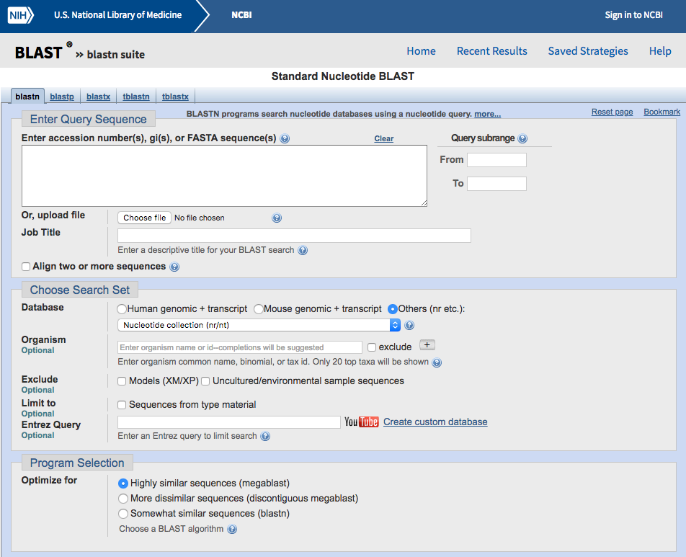
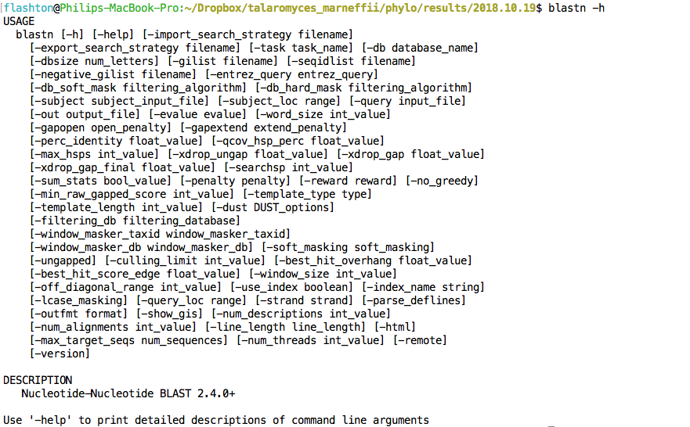
BLAST vs web service
Notes:
So, if you have used BLAST, most of you have probably used it via the NCBI website. On the left hand side. NCBI host a service which uses blast to search against pre-computed databases, like the entire of the NCBI nucleotide collection. It’s very convenient and is widely used, around 200 000 queries per week. It is useful for what you could describe as ‘gene‘ scale analyses.
However, that isn’t BLAST, blast is a standalone computer program, which you can also download and install yourself to run locally. This gives you much more flexibility and is really the key to using BLAST for genome scale analyses, where you might look at tens or hundreds of genes.
In the practical, we are going to use standalone BLAST on the command line.

Slide 15
Repeats
Simple
Repeats of the same nucleotide e.g. TTTTTTTTTTTTT
Repeats of the same di-nucleotide e.g. CACACACACACACA
Repeats of the same tri-nucleotide e.g. TGCTGCTGCTGC
Etc
Complex
Non-coding RNAs like ribosomal RNA – E. coli has 7 identical copies of rRNA encoding locus
Transposons – ‘jumping genes’, and their ‘cargo’ (e.g. AMR genes)
Repeated protein domains
Notes:
You need to be aware of different types of repeat in order to interpret your BLAST results

Slide 16
Different types of BLAST
Program | Query sequence type | Target sequence type
BLASTP | Protein | Protein | Compares an amino acid query sequence against a protein sequence database
BLASTN | Nucleotide | Nucleotide | Compares a nucleotide query sequence against a nucleotide sequence database
BLASTX | Nucleotide (translated) | Protein | Compares a nucleotide query sequence translated in all reading frames against a protein sequence database
TBLASTN | Protein | Nucleotide (translated) | Compares a protein query sequence against a nucleotide sequence database dynamically translated in all reading frames
TBLASTX | Nucleotide (translated) | Nucleotide (translated) | Compares the six-frame translations of a nucleotide query sequence against the six-frame translations of a nucleotide sequence database
Having a BLAST with bioinformatics, Pertsemlidis & Fondon, 2002

Slide 17
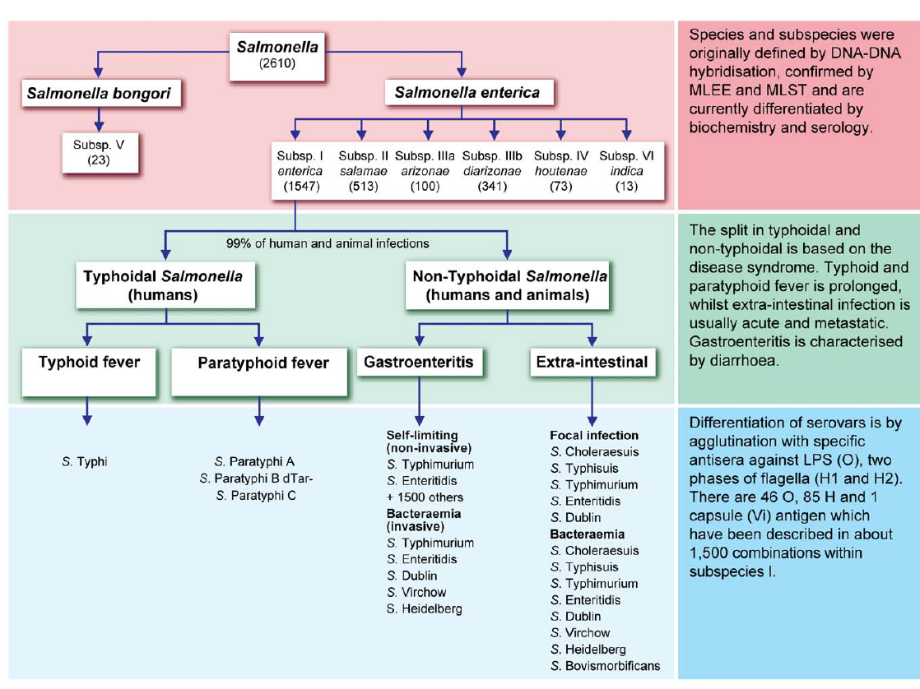
Introduction to Salmonella serotyping
Kauffman-White scheme
46 O antigens (lipopolysaccharide)
85 H antigens (flagellar)
1500 combinations in subsp enterica
O antigen; phase 1; phase 2
E.g. S. Paratyphi A is 1,4,5,12; b; 1,2
Notes:
So, you will need to know a little bit about salmonella serotyping for the practical. There are two species blah blah blah.
Match up the o antigen and phases better twith teh paratyphi example

Slide 18
Bandage Example

Slide 19
Further reading
BLAST; Korf, Bedell, Yandell; O’Reilly Media; 2003
http://shop.oreilly.com/product/9780596002992.do
Having a BLAST with bioinformatics, Pertsemlidis & Fondon, 2002
https://www.ncbi.nlm.nih.gov/pmc/articles/PMC138974/

