Slide 1
Core and accessory genomes

Slide 2
What is the core/accessory/pangenome?
Bacterial strains have different sets of genes
Present in all/nearly all strains in a species – core
Present only in some strains – accessory
Everything seen in a species - pangenome

Slide 3
Why look at the pangenome?
Choice of reference genome biases the gene content
Find pathways/genes present in only some strains
virulence genes, antibiotic resistant genes, metabolic pathways
Association of genes with other characteristics
virulence, environmental vs clinical isolates, disease severity
Core genome are in every strain, represent essential genes

Slide 4
Determining the core genome from genes
Start with a collection of genome assemblies
Alignment to a reference genome will miss genes not in that ref
Annotate the genes in the genome
Cluster the genes based on strain presence/absence

Slide 5
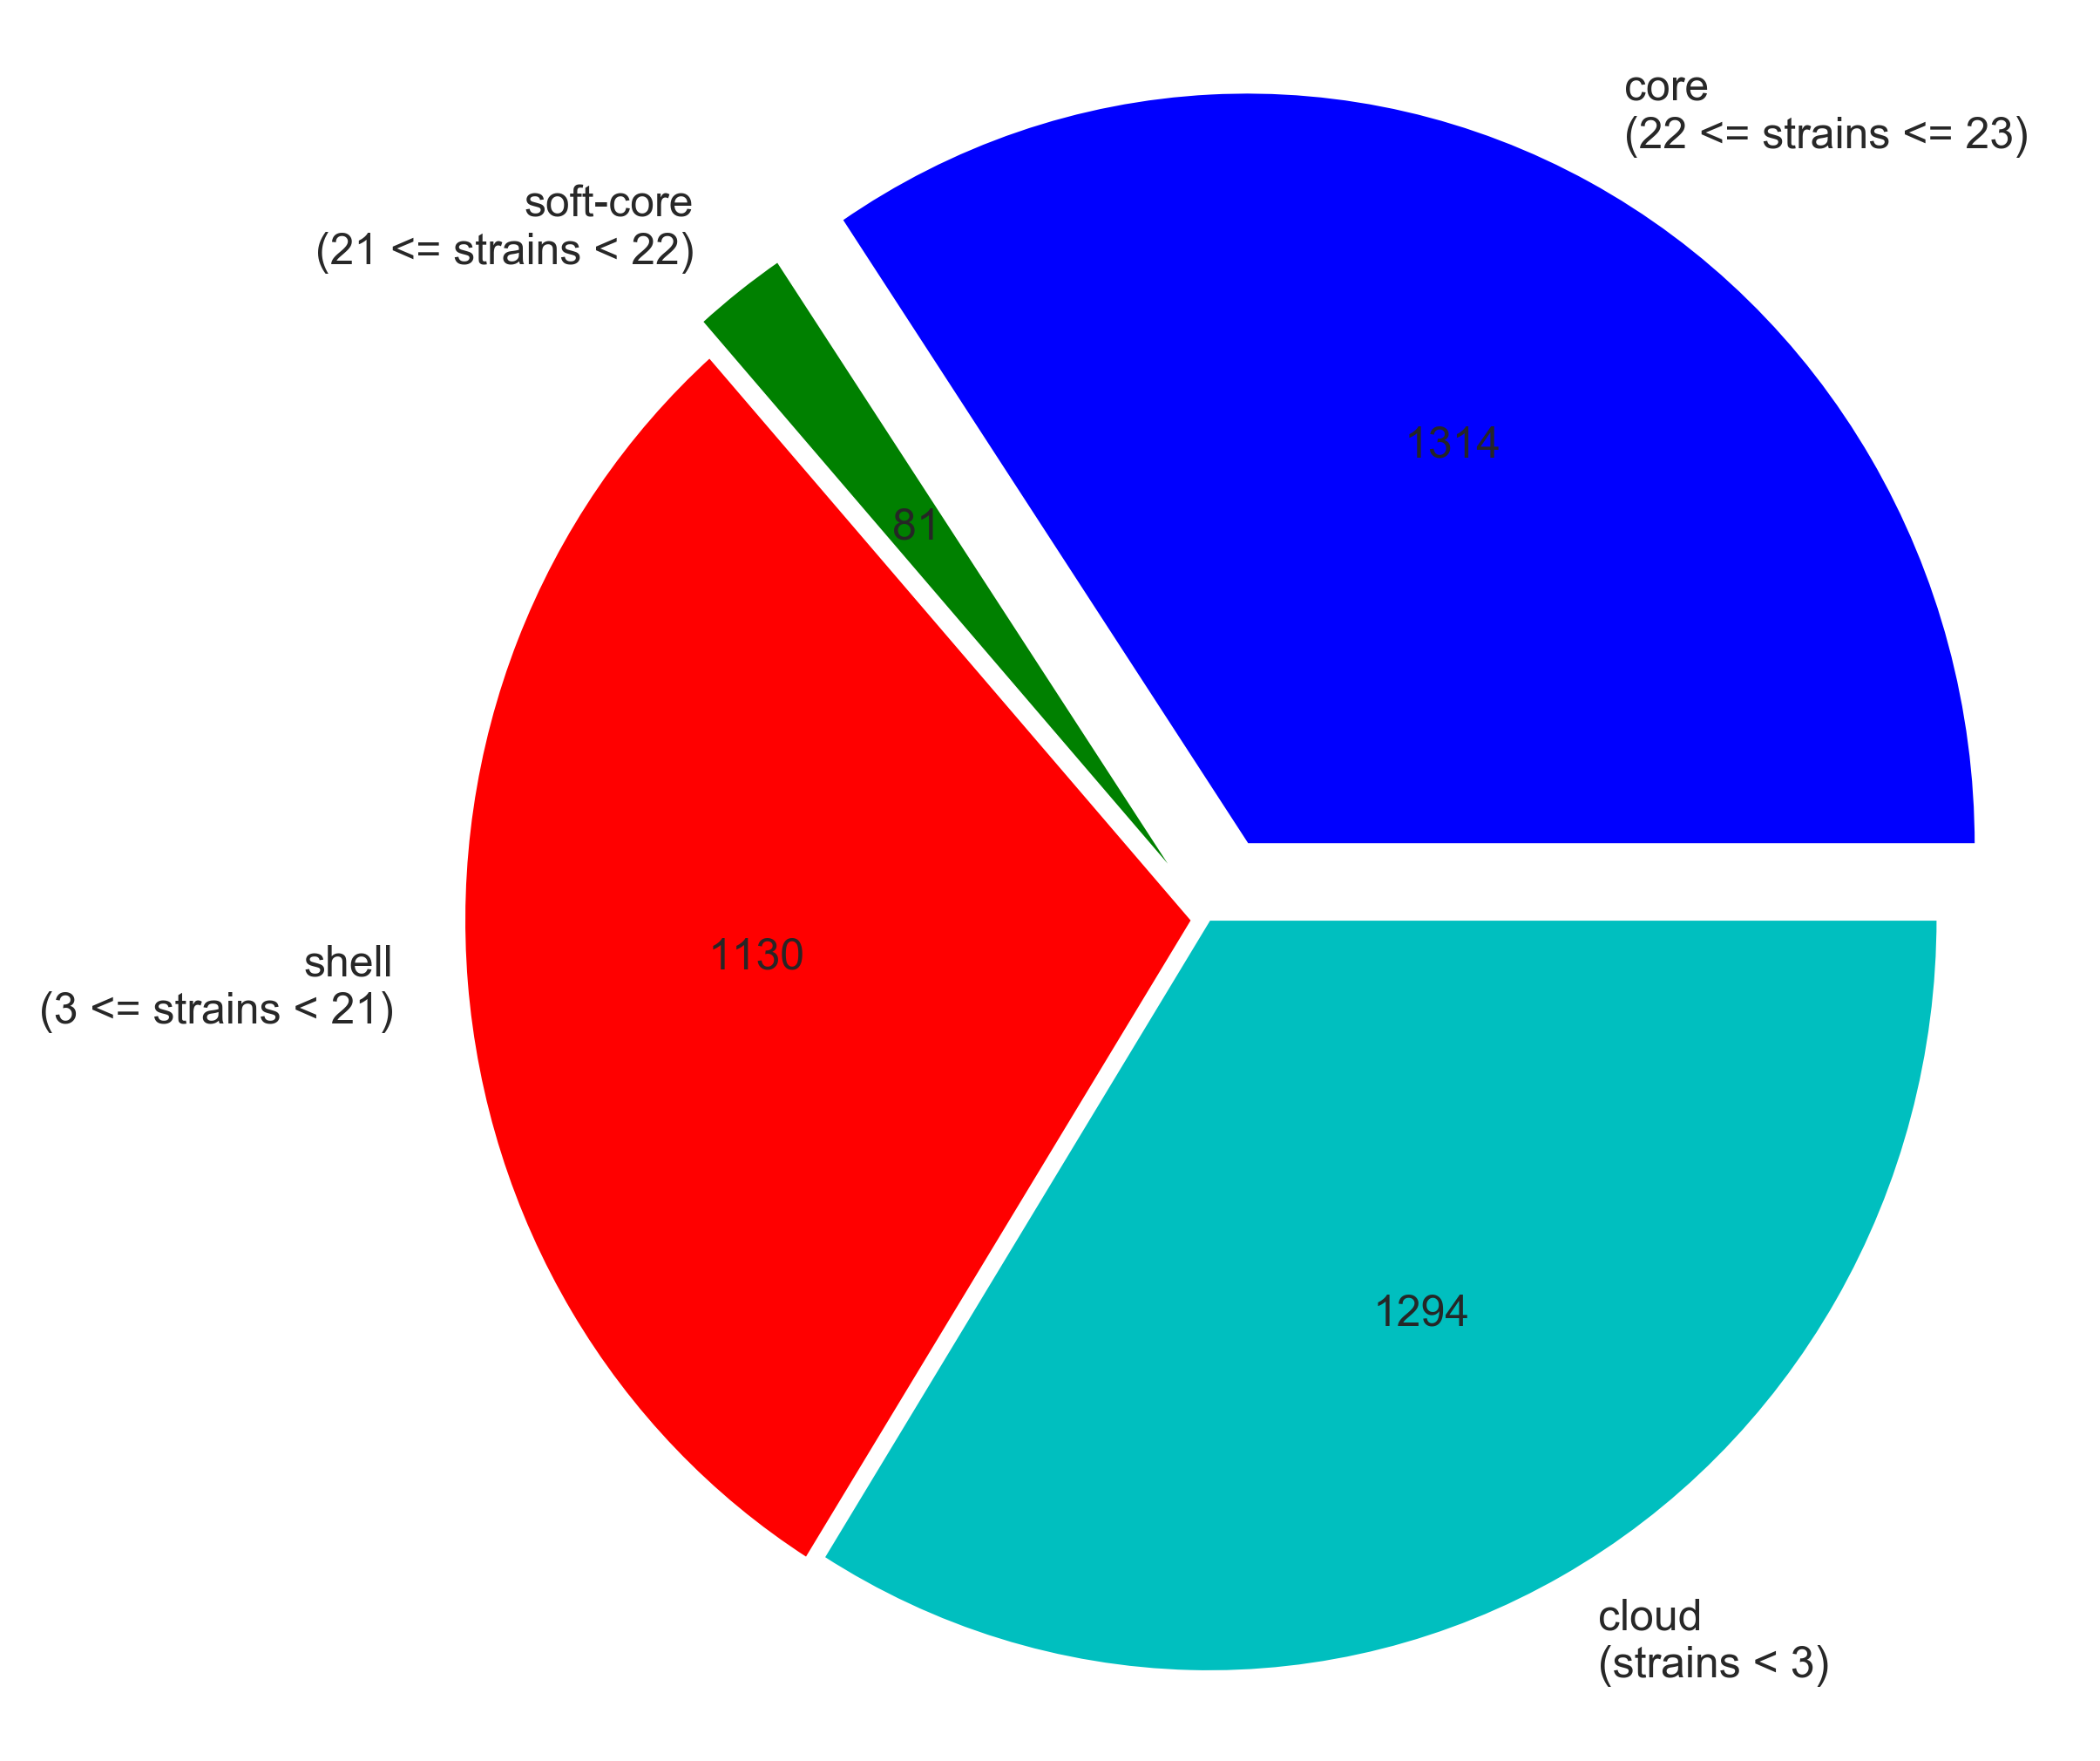

Slide 6
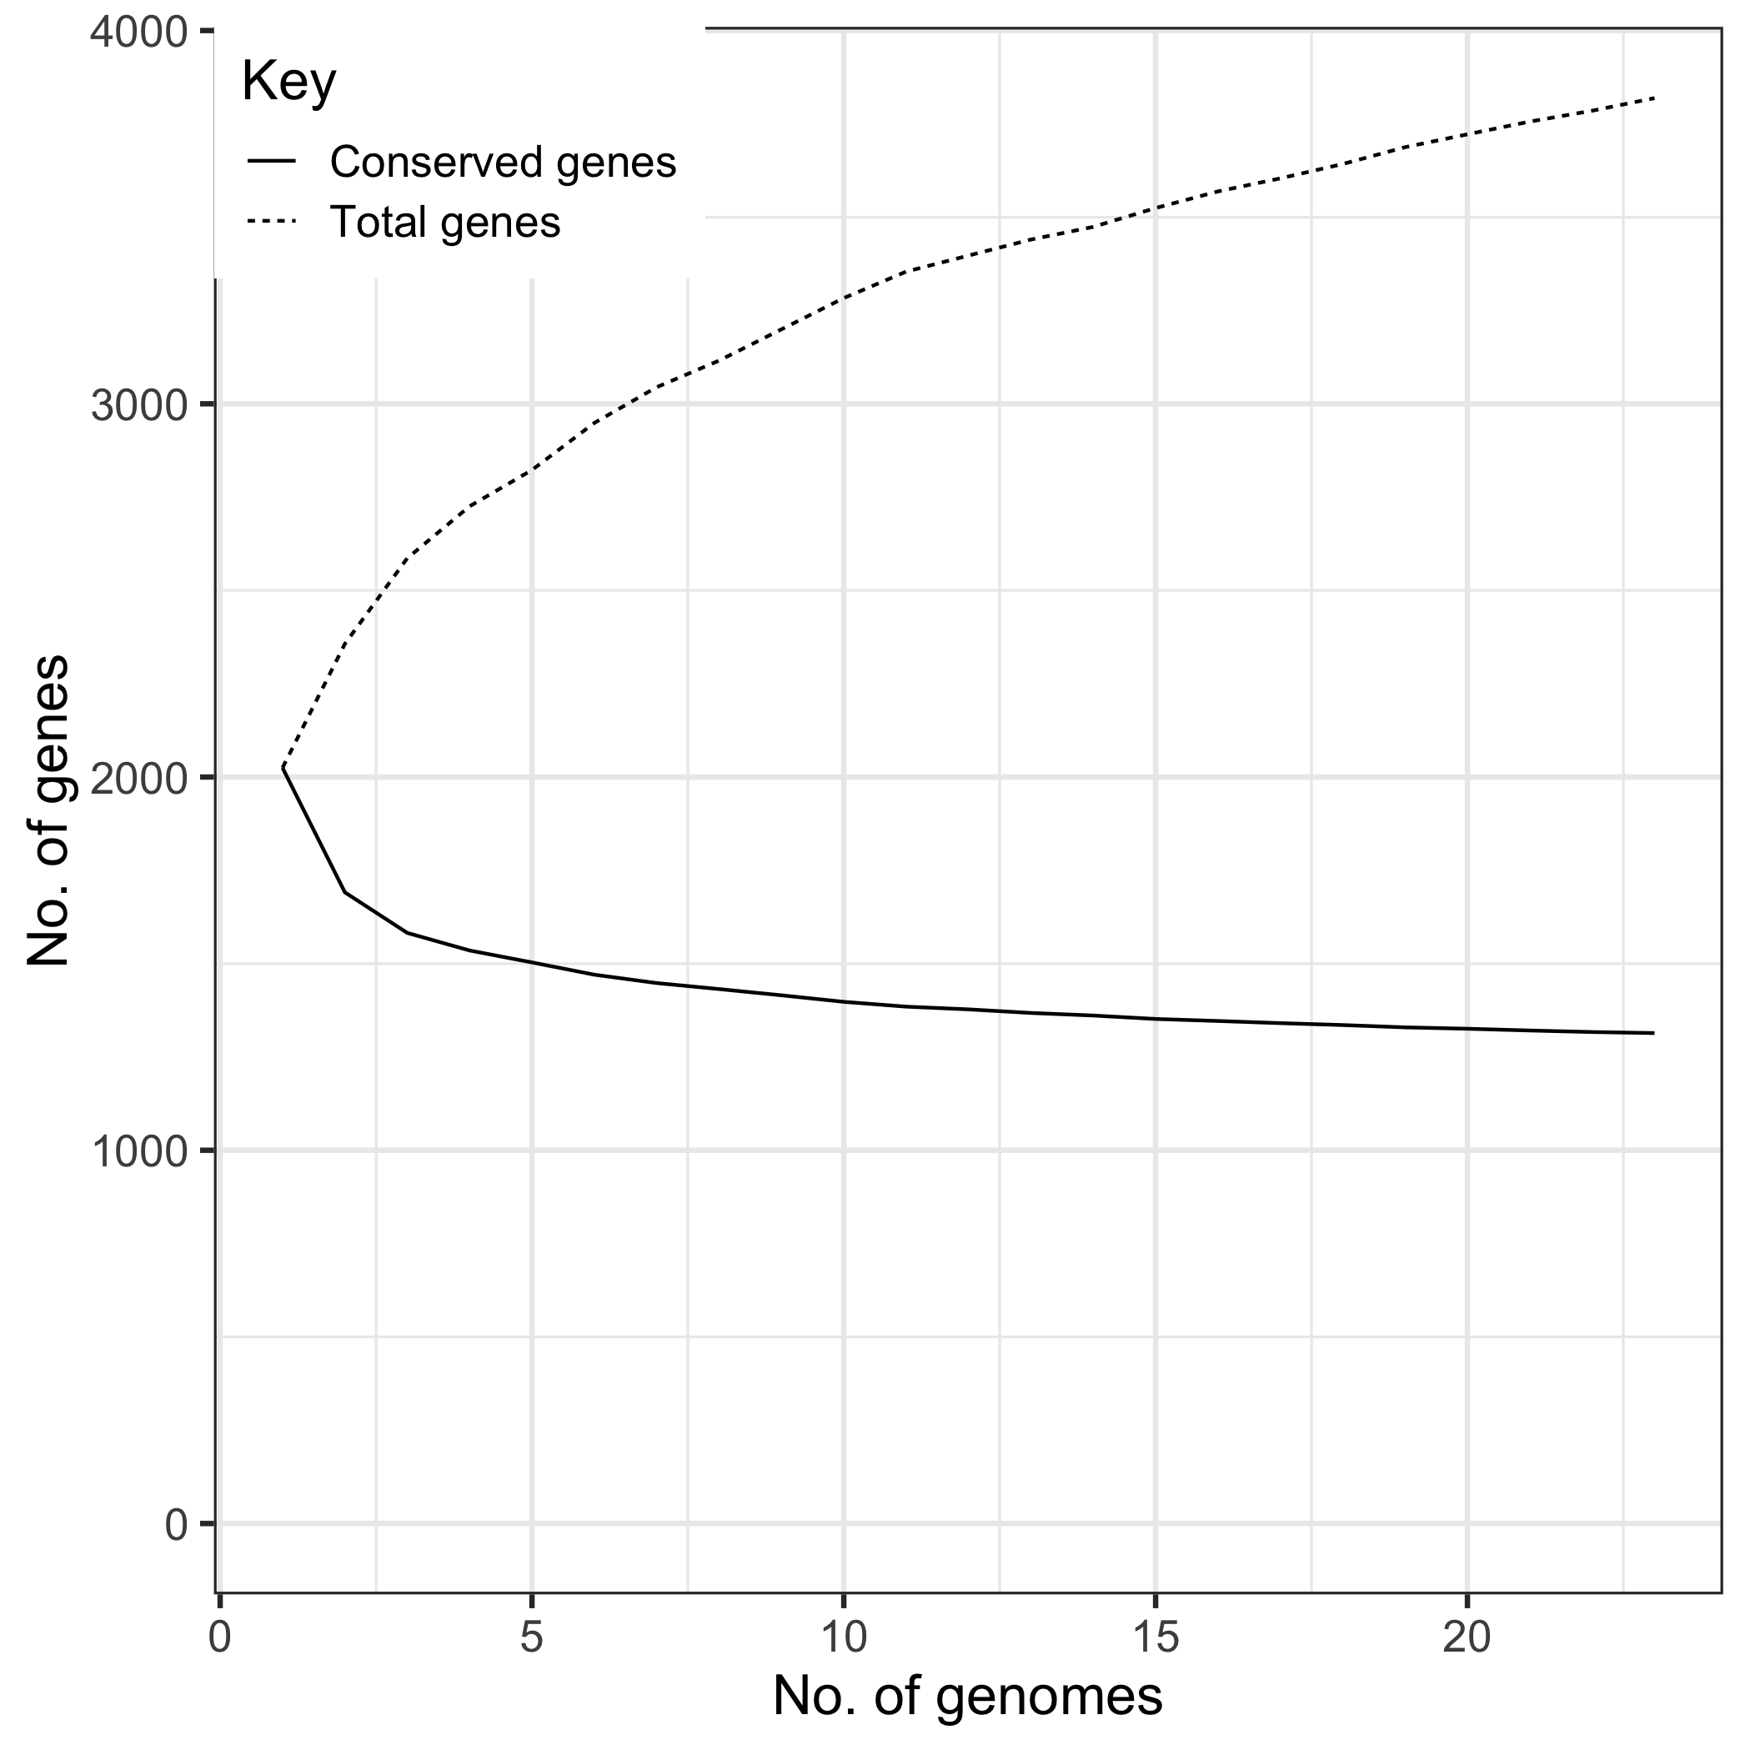

Slide 7


Slide 8
Visualisation tools
Phandango demo

