Slide 1

Genome Assembly
25th - 29th March 2019

Slide 2
Activities
A paper genome assembly
de novo Assembly of a bacterial genome sequence from an Illumina readset
Annotation of the draft genome sequence

Slide 3

The first analysis step is either:
de novo assembly
reconstruct the original sequences from reads alone
like a jigsaw puzzle but ambiguous
Align to reference (Read Mapping)
find where reads fit on a known sequence
can not always be uniquely placed

Slide 4
de novo Assembly

Slide 5

de novo Assembly
Reconstruct the original DNA sequences using the sequence reads alone
When is de novo assembly required?
new "non-model" organisms
no sufficiently related reference genome
novel DNA segments
novel RNA transcripts and splice variants
discover fusion genes
identify contamination

Slide 6

de novo Assembly
One contig per chromosome/plasmid
not with current Illumina sequencing technology
?

Slide 7
Long Reads
One contig per Chromosome?
When Reads are longer than Longest Repeated in a genome
Bacteria: rRNA operons, transposons: longest ~7 kb
PacBio, Oxford Nanopore - Reads longer than 7 kb
Still expensive
extra information does not always justify the extra cost

Slide 8
de novo Assembly
What Purpose?
Reconstruction of the genome sequence
conservative (no false joins!)
Output?
A set of Contigs - multi-fasta file
Software?
Illumina reads: Velvet, MegaHit or SPAdes Shovill Unicycler

Slide 9
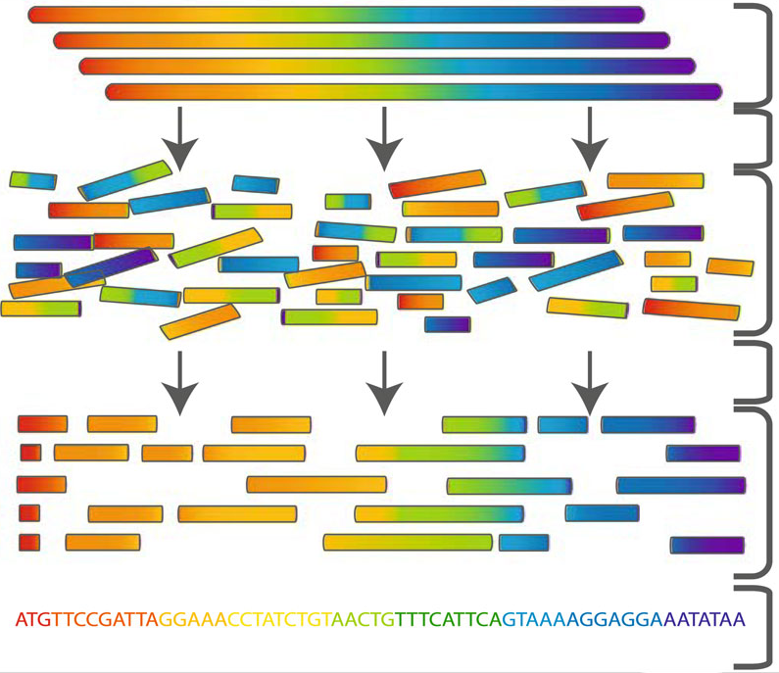

Slide 10
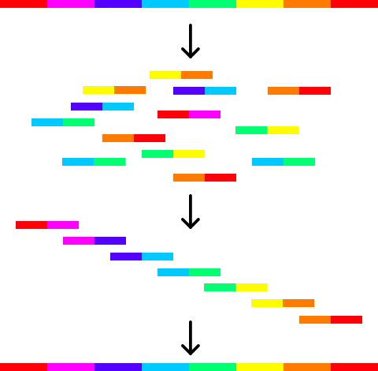

Slide 13
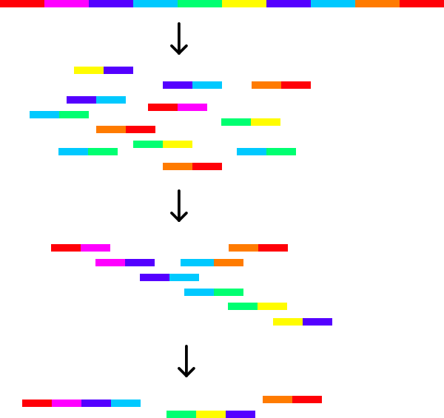

Slide 14
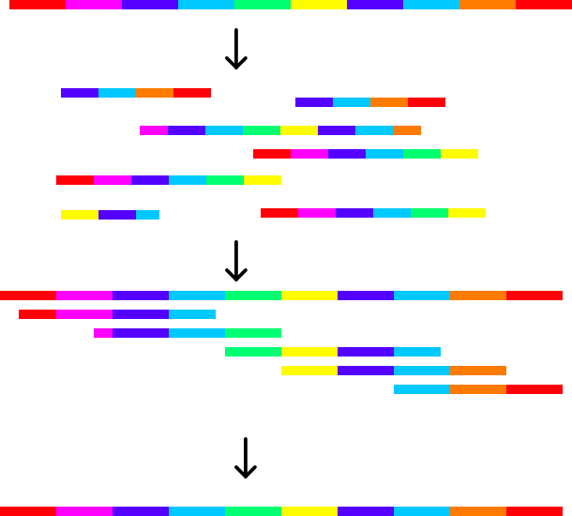

Slide 15
Assessing assembly quality
How many contigs?
How long are the contigs?
How correct are the contigs?

Slide 16
n50
“the minimum contig length needed to cover 50% of the genome”
So if the n50 is 100kb, half of the total genome length is in contigs 100kb or bigger

Slide 18
Exercise:
Paper genome assembly

Slide 19
Assemble these 45 sequences
_ass _gen _gen mbly acte al_g al_g al_g al_g al_g asse asse asse bact cter cter cter cter e_as e_as e_as enom enom eria gejo geno ial_ ial_ ial_ me_a me_a me_a mial ome_ ome_ ome_ ome_ me_a rial rial semb semb semb teri

Slide 20
Answer
bacterial_genome_assembly

