Slide 1



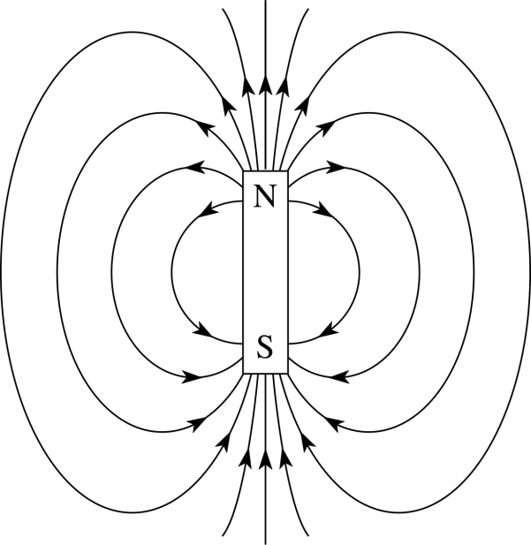
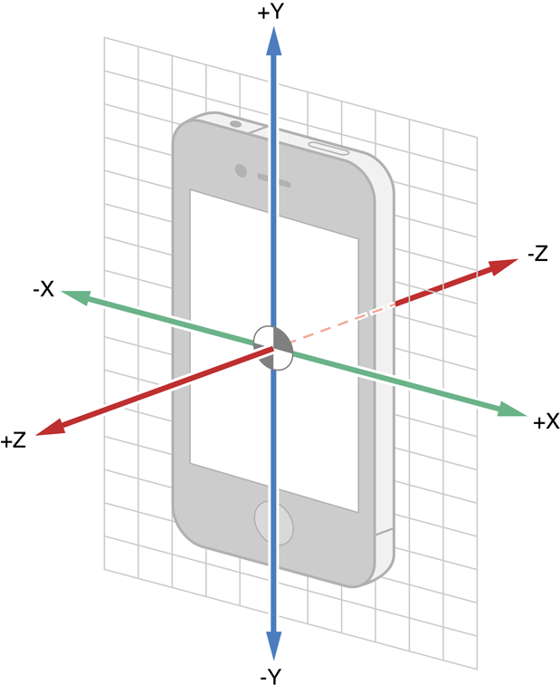
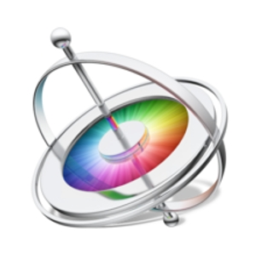
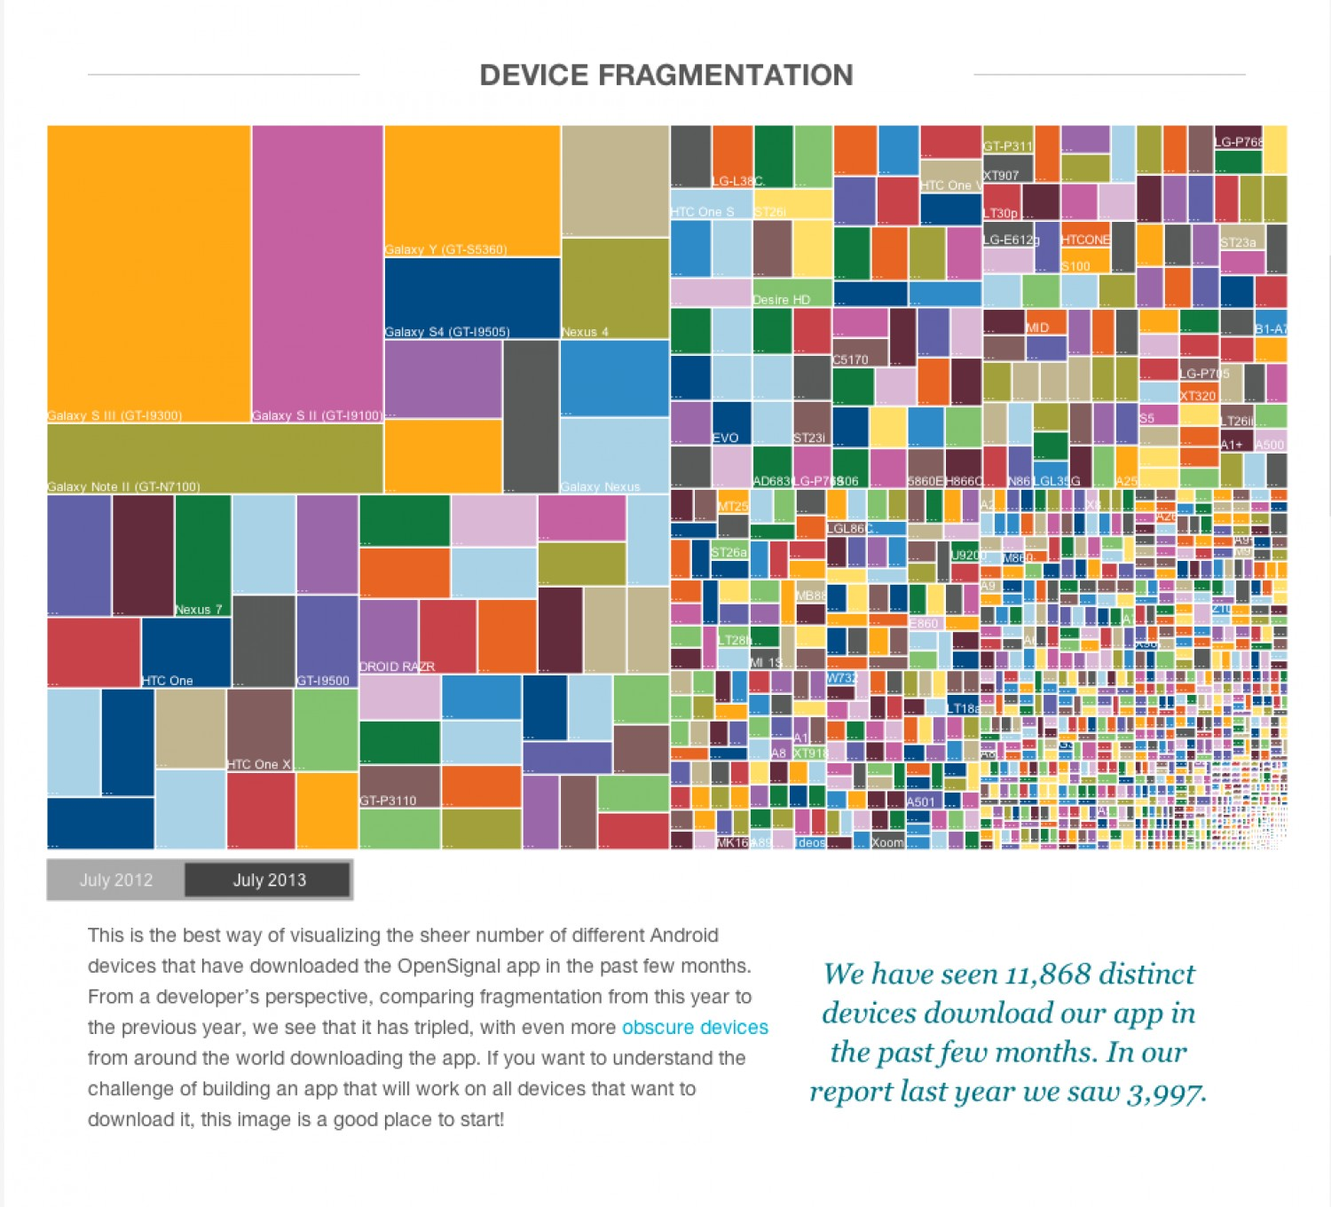
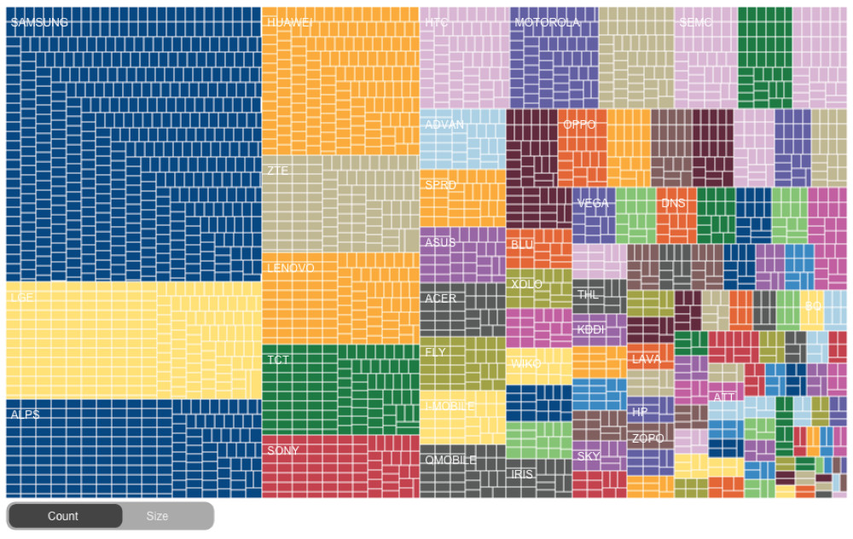
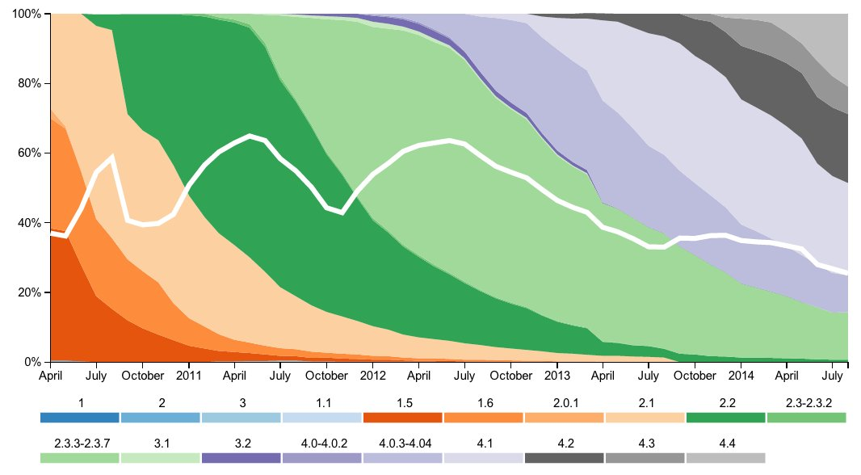
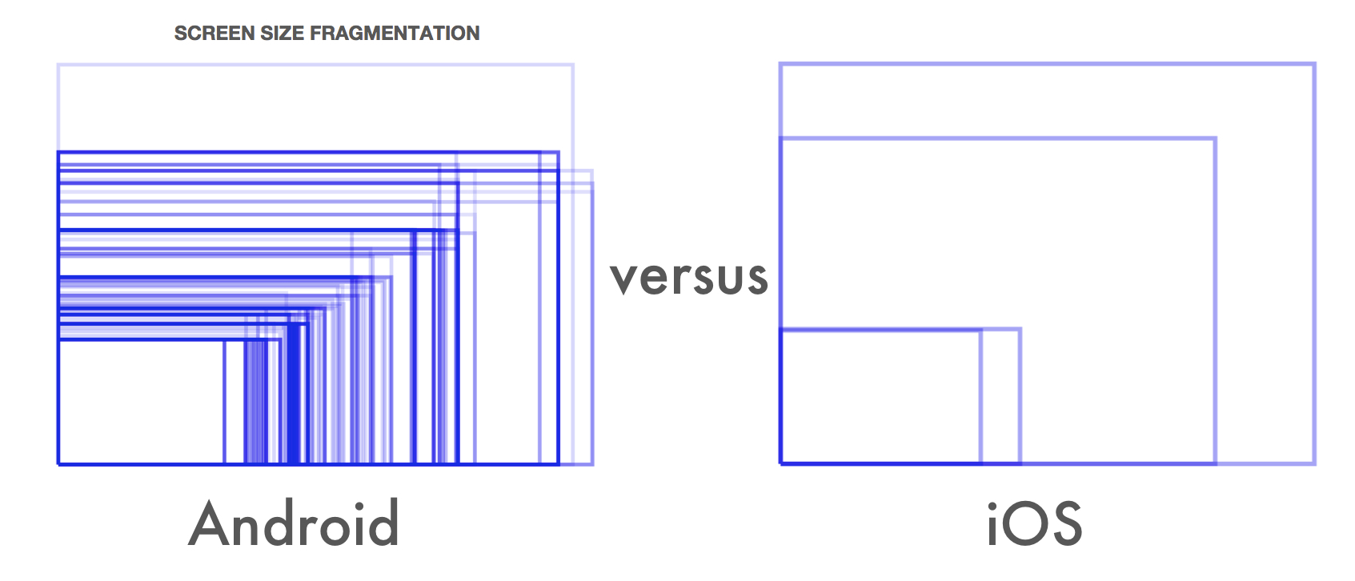

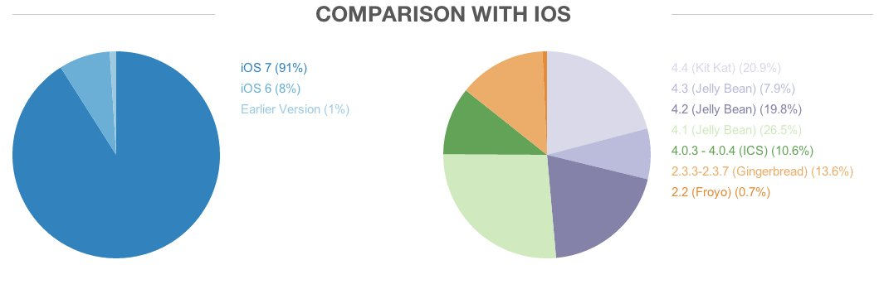






A Fast And Sensor Rich Android Emulator For x86 Processors
Team Members: Jeremiah Frank, Omar Saadoun, Solomon Habtemariam Advisor: Tom Schubert Sponsor: Intel
Problem Statement:
Sensors:
Due to the fragmentation of the Android ecosystem the typical Android app developer must choose between:
Purchasing and maintaining a growing collection of physical mobile devices.
Outsourcing testing to a testing lab with a large collection of physical mobile devices.
Utilizing a cloud testing service who maintain a large collection of physical mobile devices.
All 3 of these alternatives can quickly become expensive, especially for the smaller app development companies. This project is an attempt to create a rich featured, low cost, fast and automated software emulation platform for x86 host machines regardless of host OS. The target device’s sensors must be controllable reliably and repeatedly for regression testing.
http://developer.android.com/reference/android/hardware/Sensor.html
Fragmentation By Manufacturer:
Fragmentation By Device:
Emulator:
Oracle’s Virtualbox was used to create snapshots of several target devices to cover a reasonable representation of the Android ecosystem. These virtual machines are built from an android kernel specific to the device’s manufacturer combined with the target device’s hardware binary file.
http://www.android-x86.org/
https://source.android.com/
Python scripts were written to manage the startup and shutdown of these snapshots to automate the use of the emulator for any target device. These scripts were developed to work across Linux, Windows and Macintosh file directory and command line interfaces.
https://www.python.org/
https://www.virtualbox.org/wiki/Downloads
A networking plug-in for Virtualbox was used to allow port forwarding between the host machine and the virtual device. The Android Debugging Bridge was installed to communicate between the host machine and the virtual device. Python scripts for operating the ADB were written and developed across Linux, Windows and Macintosh file directory and command line interfaces.
http://developer.android.com/tools/help/adb.html
An open source program for sending Android sensor data through the ADB to a device was modified to work with Virtualbox. A test harness was written to take a test bench of sensor events and a sampling rate then forward that data to the emulated device in real time.
https://code.google.com/p/openintents/wiki/SensorSimulator
The result is a free, open source, fast, reliable and fully featured emulator that runs on Linux, Windows and Macintosh host machines.
Fragmentation By OS:
Fragmentation By Screen Size:
Department of Electrical and Computer Engineering

