Slide 1
Grafana & Prometheus
Palani Karthikeyan

Slide 2
DAY-1
Introduction about Grafana
Other Visualization tools – Overview
Grafana - Setup
Unit (or) service file & Grafana server daemon
Dash board setup
Grafana - features
Grafana panels
Deep dive into Grafana
Time series database
Influx DB
Influx DB with Grafana integration

Slide 3
DAY-2
Importing & Exporting Dashboards
Using variable - Dynamic Dash board creations
Annotations & alert
Administration
Grafana CLI
Plugin and admin commands

Slide 4
DAY-3
Integration – using OCI in Grafana
Grafana loki
Introduction to Prometheus
Prometheus Installation
Basic Concepts
Prometheus Configuration
Monitoring Nodes (Servers) with Prometheus
Prometheus Architecture
Expression Browser
Client Libraries

Slide 5
DAY-4
Prom QL
Prom QL operations and Functions
Recording Rules
Scraping Pull and Pushing monitoring
Node Exporters
Service discovery – OCI Monitoring
Introduction to Alerting
Alert Manager
Alerting Rules
Setting up Alerts

Slide 6
DAY-5
Prometheus internals
Prometheus Storage
Prometheus Security
TLS & Authentication on Prometheus Server
Mutual TLS for Prometheus Targets

Slide 7
Grafana
Grafana is an open-source data visualization and analysis tool which allows us to view our data in the form of beautiful graphs.
Grafana designed by Torkel Odegaard in January 2014.

Slide 8
Grafana
It enables us to create a dashboard for collecting, processing, storing, and analyzing data from various different sources.
It allows us to query, visualize, alert on, and understand our metrics.

Slide 9
Grafana
It includes a variety of visualization option that helps us to understand our data, beautifully.
Grafana is written in Go and Node.js LTS language with a strong API (Application Programming Interface).

Slide 10
Grafana Dashboard
Grafana Dashboard is used to pull data from various data sources such as Prometheus, Influx DB, Graphite, ElasticSearch, MySQL, PostgreSQL, CloudWatch, Microsoft SQL Server, and many more.
A Grafana Dashboard contains various visualization options such as heat maps, geomaps, histograms, tables, free text panels, and different types of charts & graphs to study and understand business data easily.

Slide 11
Why Grafana?
Easy virtualization
Drag and Drop panels
Flexible to use
Supports different data source
Open source
Multi-platform support

Slide 12
Features of Grafana
Plugins Platform
Transformation
Dynamic Dashboards
Authentication
Explore metrics and Logs
Alerting
Annotations
Mixed data sources

Slide 13
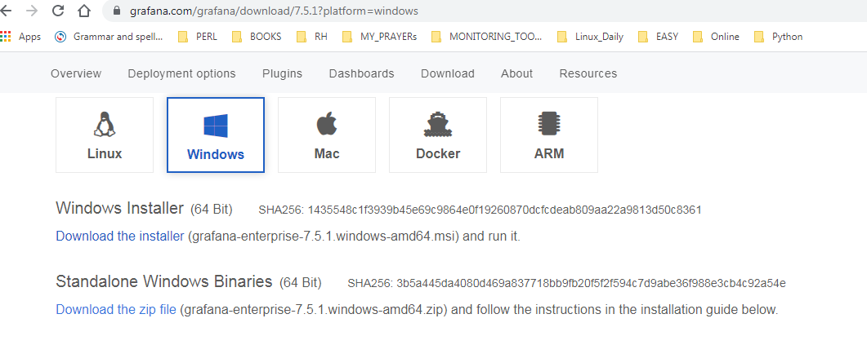
Install Grafana on Windows

Slide 14
Step 1: Go to any web browser, copy-paste the below link, or simply click on the below link.
https://grafana.readthedocs.io/en/latest/sources/installation/windows.html
Step 2: Once the link is opened, the below window appears on the screen, in which click on the grafana.4.4.1.windows-x64.zip.

Slide 15
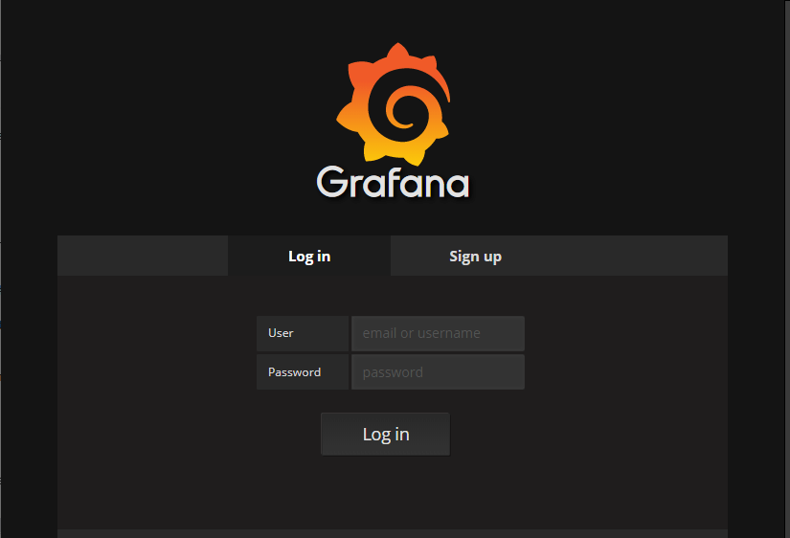

Slide 16
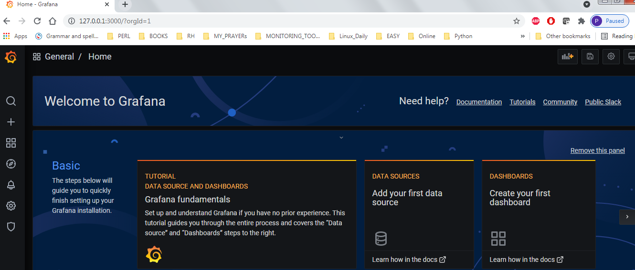

Slide 17
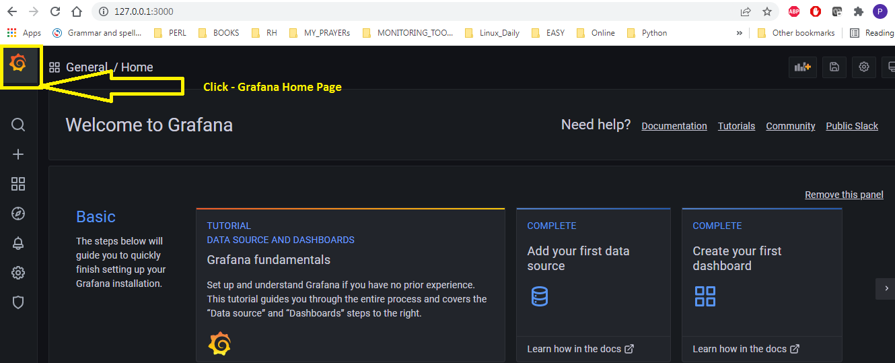
1

Slide 18
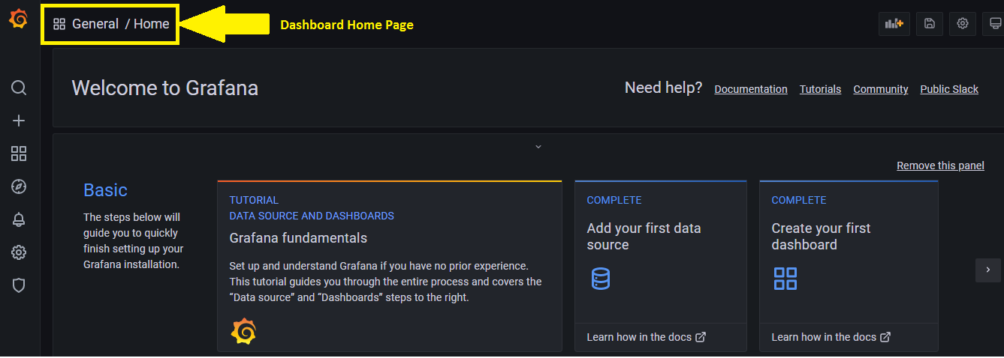
2

Slide 19
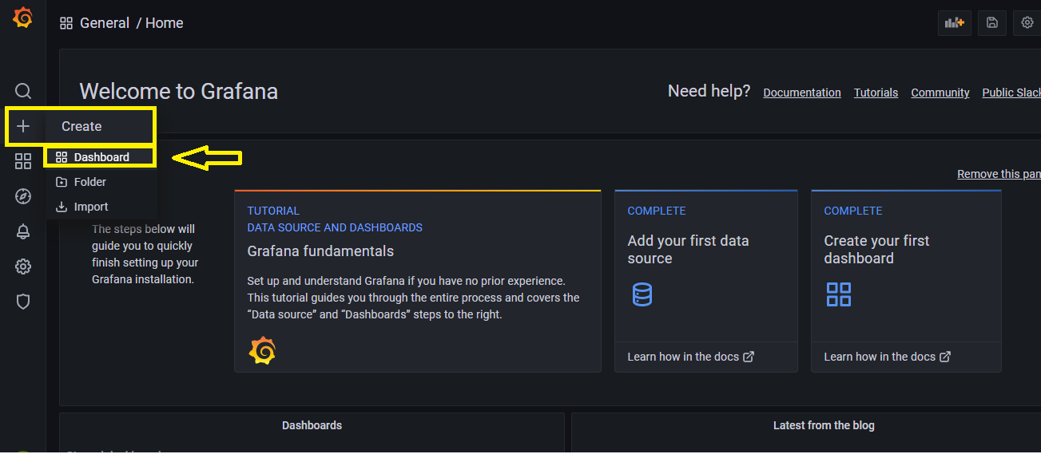
3

Slide 20
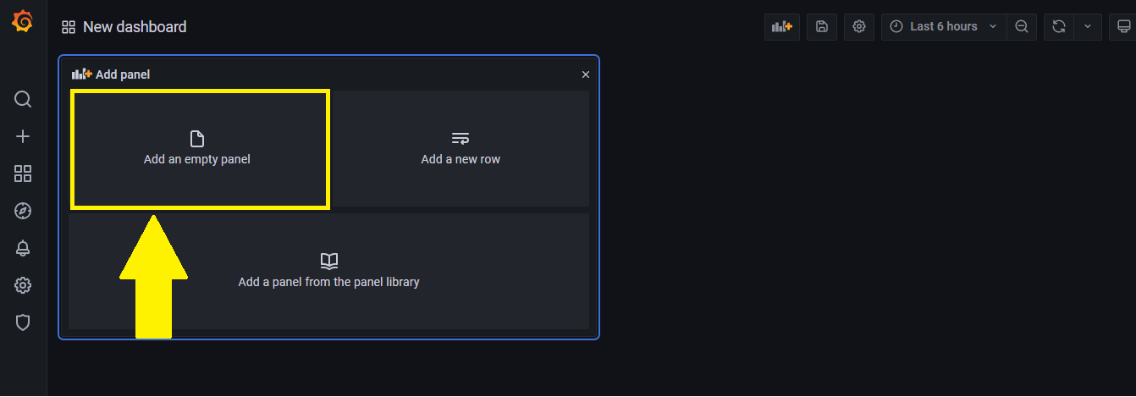
4

Slide 21
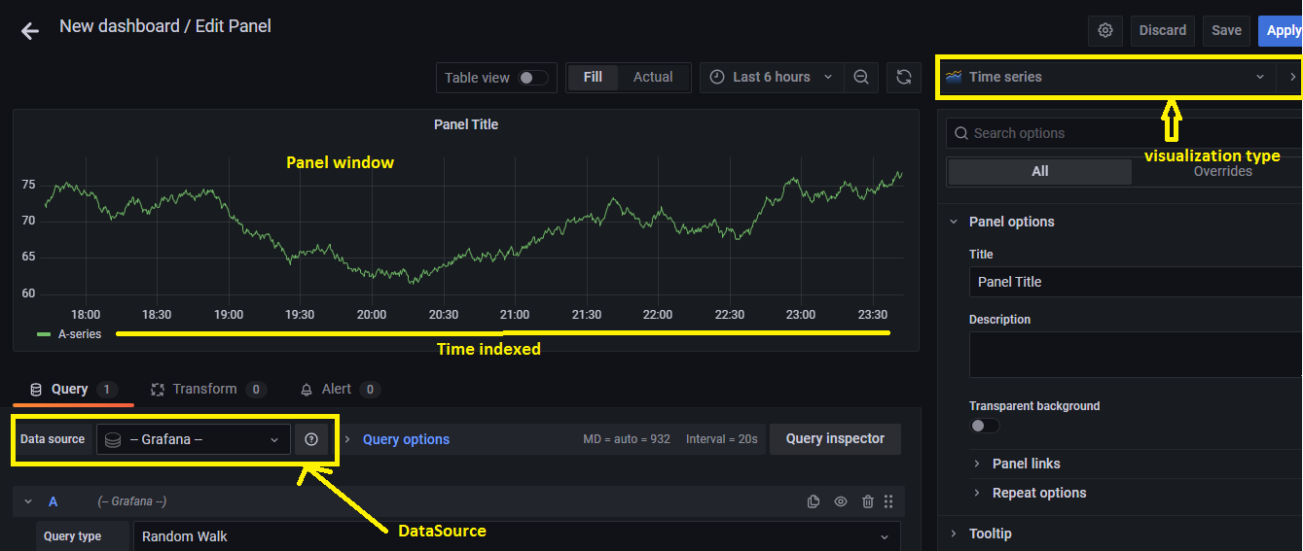
5

Slide 22
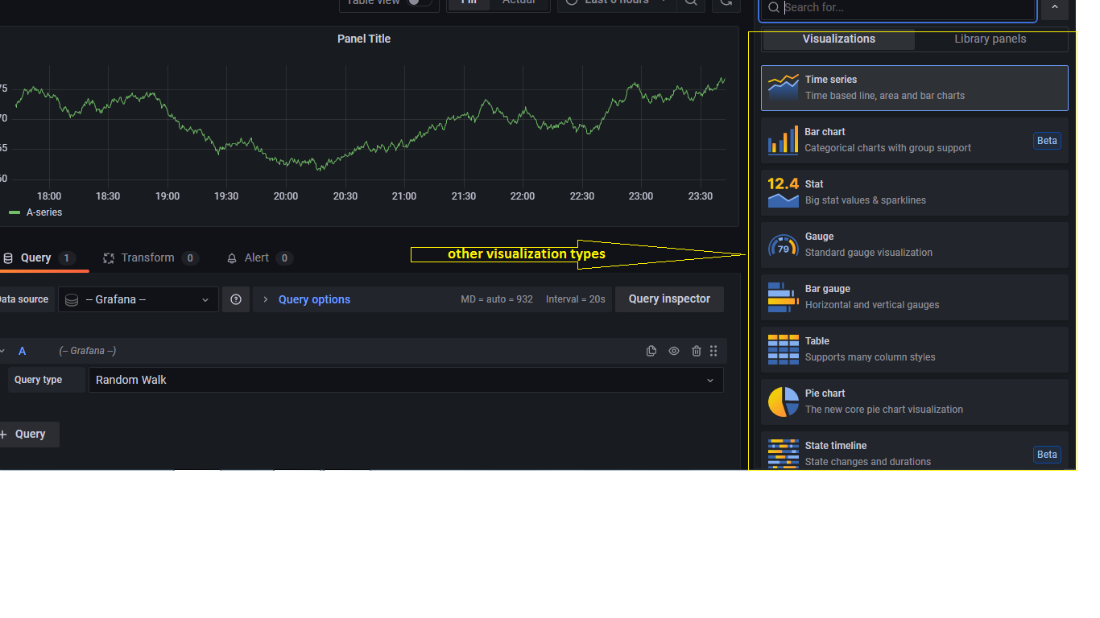
6

Slide 23
Data Source
Grafana works with data, which must be stored in a database before it can be accessed by Grafana.
There are several different kinds of databases.
Additionally, some other systems can be used to store data, even though their main purpose is not focused on data storage.
A Grafana data source is any place from which Grafana can pull data.

Slide 24
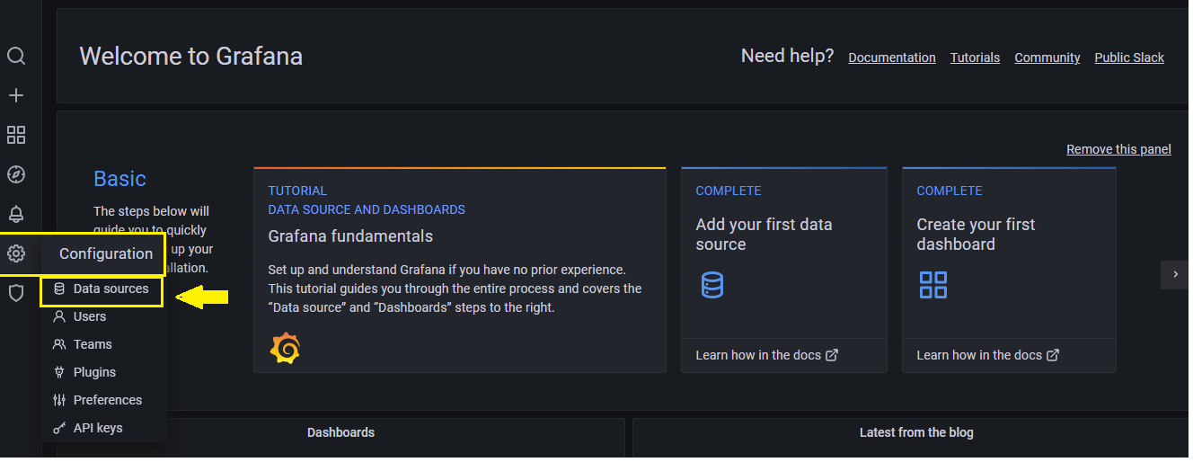
How to add a data source in Grafana

Slide 25
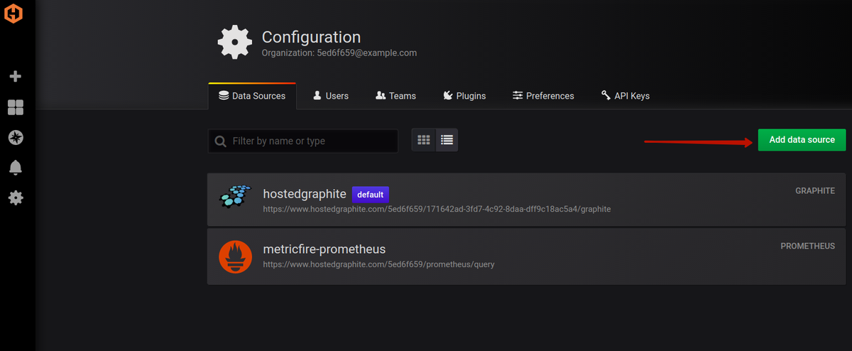
When you click the Add data sources button, you will see the list of officially supported data sources available for connection

Slide 26
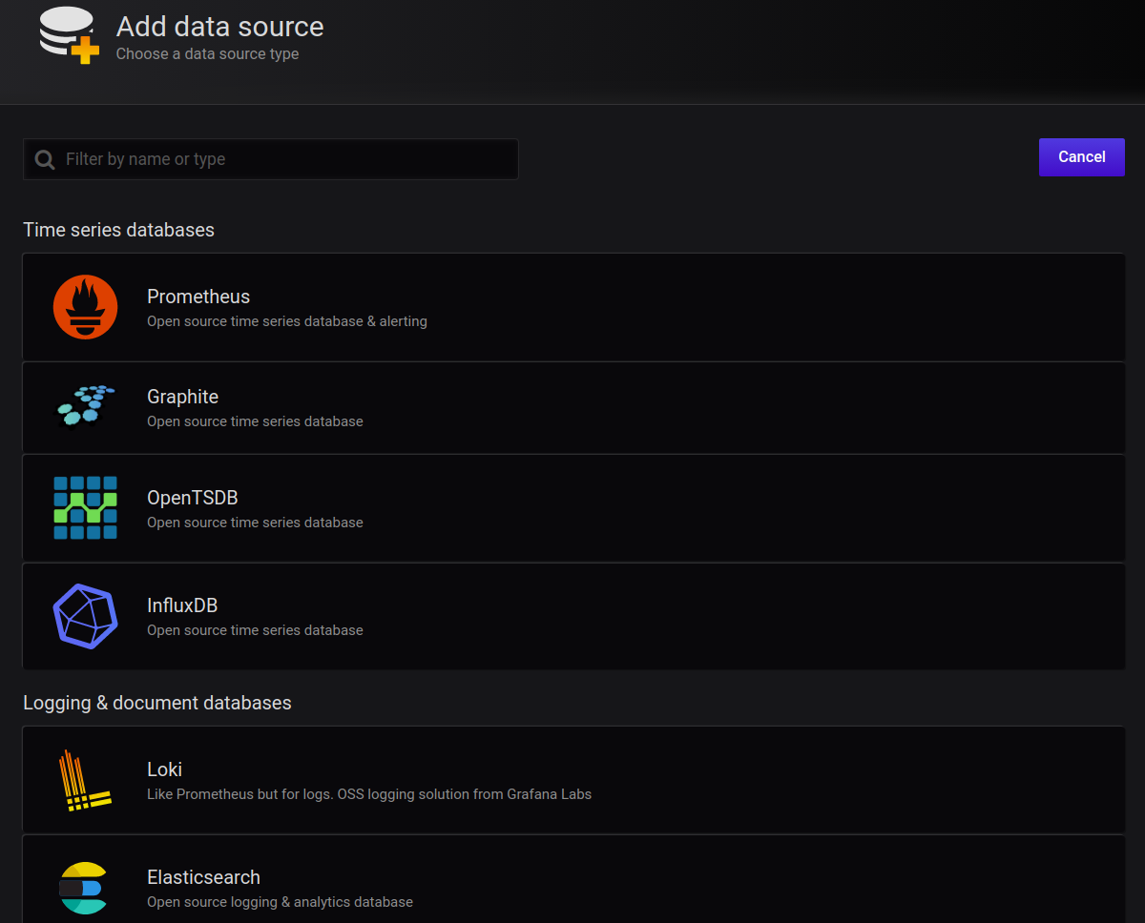

Slide 27
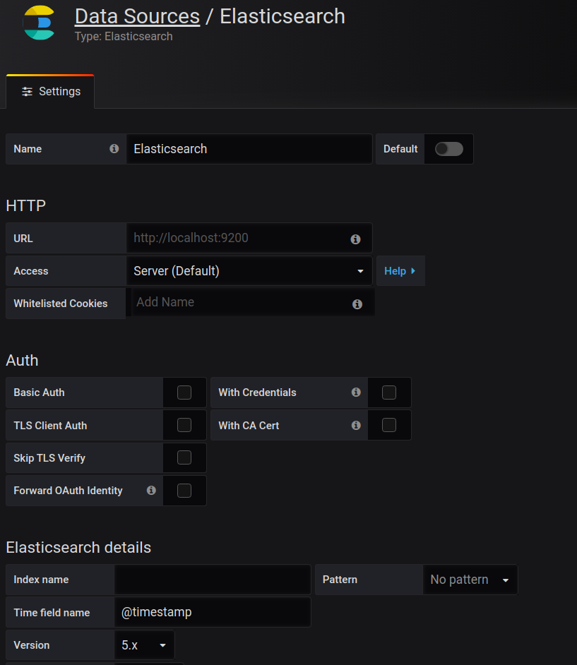

Slide 28
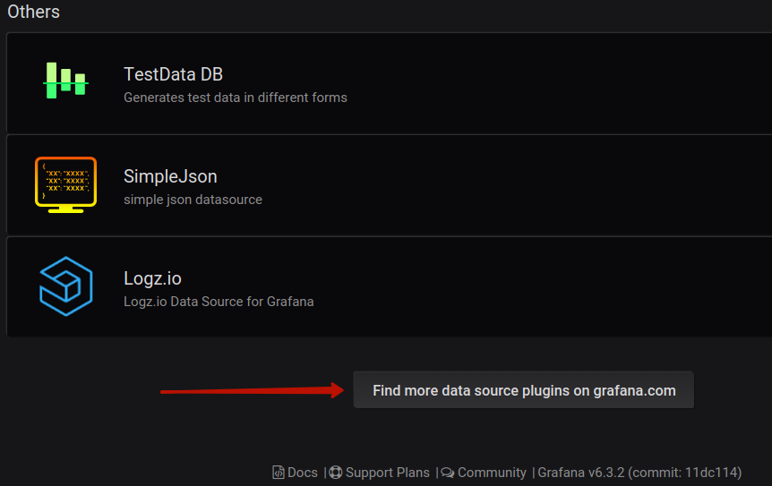
Installing third-party data sources

Slide 29
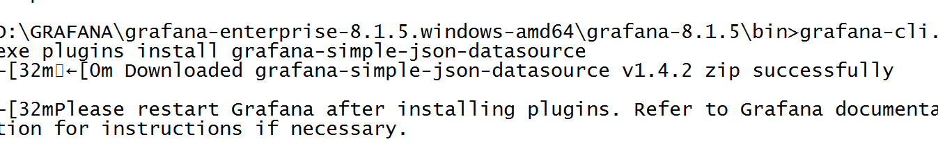
grafana-cli

Slide 30
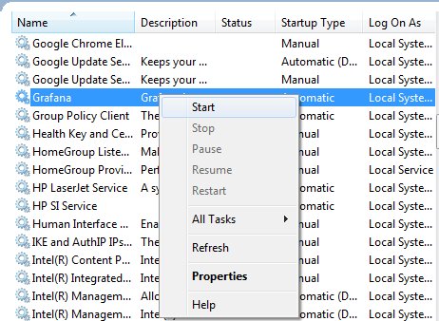

Slide 31
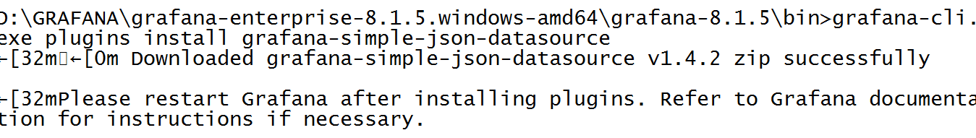

Slide 32
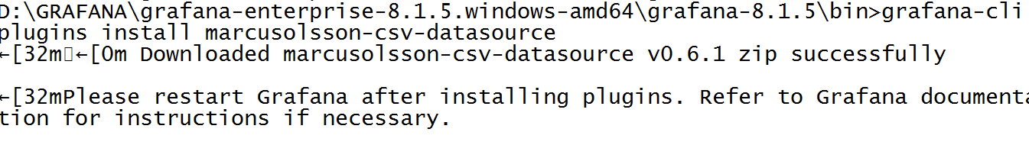

Slide 33
Time series
A time series database (TSDB) is a software system that is optimized for storing and serving time series through associated pairs of time(s) and value(s).
Time series datasets are relatively large and uniform compared to other datasets―usually being composed of a timestamp and associated data.

Slide 34
InfluxDB
InfluxDB is one of the most popular time series databases among DevOps, which is written in Go.
InfluxDB was designed from the ground up to provide a highly scalable data ingestion and storage engine.
It is very efficient at collecting, storing, querying, visualizing, and taking action on streams of time series data, events, and metrics in real-time.

Slide 35
Influxdata is a platform for storing, collecting, visualizing and managingtime-series data.
$ influx
Connected to http://localhost:8086 version 0.13.x
InfluxDB shell 0.13.x>

Slide 36
Features
High performance for time series data with high throughout ingest and real-time querying
InfluxQL to interact with data which is a SQL like a query language
Core component of the TICK (Telegraf, InfluxDB, Chronograf, and Kapacitor) stack.
Plugin support for protocols such as collectd, Graphite, OpenTSDB for data ingestion
Can handle millions of data points in just 1 second
Retention policies for automatically removing the stale data

Slide 37
To create a database
create database mydb
To view the list of all databases
show databases
To use a particular database
use mydb

Slide 38
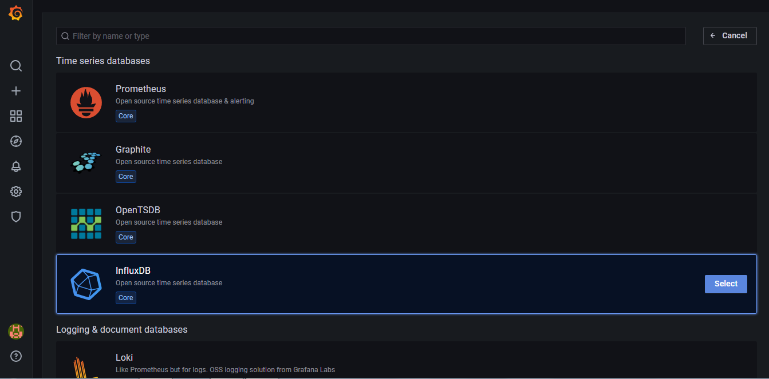
Influx DB with Grafana integration

Slide 39
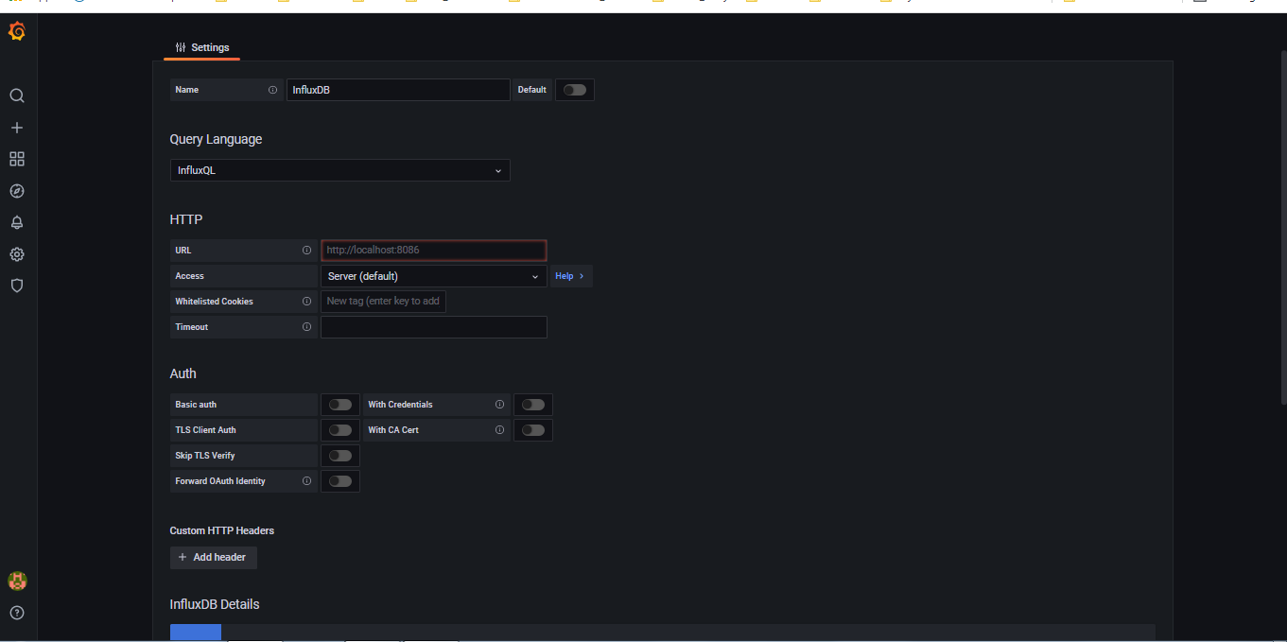

Slide 40
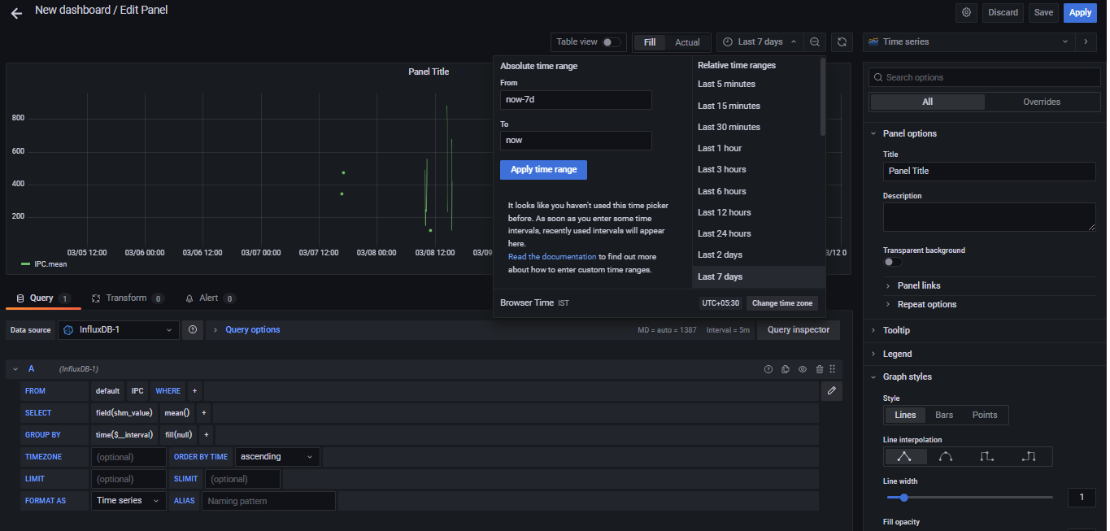

Slide 41
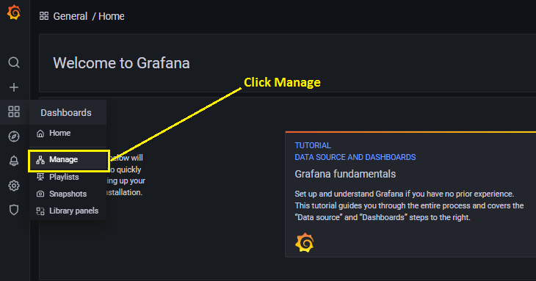
How to list out Dashboards?

Slide 42
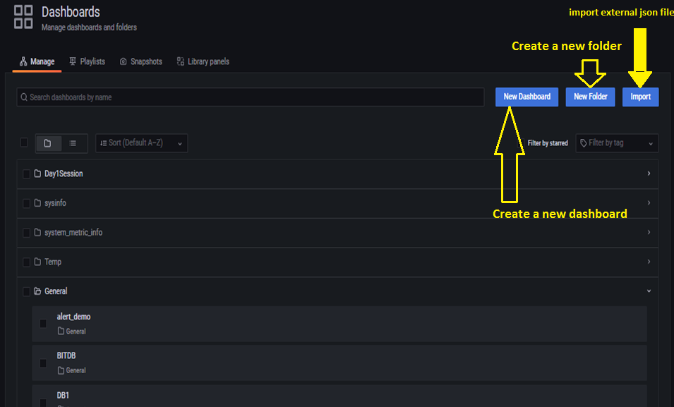

Slide 43
Grafana-Playlist
https://grafana.com/docs/grafana/latest/http_api/playlist/

Slide 44
Share a dashboard
share a dashboard as a direct link or as a snapshot.
To share a dashboard:
Go to the home page of your Grafana instance.
Click on the share icon in the top navigation. The share dialog opens and shows the Link tab.

Slide 45
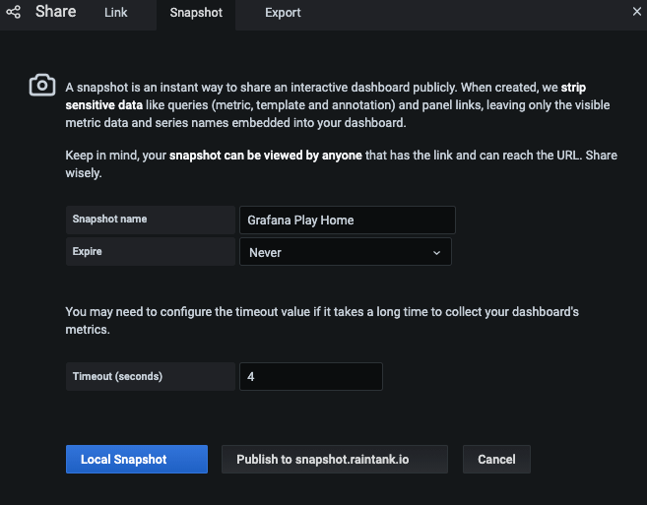

Slide 46
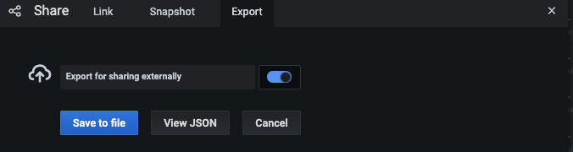
Dashboard export

Slide 47
Share a panel
share a panel as a direct link, as a snapshot or as an embedded link.
create library panels using the “Share” option for any panel.

Slide 48
To share a panel
Click a panel title to open the panel menu.
Click Share. The share dialog opens and shows the Link tab.

Slide 49
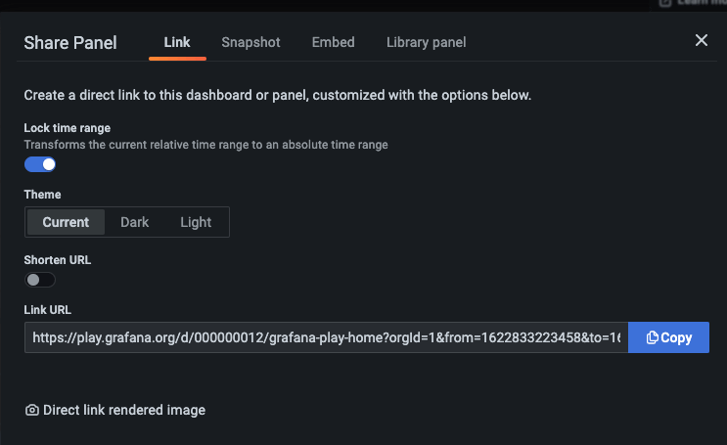

Slide 50
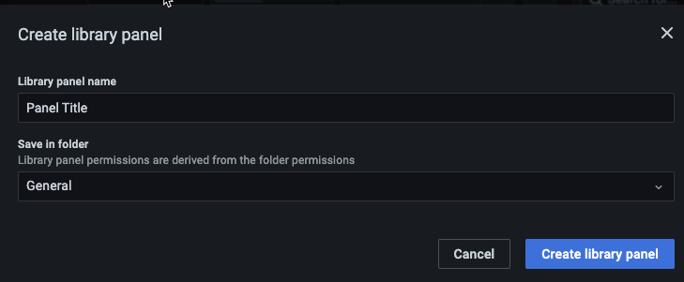
Library panel
Click Library panel.
In Library panel name, enter the name.
In Save in folder, select the folder to save the library panel. By default, the General folder is selected.
Click Create library panel to save your changes.
Save the dashboard.

Slide 51
Grafana alerts
Alerts allow you to learn about problems in your systems moments after they occur.
Grafana 8.0 introduced new and improved alerting that centralizes alerting information in a single, searchable view. It allows you to:
Create and manage Grafana alerts
Create and manage Cortex and Loki managed alerts
View alerting information from Prometheus and Alertmanager compatible data sources

Slide 52
Grafana alerting has four key components
Alerting rule - Evaluation criteria that determine whether an alert will fire. It consists of one or more queries and expressions, a condition, the frequency of evaluation, and optionally, the duration over which the condition is met.
Contact point - Channel for sending notifications when the conditions of an alerting rule are met.
Notification policy - Set of matching and grouping criteria used to determine where and how frequently to send notifications.
Silences - Date and matching criteria used to silence notifications.

Slide 53
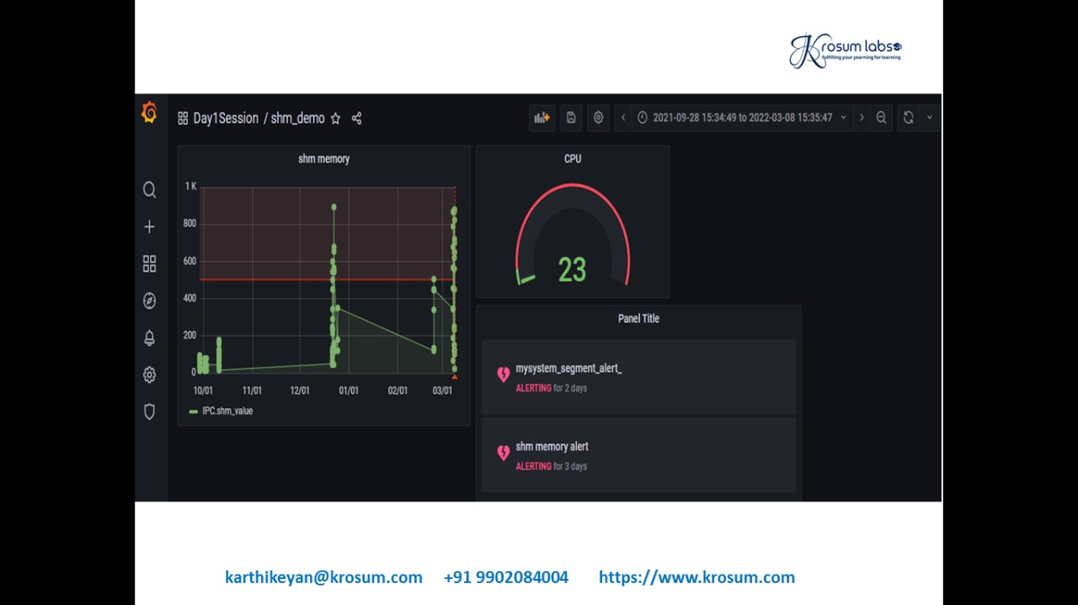

Slide 54
API Reference
https://grafana.com/docs/grafana/latest/packages_api/

Slide 55
Grafana Loki
Grafana Loki is a set of components that can be composed into a fully featured logging stack.
Unlike other logging systems, Loki is built around the idea of only indexing metadata about your logs: labels (just like Prometheus labels).
Log data itself is then compressed and stored in chunks in object stores such as S3 or GCS, or even locally on the filesystem.
A small index and highly compressed chunks simplifies the operation and significantly lowers the cost of Loki.

Slide 56
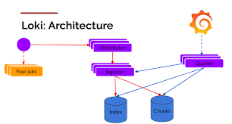
Loki architecture

Slide 57
General process
Download and install both Loki and Promtail.
Download config files for both programs.
Start Loki.
Update the Promtail config file to get your logs into Loki.
Start Promtail.

Slide 58
A Loki-based logging stack consists of 3 components
promtail is the agent, responsible for gathering logs and sending them to Loki.
loki is the main server, responsible for storing logs and processing queries.
Grafana for querying and displaying the logs.

Slide 59
I Installing Loki and Promtail
wget https://raw.githubusercontent.com/grafana/loki/master/cmd/loki/loki-local-config.yaml
./loki-linux-amd64 -config.file=loki-local-config.yaml
./promtail-linux-amd64 -config.file=promtail-local-config.yaml

Slide 60
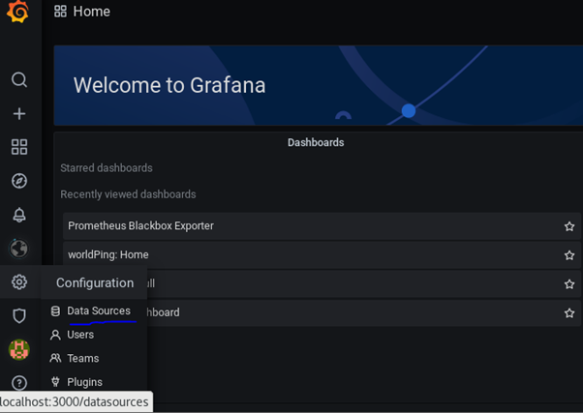
Visualize Log using Loki and Grafana
Step 1: Go to Grafana Configurations and Click on “Data Sources”.

Slide 61
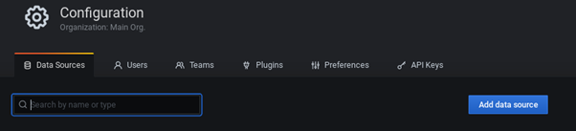
Step 2: In Data Sources, you can search the source by name or type.

Slide 62
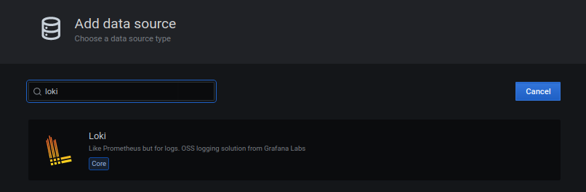
Step 3: Search by the name Loki.

Slide 63
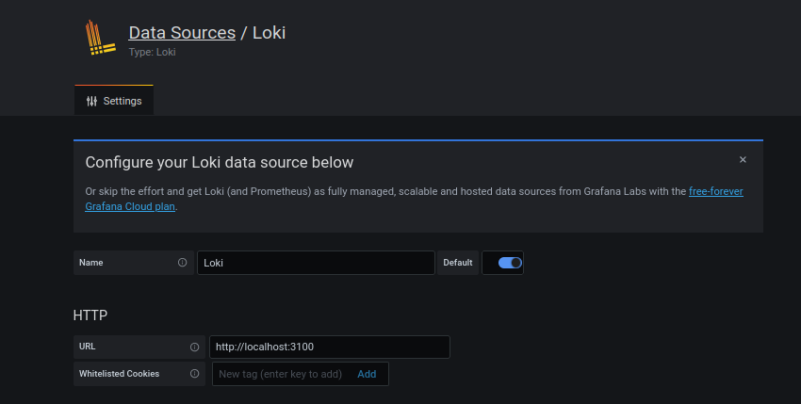
Step 4: Enter the name you want to give to the data source and put http://localhost:3100 (change this to server IP if Loki is running on a different server than Grafana) in the URL because we have started Loki on port 3100

Slide 64
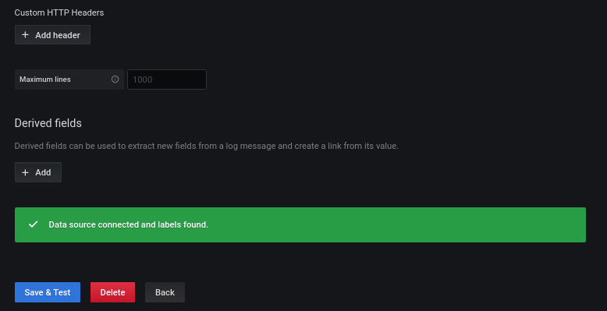

Slide 65
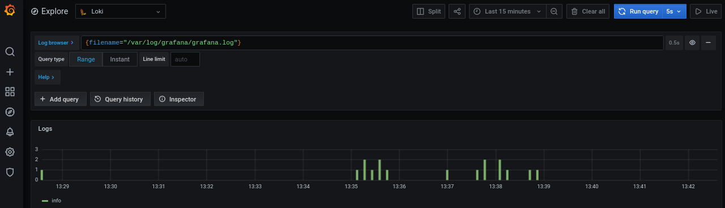

Slide 66
