Slide 1
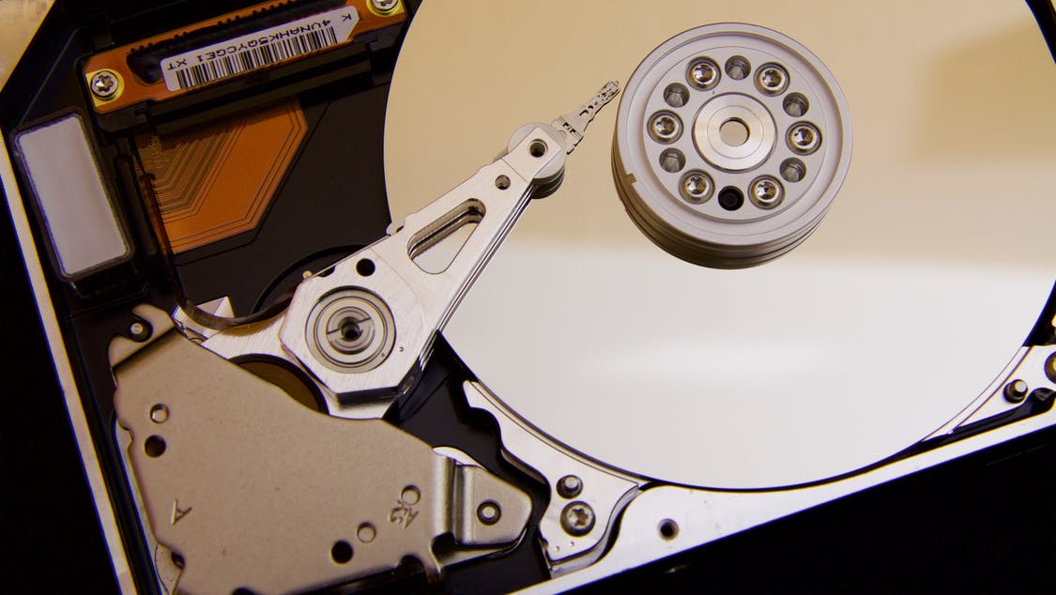
How To Use FileEncryption
Encrypt your files to keep your data safe when stored elsewhere
Ove Bakken
Revision 2
September 6th, 2020
Norway, Innlandet

Slide 2

Welcome!
How To Use FileEncryption
Ove Bakken
Since you’re here you’re probably curious about how you use the FileEncryption tool.
The truth is you don’t need to read a user manual. All you have to do is to pick your encryption password and start dragging and dropping files to be encrypted.
FileEncryption uses AES-GCM cryptography. Has a MIT license. And is free for all.
Executables and source code can be found at github.com/flaskevann/FileEncryption

Slide 3
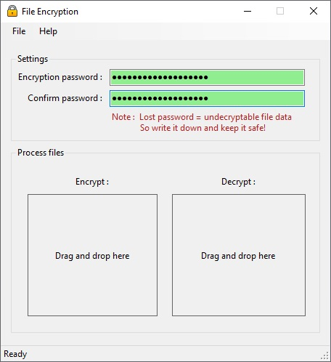
Setup
How To Use FileEncryption
Ove Bakken
Before encrypting or decrypting any files you must type a file encryption password:

Slide 4
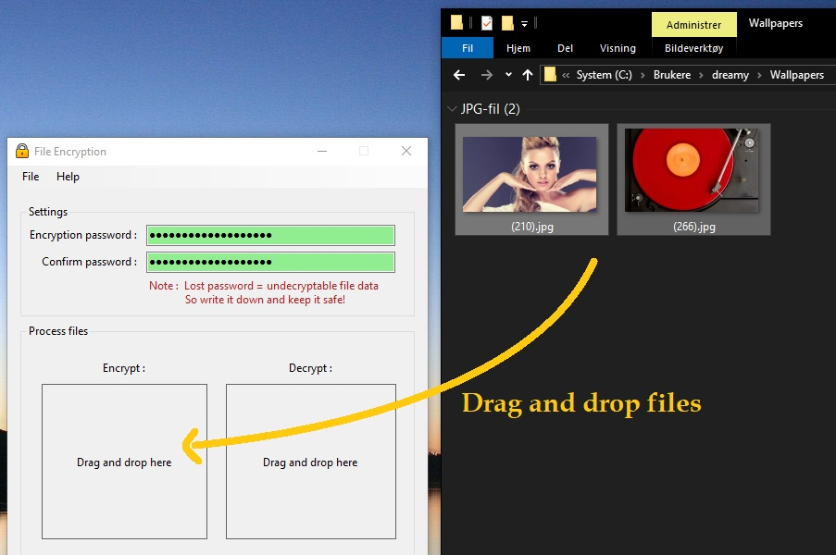
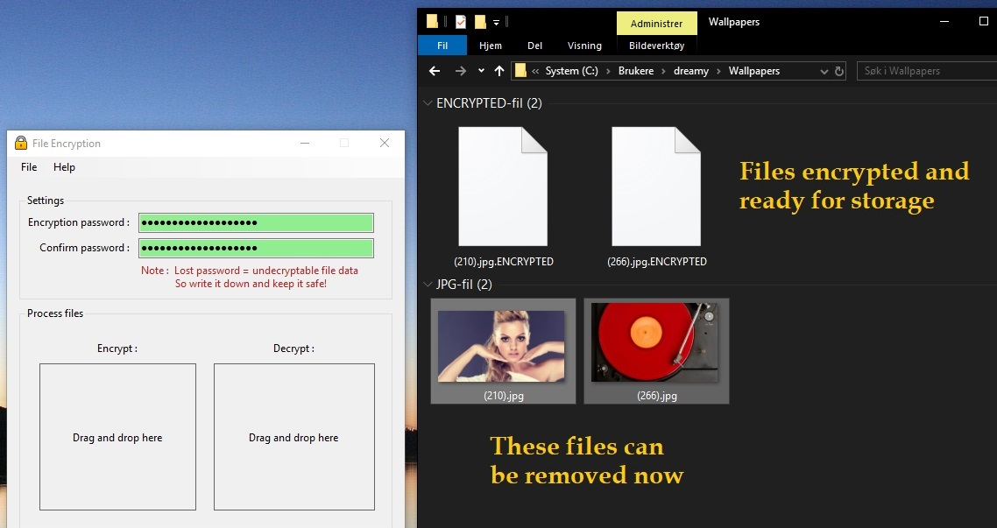
Encryption Example
How To Use FileEncryption
Ove Bakken
A simple example showing two JPG-files getting encrypted:
1
2
The process is painless and simple. Now you do it!

Slide 5
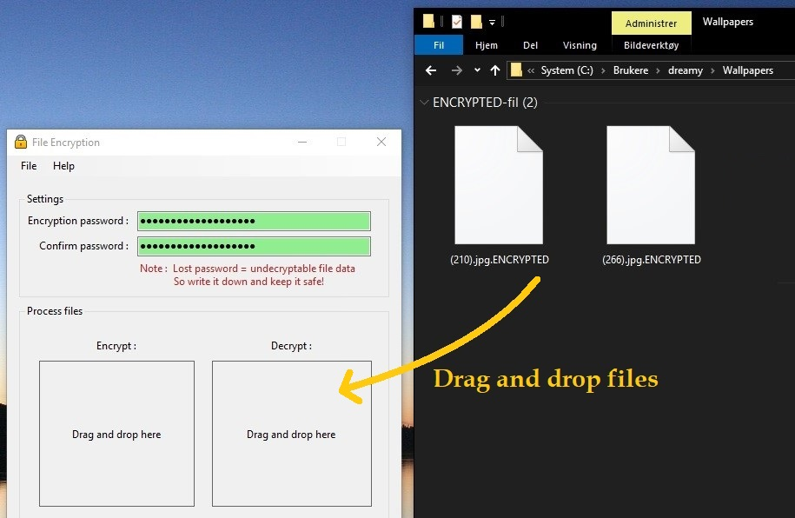
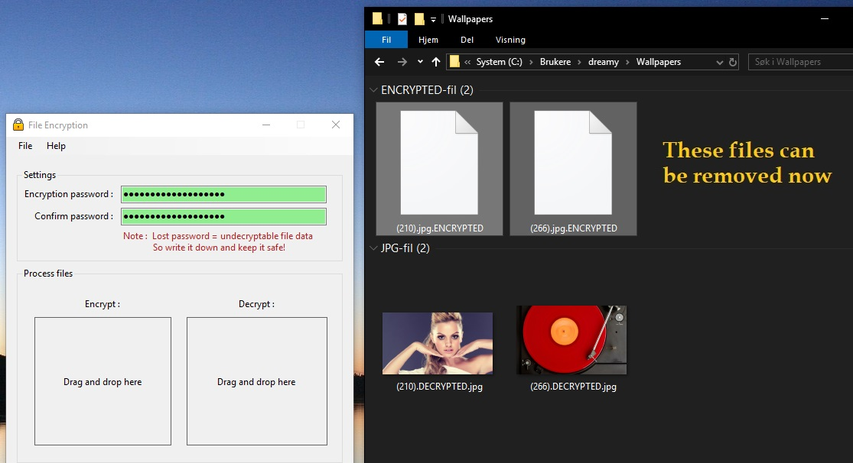
Decryption Example
How To Use FileEncryption
Ove Bakken
Later when the encrypted files needs to be decrypted:
1
2
2
(If you use the wrong password, or try to decrypt a file that’s not encrypted, you get an error!)
Be careful not to lose your encryption password. If you do, your data is lost forever.

Slide 6
Thank You
I appreciate your interest and welcome questions and feedback!
post(a)ovebakken.no

