Slide 1
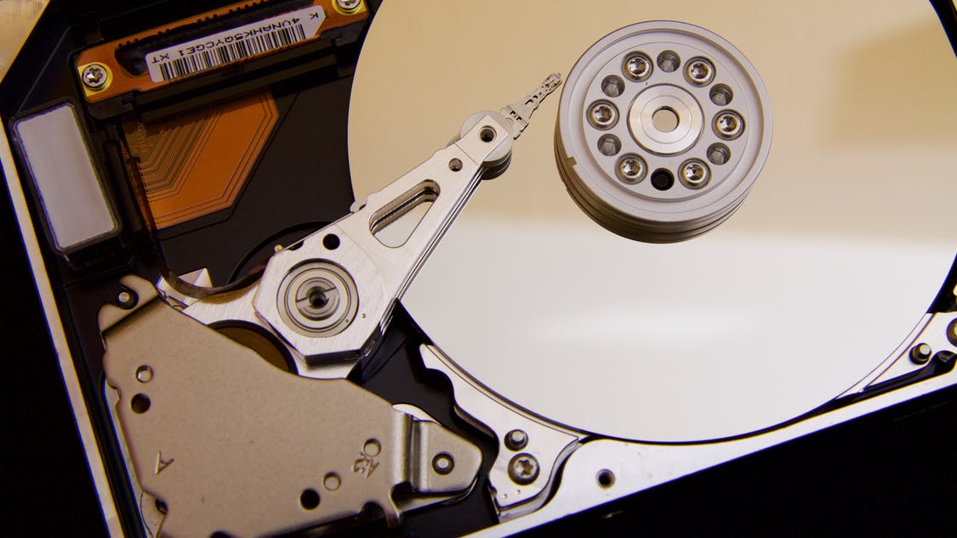
How To Use FileEncryption
Encrypt your files to keep your data safe when stored elsewhere
Ove Bakken
Revision 2
September 6th, 2020
Norway, Innlandet

Slide 2

Welcome!
How To Use FileEncryption
Ove Bakken
Since you’re here you’re probably curious about how you use the FileEncryption tool.
The truth is you don’t need to read a user manual. All you have to do is to pick your encryption password and start dragging and dropping files to be encrypted.
FileEncryption uses AES-GCM cryptography. Has a MIT license. And is free for all.
Executable and checksum can be found at: github.com/flaskevann/FileEncryption
If you don’t trust the uploaded build, feel free to download the project yourself and make your own. After installing the needed NET Core tools all you have to do is to run the build command.

Slide 3
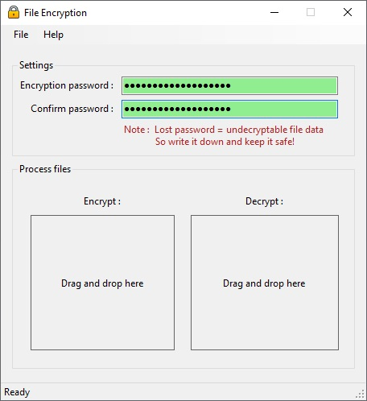
Setup
How To Use FileEncryption
Ove Bakken
Before encrypting or decrypting any files you must type a file encryption password:

Slide 4
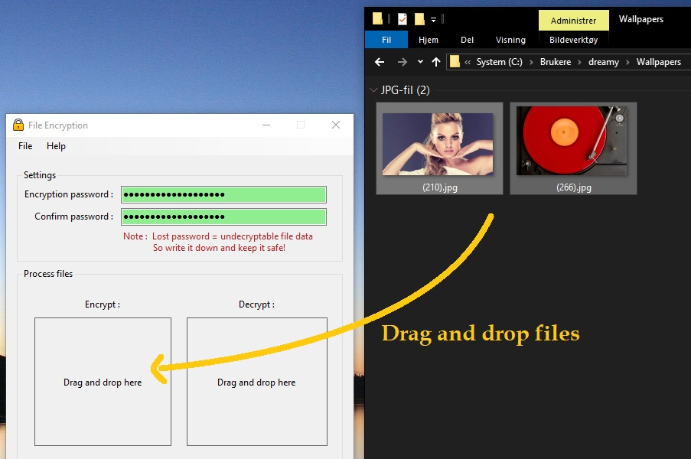
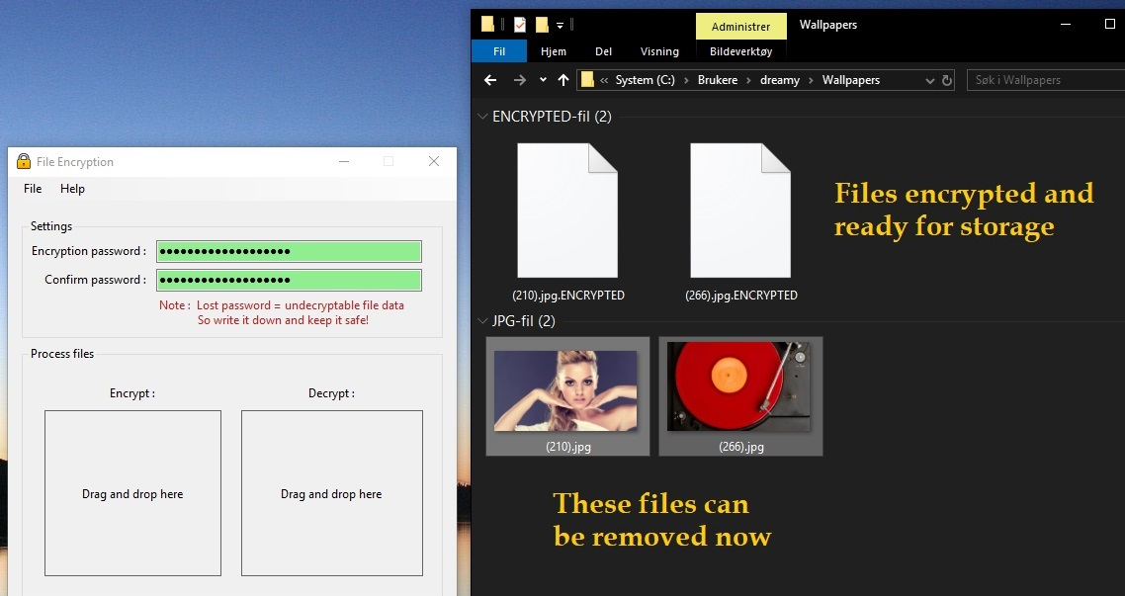
Encryption Example
How To Use FileEncryption
Ove Bakken
A simple example showing two JPG-files getting encrypted:
1
2
The process is painless and simple. Now you do it!

Slide 5
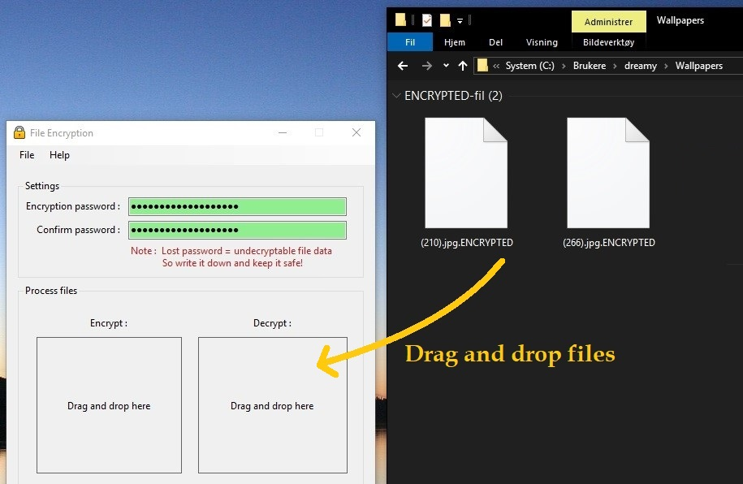
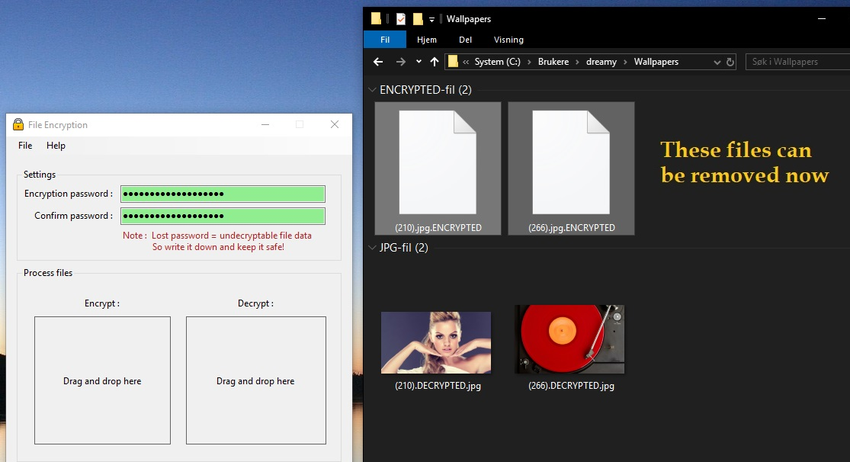
Decryption Example
How To Use FileEncryption
Ove Bakken
Later when the encrypted files needs to be decrypted:
1
2
2
(If you use the wrong password, or try to decrypt a file that’s not encrypted, you get an error!)
Be careful not to lose your encryption password. If you do, your data is lost forever.

Slide 6
Thank You
I appreciate your interest and welcome questions and feedback!
post(a)ovebakken.no

