Slide 1
L-Type Calcium Channel Ligands

Slide 2
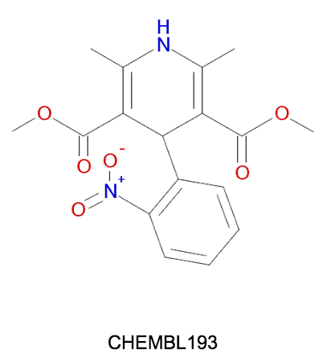
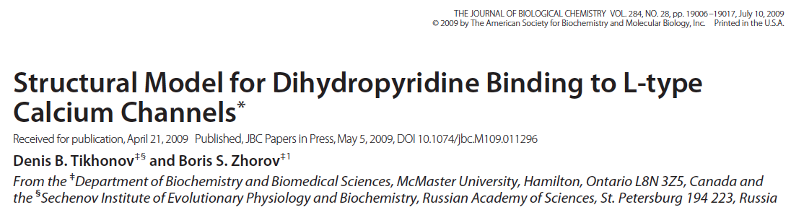
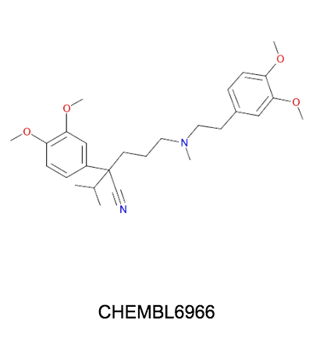
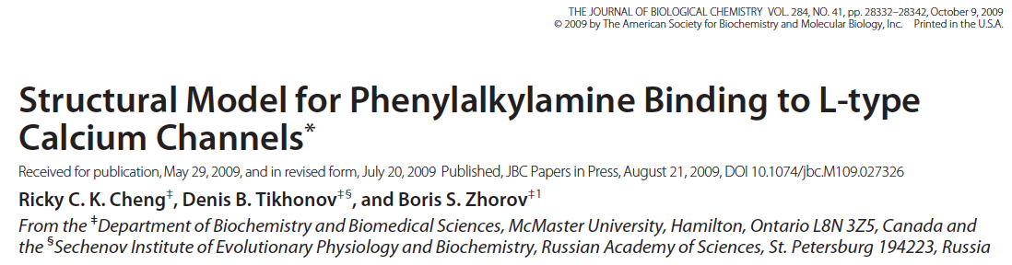
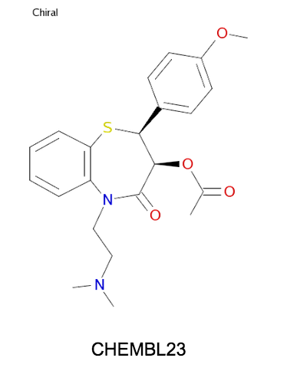
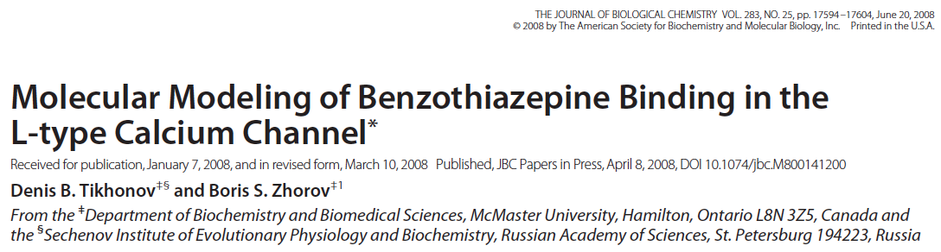
Chemotypes in the clinic
Dihydropyridines (DHP): Nifedipine
Smooth Muscle > Cardiac
Antagonist or agonist
Phenylalkyamines (PAA): Verapamil
Cardiac >
Smooth Muscle
Antagonist
Benzodiazepines (DTZ): Dilitiazem
Cardiac >
Smooth Muscle
Antagonist

Slide 3
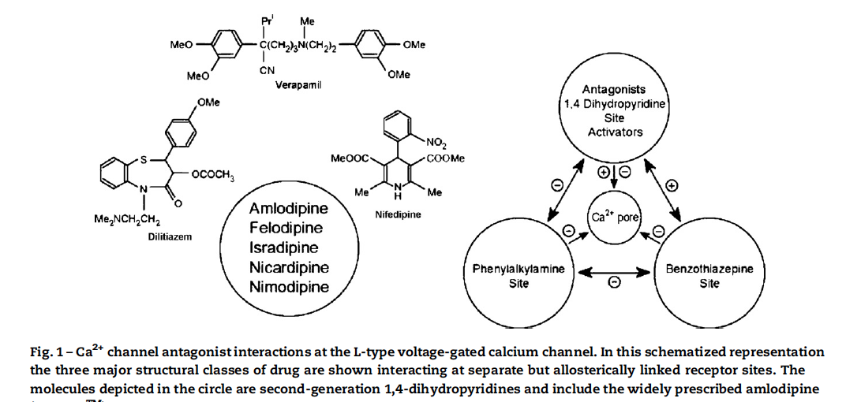
Multiple coupled binding sites

Slide 4
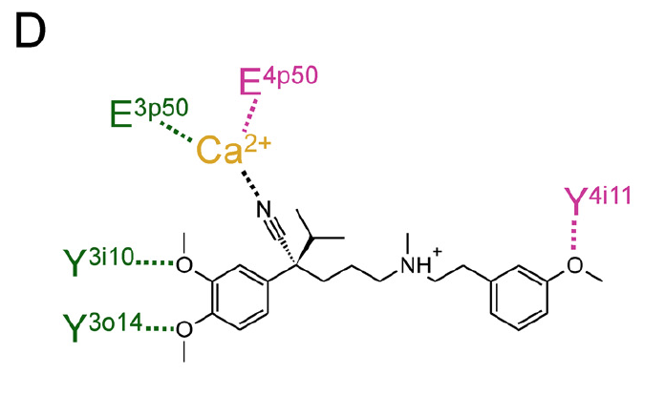
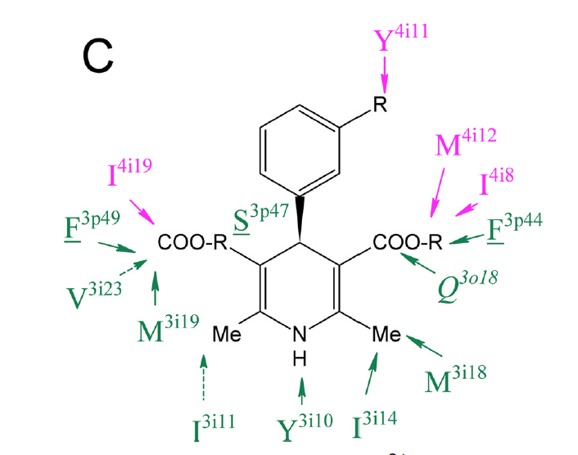
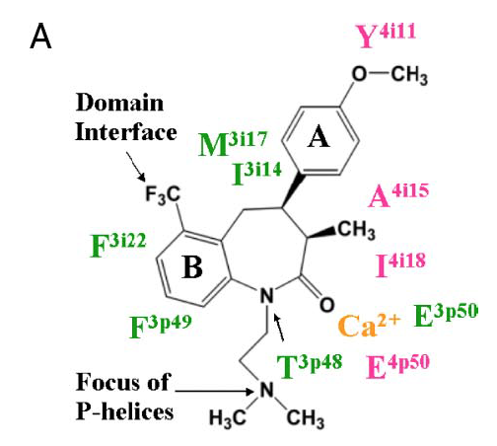
Sites are distinct but overlapping

