Slide 1
Retail stores use it to forecast sales
Energy companies use it to forecast reserves, production, demand, and prices.
Educational institutions use it to forecast enrollment.
Governments use it to forecast tax receipts and spending.
Transportation companies use time series forecasting to forecast future travel
Time Series Analysis and Forecasting

Slide 2

What is a time series?
A time series is a series of data points indexed in time order, taken at successive equally spaced points in time. Examples are:
heights of ocean tides
monthly sales of a company
the daily closing value of the Dow Jones Industrial Average.
Time series data are used for:
Analysis: Methods of analyzing time series data to extract information
Forecasting: Use of a model to predict future values based on previous ones

Slide 3
Forecasting Methods
Two main types of forecasting:
Regression methods: User specifies a model and estimates it from the time series
Smoothing methods: Method learns patterns from the data
Many data mining techniques, such as neural networks are used for time series forecasting.
A popular approach is to combine forecasting methods which can be done:
via multi-level forecasters, where the first method uses the original time series to forecast and the second method uses the residuals of the first model to "correct" the forecasts
via ensembles, where multiple methods are used and their forecasts are averaged to produce the final forecast
Ensembles produces more robust and of higher precision solutions.

Slide 4
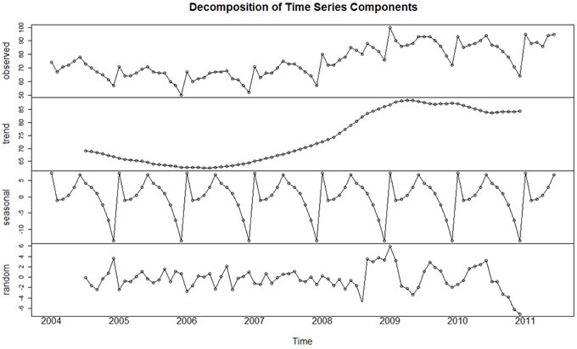
Time Series Components
In forecasting methods we usually dissect a time series into four components, as followed:
Level: Describes the average value of the series
Trend: Change of series from one period to the next
Seasonality: Short-term cyclical behavior of the series which can be observed within them
Noise: Random variation that results from measurement error or other causes and is always present to some extent.

Slide 5
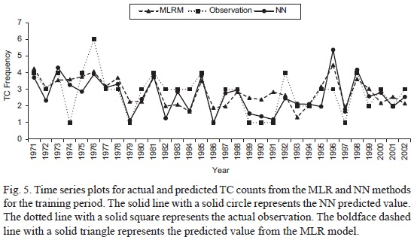
Data-Partitioning and Performance Evaluation
The partitioning of our data, in order to overcome overfitting, into a training and a validation set, depends on their nature. For example:
In cross-sectional data: Random partition
In time series: Our series is divided into 2 periods. The earlier one is the training data and the latter is the validation data. Data is trained in the earlier period and evaluated in the latter one.
We also need to evaluate our performance with:
Metrics: MAE, MAPE and RMSE are the most popular metrics in practice
Visualization: Examination of time plots of actual and predicted time series
This Photo by Unknown author is licensed under CC BY-SA.
This Photo by Unknown author is licensed under CC BY-SA.

Slide 6
Generating Future Forecasts
Another important difference of time-series with cross-sectional data is that the training and validation set on them are recombined, to forecast future values. The logic behind this, is :
Valuable information: The validation set is the most recent period , so it contains the information closest to our forecast
Data size: More data means better accuracy
Harder forecast: Usage of the training data only means forecasting further into the future
This Photo by Unknown author is licensed under CC BY-NC.

Slide 7
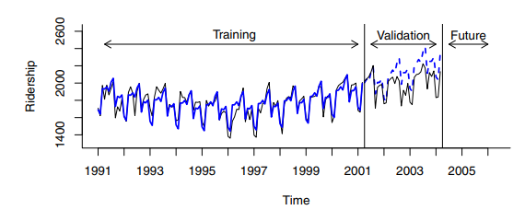
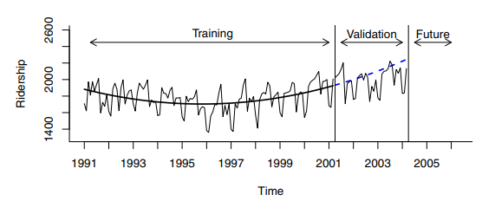
Example of time series with trend and seasonality
The following time series data (Amtrak ridership) seems to have a polynomial trend (using predictors 𝑡 and 𝑡^2) and monthly seasonality.
Seasonal pattern means that observations in some seasons have consistently lower or higher values than other seasons.
Seasonality here is captured as a new categorical variable that denotes the season for each value. Using the polynomial trend and monthly seasonality we calculate our regression line.

Slide 8
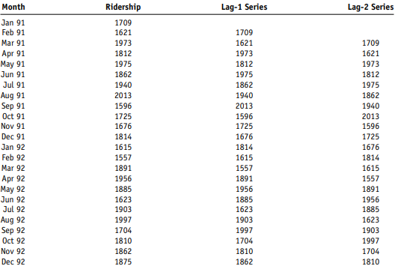
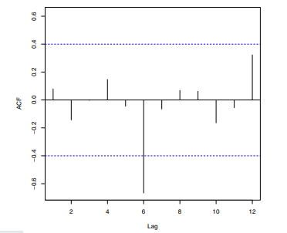
Autocorrelation
Correlated values in neighboring periods. Calculated by the correlation of the time series and a lagged version of it.
Autocorrelation behaviors:
Strong autocorrelation at lag k larger than 1 and its multiples(2k,3k,…): Cyclical pattern
Positive lag-1 autocorrelation: Consecutive values in the same direction
Negative lag-1 autocorrelation : Swings, high values followed by low values
The autocorrelation plot for lags 1-12 of the Amtrak ridership data. Strong negative lag 6 autocorrelation observed.

Slide 9
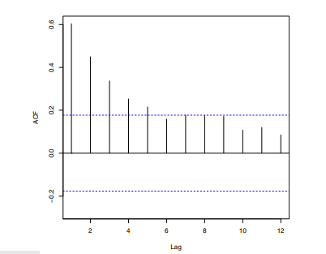
Autocorrelation for residuals
Examination of autocorrelation for residuals is not possible if the pattern is adequately modeled.
If there is though we can extract useful information to improve our forecasts.

Slide 10
Improving Forecasts by Integrating Autocorrelation Information
Two approaches:
Building autocorrelation directly in the regression model
Constructing second-level forecasting model on the residual series
Regression-type models for autocorrelation(AR-autoregressive models)
They can be written as: 𝑌(𝑡)=𝑏0+𝑏1𝑌(𝑡−1)+𝑏2𝑌(𝑡−2)+ … 𝑏n𝑌(𝑡−n)+𝜖

Slide 11
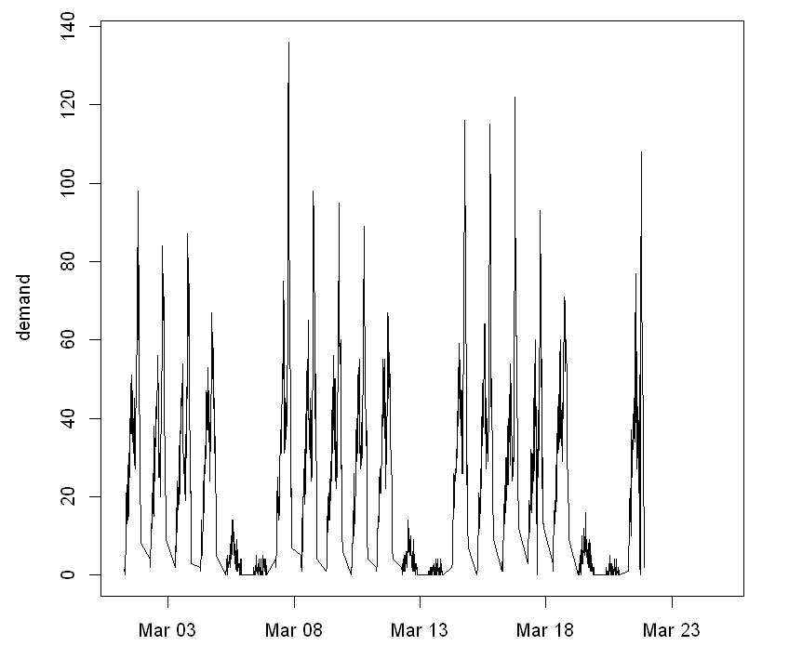
Our case study : Forecasting Public Transportation Demand
The company's data is set on 15-minute intervals between 6:30 and 22:00, based on how many passengers arrive at the terminal.
We were asked to forecast the number of passengers arriving at the terminal.

Slide 12
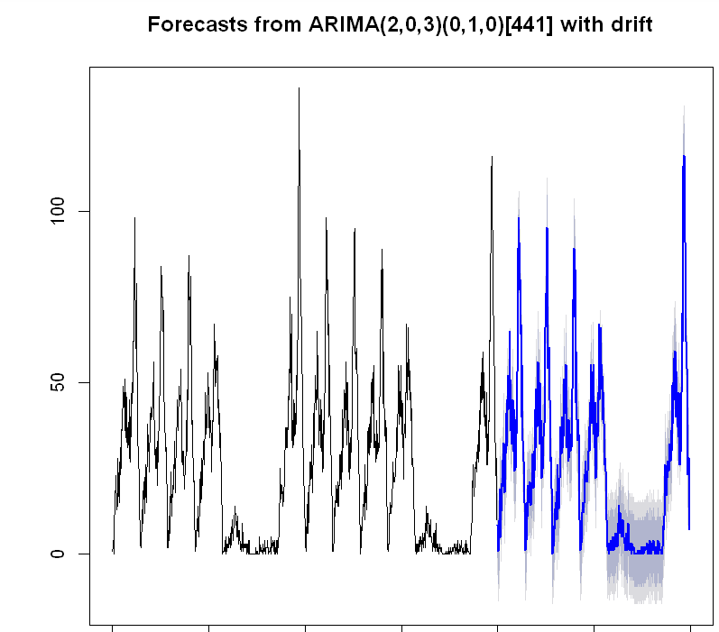
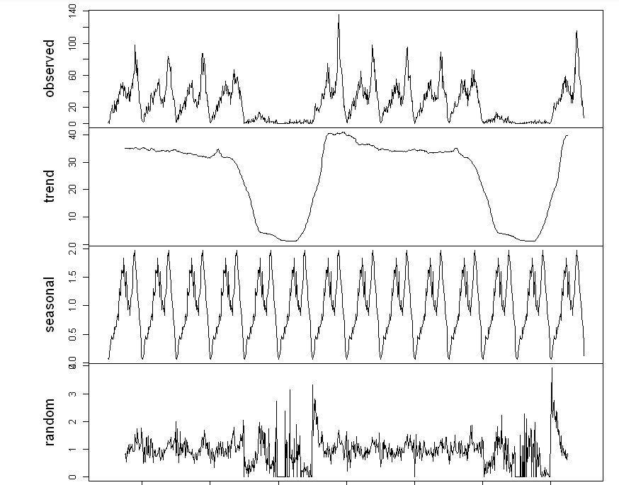
First choice
R’s auto ARIMA model
Decent fit but we wanted to do better
Decomposition of timeseries
Notice anything about the trend component?

Slide 13

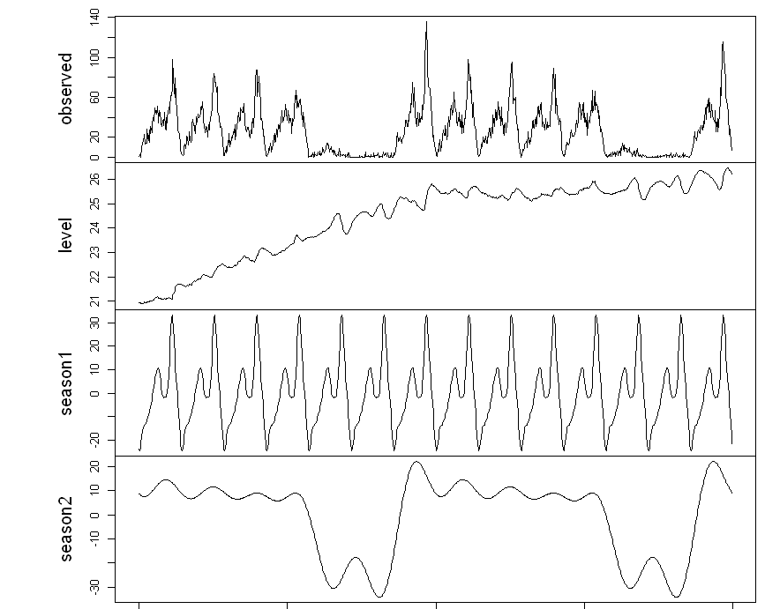
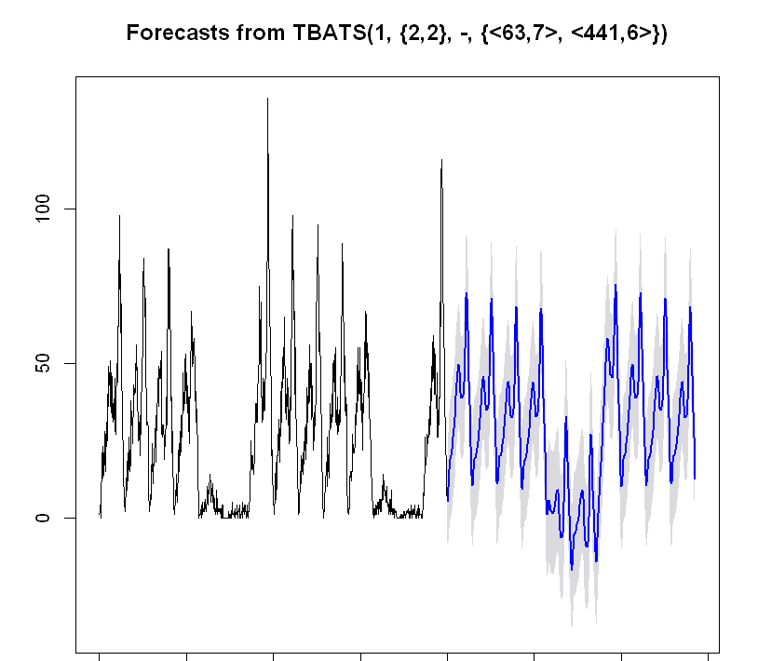
A model built for multiple seasonality
Multiple season decomposition
TBATS
Automated modelling algorithm that captures multiple seasonality
Running the model to make predictions we get:

Slide 14
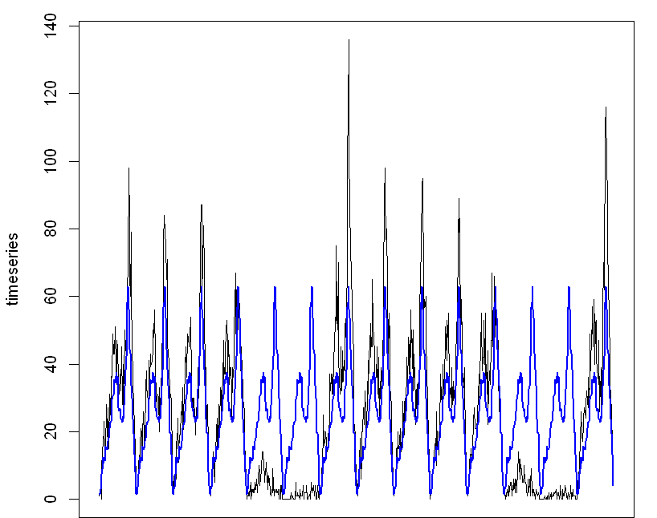
Our own model
First version: linear model using a categorical variable with 62 levels to describe daily seasonality
demand = b0 + b1*S1 + b2*S2 + … + b62*S62
Obviously not a good fit but it’s a start
Next step: Capture weekly seasonality

Slide 15
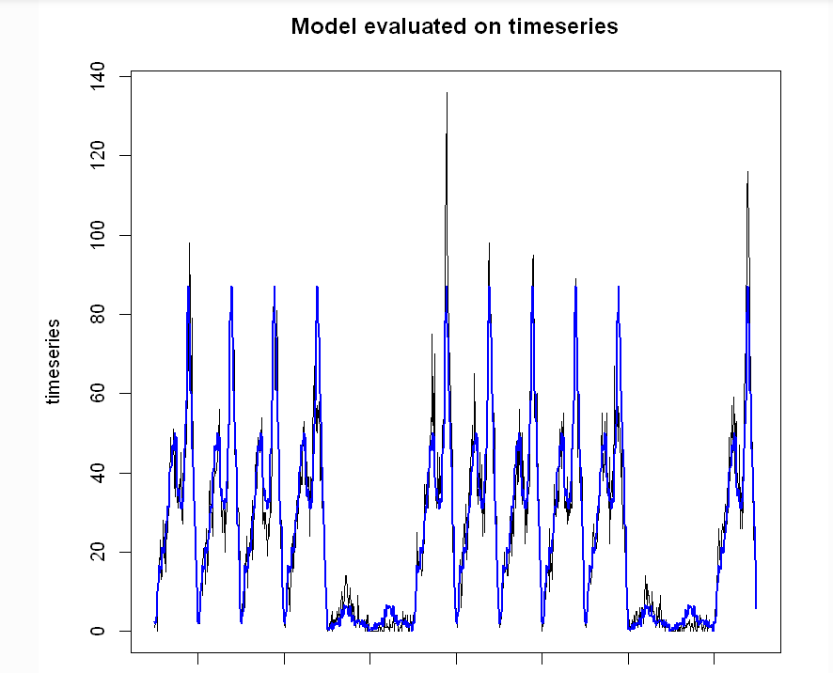
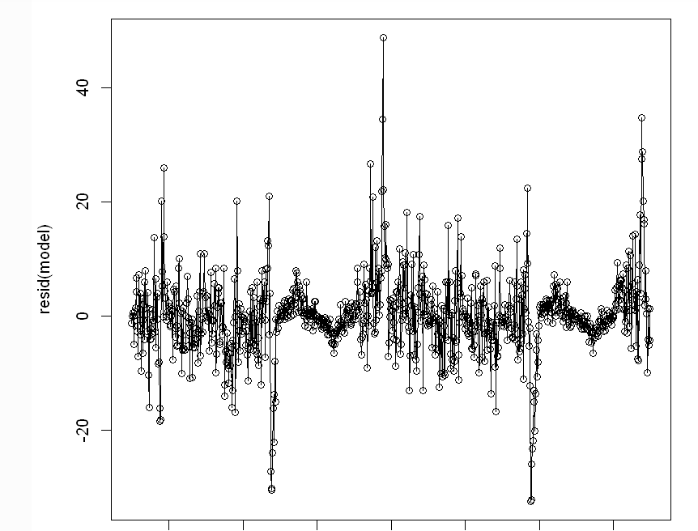
Updated version
Daily seasonality: Categorical variable with 62 levels, one for each observation.
Weekly seasonality: Categorical variable with 2 levels, one for weekdays and one for weekends.
A total of 126 parameters for our model.
demand = b0 + daytype + b1*S1 + b2*S2 + … + b62*S62 +
b63* daytype*S1 + b64* daytype*S2 … + b125*daytype*S62
But there is a problem here. Let's plot the residuals and find out.
Notice a pattern here?

Slide 16
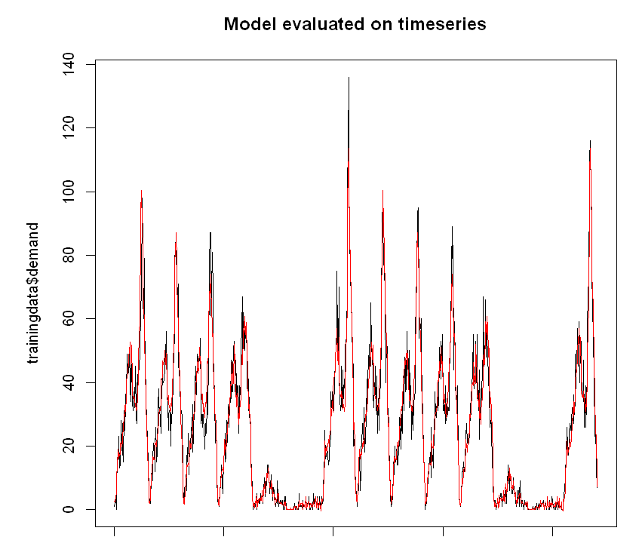
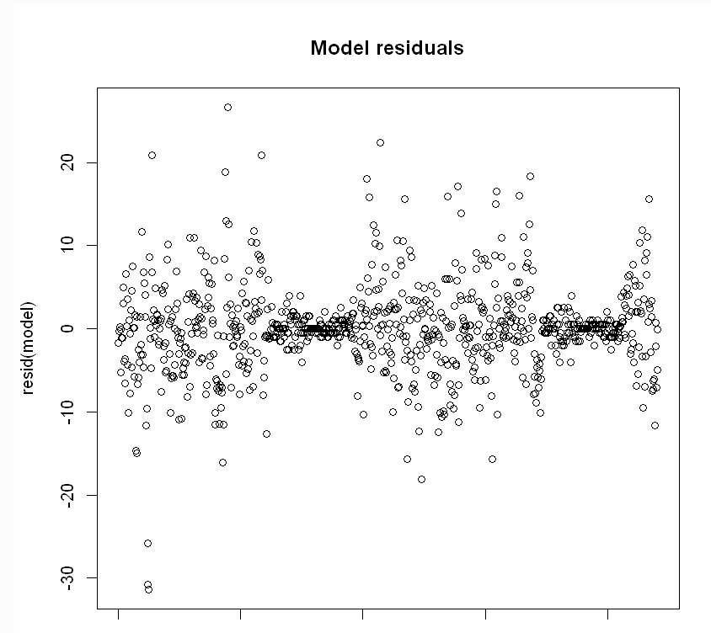
Almost final version
We create another dummy variable with 7 levels, one for each day.
The model now uses 3 variables and more parameters than before.
demand = b0 + daytype + b1*S1 + b2*S2 + … + b62*S62
+ b63* daytype*S1 + b64* daytype*S2 … + b125*daytype*S62
+ b126* daynumber*S1 + b127* daynumber*S2 … + b187*daynumber*S62
+ b188*daytype* daynumber*S1 + b189* daytype*daynumber*S2 … + b249*daytype*daynumber*S62

Slide 17
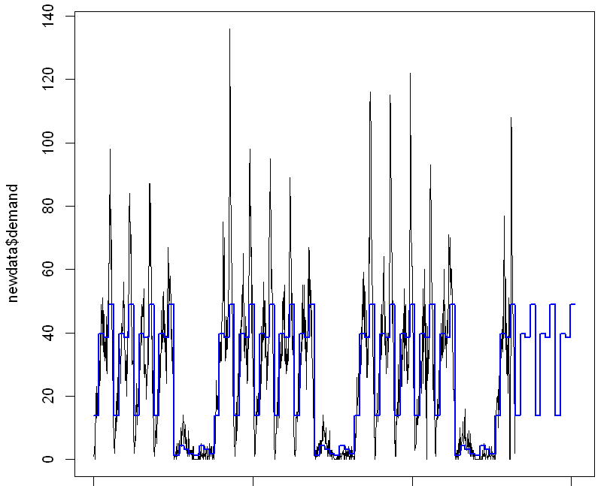
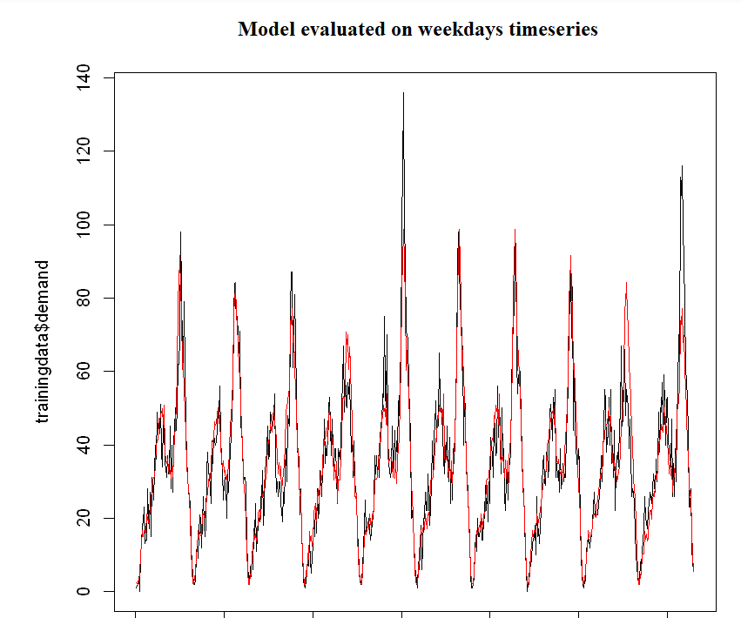
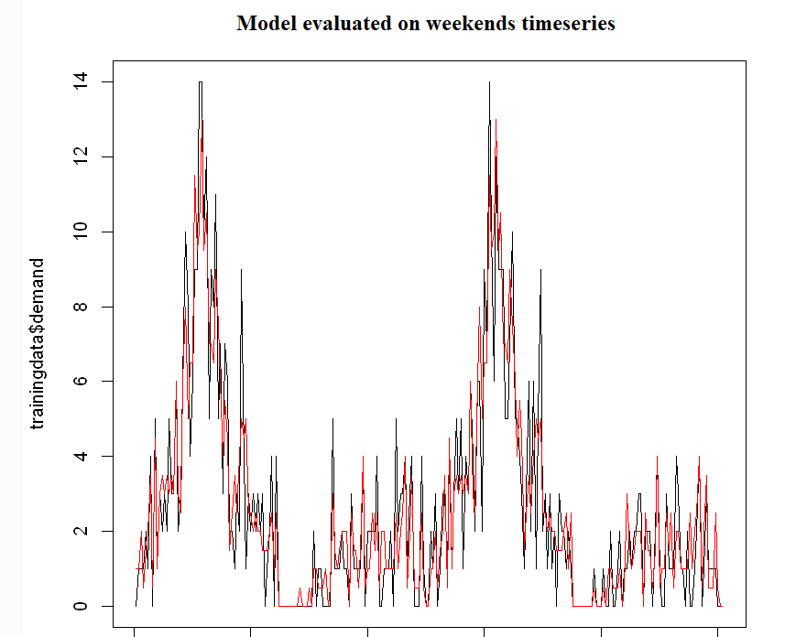
Variations of the model
4 seasons instead of 62
Experiments with different numbers of seasons failed to improve performance
Another variation was the fit of 2 models: one for weekdays and another for weekends. Here's what we got:
While the fit seems good, the metrics were worse

Slide 18

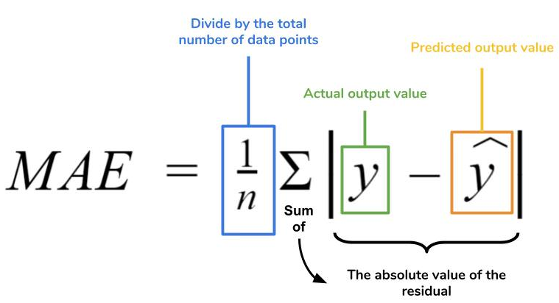
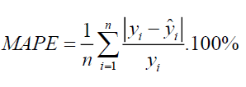
Performance metrics and problem with MAPE
R squared:
Training set: 0.9262
Validation set: 0.617
MAE(Mean Absolute Error):
Training set: 3.474
Validation set: 5.393
MAPE(Mean Absolute Percentage Error)
Training set: 28.786
Validation set: 160.446
In the case of MAPE, if we have zero demand then our value goes to infinity. We decided to divide by 0.5 instead of zero as a cheap fix.

Slide 19
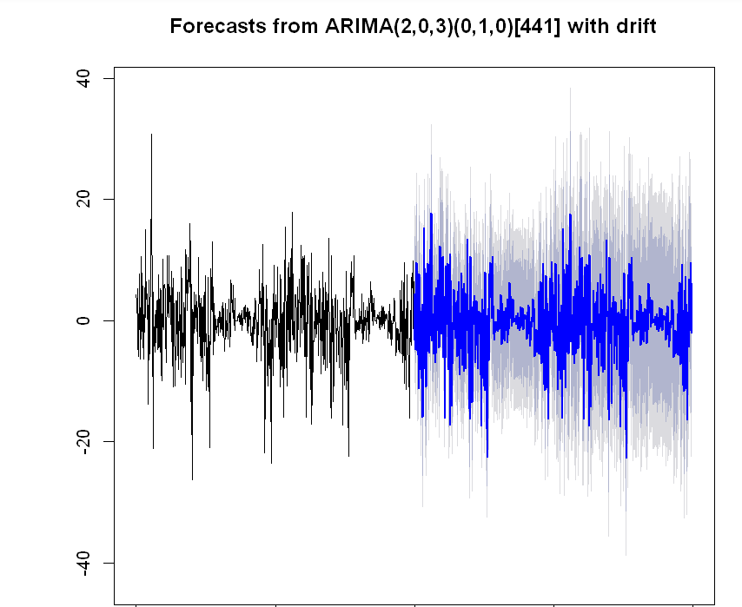
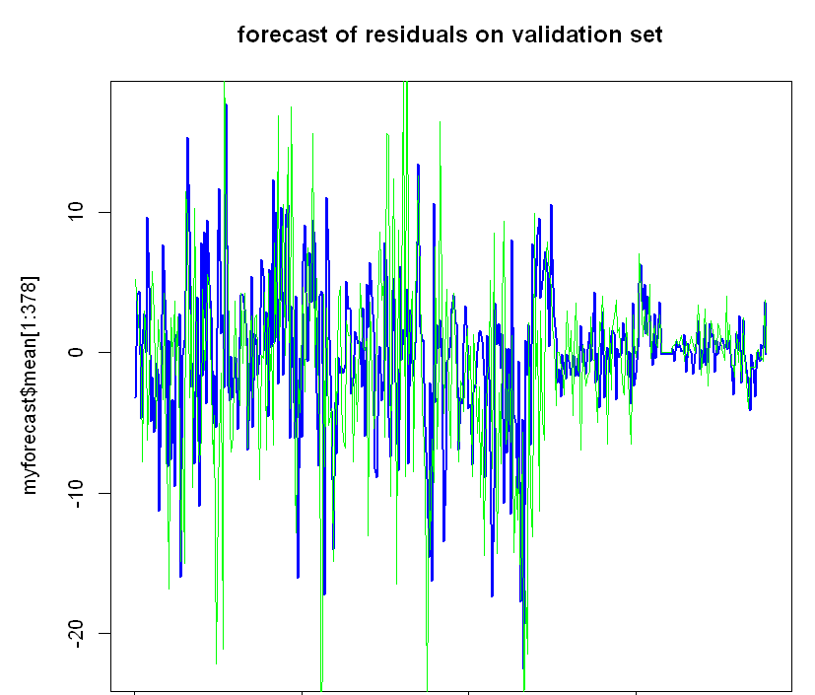
Integrating residuals to the forecast
Didn’t improve forecasts. Possibly because residuals contained less information than necessary.

Slide 20
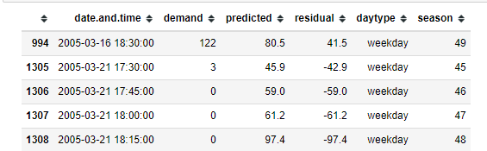
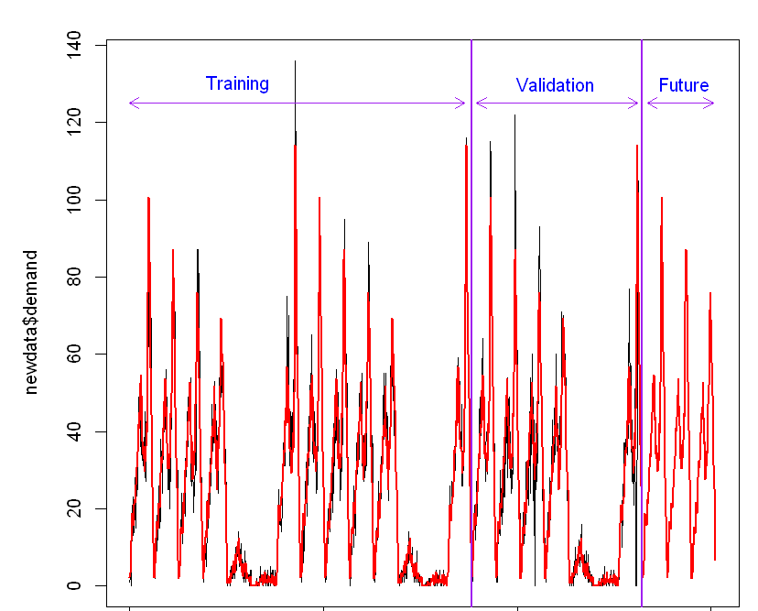
Unusual observations and an almost final version of our model
Our dataset has observations that are unusual, possibly due to external factors. We notice that in this image:
Unusual demand values
Fit to entire period and forecasts
Seems like a good model but we don't like the fact that it has so many predictors.

Slide 21
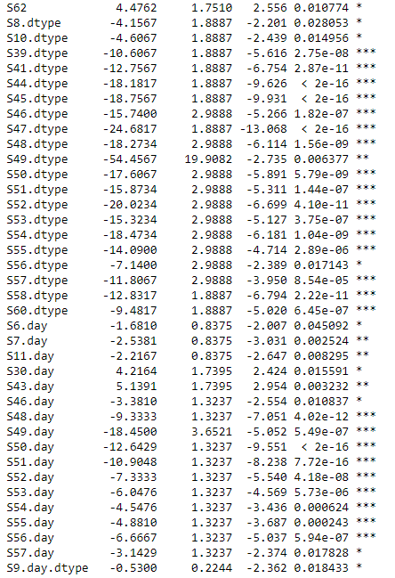
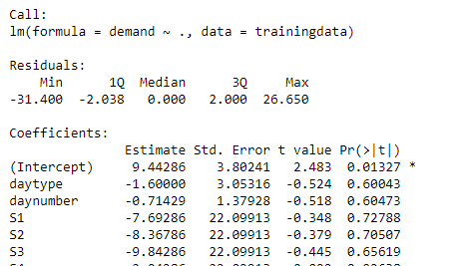
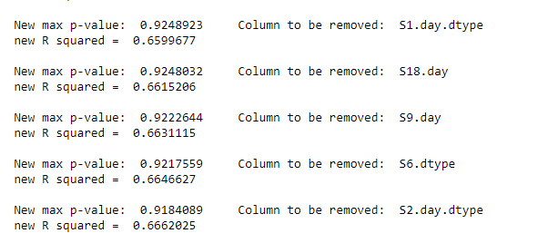
Removing insignificant predictors
We check the predictors that have high p-values.
And we remove them iteratively till all coefficients have p-values less than 0.05
So let's check the final coefficients:

Slide 22
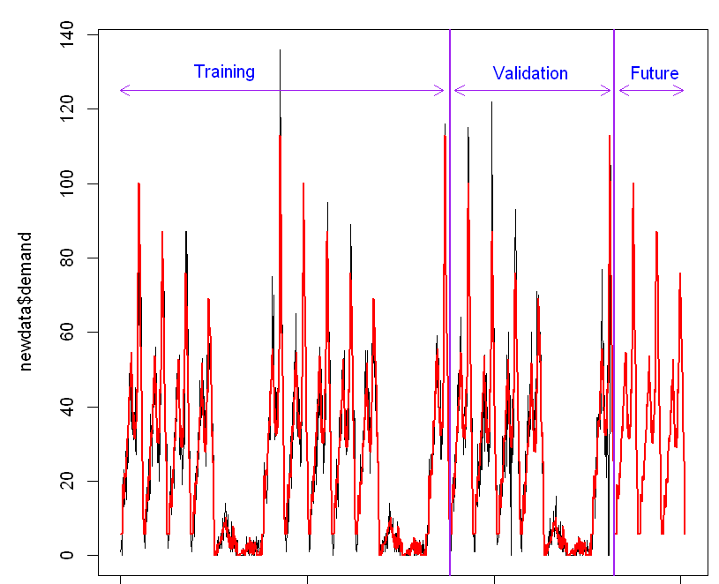

Updated final model and metrics
So our final model ,which is presented below, forecasts the demand for the next 3 days:
Our metrics for the final model are:

Slide 23


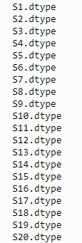

Reason behind removed variables
The removed variables represented interactions between:
Season and daynumber
Season and daytype
For roughly the first 2/3 of the day
(6:30 – 16:00)

Slide 24
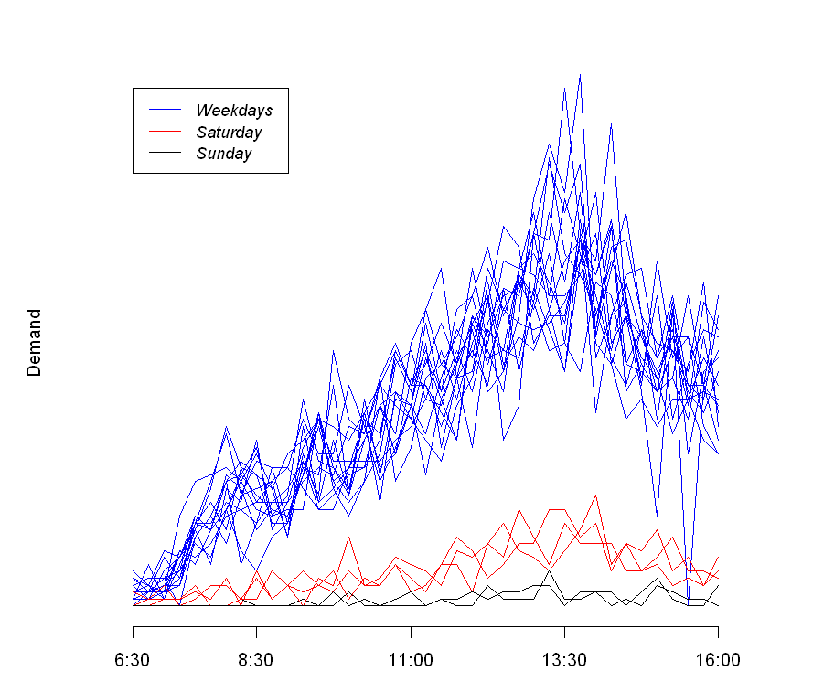
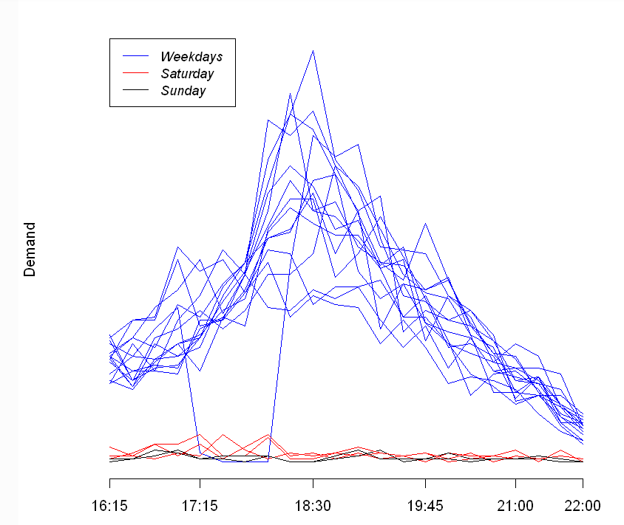
Daily demands comparison

