Slide 1
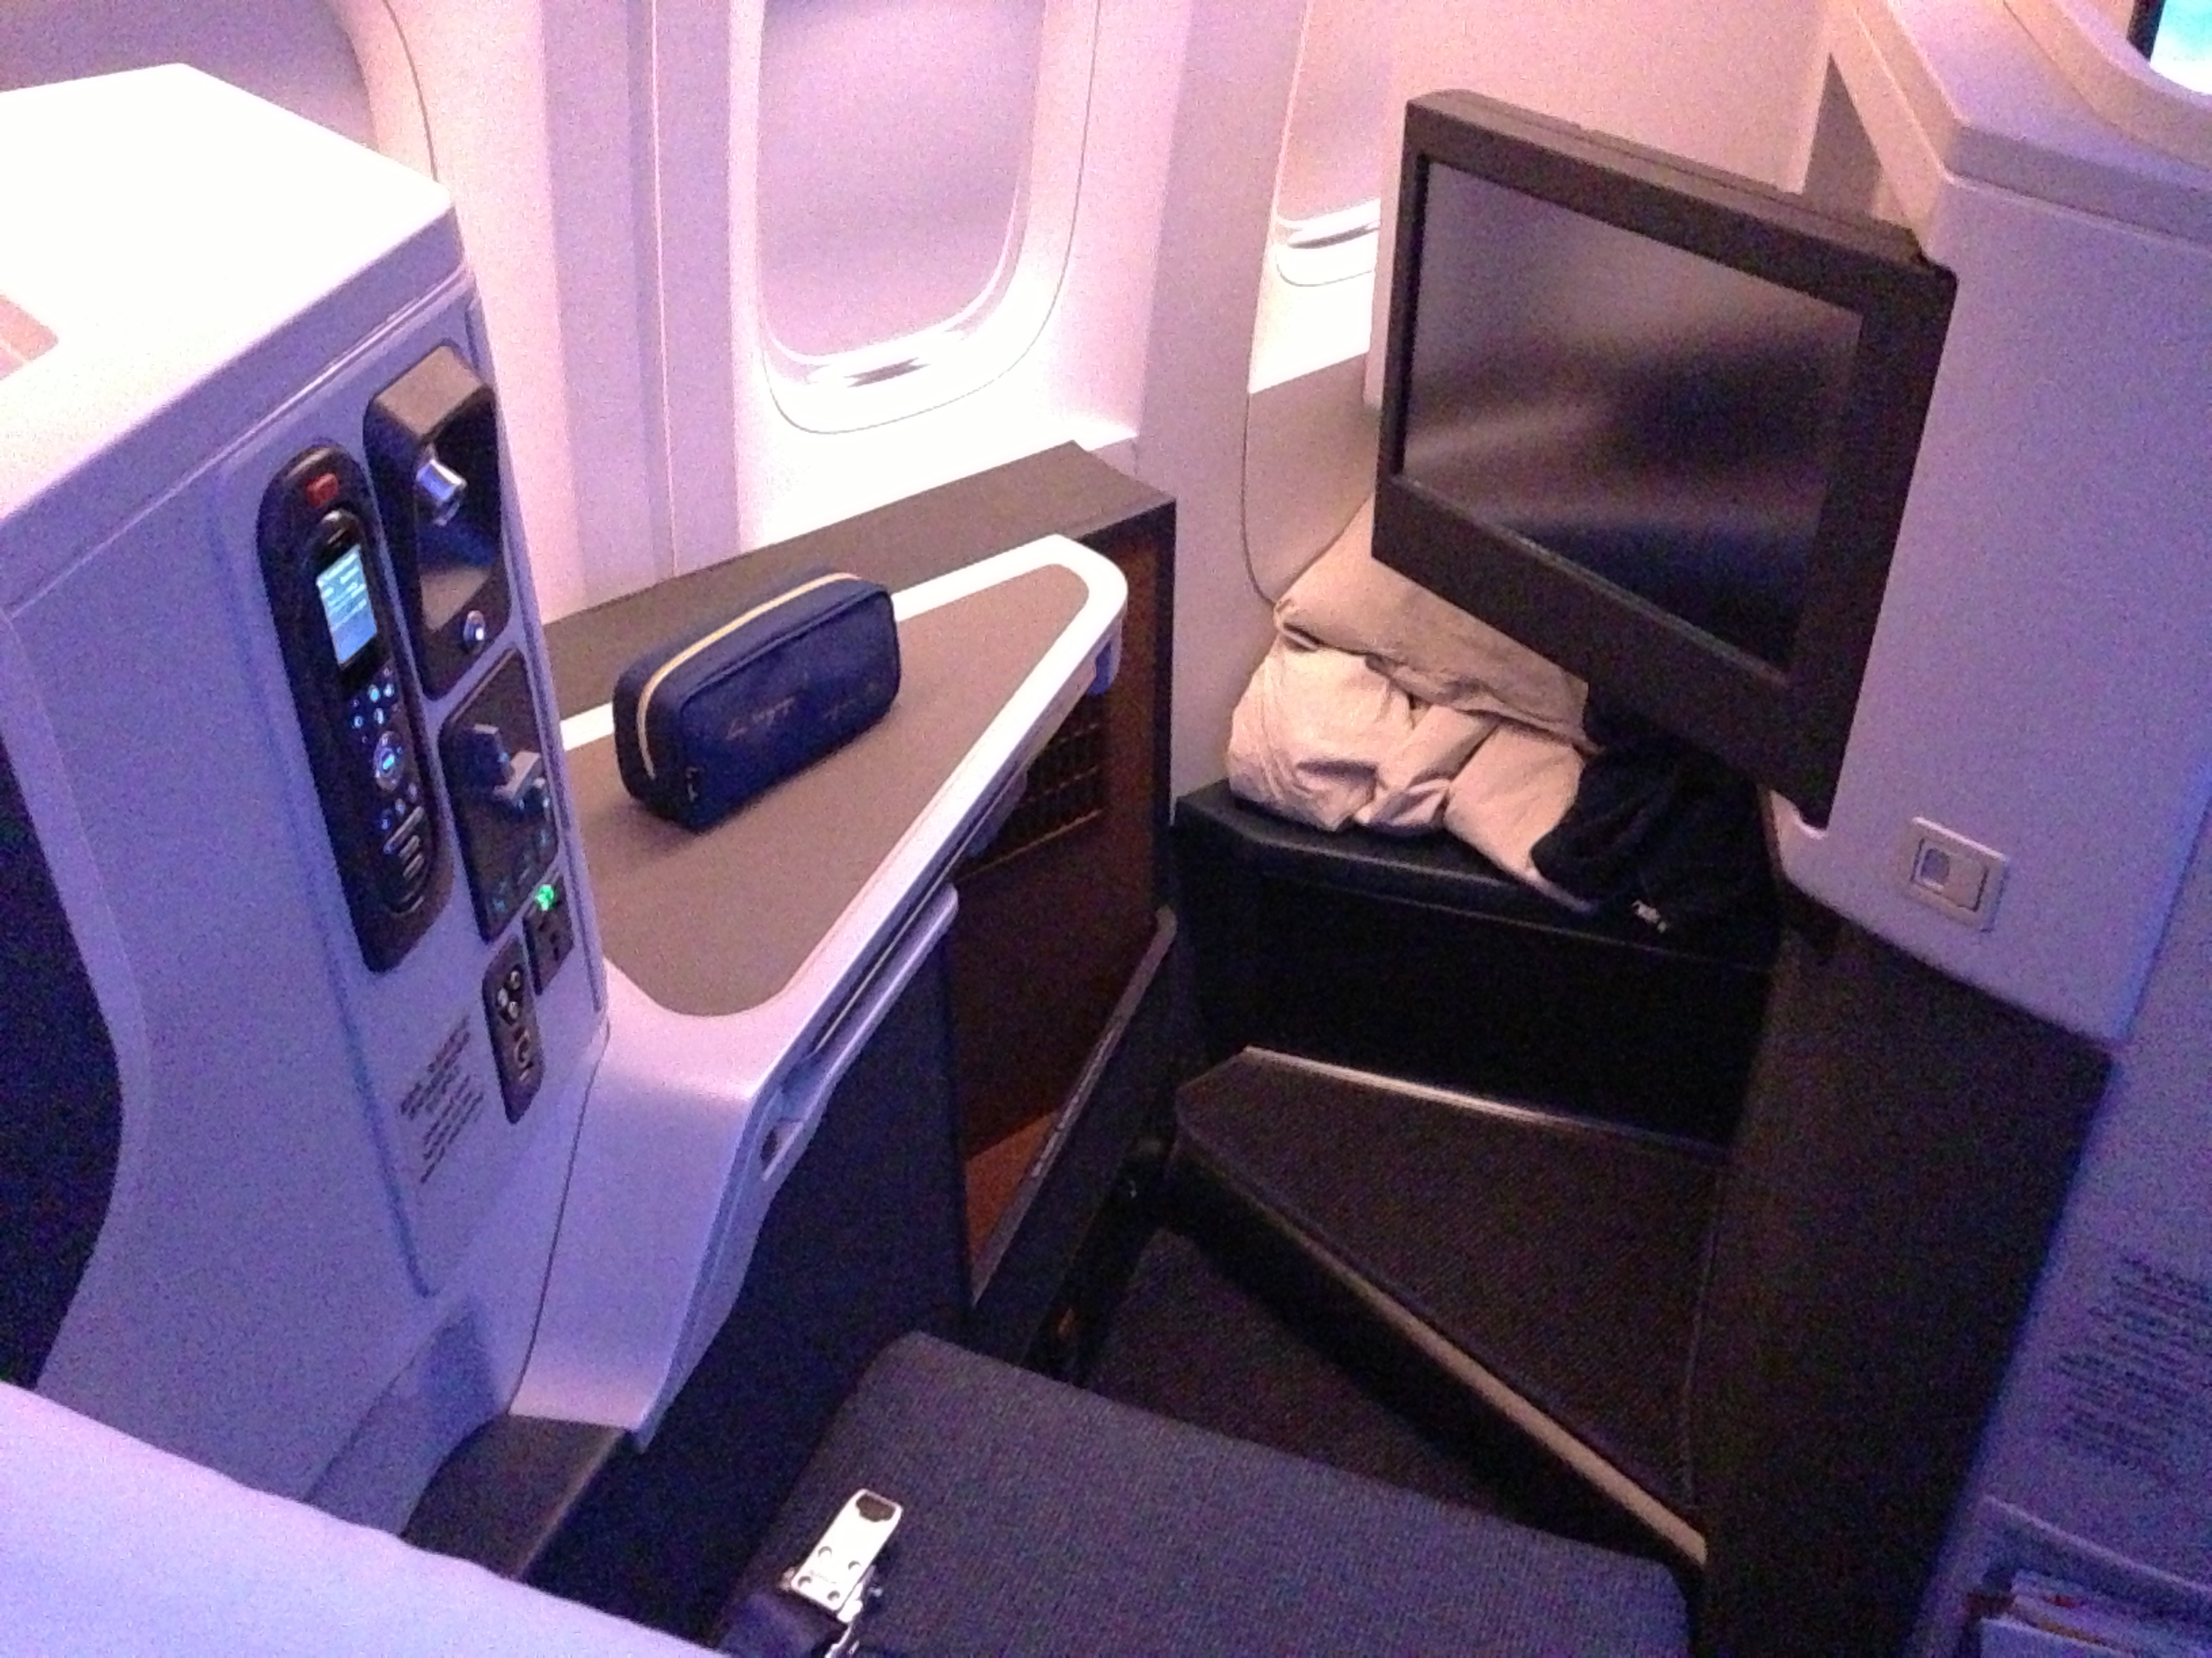
Customer Onboarding Process

Slide 2
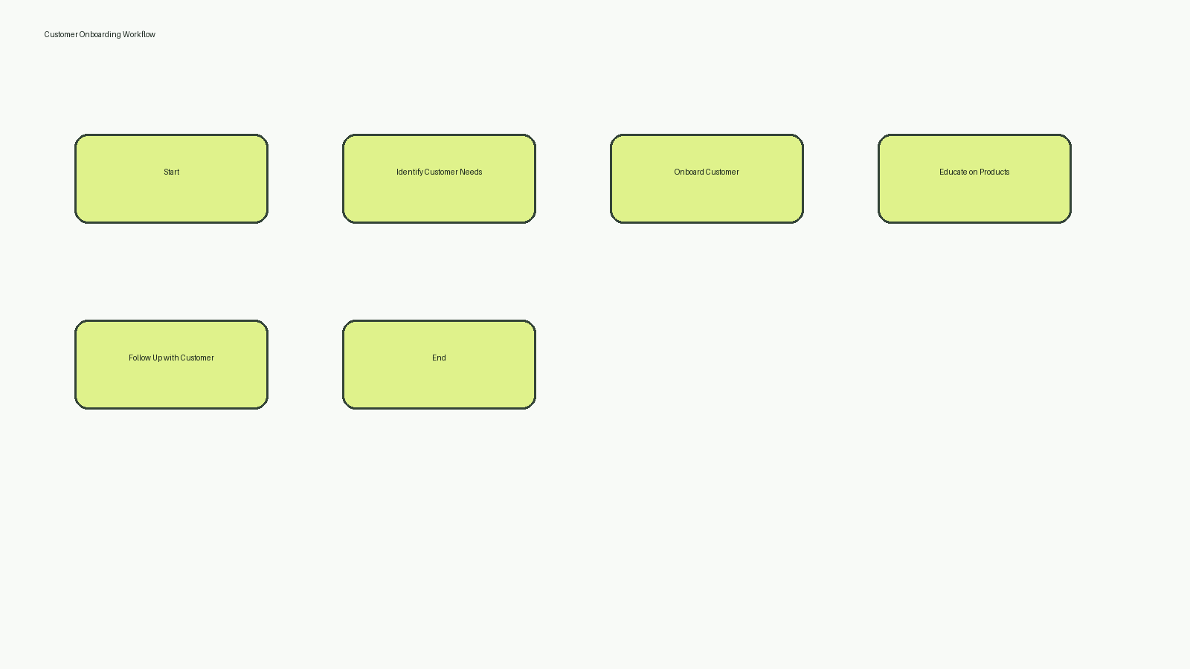
Workflow Diagram

