Slide 1


Afferent/Efferent Pitch Processing
Matt R. Flax <flatmax@ieee.org>

Slide 2
Terms and Definitions
Afferent neural signals are signals which propagate towards the brain.
Efferent neural signals are signals which propagate away from the brain.
Olivocochlear (OC) is a neural section of the brain to which and from which the afferent and efferent neurons project.
Lateral Olivocochlear (LOC) is a lateral OC system which projects to the neurons which synapse on the inner hair cells.

Slide 3
Aims
To model afferent and efferent innervation at the periphery and cross processing.
To assess the implications of the model for place pitch processing.
Outline
Neurology
Processing Algorithms
Experiment (Deriving pitch salience)
Conclusion / Further work

Slide 4
Neurology

Slide 5
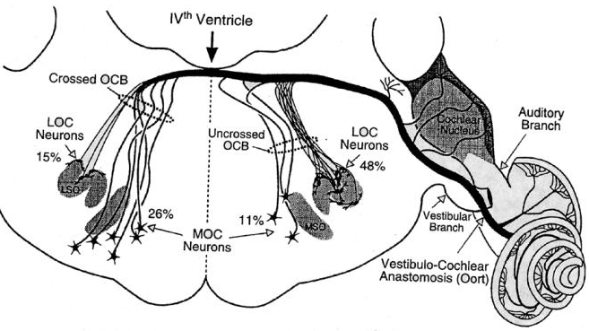
Olivocochlear Efferent Sources

Slide 6
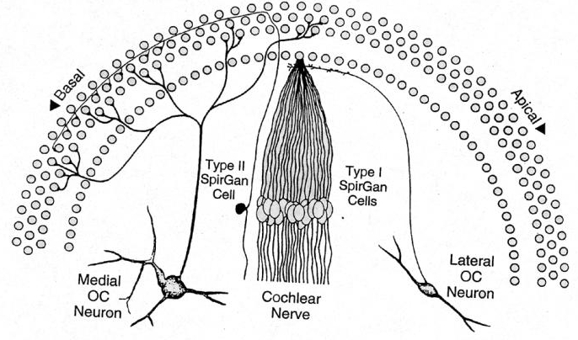
Afferent/Efferent Innervation

Slide 7
Afferent/Efferent Assumptions
Organ of Corti is innervated uniformly by the afferent system.
LOC projection crosses the afferents yielding a cross processed signal.
LOC efferent innervation is non-uniformly sampled from base to apex. It oversamples the base, undersamples the apex.
LOC returns a signal preserving tonotopic topology, with little signal alteration.

Slide 8
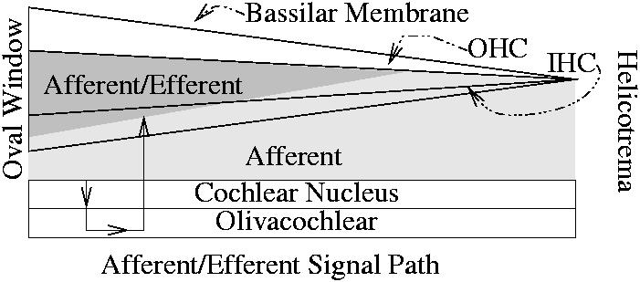
Organ of Corti - Neural View

Slide 9

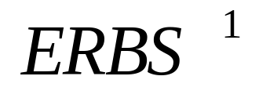
Afferent/Efferent Tonotopic Mapping
The afferent system is innervated uniformly and approximates the ERB scale (ERBS), as given by this formula :
The efferent LOC system innervates the audio periphery non-uniformly. The innervation inverts the ERBS. This is notated
Glasberg and Moore (1990)

Slide 10
Processing Models

Slide 11
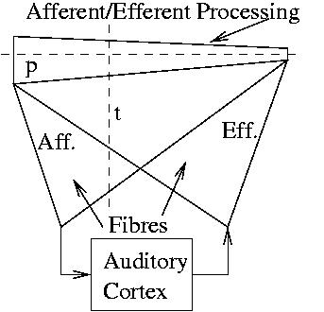
Temporal and Place Systems

Slide 12


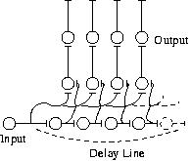
Afferent Pitch Processing
Temporal
Place
Wightman (1973)
Meddis & Hewitt (1991)
Licklider's autocorrelation (1951)

Slide 13
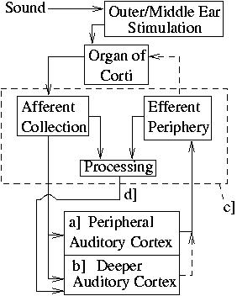
Auditory System
Afferent
Efferent

Slide 14
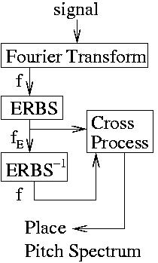
Processing Algorithm

Slide 15
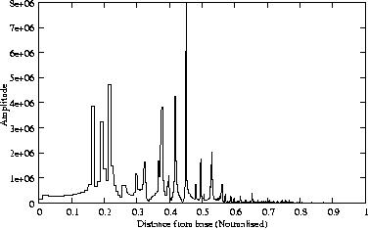
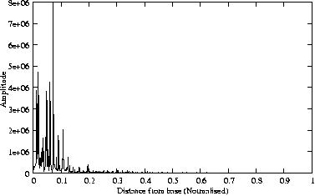
Processing Algorithm

Slide 16
Experiment

Slide 17
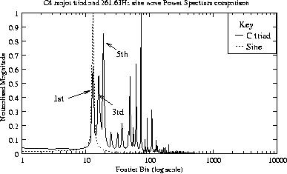
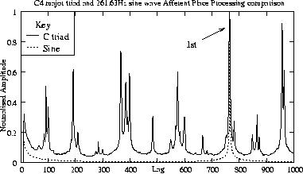
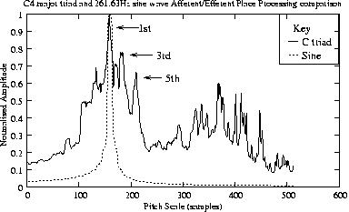
Results

Slide 18
Conclusion
Neural innervation of the afferent system maps an incoming signal to an ERB type scale.
Neural innervation of the efferent LOC system maps the signal to a linear frequency scale.
Cross processing (afferent/efferent) yeilds accurate pitch salience.

Slide 19
Further Work
Mathematically define the pitch scale which is the unknown scale derived by the algorithm. This definition must convert from a pitch scale location (pitch scale bin) to Hz equivalent.

