Slide 1
Gráficos

Slide 2
Q1 - "Are you self-employed?"
Q2 - "How many employees does your company or organization have?"
Q3 - "Is your employer primarily a tech company/organization?"
Q4 - "Is your primary role within your company related to tech/IT?"
Q5 - "Does your employer provide mental health benefits as part of healthcare coverage?"
Q6 - "Do you know the options for mental health care available under your employer-provided coverage?"
Q7 - "Has your employer ever formally discussed mental health (for example, as part of a wellness campaign or other official communication)?"
Q8 - "Does your employer offer resources to learn more about mental health concerns and options for seeking help?"
Q9 - "Is your anonymity protected if you choose to take advantage of mental health or substance abuse treatment resources provided by your employer?"
Q10 - "If a mental health issue prompted you to request a medical leave from work, asking for that leave would be:..."
Q11 - "Do you think that discussing a mental health disorder with your employer would have negative consequences?"
Q12 - "Do you think that discussing a physical health issue with your employer would have negative consequences?"
Q13 - "Would you feel comfortable discussing a mental health disorder with your coworkers?"
Q14 - "Would you feel comfortable discussing a mental health disorder with your direct supervisor(s)?"
Q15 - "Do you feel that your employer takes mental health as seriously as physical health?"
Q16 - "Have you heard of or observed negative consequences for co-workers who have been open about mental health issues in your workplace?"
Q17 - "Do you have medical coverage (private insurance or state-provided) which includes treatment of mental health issues?"
Q18 - "Do you know local or online resources to seek help for a mental health disorder?"
Q19 - "If you have been diagnosed or treated for a mental health disorder, do you ever reveal this to clients or business contacts?"
Q20 - "If you have revealed a mental health issue to a client or business contact, do you believe this has impacted you negatively?“
Q21 - "If you have been diagnosed or treated for a mental health disorder, do you ever reveal this to coworkers or employees?"
Q22 - "If you have revealed a mental health issue to a coworker or employee, do you believe this has impacted you negatively?"
Q23 - "Do you believe your productivity is ever affected by a mental health issue?"
Q24 - "If yes, what percentage of your work time (time performing primary or secondary job functions) is affected by a mental health issue?","Do you have previous employers?"
Q25 - "Have your previous employers provided mental health benefits?"
Q26 - "Were you aware of the options for mental health care provided by your previous employers?"
Q27 - "Did your previous employers ever formally discuss mental health (as part of a wellness campaign or other offi8cial communication)?"
Q29 - "Did your previous employers provide resources to learn more about mental health issues and how to seek help?"
Q30 - "Was your anonymity protected if you chose to take advantage of mental health or substance abuse treatment resources with previous employers?"
Q31 - "Do you think that discussing a mental health disorder with previous employers would have negative consequences?"
Q32 - "Do you think that discussing a physical health issue with previous employers would have negative consequences?"
Q33 - "Would you have been willing to discuss a mental health issue with your previous co-workers?"
Q34 - "Would you have been willing to discuss a mental health issue with your direct supervisor(s)?"
Q35 - "Did you feel that your previous employers took mental health as seriously as physical health?"
Q36 - "Did you hear of or observe negative consequences for co-workers with mental health issues in your previous workplaces?"
Q37 - "Would you be willing to bring up a physical health issue with a potential employer in an interview?"
Q38 - "Why or why not?"
Q39 - "Would you bring up a mental health issue with a potential employer in an interview?"
Q40 - "Why or why not?"
Q41 - "Do you feel that being identified as a person with a mental health issue would hurt your career?"
Q42 - "Do you think that team members/co-workers would view you more negatively if they knew you suffered from a mental health issue?"
Q43 - "How willing would you be to share with friends and family that you have a mental illness?"
Q44 - "Have you observed or experienced an unsupportive or badly handled response to a mental health issue in your current or previous workplace?"
Q45 - "Have your observations of how another individual who discussed a mental health disorder made you less likely to reveal a mental health issue yourself in your current workplace?"
Q46 - "Do you have a family history of mental illness?"
Q47 - "Have you had a mental health disorder in the past?"
Q48 - "Do you currently have a mental health disorder?"
Q49 - "If yes, what condition(s) have you been diagnosed with?"
Q50 - "If maybe, what condition(s) do you believe you have?"
Q51 - "Have you been diagnosed with a mental health condition by a medical professional?"
Q52 - "If so, what condition(s) were you diagnosed with?"
Q53 - "Have you ever sought treatment for a mental health issue from a mental health professional?"
Q54 - "If you have a mental health issue, do you feel that it interferes with your work when being treated effectively?"
Q55 - "If you have a mental health issue, do you feel that it interferes with your work when NOT being treated effectively?"
Q56 - "What is your age?","What is your gender?"
Q57 - "What country do you live in?"
Q58 - "What US state or territory do you live in?"
Q59 - "What country do you work in?"
Q60 - "What US state or territory do you work in?"
Q61 - "Which of the following best describes your work position?"
Q62 - "Do you work remotely?"

Slide 3
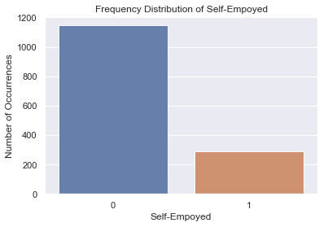
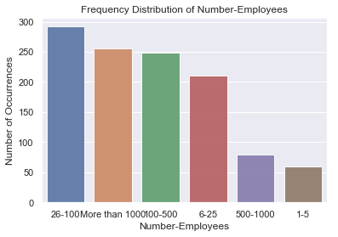
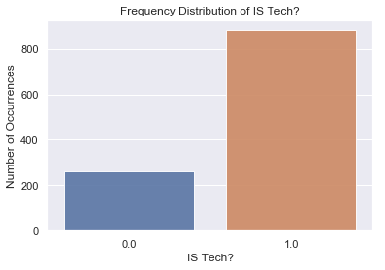
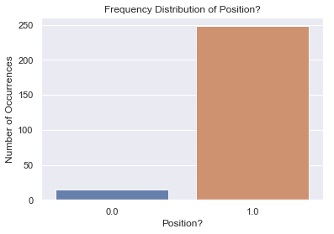
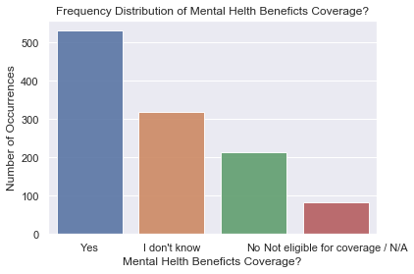
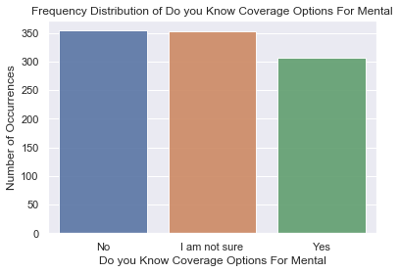
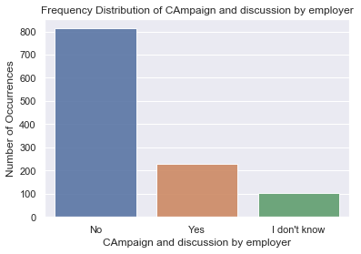
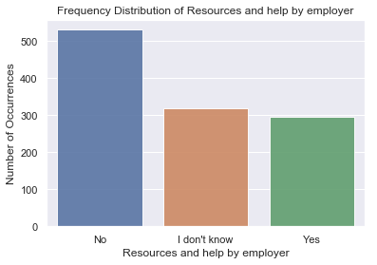
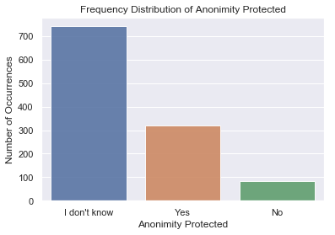
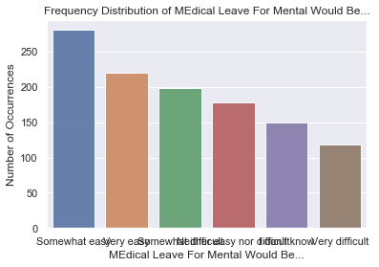
Somewhat easy 281
Very easy 220
Somewhat difficult 199
Neither easy nor difficult 178
I don't know 150
Very difficult 118

Slide 4
