Slide 1
ICRMS Healthch

Slide 2
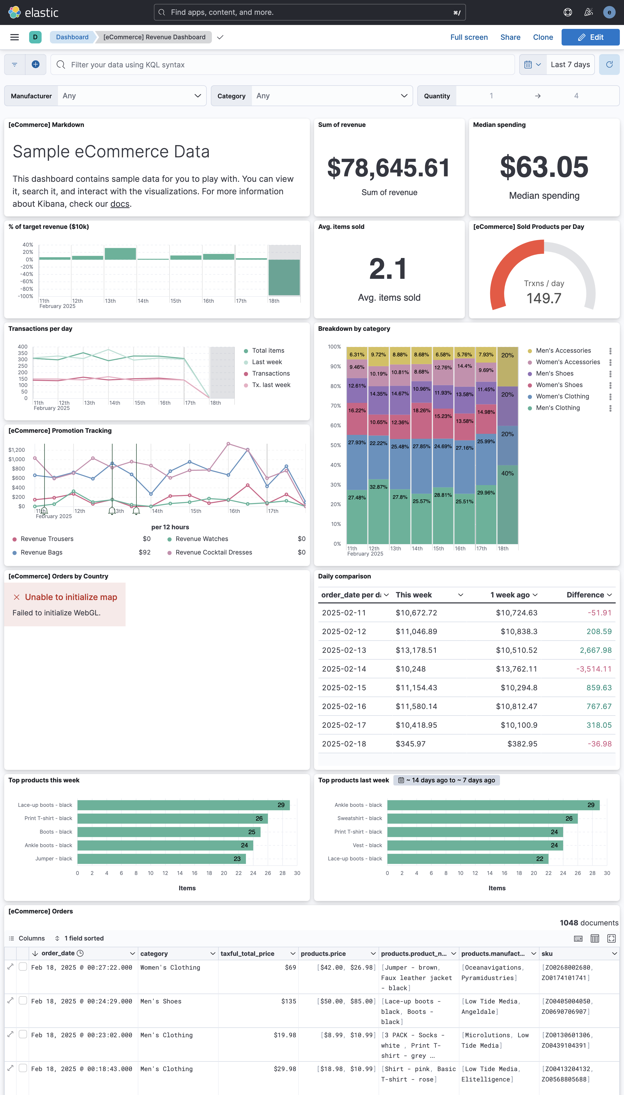
RMS 1

Slide 3
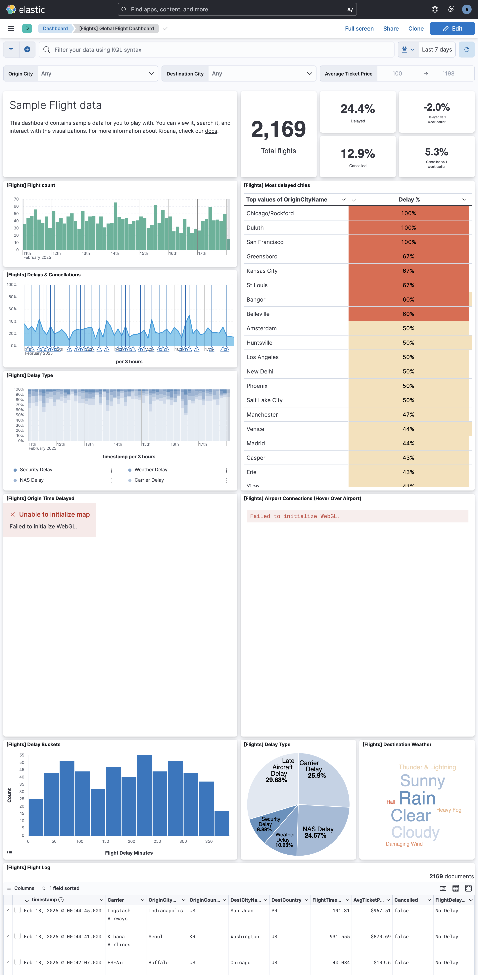
RMS 2

