Slide 1
ADVANCED MACHINE LEARNING FOR PHYSICS
INTRODUCTION
Machine Learning-Assisted
Optimization in High-Dimensional
Complex Landscapes
+
−
+
−
+
+
+
+
−
−
−
−
−
−
−
+
+
−
−
+
−
+
+
−
+
Spin-glass optimization with SA, PA and Global Annealing
Flavio Massimiliano Ricci
Assiem Vigiani
Friedrich Rauno Zander
01

Slide 2
Can ML navigate a spin-glass energy landscape?
INTRODUCTION
Goal
Find the ground state of a frustrated Ising spin glass.
SA
PA
GA
local moves
local moves + resampling
local + MADE global moves
2ᴺ configurations · many metastable minima
Same population size, GPU implementation, and temperature schedule.
02

Slide 3
Index
INTRODUCTION
01
Introduction
Question and benchmark
02
Problem & model
Edwards–Anderson energy and Gibbs distribution
03
Monte Carlo
Acceptance, checkerboard and schedule
04
Classical annealing
Simulated and Population Annealing
05
Global annealing
MADE, training, generation and MLMC
06
Optimization results
Energy-gap convergence
07
Fixed-T sampling
Energy, overlap and measured acceptance
08
SK model
Fully connected model, sequential update and results
03

Slide 4
3D Edwards–Anderson spin glass
PROBLEM & MODEL
IMPLEMENTED HAMILTONIAN
H(s) = −½ Σᵢⱼ Jᵢⱼ sᵢ sⱼ
+
−
+
−
+
+
+
+
−
−
−
−
−
−
−
sᵢ ∈ {−1,+1}, N = L³
+
+
−
−
+
−
+
+
−
+
GIBBS TARGET
pᵦ(s) = Zᵦ⁻¹ exp[−βH(s)]
L = 10 · N = 1000
β → ∞ ⇒ energy distribution concentrates on the minima
• Gaussian nearest-neighbour couplings
• Frustration creates competing minima
• Objective: s* = arg minₛ H(s)
04

Slide 5
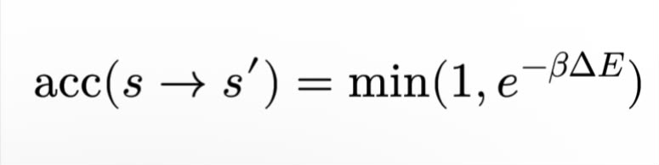


Metropolis-Hastings
MONTE CARLO
Metropolis-Hastings
Log-Hastings
log u < log A
u ∼ Uniform(0,1)
05

Slide 6

Checkerboard update & montecarlo_step
MONTE CARLO
MONTECARLO_STEP · CHECKERBOARD METROPOLIS
i = xL² + yL + z
for indices in [even_indices, odd_indices]:
proposed = population.clone()
proposed[:, indices] *= -1
# ΔE_i = H(s^(i)) - H(s)
delta_E = -2 * torch.einsum(
"ki,ki->ki", proposed[:, indices],
torch.einsum("kj,ji->ki",
population, J[indices, :].T))
accept = (delta_E < 0) | (
torch.rand_like(delta_E) < torch.exp(-delta_E / T))
population[:, indices] = torch.where(
accept, proposed[:, indices], population[:, indices])
Pass 1
Pass 2
even sites
odd sites
ΔEᵢ = H(s⁽ⁱ⁾) − H(s) = 2 sᵢ hᵢ, hᵢ = Σⱼ Jᵢⱼ sⱼ
06

Slide 7
Log-T schedule
MONTE CARLO
Annealing: progressively increase β = 1/T
Cᵥ-based schedule
T = 1.92
T = 0.10
Δβ ∝ Cᵥ⁻¹ᐟ²
log-spaced T places more points in the low-temperature regime
Chosen schedule: log T
TEMPERATURE_CHANGE
• Good performance for PA in the tested setup
• Avoids giving GA a schedule-specific advantage
temperatures = np.logspace(
np.log10(T_max), np.log10(T_min), temp_steps)
07

Slide 8
Simulated Annealing
CLASSICAL ANNEALING
Equilibrate at high T
Lower temperature
Local MC sweeps
Repeat
M random replicas
β ← β + Δβ(β)
until Tₘᵢₙ
The M trajectories never communicate.
Fair benchmark
Exploration
Consequence
We run M replicas in parallel even though standard SA needs only one.
Only local spin flips cross barriers; low-T dynamics can stall.
Finding the ground state is largely left to rare independent trajectories.
08

Slide 9
Simulated Annealing: implementation
CLASSICAL ANNEALING
SIMULATED_ANNEALING
1.92 → 0.10
def simulated_annealing(...):
temperatures = temperature_change(T_min, T_max, temp_steps)
population = torch.randint(0, 2, (pop_size, N),
device=J.device).float() * 2 - 1
for _ in range(high_thermalisation_steps):
population = montecarlo_step(
population, J, temperatures[0], even, odd)
for T in temperatures[1:]:
for _ in range(mc_steps):
population = montecarlo_step(
population, J, T, even, odd)
observ.update(population, T=T)
Temperature range
M = 10,000
Parallel replicas in our run
200
High-T thermalization sweeps
320 × 30
MC sweeps × temperatures
09

Slide 10
Population Annealing
CLASSICAL ANNEALING
Population at β
Lower T
Reweight
Resample
Local MC sweeps
M replicas
β′ > β
wₘ ∝ e⁻⁽ᵝ′⁻ᵝ⁾ᴱᵐ
copy low-E states
pₘ = softmax[−(Eₘ−Eₘᵢₙ)(β′−β)]
Information sharing
Trade-off
When one replica finds a good spin configuration, resampling propagates it across the population.
Resampling reduces high-energy replicas but can also reduce population diversity.
10

Slide 11
Population Annealing: implementation
CLASSICAL ANNEALING
POPULATION_ANNEALING · RESAMPLE + LOCAL MC
for T in temperatures[1:]:
DeltaB = 1 / T - 1 / oldT
energies = compute_energy(population, J)
shifted = energies - energies.min()
probabilities = torch.softmax(-shifted * DeltaB, dim=0)
indices = torch.multinomial(
probabilities, num_samples=pop_size, replacement=True)
population = population[indices]
for _ in range(mc_steps):
population = montecarlo_step(
population, J, T, even_indices, odd_indices)
observ.update(population, T=T)
oldT = T
softmax
Stable normalized weights after shifting E by Eₘᵢₙ
replacement=True
Low-energy replicas may create multiple descendants
local MC
Mutation restores diversity after selection
11

Slide 12
Global Annealing
GLOBAL ANNEALING
Train MADE
Lower T
Global proposal
Local sweeps
Retrain
current population
β′ > β
×5
×15
1 epoch
repeat for every lower temperature
Why local moves are essential
• GA₀ does not reliably reach the minimum
• Performance improves up to GA₁₅, then saturates
12

Slide 13
MADE (Masked Autoencoder for Distribution Estimation)
GLOBAL ANNEALING
q_w(s) = ∏ᵢ q_w(sᵢ | s₁,…,sᵢ₋₁)
MADE · FORWARD AND FORWARD_N
class MADE(nn.Module):
def __init__(self, input_size):
super().__init__()
self.layer = nn.Linear(input_size, input_size,
bias=False)
self.activation = nn.Sigmoid()
def forward(self, x):
return self.activation(2 * self.layer(x))
def forward_n(self, x, n):
nth_row = self.layer.weight[n]
out = torch.einsum("ij,j->i",
x[:, :n], nth_row[:n])
return self.activation(2 * out)
s1
s2
s3
s4
p1
0
0
0
0
p2
w
0
0
0
p3
w
w
0
0
p4
w
w
w
0
wᵢⱼ = 0 for j ≥ i
single dense layer · no bias · sigmoid
13

Slide 14
Training
GLOBAL ANNEALING
TRAIN_MADE · INITIAL TRAINING
BCE = −Σ log q_w(s) ≡ KL[p_GB ‖ q_w] + const.
model = MADE(input_size).to(device)
optimizer = optim.Adam(model.parameters(), lr=1e-3)
criterion = nn.BCELoss(reduction="sum")
scheduler = ExponentialLR(optimizer, gamma=0.5)
for epoch in range(40):
for _ in range(len(data) // 256):
batch = data[torch.randint(len(data), (256,))]
output = model(batch)
target = (batch + 1) / 2
loss = criterion(output, target)
optimizer.zero_grad()
loss.backward()
optimizer.step()
model.apply(clipper)
if (epoch + 1) % 10 == 0:
scheduler.step()
Input
N = 1000 spins
Data
current population
Epochs
40 initial
Batch
256
Optimizer
Adam
Learning rate
10⁻³
LR decay
×0.5 every 10 epochs
Early stop
patience = 10
14

Slide 15
Retraining
GLOBAL ANNEALING
T = 1.92
Lower T
Retrain
Lower T again
train 40 epochs
global + local moves
1 epoch
reuse weights
RETRAIN_MADE · WARM-STARTED UPDATE
def retrain_made(model, dataset, epochs=1, batch_size=256):
data = dataset.detach()
optimizer = optim.Adam(model.parameters(), lr=1e-3)
criterion = nn.BCELoss(reduction="sum")
for _ in range(epochs):
for _ in range(len(data) // batch_size):
idx = torch.randint(len(data), (batch_size,))
batch = data[idx]
loss = criterion(model(batch), (batch + 1) / 2)
optimizer.zero_grad()
loss.backward()
optimizer.step()
model.apply(clipper)
Why no scheduler?
• Only one retraining epoch per temperature
• The model starts from nearby-temperature weights
15

Slide 16
generate_config
GLOBAL ANNEALING
config = 0
for n = 0…N−1
Bernoulli(pₙ)
return config
pₙ = model.forward_n(...)
0/1 → −1/+1
GENERATE_CONFIG · ANCESTRAL SAMPLING
def generate_config(model, N_spins, N_config, device):
model.eval()
with torch.no_grad():
config = torch.zeros(
(N_config, N_spins), device=device)
for n in range(N_spins):
p_n = model.forward_n(config, n)
config[:, n] = (
torch.bernoulli(p_n) * 2 - 1)
return config
15

Slide 17
MLMC_fast
GLOBAL ANNEALING
A = −β[H(s′)−H(s)] + log q_w(s) − log q_w(s′) · accept if log u < min(0, A)
MLMC_FAST · VECTORIZED LOG-HASTINGS TEST
proposal = generate_config(model, N, len(data), device)
E = compute_energy(current, J)
E_new = compute_energy(proposal, J)
bce = nn.BCELoss(reduction="none")
BCE = bce(model(current), target(current)).sum(1)
BCE_new = bce(model(proposal), target(proposal)).sum(1)
log_ratio = -beta * (E_new - E) + BCE_new - BCE
accept = torch.log(torch.rand(len(data), device=device)) < log_ratio
current = torch.where(accept[:, None], proposal, current)
acc_rates.append(accept.float().mean())
Why BCE appears here
BCE(s) = −log q_w(s)
A = −βΔE + BCE(s′) − BCE(s)
BCE is only a convenient evaluation of the proposal log-density required by Metropolis–Hastings. No training occurs inside MLMC_fast.
16

Slide 18
Global Annealing: implementation
GLOBAL ANNEALING
GLOBAL_ANNEALING · UPDATE BLOCK
Per temperature
for currT in temperatures[1:]:
beta = 1 / currT
for _ in range(MLMC_steps): # 5 global moves
population, _ = MLMC_fast(
model, population, beta, N, J, num_steps=1)
for _ in range(swap_step): # 15 local sweeps
population = montecarlo_step(
population, J, currT, even_indices, odd_indices)
model = retrain_made(
model, population, epochs=1, batch_size=256)
observ.update(population, T=currT)
MLMC
Local
Retrain
×5
×15
×1 epoch
Full cost
Training and retraining time is included in every runtime comparison.
17

Slide 19
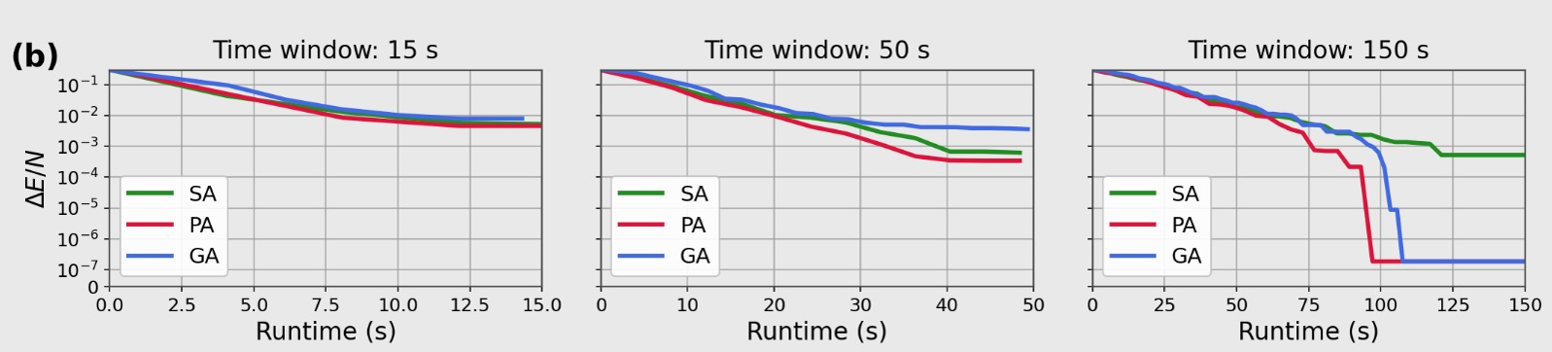
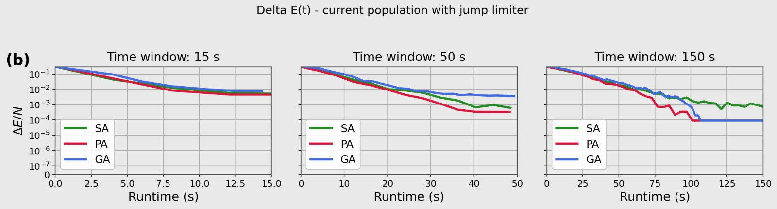
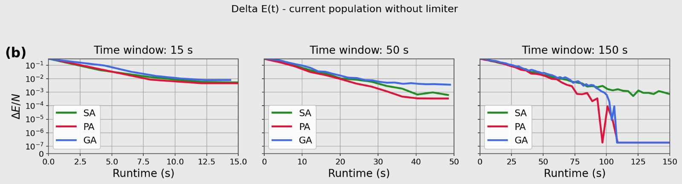
ΔE / N vs runtime
OPTIMIZATION RESULTS
Three modes
Best-so-far
Jump-limited
Raw
18

Slide 20
A sampler holds temperature fixed after annealing
FIXED-T SAMPLING
Temperature protocol
Optimizer
Sampler
s* ≃ arg minₛ H(s)
equilibrium ensemble
thermalize
anneal
hold T_sample = 0.77
Fixed-T implementations
• SA / PA: local checkerboard sweeps
• GA: local, local + global, or periodic retraining
• 2000 global steps; 15 local per global
19

Slide 21
Samplers routes
FIXED-T SAMPLING
RUN_FIXED_TEMPERATURE_SAMPLER · CORE LOOP
Routes
for step in range(1, n_samples + 1):
acc_list = []
if use_ga and sampler_mode in {
"local_global", "local_global_retrain"}:
population, acc_list = MLMC_fast(
model=model, data=population, beta=beta,
N=N, J=J, num_steps=sampler_global_steps)
for _ in range(sampler_local_steps):
population = montecarlo_step(
population, J, T_sample, even_indices, odd_indices)
if sampler_retrain_every is not None and step % sampler_retrain_every == 0:
model = retrain_made(
model, population, epochs=sampler_retrain_epochs,
batch_size=batch_size)
energies = observ.update(population, T=T_sample)
q_mean, q_std = _population_two_half_overlap(population)
trace["acc_rate"].append(_mean_acceptance(acc_list))
SA / PA
local only
GA frozen
local + global
GA retrained
local + global
+ retrain every k
20

Slide 22
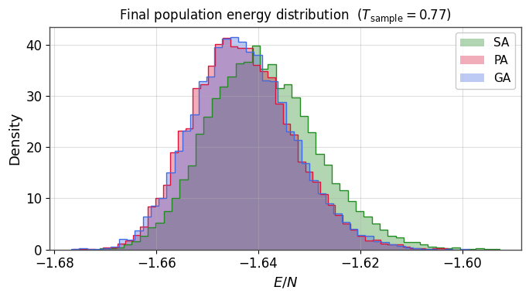
Energy distribution
FIXED-T SAMPLING
T_sample = 0.77
PA ≈ GA
Their histograms almost overlap, including the low-energy side.
SA is shifted
The SA population is broader and displaced toward higher energy.
21

Slide 23
Overlap
FIXED-T SAMPLING
q_ab = (1/N) Σᵢ sᵢᵃ sᵢᵇ ∈ [−1,1]
−1
0
+1
_POPULATION_TWO_HALF_OVERLAP
def _population_two_half_overlap(population):
half = population.shape[0] // 2
first = population[:half]
second = population[half:2 * half]
q = (first * second).sum(dim=1)
q = q / population.shape[1]
return (float(q.mean().item()),
float(q.std().item()))
global spin flip
uncorrelated
identical
Same J · independent replicas
Pair the two halves of the population
replicas 1…M/2
replicas M/2+1…M
22

Slide 24
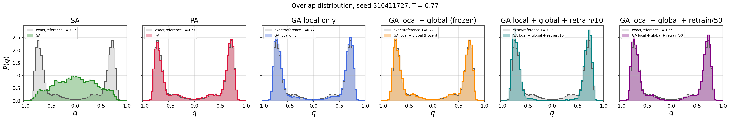
Overlap results
FIXED-T SAMPLING
23

Slide 25
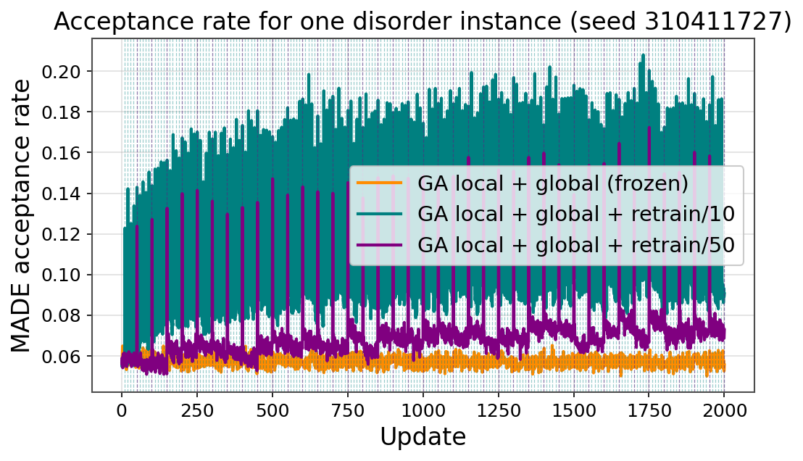
Acceptance rate
FIXED-T SAMPLING
24

Slide 26
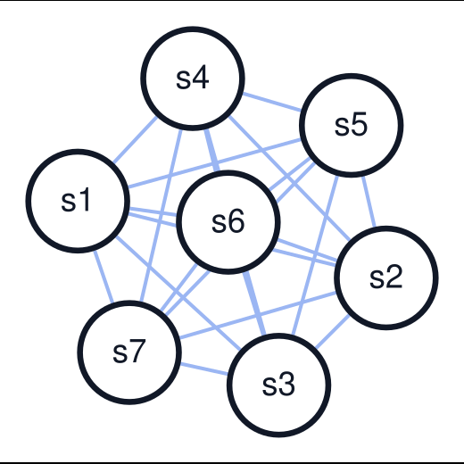
SK model (Sherrington-Kirkpatrick) & Monte Carlo update
SK MODEL
MONTECARLO_STEP_SK · SEQUENTIAL METROPOLIS
Hₛₖ(s) = −∑ᵢ<ⱼ Jᵢⱼ sᵢ sⱼ
def montecarlo_step_sk(population, J, T):
population = population.clone()
pop_size, N = population.shape
device = population.device
local_fields = population @ J.T
for i in torch.randperm(N, device=device):
old_spin = population[:, i].clone()
delta_E = 2.0 * old_spin * local_fields[:, i]
log_u = torch.log(torch.rand(pop_size, device=device))
accepted = log_u < (-delta_E / T)
population[accepted, i] *= -1
if accepted.any():
local_fields[accepted] -= (
2.0 * old_spin[accepted, None]
* J[:, i][None, :])
return population
SK: mean field
EA: lattice
N − 1 neighbours
6 neighbours
25

Slide 27
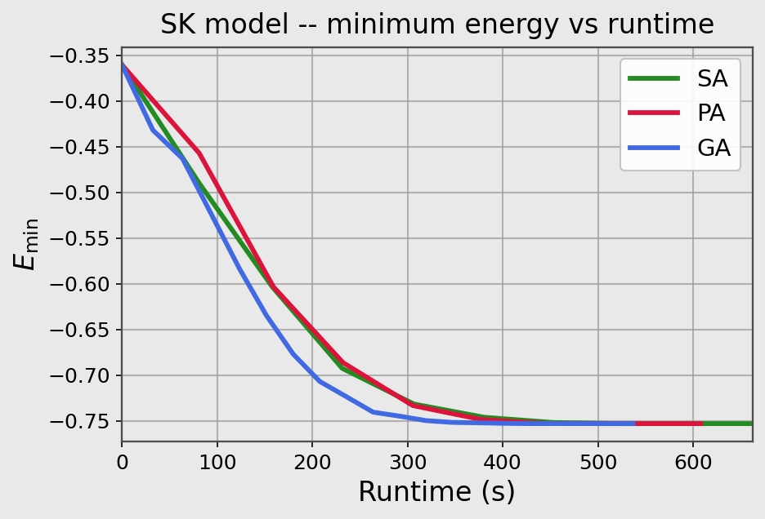
SK model: results
SK MODEL
N = 512 · one disorder instance
Population = 4096
26

