Slide 1

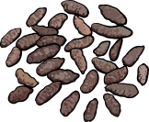
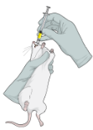
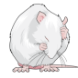
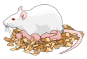
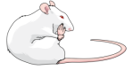
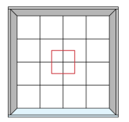

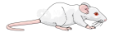


PND90
PND132
F0
Exposure: gestation + lactation
(Dams)
CN Mineral Oil
VitA 7500 RAE/kg/day
MeHg 0.5mg/kg/day
VitA + MeHg Both
GD0
PND21
PND90
PND365
F1
Adulthood
Colon
Microbiome
GD0
PND21
PND365
Serum
F2
Open Field
Adulthood
Breeding of unrelated animals
within each group
Plus Maze
Liver

