Slide 1
Improving Generalization of Deepfake Detectors by Imposing Gradient Regularization
Group Members:
Francesco Barbetta – 1991907
Marco Antonio Iossa – 2001300
Flavio Ialongo – 2000932
Computer Vision – A.A. 2024/2025

Slide 2
Outline
Introduction to the Deepfake Problem
Related Works
Proposed Methods
Dataset
Experimental Setup
Evaluation Metrics and Results
Conclusions and Future Work
References

Slide 3
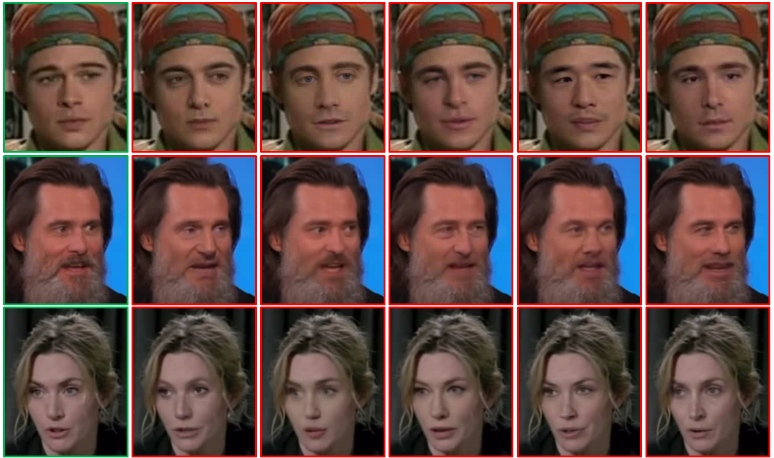
What are Deepfakes?
Deepfakes are synthetic media generated by AI models (e.g., GANs), capable of producing realistic faces and expressions.
These videos are often indistinguishable from real ones to the human eye.

Slide 4
Why is Detection important?
📰
Disinformation
Fake videos spread misinformation, manipulate public opinion, and undermine democracy.
🎭
Defamation
Famous people can be falsely shown in compromising contexts, damaging their image.
🔒
Trust
Reliable detectors protect media integrity and public confidence in digital content.

Slide 5
Related Works
CNN-based Deepfake Detection
Use convolutional architectures trained on visual features (e.g., EfficientNet) [2, 3]
Performance drops under perturbations
Attack Techniques:
Methods to subtly alter images and fool the model [5, 6, 7]
Robustness Techniques
Adversarial Training: [6]
Gradient Regularization: enhances generalization and smoothness [1]
Evaluation protocols highlight robustness under attack [4]

Slide 6
Proposed Methods 1
In order to improve the robustness and generalization of our detector, we employ two complementary regularization techniques:
Perturbation Injection Module (PIM) – Simulates distribution shifts by perturbing shallow feature statistics through a regularization term added to the loss function.
Adversarial Training – Improves resistance to input perturbations using adversarial examples in the training step
These strategies are tested independently and in combination.

Slide 7
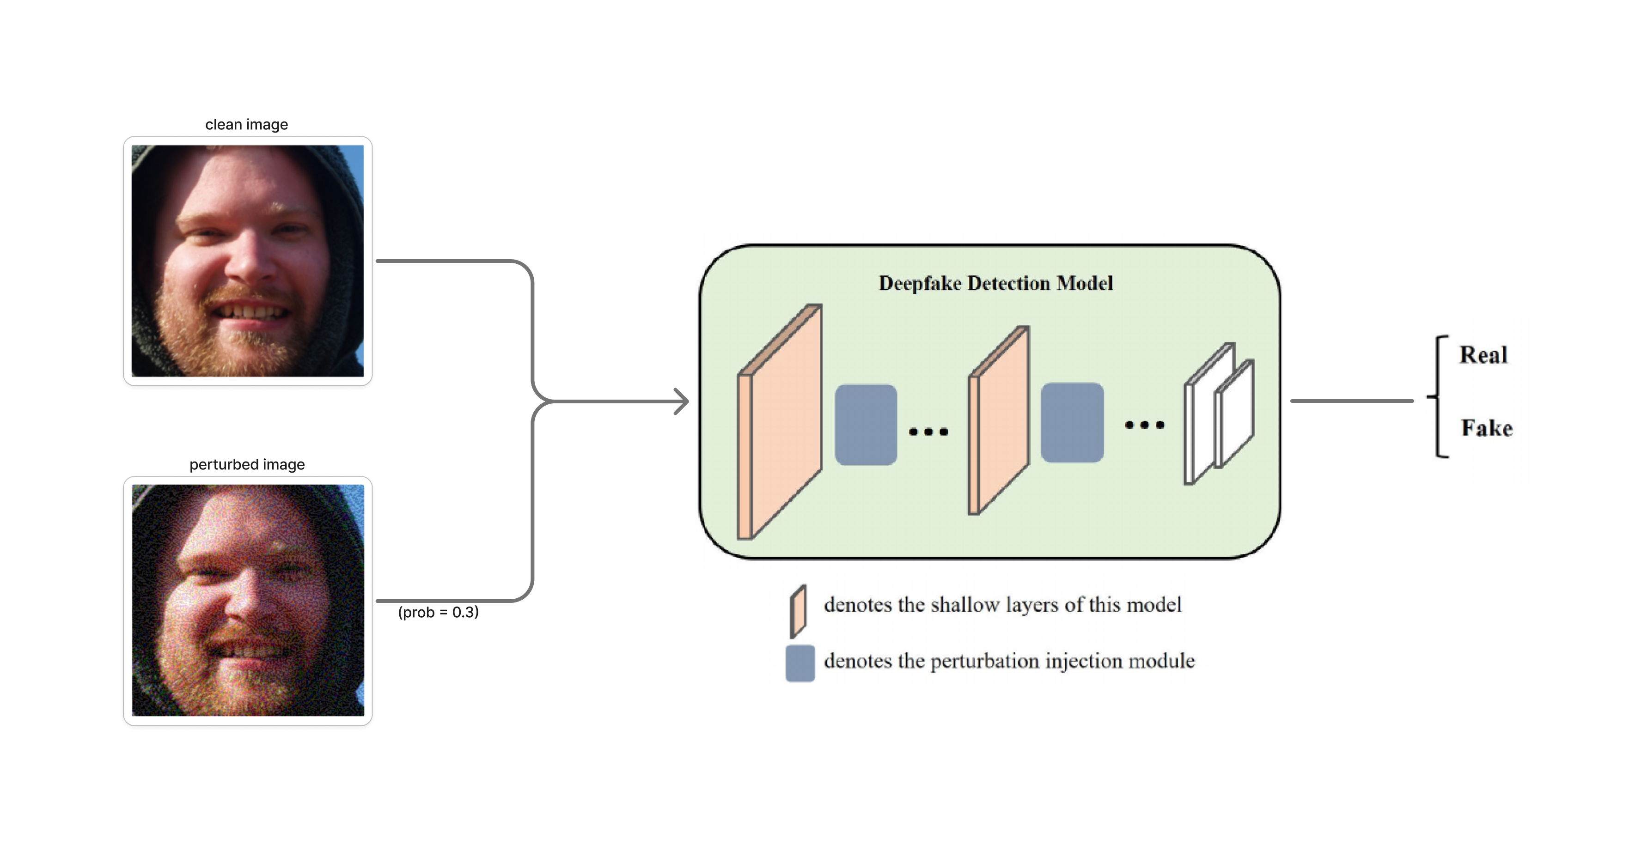
Proposed Methods 2

Slide 8
Adversarial Attacks
To evaluate model robustness, we tested all configurations against four white-box adversarial attacks:
FGSM (Fast Gradient Sign Method) Adds a single-step perturbation in the direction of the gradient sign.
I-FGSM (Iterative FGSM) Applies FGSM multiple times with small steps and clipping at each iteration.
DeepFool Optimization-based attack that computes the minimal perturbation required to change the model’s prediction.
PGD (Projected Gradient Descent) Strongest first-order adversary; iteratively adds perturbations and projects into an ϵ-ball.

Slide 9
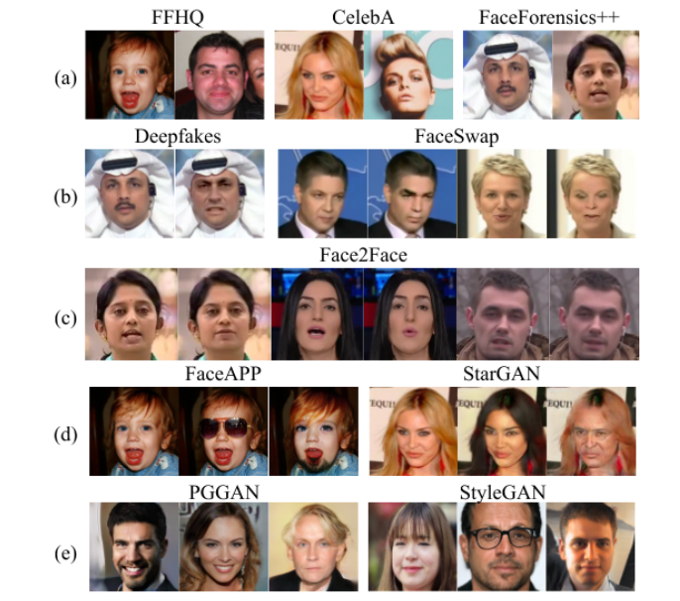
DFFD: Diverse Fake Face Dataset

Slide 10
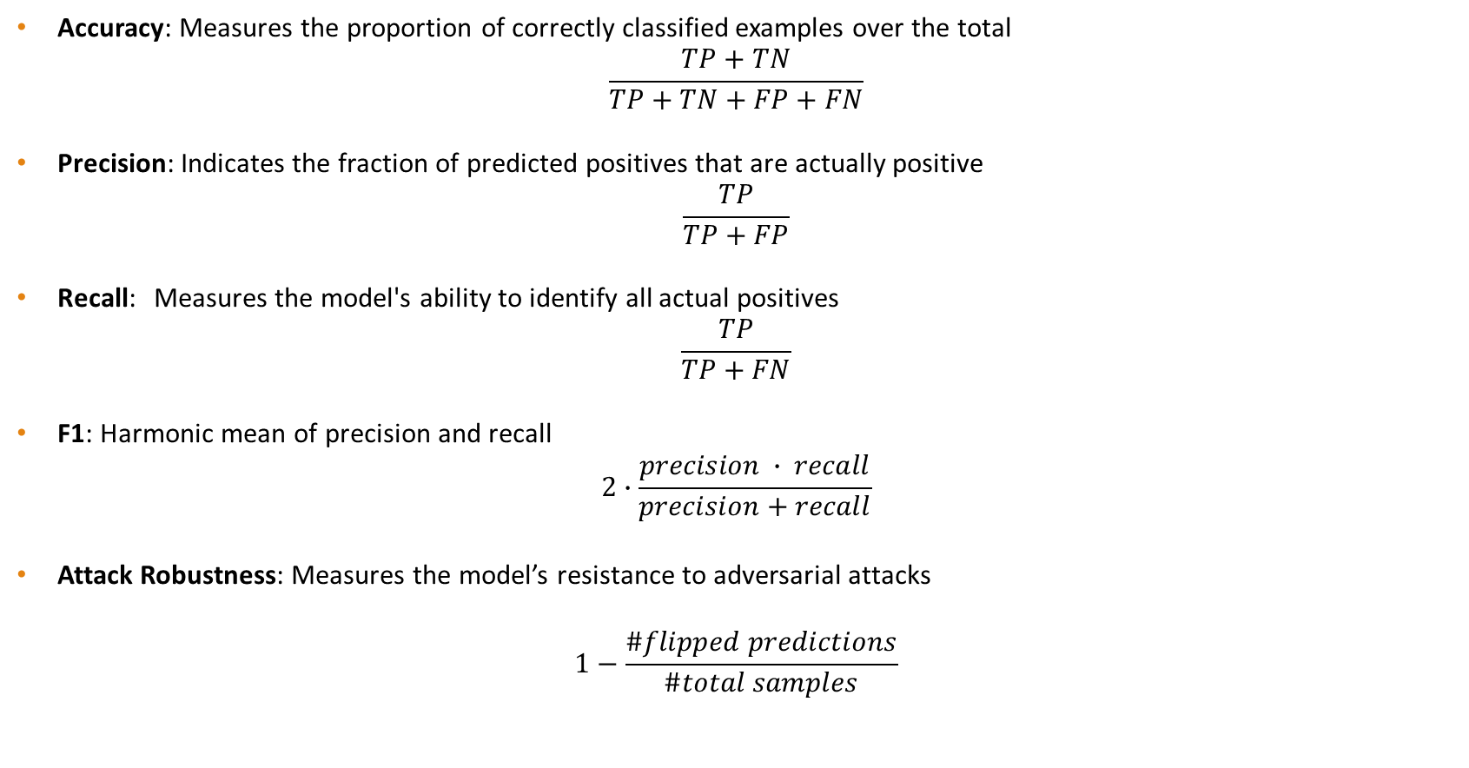
Evaluation Metrics
Accuracy: Measures the proportion of correctly classified examples over the total
$$\frac{TP+TN}{TP+TN+FP+FN}$$
Precision: Indicates the fraction of predicted positives that are actually positive
$$\frac{TP}{TP+FP}$$
Recall: Measures the model's ability to identify all actual positives
$$\frac{TP}{TP+FN}$$
F1: Harmonic mean of precision and recall
$$2∙\frac{precision ∙ recall}{precision+recall}$$
Attack Robustness: Measures the model’s resistance to adversarial attacks
$$1−\frac{\#flipped predictions}{\#total samples}$$
Attack success rate

Slide 11
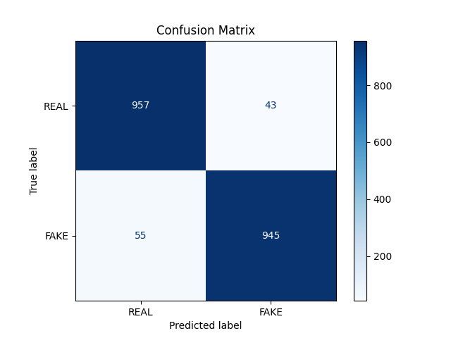
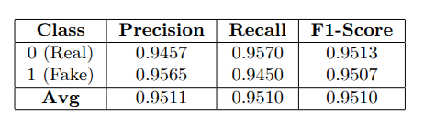
Baseline Evaluation
We first fine-tune the EfficientNet-B0 baseline model on our dataset to create a reference point.
The results demonstrate that the model achieves high performances on clean data.

Slide 12
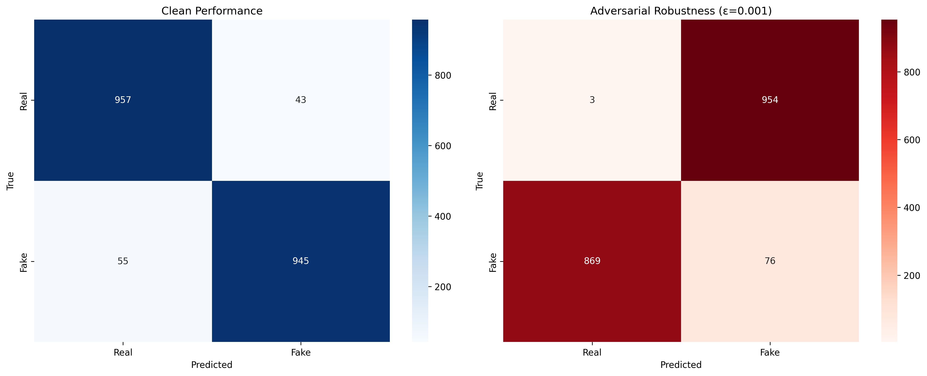
Adversarially Attacked Model Evaluation
Despite achieving high accuracy on clean data, the model’s performance drops significantly when subjected to even small perturbations, revealing its lack of robustness to adversarial inputs.
This highlights the need for targeted robustness strategies to ensure reliability in real-world scenarios.

Slide 13
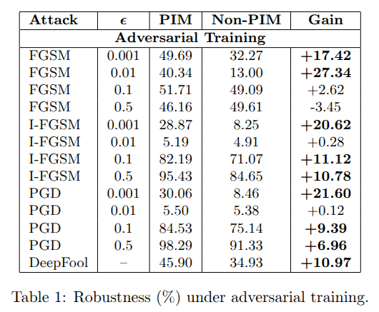
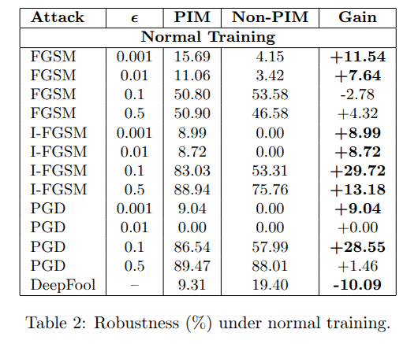
Robustness Evaluation
Under adversarial training, PIM improves robust accuracy consistently across most attacks.
These results show that our methods make the model much more resistant to adversarial attacks, helping it perform more reliably in real-world situations.

Slide 14
Conclusion and Future Work
Our findings highlight that the Perturbation Injection Module (PIM), when combined with adversarial training, significantly improves the robustness of deepfake detection against a wide range of adversarial attacks.
Future research could focus on extending our evaluation to enclude a wider range of deepfake generation techniques and more challenging datasets. It would also be valuable to investigate whether combining PIM and adversarial training with other defense strategies can further enhance robustness and generalization.

Slide 15
Bibliography
[1] Guan, S., Li, Z., Zhou, Y., & Liu, X. (2024). Improving Generalization of Deepfake Detectors by Imposing Gradient Regularization. IEEE Transactions on Information Forensics and Security (TIFS).
[2] Tan, M., & Le, Q. V. (2019). EfficientNet: Rethinking Model Scaling for Convolutional Neural Networks. In Proceedings of the 36th International Conference on Machine Learning (ICML).
[3] Dang, H., Liu, F., Stehouwer, J., Liu, X., & Jain, A. K. (2020). On the Detection of Digital Face Manipulation. In Proceedings of the IEEE/CVF Conference on Computer Vision and Pattern Recognition (CVPR).
[4] Abbasi, M., Kumar, A., & Singh, R. (2025). Comprehensive Evaluation of Deepfake Detection Models. Applied Sciences.
[5] Goodfellow, I. J., Shlens, J., & Szegedy, C. (2015). Explaining and Harnessing Adversarial Examples. In International Conference on Learning Representations (ICLR).
[6] Madry, A., Makelov, A., Schmidt, L., Tsipras, D., & Vladu, A. (2018). Towards Deep Learning Models Resistant to Adversarial Attacks. In International Conference on Learning Representations (ICLR).
[7] Moosavi-Dezfooli, S.-M., Fawzi, A., & Frossard, P. (2016). DeepFool: A Simple and Accurate Method to Fool Deep Neural Networks. In Proceedings of the IEEE Conference on Computer Vision and Pattern Recognition (CVPR).

