Slide 1
Cosmos Fiware
Jairson Rodrigues – jbr@cin.ufpe.br
Big Data Analysis

Slide 2
Cosmos Fiware
https://cosmos.lab.fiware.org
Plataforma para Big Data Analysis com o intuito de evitar que cientistas de dados tenham que provisionar sua própria infraestrutura em cluster.
Último update da documentação: 26/Novembro/2015
Composição
Apache Hadoop (nativo)
Apache Spark (plugin)
Apache Flink (em estudo)

Slide 3

Contexto
IoT & Big Data, um casamento feito nas Nuvens

Slide 4
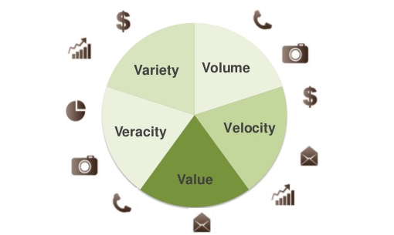
Big Data

Slide 5
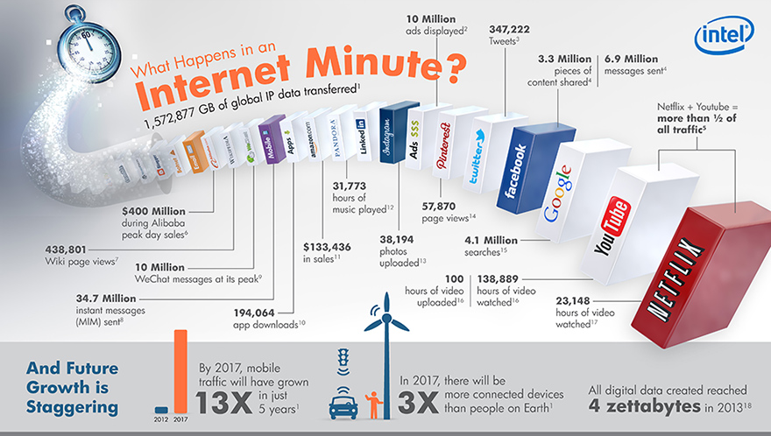
Quão Big é Big Data?

Slide 6
A Era do Yottabyte
1 Bit = Dígito Binário (0 ou 1)
8 Bits = 1 Byte
1024 Bytes = 1 Kilobyte
1024 Kilobytes = 1 Megabyte
1024 Megabytes = 1 Gigabyte
1024 Gigabytes = 1 Terabyte
1024 Terabytes = 1 Petabyte
1024 Petabytes = 1 Exabyte
1024 Exabytes = 1 Zettabyte
1024 Zettabytes = 1 Yottabyte
1024 Yottabytes = 1 Brontobyte
1024 Brontobytes = 1 Geopbyte

Slide 7
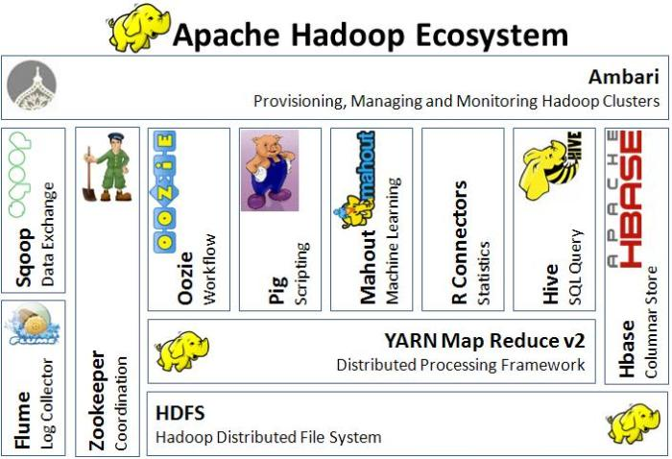
Como Manipular Big Data?

Slide 8
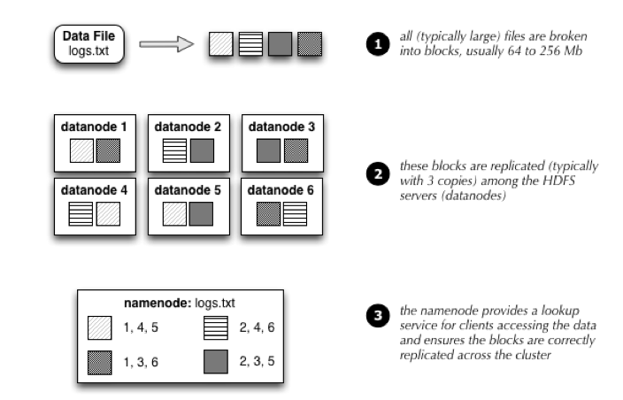
E por trás de tudo
8
Hadoop Distributed Filesystem (HDFS)
CCMP0081 - Sistemas Distribuídos II - Engenharia da Computação - Prof. Jairson Rodrigues

Slide 9
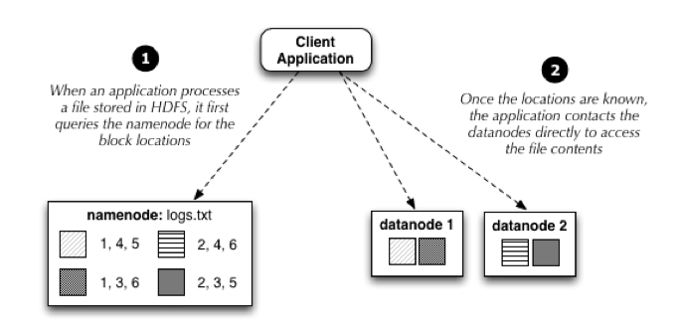
E por trás de tudo
9
Hadoop Distributed Filesystem (HDFS)
CCMP0081 - Sistemas Distribuídos II - Engenharia da Computação - Prof. Jairson Rodrigues

Slide 10
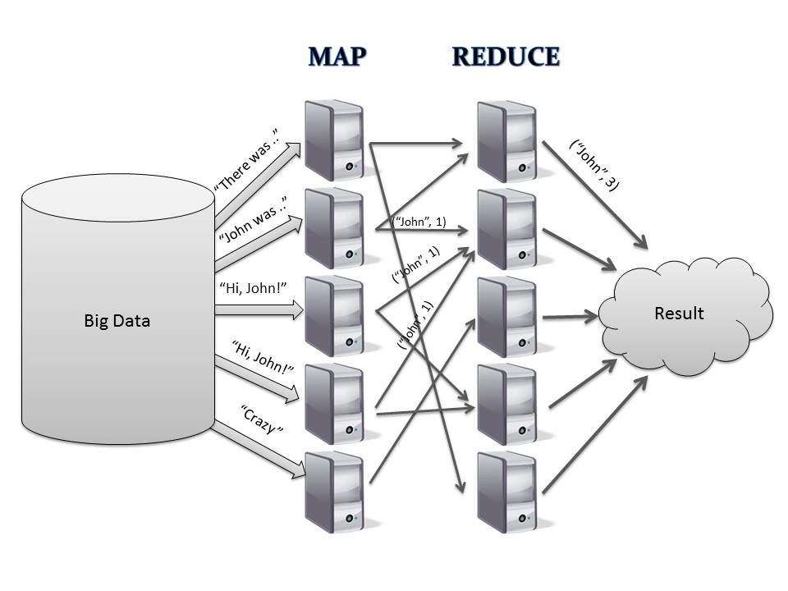
E por trás de tudo
MapReduce: simplified data processing on large clusters (by Google)

Slide 11
Cosmos Fiware
BigData Analysis Generic Enabler reference implementation (GEri)
HaaS (Hadoop as a Service)
OpenStack Sahara
Cosmos GUI (REST API)
Cygnus (Orion Context Broker)

Slide 12
Cosmos Fiware
Go directly to the FIWARE Lab global instance of Cosmos, there you will find an already deployed infrastructure ready to be used through the different APIs.

Slide 13
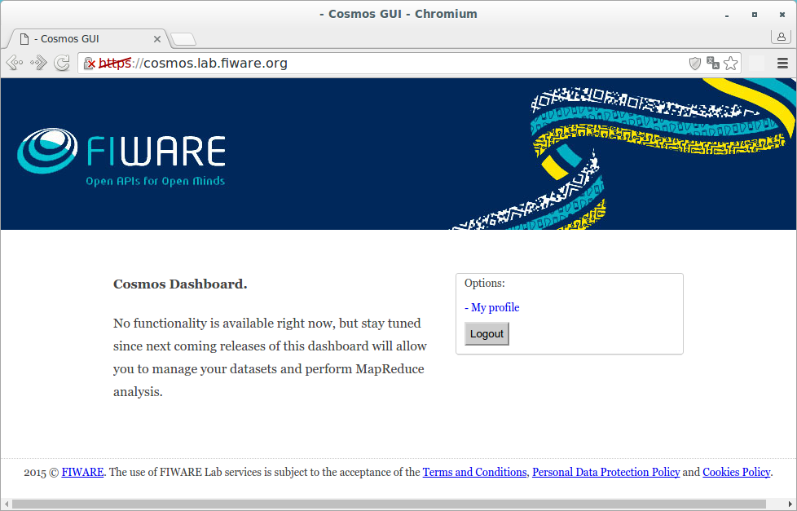
Cosmos Fiware

Slide 14
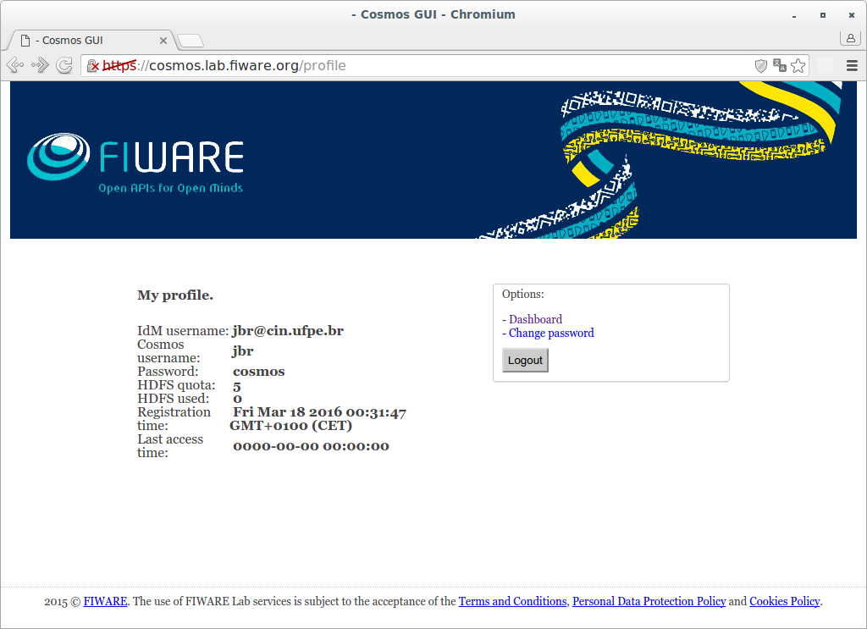
Cosmos Fiware

Slide 15
Alternativas (Nova versao do Cosmos)
storage.cosmos.lab.fiware.org
Service Nodes: 1
Namenodes: 2
Datanodes: 8
Capacidade de armazenamento: 52.5 TB
(17.5 TB se considerado um fator de replicaçao = 3)
computing.cosmos.lab.fiware.org
Service Nodes: 1
Namenodes: 2
Datanodes: 11
Liberado mediante contato e posterior aprovacao

Slide 16
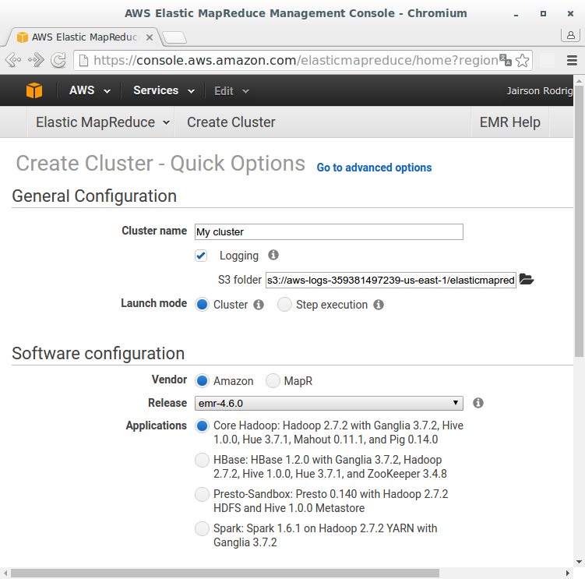
Alternativas (Amazon EMR)

Slide 17
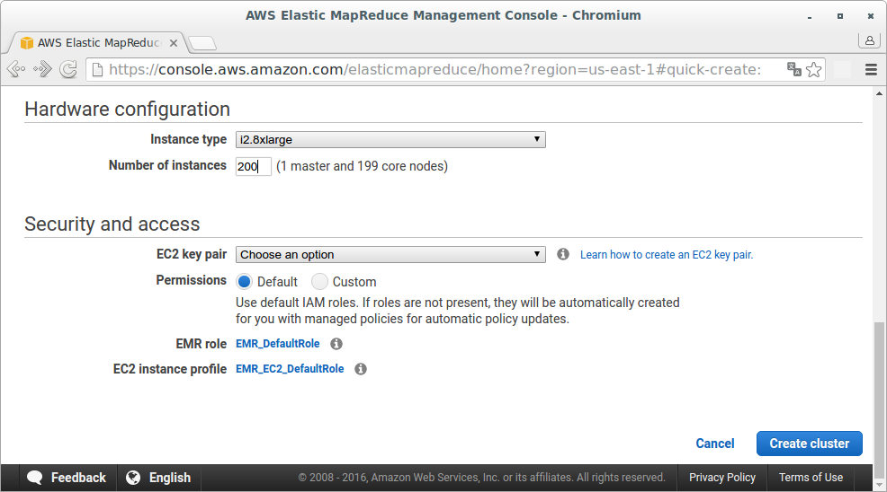
Alternativas (Amazon EMR)

Slide 18
Alternativas
Google Cloud
cloud.google.com/hadoop
Cloudera Live Demo
http://www.cloudera.com/get-started/cloudera-live.html
HDP
hortonworks.com/products/hdp/
Etc etc etc

Slide 19
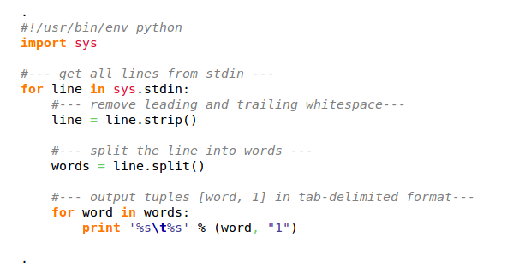
Demo – Código Map (Python)

Slide 20
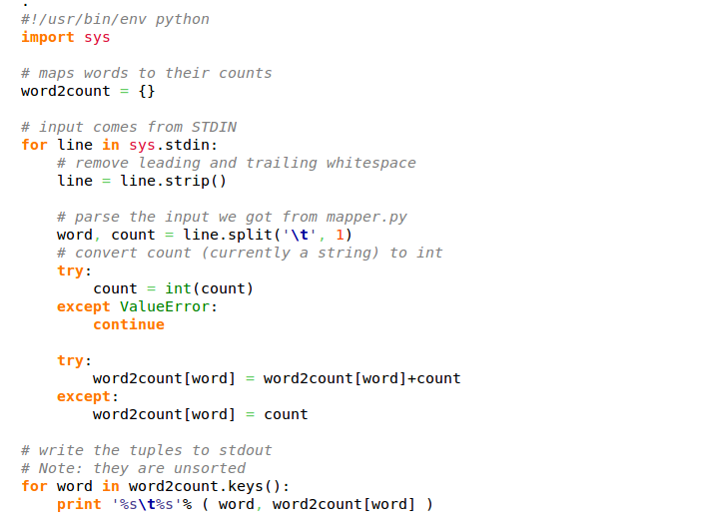
Demo – Código Reduce (Python)

Slide 21
Demo 1 – Cosmos Command Line
#login no Cosmos
ssh jbr@cosmos.lab.fi-ware.org
# copia arquivos locais do master node para o hdfs
hadoop fs -mkdir /user/jbr/input
hadoop fs -mkdir /user/jbr/inputhive
hadoop fs -put structured_data.txt /user/jbr/inputhive
hadoop fs -put unstructured_data.txt /user/jbr/input
hadoop fs -put biketrips.csv /user/jbr/input
hadoop fs -put status.csv /user/jbr/input
hadoop fs -ls /user/jbr/input
https://drive.google.com/a/cin.ufpe.br/folderview?id=0B_pU7synSV00NUNucUFwdkxZdzA&usp=sharing

Slide 22
Demo 1 – Cosmos Command Line
# inicia aplicativo HIVE
# cria schema a partir de dados brutos
Hive
create external table jbr_star_wars (name string, planet string, profession string, age int) row format delimited fields terminated by ',' location '/user/jbr/inputhive/';
select * from jbr_star_wars;
https://drive.google.com/a/cin.ufpe.br/folderview?id=0B_pU7synSV00NUNucUFwdkxZdzA&usp=sharing

Slide 23
Demo 1 – Cosmos Command Line
# processa script java para contagem de palavras em map-reduce
# arquivo 1: 55 bytes
hadoop jar /usr/lib/hadoop-0.20/hadoop-examples.jar wordcount /user/jbr/input/unstructured_data.txt /user/jbr/output1/
hadoop fs -getmerge /user/jbr/output1 /home/jbr/count_result1.txt; cat count_result1.txt
https://drive.google.com/a/cin.ufpe.br/folderview?id=0B_pU7synSV00NUNucUFwdkxZdzA&usp=sharing

Slide 24
Demo 1 – Cosmos Command Line
# arquivo 2: 16,42 Mb
hadoop jar /usr/lib/hadoop-0.20/hadoop-examples.jar wordcount /user/jbr/input/biketrips.csv /user/jbr/output2/
hadoop fs -getmerge /user/jbr/output2 /home/jbr/count_result2.txt; cat count_result2.txt | more
# arquivo 3: 593,5 Mb
hadoop jar /usr/lib/hadoop-0.20/hadoop-examples.jar wordcount /user/jbr/input/status.csv /user/jbr/output3/
hadoop fs -getmerge /user/jbr/output3 /home/jbr/count_result3.txt; cat count_result3.txt | more
https://drive.google.com/a/cin.ufpe.br/folderview?id=0B_pU7synSV00NUNucUFwdkxZdzA&usp=sharing

Slide 25
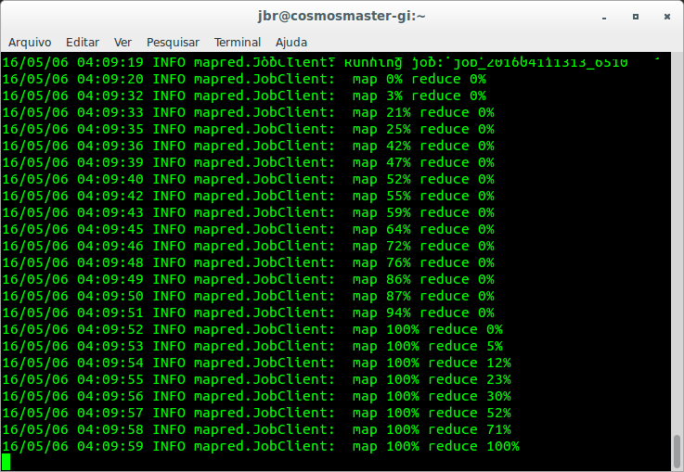
Demo 1 – Cosmos Command Line

Slide 26
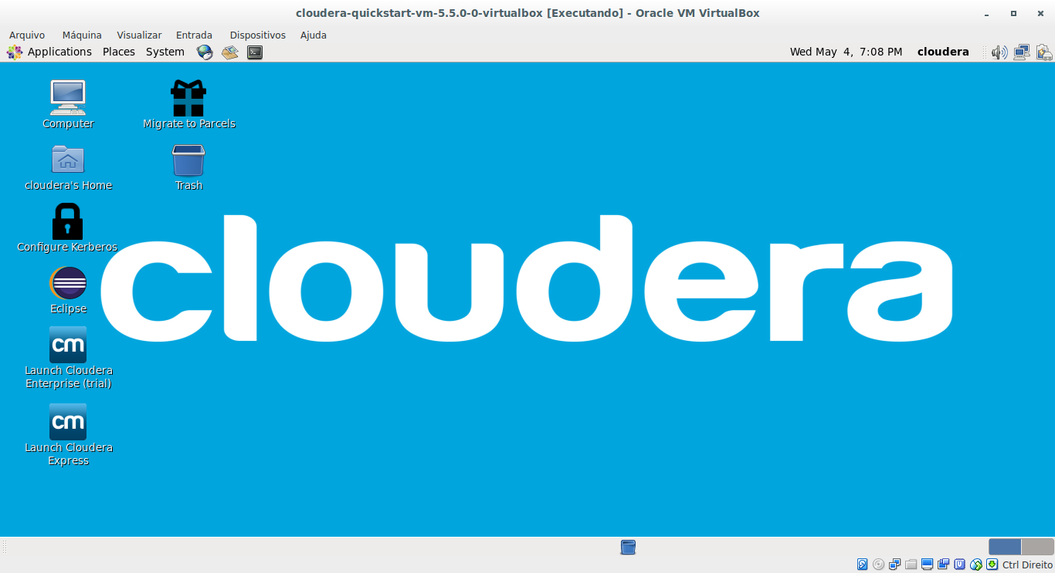
Demo

