Slide 1
Second law of Thermodynamics
A gas expands to fill the available volume.
A hot body cools to the temperature of its surroundings.
A chemical reaction runs in one direction rather than another.
The direction of change that does not require work to be done to bring the change about is called spontaneous direction of change.
Internal energy lets us access whether a change is permissible. Only those changes occurs for which the internal enegy of an isolated system remains constant.

Slide 2
Is it perhaps the internal energy that tends toward minimum for a spontaneous process?
System
dU<0
dU>0
Surroundings
Perfect gas expands spontaneously into vaccum. dU=0

Slide 3
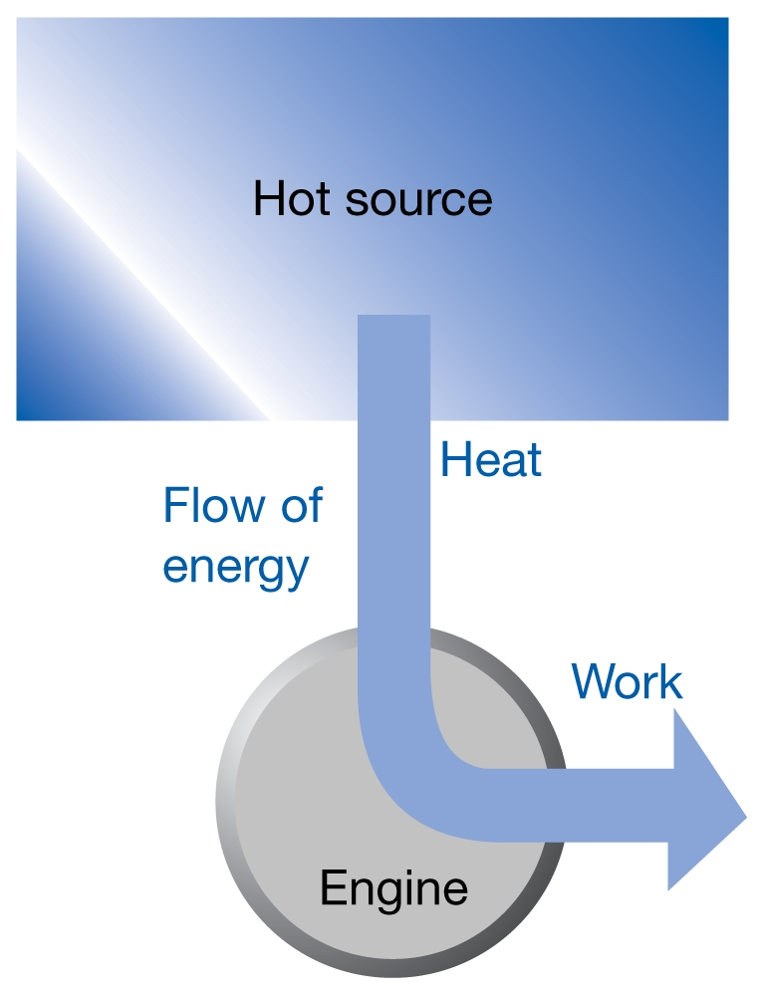
No process is possible in which the sole result is the absorption of heat from a reservoir and its complete conversion into work.

Slide 4
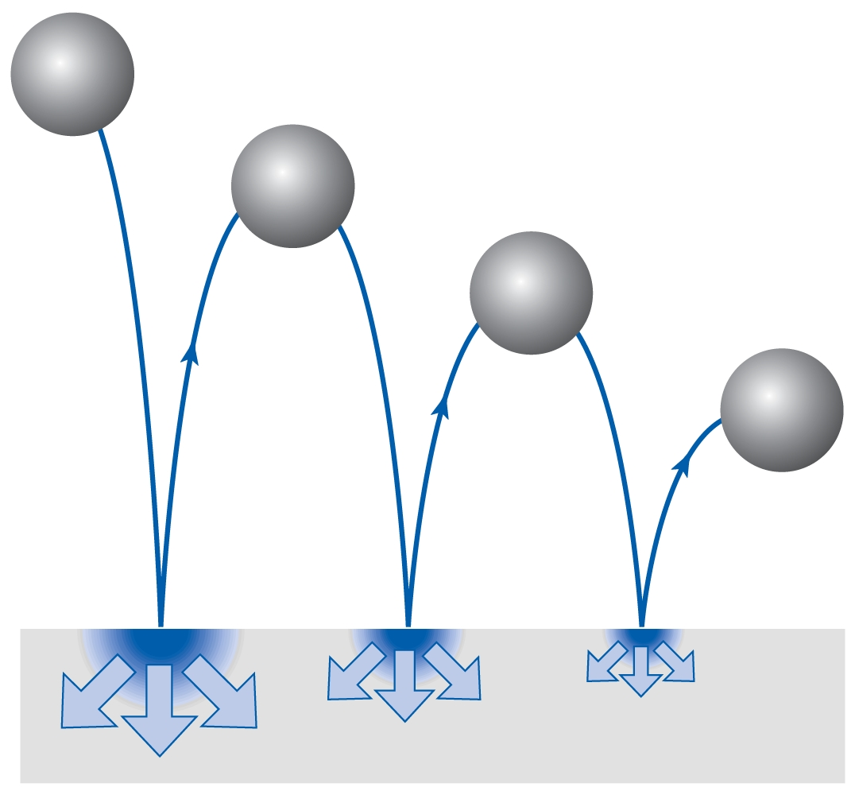
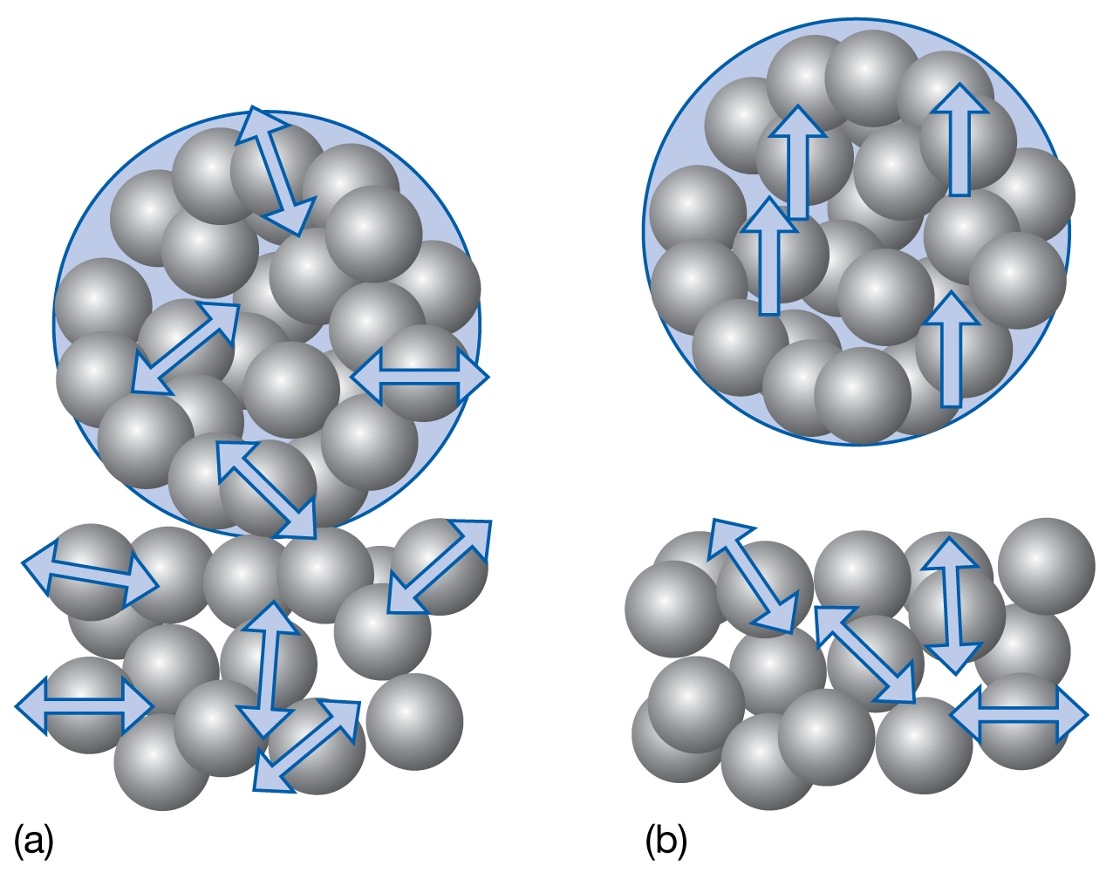
A ball bouncing on the floor
A ball resting on the warm surface.

Slide 5
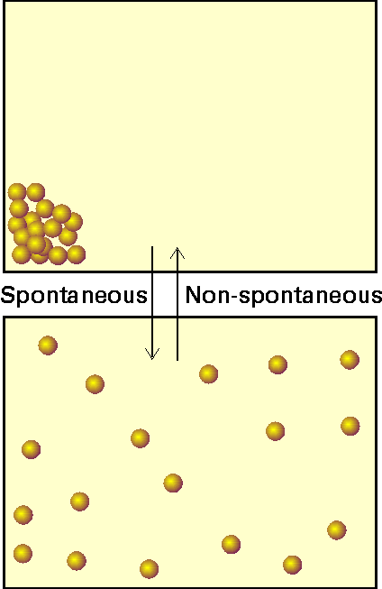
Entropy is measure of randomness/ chaosness.
Total entropy of the system and its surroundings increases in the course of a spontaneous change.

Slide 6
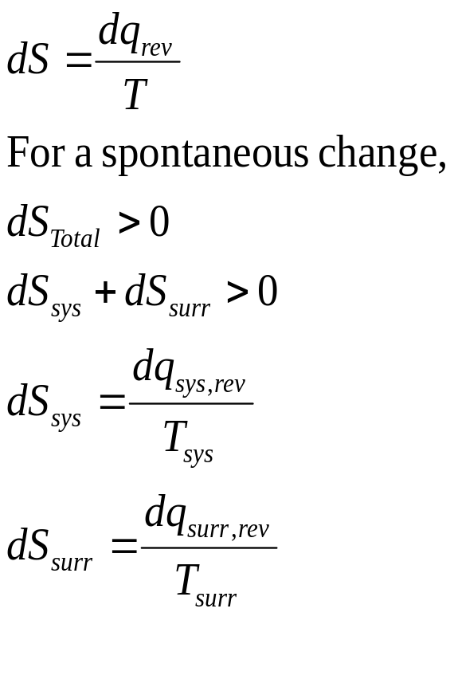
Thermodynamic definition of entropy.

Slide 7
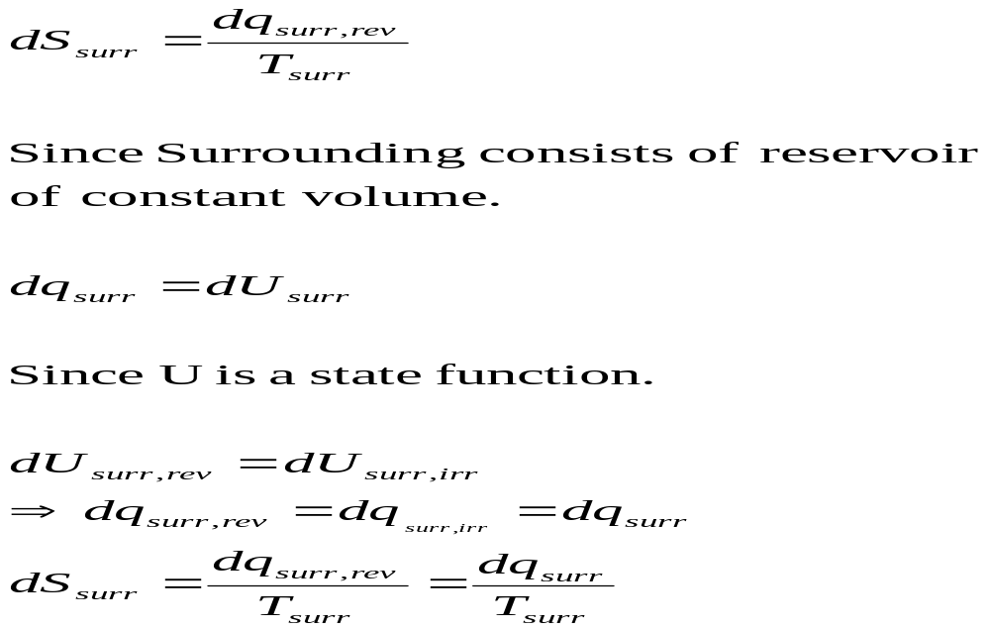

Slide 8
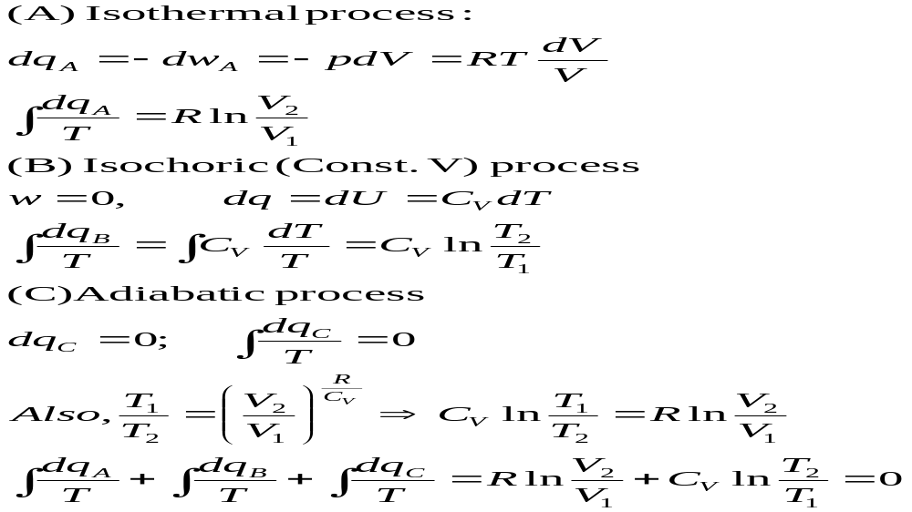
T₁,V₁,p₁
T₁,V₂,p₂
A
T
B
C
T₂,V₂,p₃
V

Slide 9
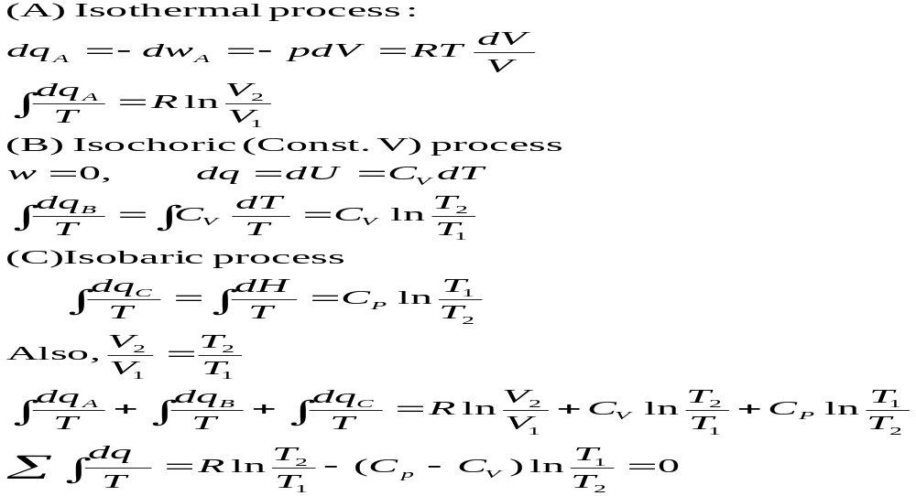
T₂,V₂,p₁
B
T
C
A
T₁,V₁,p₁
T₁,V₂,p₂
V

Slide 10
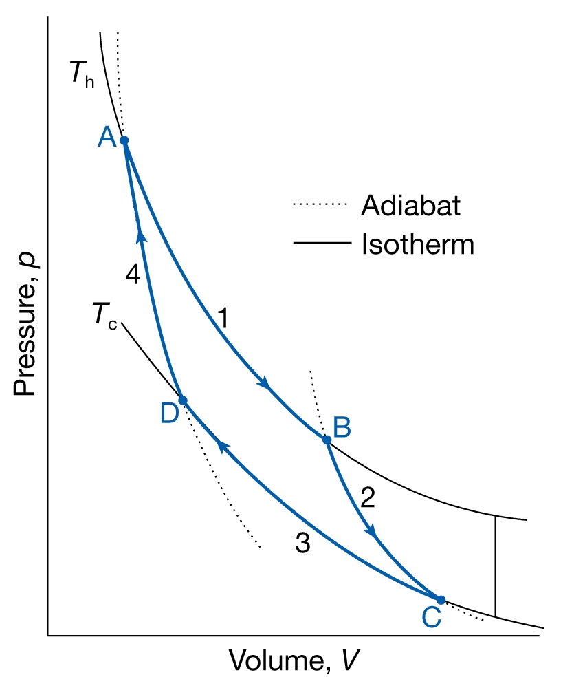
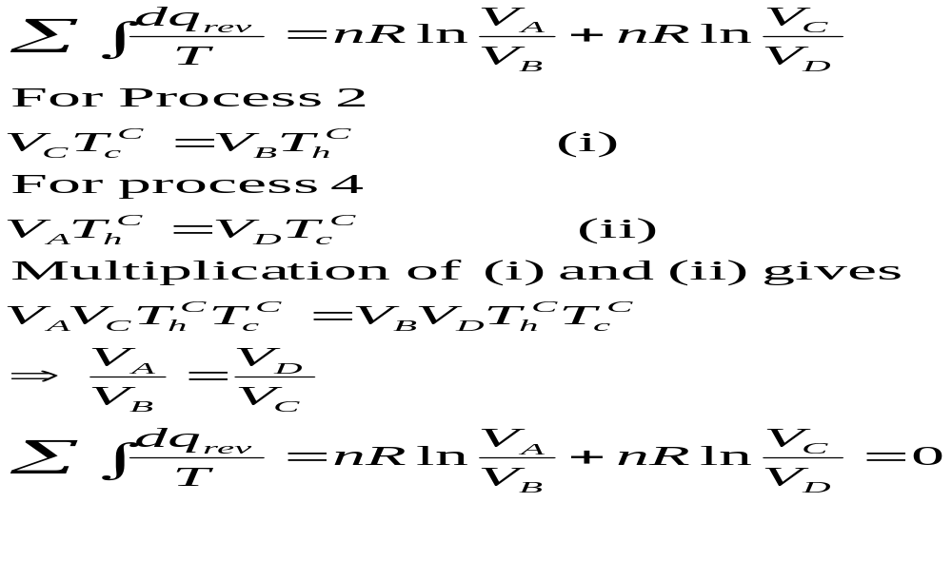

Slide 11
A
Isothermal
Constant V
B
P
Adiabatic
C
D
Constant P
V

Slide 12
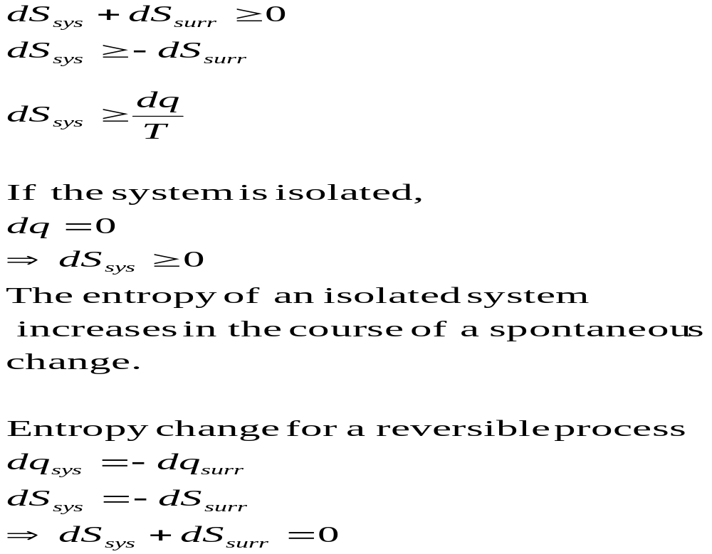
Clausius inequality theorm

Slide 13
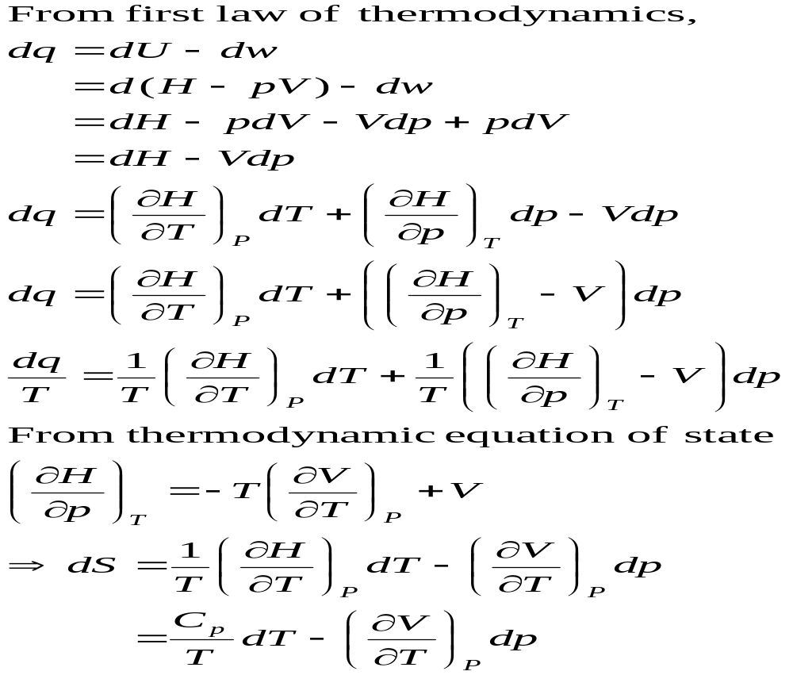

Slide 14
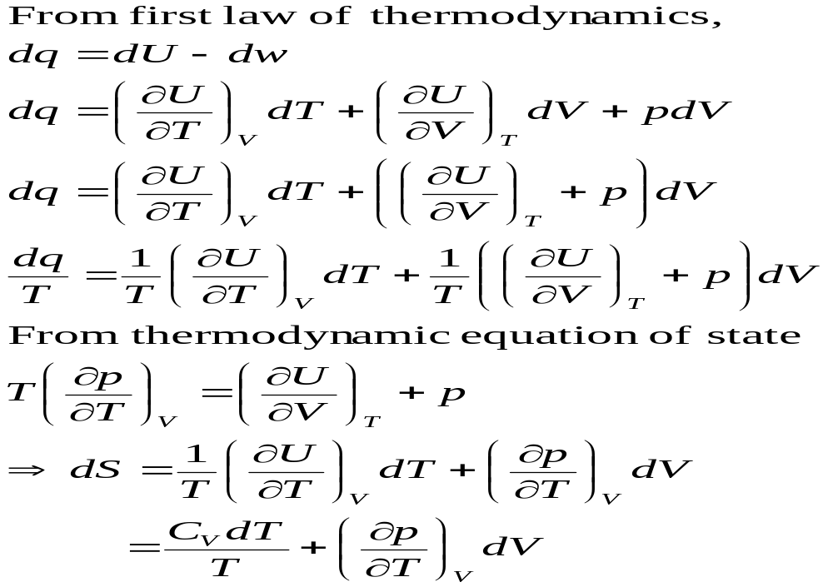

Slide 15
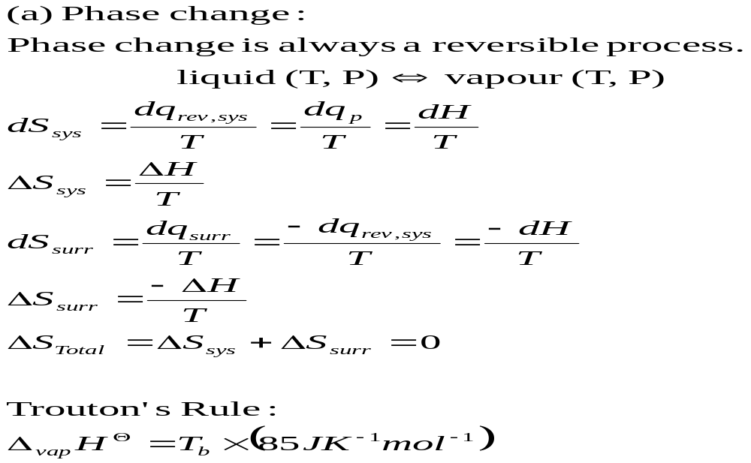
Entropy changes in a Reversible process

Slide 16
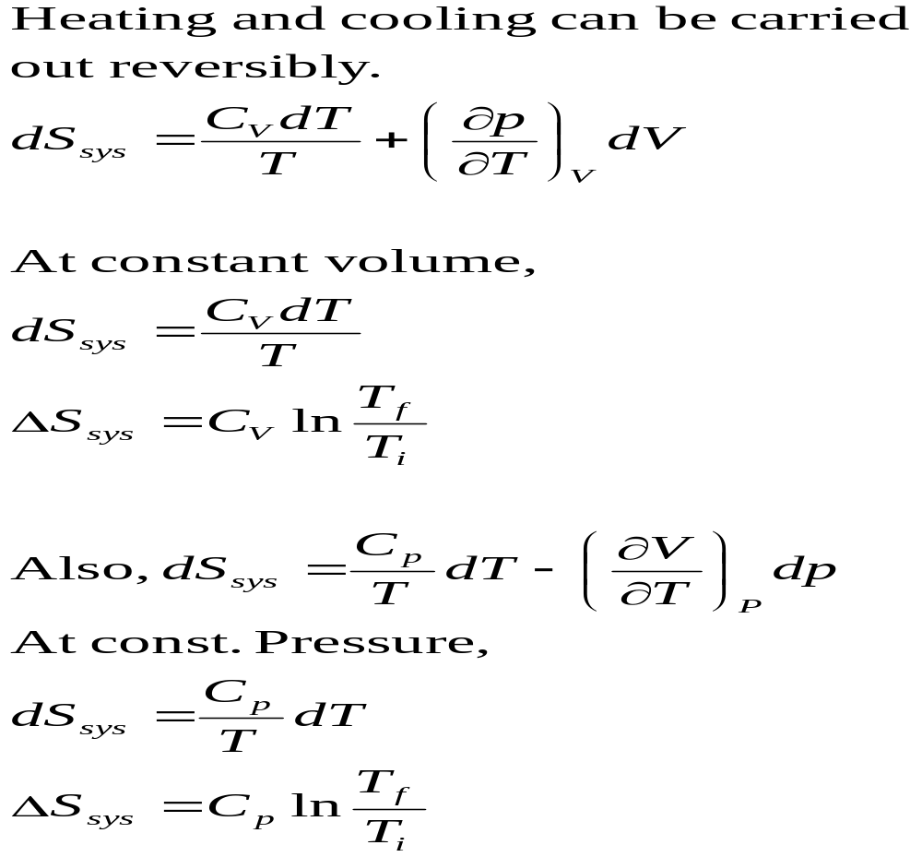
Heating or Cooling process

Slide 17
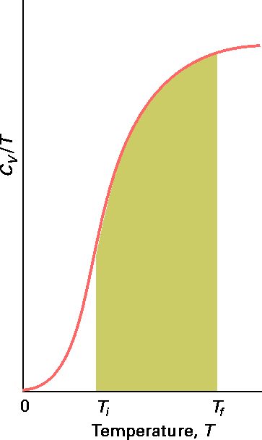
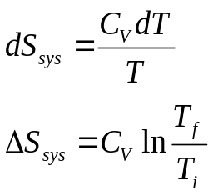
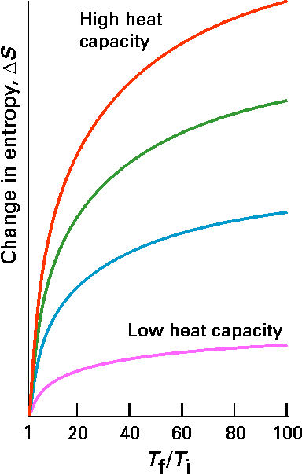

Slide 18
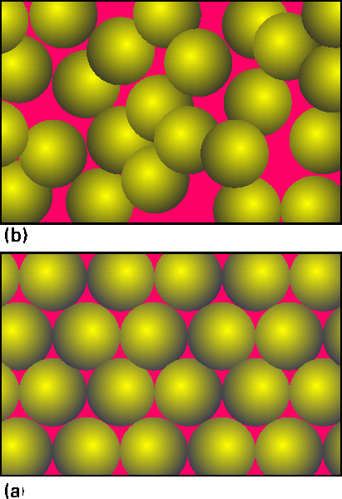

Slide 19
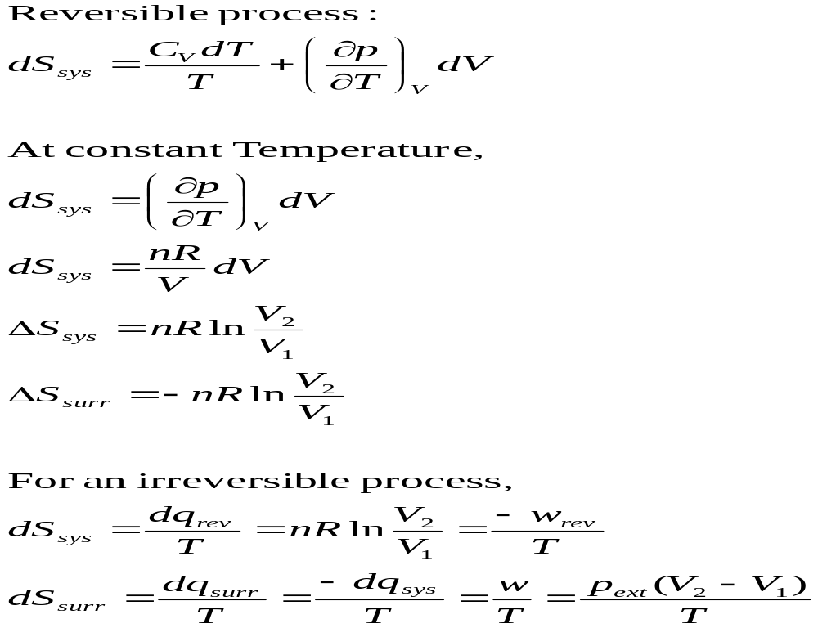
Isothermal process for an ideal gas

Slide 20
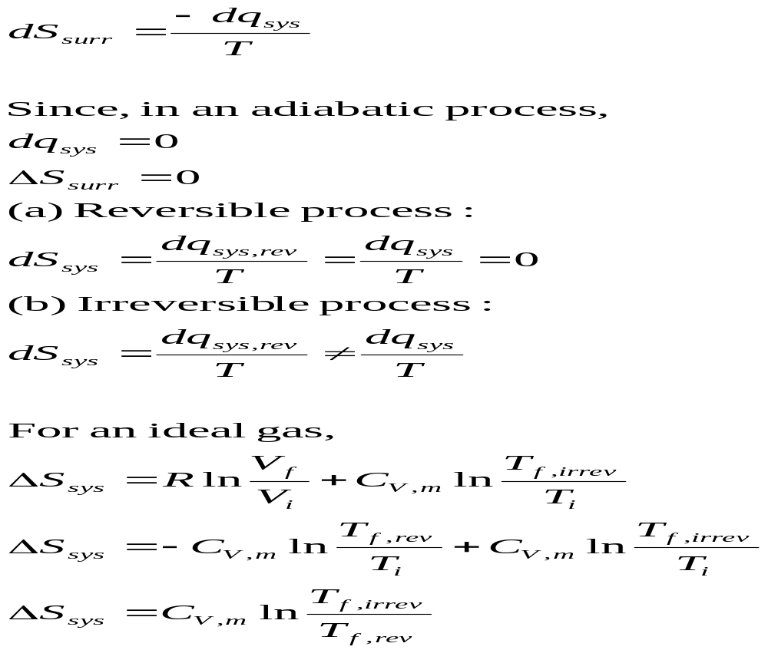
Adiabatic Processes for an ideal gas

Slide 21
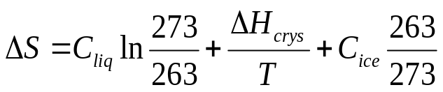
Entropy changes in irreversible Processes
To obtain the change in entropy in an irreversible process we have to calculate ΔS along a reversible path between the initial state and the final state.
Freezing of water below its freezing point
Irrev
H₂O( l , -10 °C)
H₂O( s , -10 °C)
H₂O( l , 0°C)
H₂O( s , 0 °C)

Slide 22
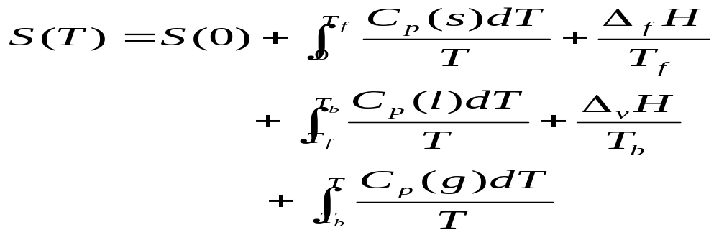
Absolute entropy of a substance
Third law of thermodynamics:
The entropy of each pure element or substance in a perfectly crystalline form is zero at absolute zero.

Slide 23
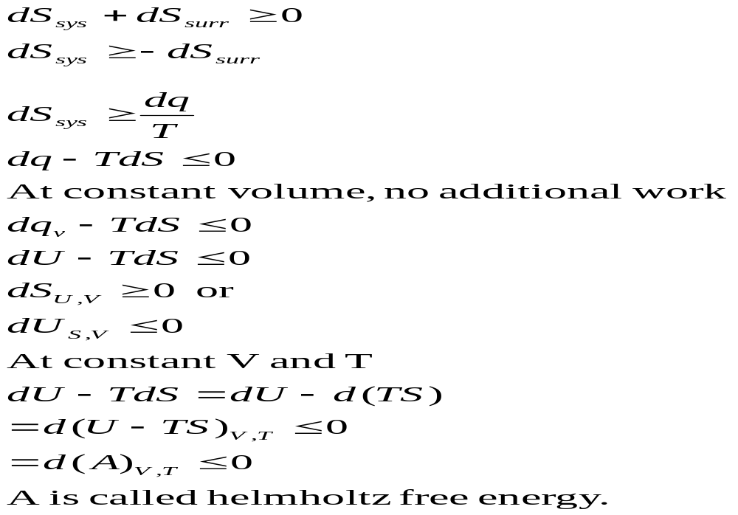
Spontaneous process

Slide 24
