Slide 1
Evidence of Quality of Textual Features on the Web 2.0
Flavio Figueiredo
flaviov@dcc.ufmg.br
Fabiano Belém | Henrique Pinto | Jussara Almeira | Marcos Gonçalves
David Fernandes | Edleno Moura | Marco Cristo
UFMG UFAM FUCAPI
BRAZIL

Slide 2
Motivation
Web 2.0
  Huge amounts of multimedia content
Information Retrieval
  Mainly focused on text (i.e. Tags)
  User generated content
  No guarantee of quality
How good are these textual features for IR?

Slide 3

User Generated Content

Slide 4
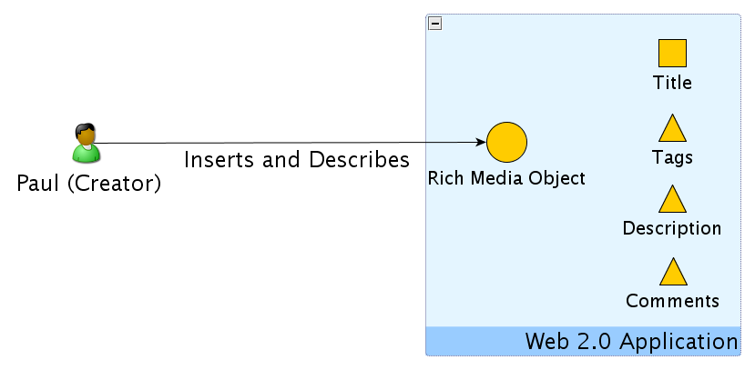
User Generated Content

Slide 5
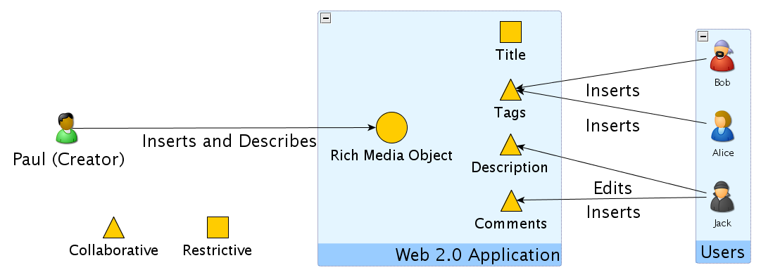
User Generated Content

Slide 6
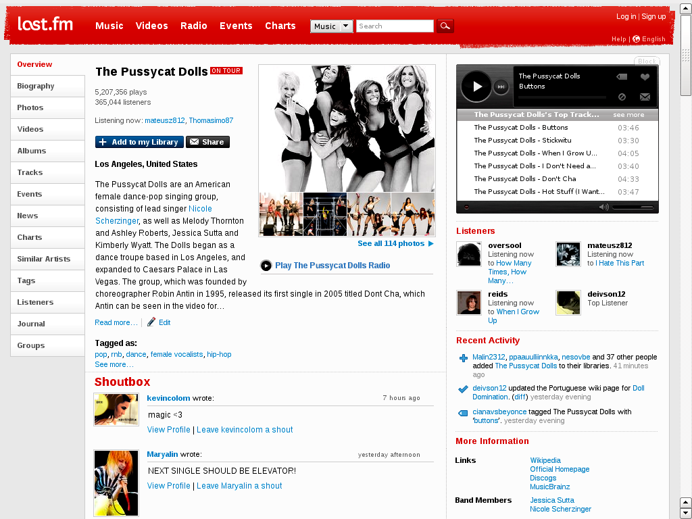
Textual Features

Slide 7
Textual Features
Multimedia Object

Slide 8
Textual Features
TITLE
Multimedia Object

Slide 9
Textual Features
TITLE
Multimedia Object
DESCRIPTION

Slide 10
Textual Features
TITLE
Multimedia Object
DESCRIPTION
TAGS

Slide 11
Textual Features
TITLE
Multimedia Object
DESCRIPTION
TAGS
COMMENTS

Slide 12
Textual Features
TITLE
Textual
Features
DESCRIPTION
TAGS
COMMENTS

Slide 13
Research Goals
Characterize evidence of quality of textual features
  Usage
  Amount of content
  Descriptive capacity
  Discriminative capacity

Slide 14
Research Goals
Characterize evidence of quality of textual features
  Usage
  Amount of content
  Descriptive capacity
  Discriminative capacity
Analyze the quality of features for object classification

Slide 15




Applications/Features
Applications
Textual Features
  Title – Tags – Descriptions – Comments

Slide 16
Data Collection
June / September / October 2008
  CiteULike - 678,614 Scientific Articles
  LastFM - 193,457 Artists
  Yahoo Video! - 227,252 Objects
  YouTube - 211,081 Objects
Object Classes
  Yahoo Video! And YouTube - Readily Available
  LastFM - AllMusic Website (~5K artists)

Slide 17
Research Goals
Characterize evidence of quality of textual features
  Usage
  Amount of content
  Descriptive capacity
  Discriminative capacity

Slide 18
Textual Feature Usage
Percentage of objects with empty features (zero terms)
 | TITLE | TAG | DESC. | COMM.
CiteULike | 0.53% | 8.26% | 51.08% | 99.96%
LastFM | 0.00% | 18.88% | 53.52% | 53.38%
YahooVid. | 0.15% | 16.00% | 1.17% | 96.88%
Youtube | 0.00% | 0.06% | 0.00% | 23.36%
Restrictive
Restrictive features more present
Tags can be absent in 16% of content
Collaborative

Slide 19
Research Goals
Characterize evidence of quality of textual features
  Usage
  Amount of content
  Descriptive capacity
  Discriminative capacity

Slide 20
Amount of Content
Vocabulary size (average number of unique stemmed terms) per feature
 | TITLE | TAG | DESC. | COMM.
CiteULike | 7.5 | 4.0 | 65.2 | 51.9
LastFM | 1.8 | 27.4 | 90.1 | 110.2
YahooVid. | 6.3 | 12.8 | 21.6 | 52.2
Youtube | 4.6 | 10.0 | 40.4 | 322.3
Restrictive
TITLE < TAG < DESC < COMMENT
Collaborative
Notes:
-Say tag = 2x title
Collaboration can increase vocabulary size

Slide 21
Amount of Content
Vocabulary size (average number of unique stemmed terms) per feature
 | TITLE | TAG | DESC. | COMM.
CiteULike | 7.5 | 4.0 | 65.2 | 51.9
LastFM | 1.8 | 27.4 | 90.1 | 110.2
YahooVid. | 6.3 | 12.8 | 21.6 | 52.2
Youtube | 4.6 | 10.0 | 40.4 | 322.3
Restrictive
Collaboration can increase vocabulary size
Collaborative
Notes:
-Say tag = 2x title

Slide 22
Research Goals
Characterize evidence of quality of textual features
  Usage
  Amount of content
  Descriptive capacity
  Discriminative capacity

Slide 23
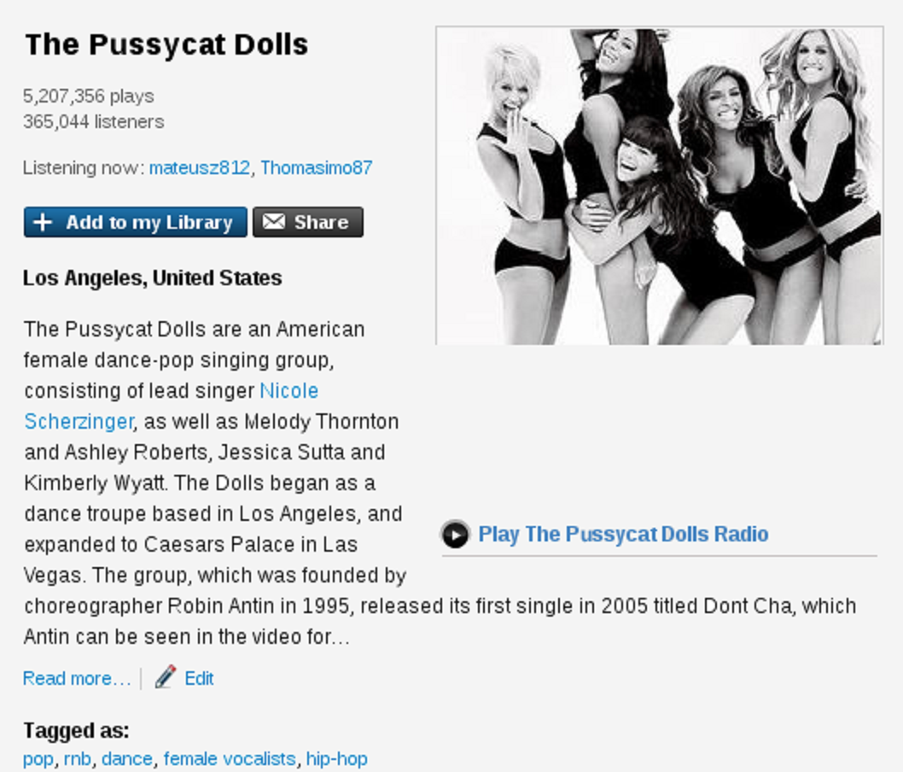
Descriptive Capacity
Term Spread (TS)
TS(DOLLS) =2

Slide 24
Descriptive Capacity
Term Spread (TS)
TS(DOLLS) =2
TS(PUSSYCAT) =2

Slide 25
Descriptive Capacity
Feature Instance Spread (FIS)
TS(DOLLS) =2
TS(PUSSYCAT) =2
FIS(TITLE) =
(TS(DOLLS) +
  TS(PUSSYCAT)) / 2 = 4/2 = 2

Slide 26
Descriptive Capacity
Average Feature Spread (AFS) – Given by the average FIS across the collection
 | TITLE | TAG | DESC. | COMM.
CiteULike | 1.91 | 1.62 | 1.12 | -
LastFM | 2.65 | 1.32 | 1.21 | 1.20
YahooVid. | 2.26 | 1.86 | 1.51 | -
Youtube | 2.53 | 2.07 | 1.72 | 1.12
TITLE > TAG > DESC > COMMENT

Slide 27
Research Goals
Characterize evidence of quality of textual features
  Usage
  Amount of content
  Descriptive capacity
  Discriminative capacity

Slide 28
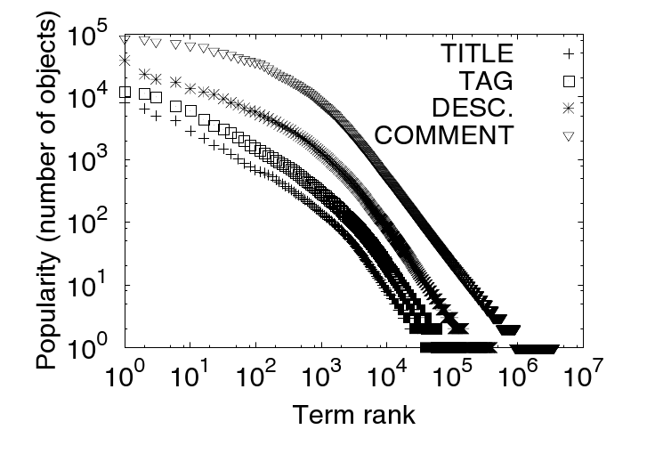
Discriminative Capacity
Inverse Feature Frequency (IFF)
  Based on Inverse Document Frequency (IDF)

Slide 29
Discriminative Capacity
Inverse Feature Frequency (IFF)
  Youtube
Bad Discriminator
“video”

Slide 30
Discriminative Capacity
Inverse Feature Frequency (IFF)
  Youtube
Bad Discriminator
“video”
Good. “music”

Slide 31
Discriminative Capacity
Inverse Feature Frequency (IFF)
  Youtube
Bad Discriminator
“video”
Good. “music”
Great. “CIKM”
Noise. “v1d30”

Slide 32
Discriminative Capacity
Average Inverse Feature Frequency (AIFF) – Average of IFF across the collection
 | TITLE | TAG | DESC. | COMM.
CiteULike | 7.31 | 7.59 | 7.02 | -
LastFM | 6.64 | 6.00 | 5.83 | 5.90
YahooVid. | 6.67 | 6.54 | 6.37 | -
Youtube | 7.12 | 7.00 | 7.73 | 6.64
(TITLE or TAG) > DESC > COMMENT

Slide 33
Research Goals
Characterize evidence of quality of textual features
  Usage
  Amount of content
  Descriptive capacity
  Discriminative capacity
Analyze the quality of features for object classification

Slide 34
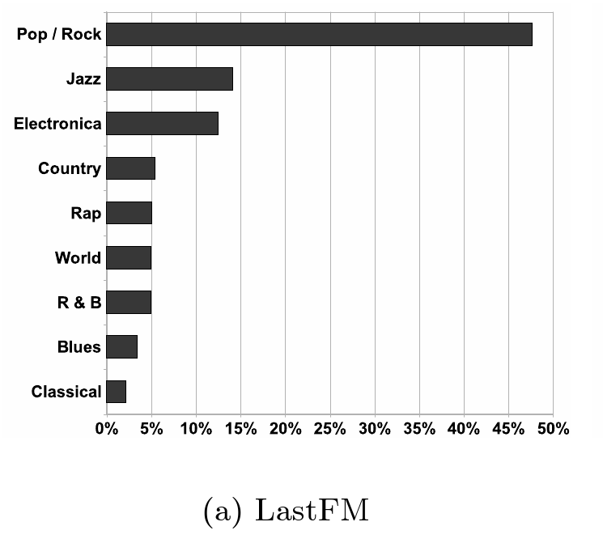
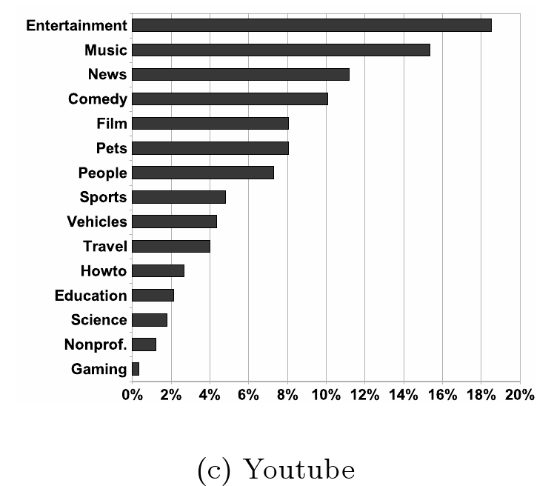
Object Classes

Slide 35
Vector Space
Features as vectors
<pussycat, dolls>
<pussycat, dolls,
american, female,
dance-pop, … >

Slide 36
Vector Combination
Average fraction of common terms (Jaccard) between top FIVE TSxIFF terms of features
 | CiteUL | LastFM | YahooV. | Youtube
TITLE X TAGS | 0.13 | 0.07 | 0.52 | 0.36
TITLE X DESC | 0.31 | 0.22 | 0.40 | 0.28
TAGS X DESC | 0.13 | 0.13 | 0.43 | 0.32
TITLE X COMM | - | 0.12 | - | 0.14
TAGS X COMM | - | 0.10 | - | 0.17
DESC X COMM | - | 0.18 | - | 0.16
Bellow 0.52. Significant amount of new content

Slide 37
Vector Combination
Feature combination using concatenation
Title:
  <pussycat, dolls>
Tags:
      <pussycat,dolls,female>
    Result:
      <pussycat,dolls,female,pussycat,dolls>
Title:
  <pussycat, dolls>
Tags:
    <pussycat,dolls,american,female>
  Bag-of-Words:
    <pussycat,dolls,american,female>

Slide 38
Vector Combination
Feature combination using Bag-of-word
Title:
  <pussycat, dolls>
Tags:
    <pussycat,dolls,american>
Result:
    <pussycat,dolls,american>

Slide 39
Term Weight
Term weight
  TS TF IFF
  TS x IFF TF x IFF
  <pussycat:1.6 , dools:0.8, american:2>

Slide 40
Object Classification
Support vector machines
Vectors
  TITLE, TAG, DESCRIPTION or COMMENT
  CONCATENATION
  BAG OF WORDS
Term weight
  TS TF IFF
  TS x IFF TF x IFF

Slide 41
Classification Results
Macro F1 results for TSxIFF
 | LastFM | YahooV. | Youtube
TITLE | 0.20 | 0.52 | 0.40
TAG | 0.80 | 0.63 | 0.54
DESCRIPTION | 0.75 | 0.57 | 0.43
COMMENT | 0.52 | - | 0.46
CONCAT | 0.80 | 0.66 | 0.59
BAGOW | 0.80 | 0.66 | 0.56
Bad results inspite good descripive/discriminative capacity
Impact due to the small amount of content

Slide 42
Classification Results
Macro F1 results for TSxIFF
 | LastFM | YahooV. | Youtube
TITLE | 0.20 | 0.52 | 0.40
TAG | 0.80 | 0.63 | 0.54
DESCRIPTION | 0.75 | 0.57 | 0.43
COMMENT | 0.52 | - | 0.46
CONCAT | 0.80 | 0.66 | 0.59
BAGOW | 0.80 | 0.66 | 0.56
Best Results
Good descriptive/discriminative capacity
Enough content

Slide 43
Classification Results
Macro F1 results for TSxIFF
 | LastFM | YahooV. | Youtube
TITLE | 0.20 | 0.52 | 0.40
TAG | 0.80 | 0.63 | 0.54
DESCRIPTION | 0.75 | 0.57 | 0.43
COMMENT | 0.52 | - | 0.46
CONCAT | 0.80 | 0.66 | 0.59
BAGOW | 0.80 | 0.66 | 0.56
Combination brings improvement
Similar insights for other weights

Slide 44
Conclusions
Characterization of Quality
  Collaborative features more absent
  Different amount of content per feature
  Smaller features are best descriptors and discriminators
  New content in each feature
Classification Experiment
  TAGS are the best feature in isolation
  Feature combination improves results

