Slide 1
AMT Second Round
  First round
    Video topic expressed by Freebase
    Perception of quality assessed by whether user is willing to share content, whether she likes it and whether she believes it will become popular
    Videos with at least 5000 views. In a pair, one video has 50% more views than the other
  Second round (differences only)
    Videos from the same month (April 2012)
    3 videos in each pop groups
      [10, 100); [1000, 10,000); [100,000, 1,000,000)
    All pairs (36) comparison following round robin tournament
    Each video potentially watched by 8*8 users

Slide 2
Results in 3 metrics
Do users agree among themselves?
  Kappa Score
  Does not have to agree with YouTube
Do users agree with YouTube?
  Measured only when users agree
  Binomial CI
Is there a correlation between user perception and popularity?
  Kendall or Spearman

Slide 3
Kappa Results
Are users collective perception of quality biased towards one video of the pair?
  Does not have to be the video with more views!
  Similar to previous results. Prediction perception is stronger than others
 | Which video do you like the most? | Which video would you share with Friends? | Which video do you predict will become more popular?
P-val <= 0.05 | A fraction of 0.30 pairs pass the test | 0.19 | 0.5
P-val <= 0.01 | 0.25 | 0.11 | 0.41
P-val <= 0.001 | 0.22 | 0.11 | 0.33

Slide 4
Kappa Results
Baseball
Music Videos
 | Which video do you like the most? | Which video would you share with Friends? | Which video do you predict will become more popular?
P-val <= 0.05 | A fraction of 0.30 pairs pass the test | 0.19 | 0.5
P-val <= 0.01 | 0.25 | 0.11 | 0.41
P-val <= 0.001 | 0.22 | 0.11 | 0.33
 | Which video do you like the most? | Which video would you share with Friends? | Which video do you predict will become more popular?
P-val <= 0.05 | A fraction of 0.13 pairs pass the test | 0.05 | 0.19
P-val <= 0.01 | 0.13 | 0.05 | 0.16
P-val <= 0.001 | 0.11 | 0.05 | 0.08

Slide 5
Binomial results
Ok. So, when users agree do they get the most popular video right?
Testing views with user pred
Testing with 36 pairs
Binomal Proportion CI of agreements: 0.889 +- 0.236
Binomial Test for 0.5 (random chance): p = 0.001
Testing views with user share
Testing with 14 pairs
Binomal Proportion CI of agreements: 1.000 +- 0.410
Binomial Test for 0.5 (random chance): p = 0.016
Testing views with user like
Testing with 22 pairs
Binomal Proportion CI of agreements: 1.000 +- 0.285
Binomial Test for 0.5 (random chance): p = 0.001

Slide 6
Binomial results
Music
Testing views with user pred
Testing with 14 pairs
Binomal Proportion CI of agreements: 1.000 +- 0.410
Binomial Test for 0.5 (random chance): p = 0.016
Testing views with user share
Testing with 4 pairs
Binomal Proportion CI of agreements: 0.500 +- 0.487
Binomial Test for 0.5 (random chance): p = 1.000
Testing views with user like
Testing with 10 pairs
Binomal Proportion CI of agreements: 0.800 +- 0.516
Binomial Test for 0.5 (random chance): p = 0.375

Slide 7
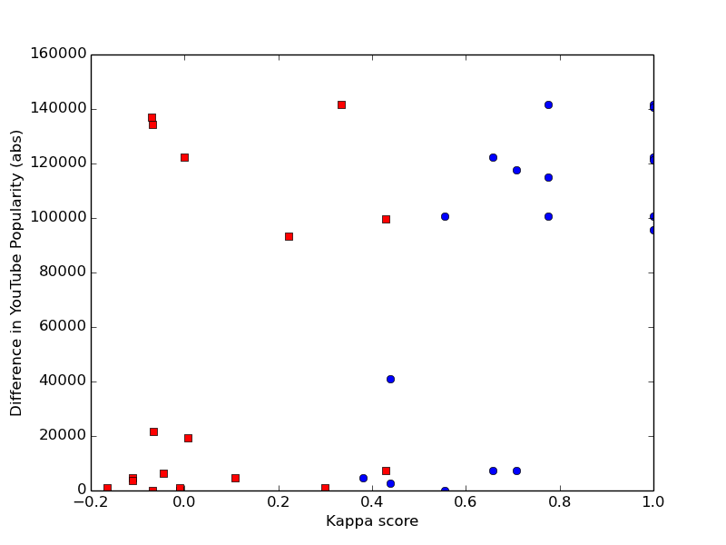
Correlation of Pairs By Kappa Score with Difference in Views
Baseball with predictions. Spearman correlation of 0.65, Kendall of 0.47. Both with p-val < 0.01 for blue dots (agreements)

Slide 8
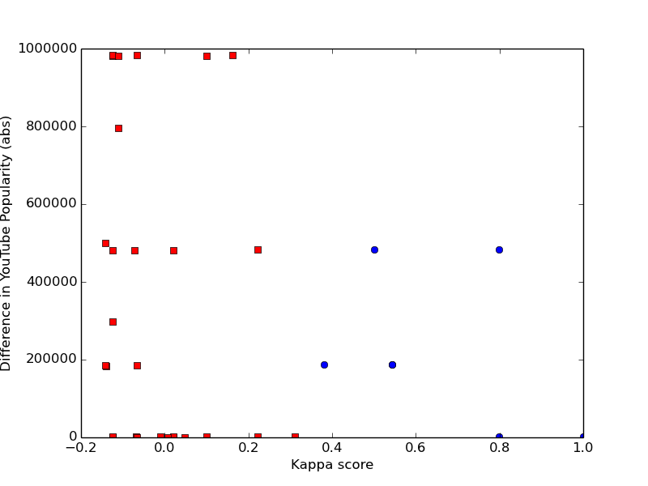
Correlation of Pairs By Kappa Score with Difference in Views
Music dataset with predictions. Spearman correlation of -0.46, Kendall of -0.41. Both with p-val < 0.28 for blue dots (agreements). Bad correlations

Slide 9
Correlation of User Perception Aggregated with Views
Baseball with predictions. Spearman correlation of 0.65, Kendall of 0.47. Both with p-val < 0.01 for blue dots (agreements)

Slide 10
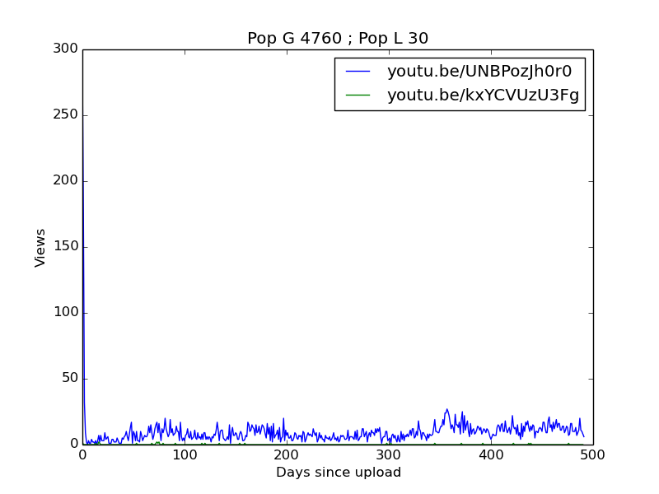
Lets have a look at cases when users disagree!
Baseball

Slide 11
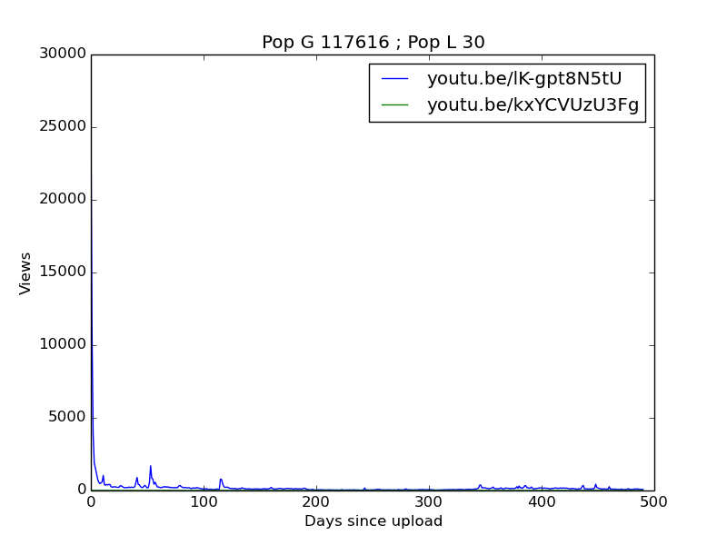
Lets have a look at cases when users disagree!
Baseball

Slide 12
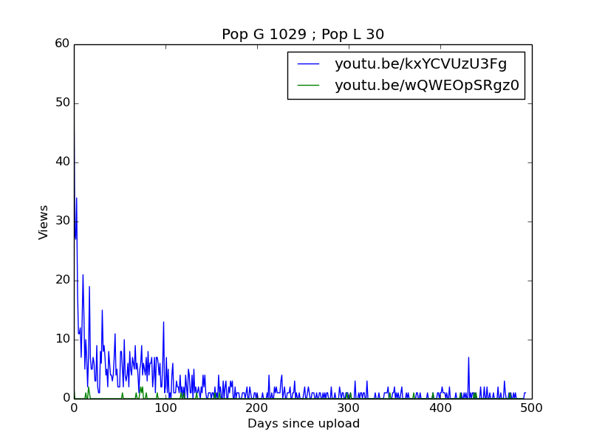
Lets have a look at cases when users disagree!
Baseball

Slide 13
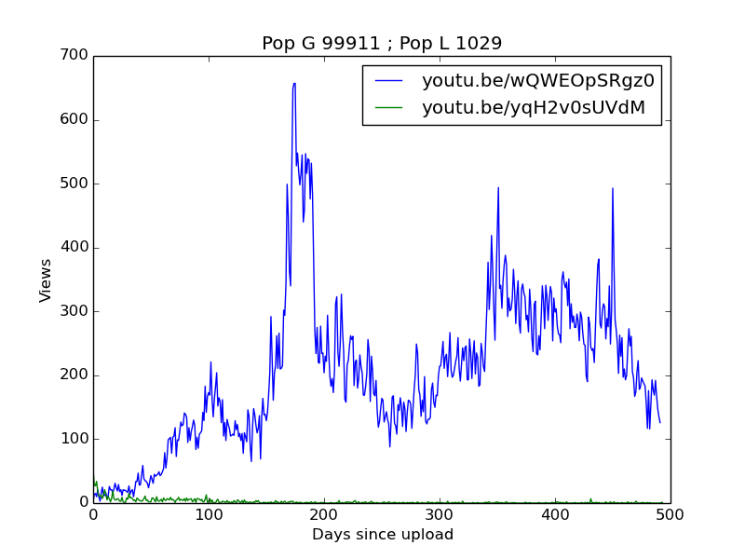
Lets have a look at cases when users disagree!
Baseball

Slide 14
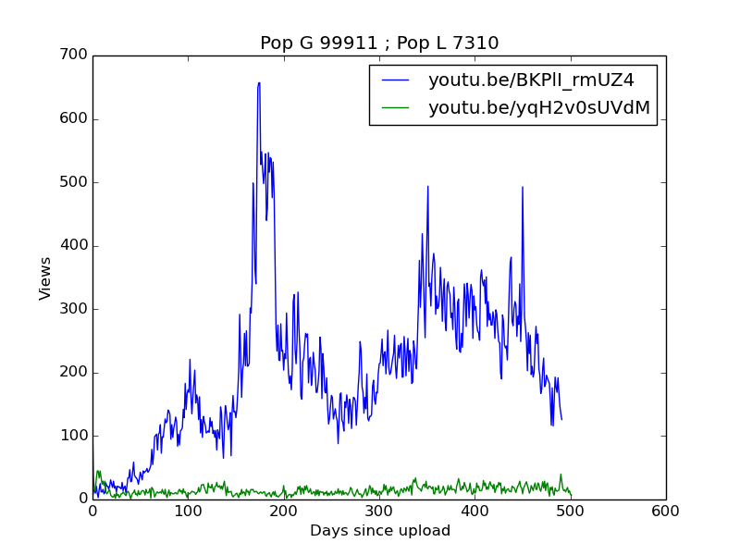
Lets have a look at cases when users disagree!
Baseball

Slide 15
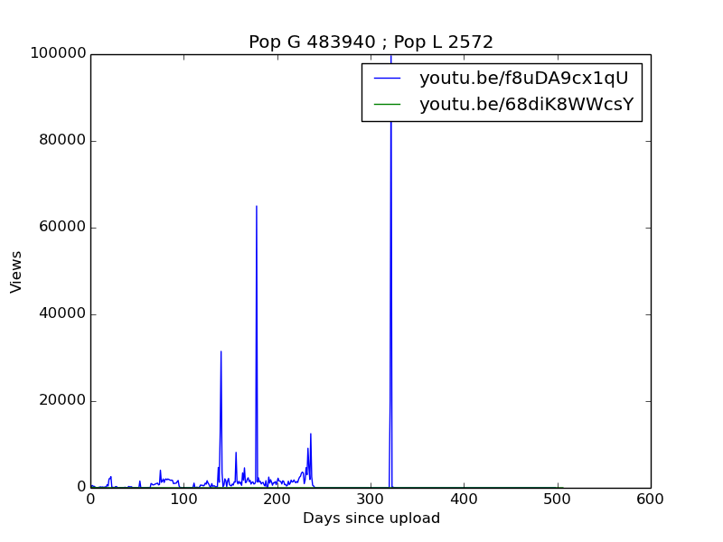
Lets have a look at cases when users disagree!
Music

Slide 16
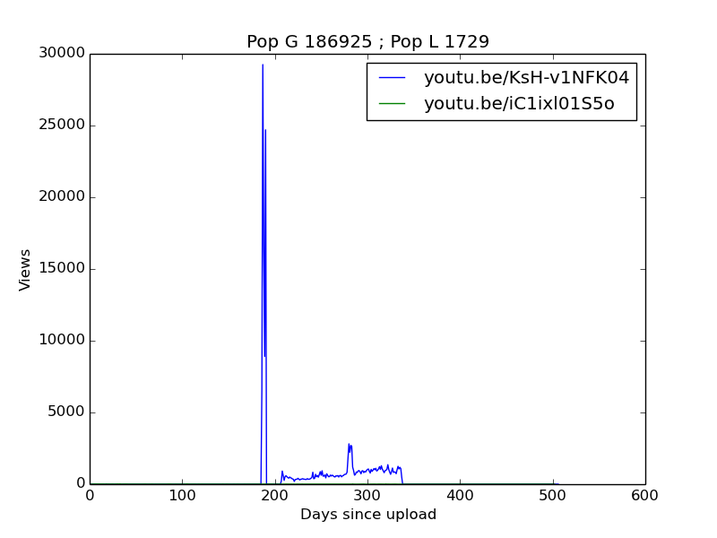
Lets have a look at cases when users disagree!
Music

Slide 17
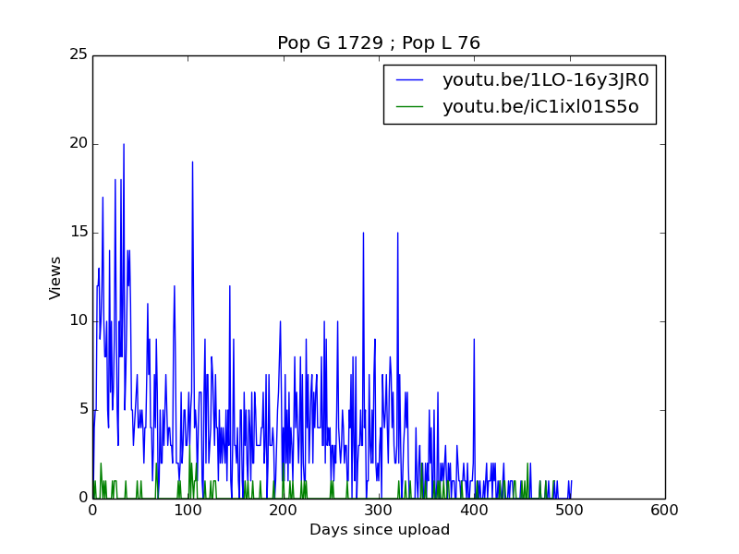
Lets have a look at cases when users disagree!
Music

