Slide 1
Brain Segmentation in MATLAB Image Processing
Team 3
Smits, H.J.G. (Hilde), Otto, F.W.H. (Frank), Marc, F. (Flavius)

Slide 2
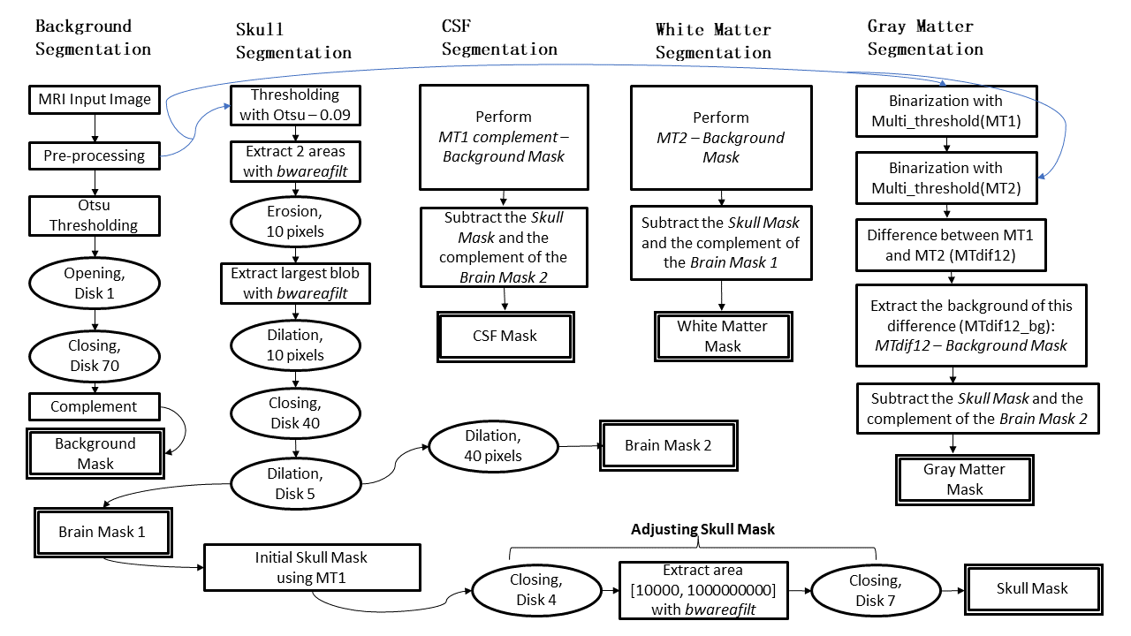
Block Diagram

Slide 3
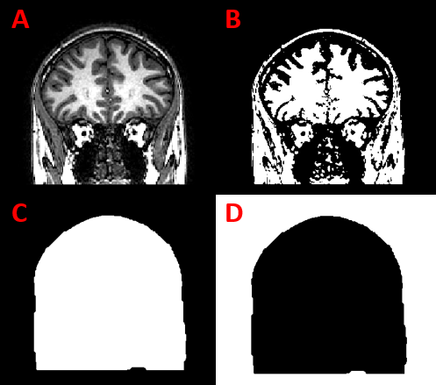
Methods - Background
Original image
Otsu threshold
Opening disk 1 and closing disk 70
Complement

Slide 4
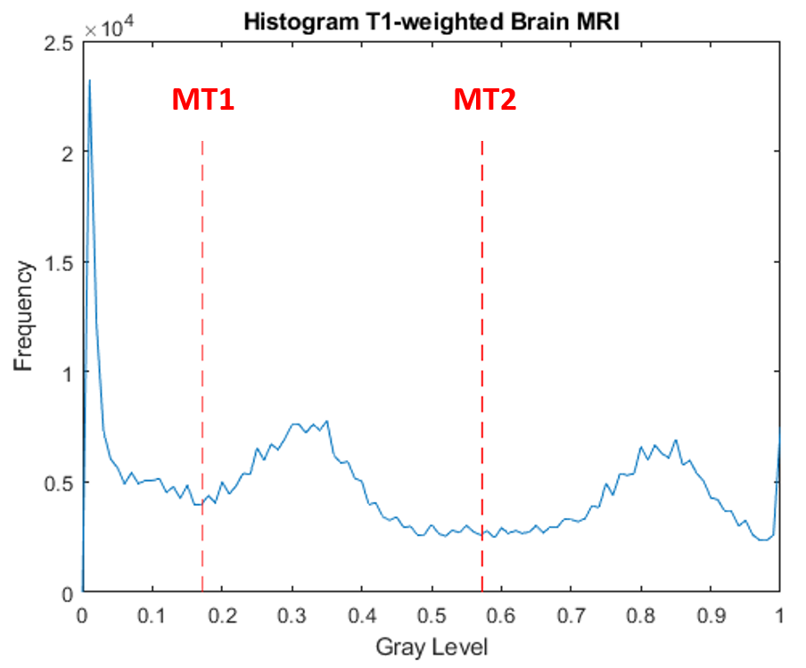
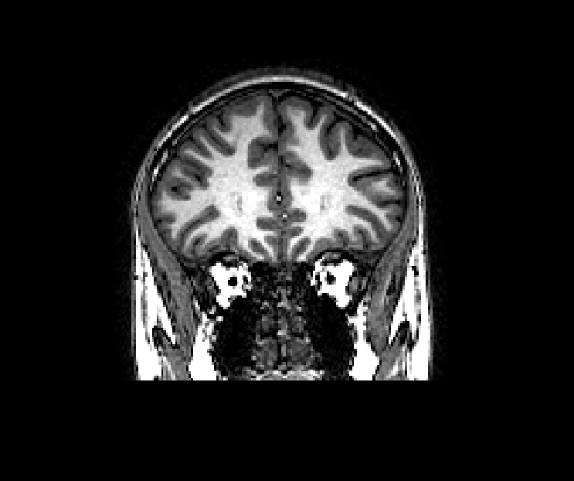
Methods - Initial Segmentation

Slide 5
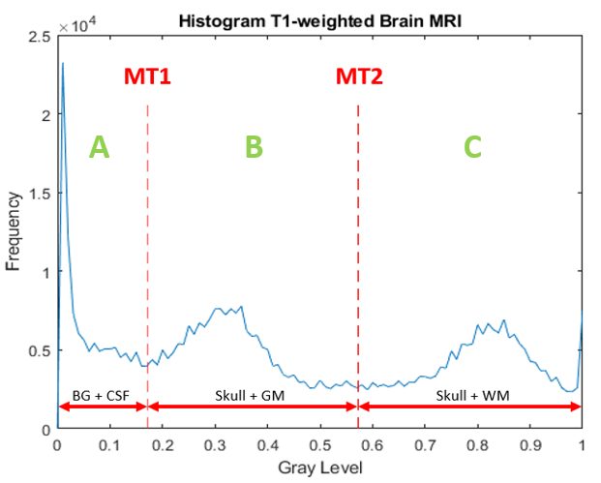
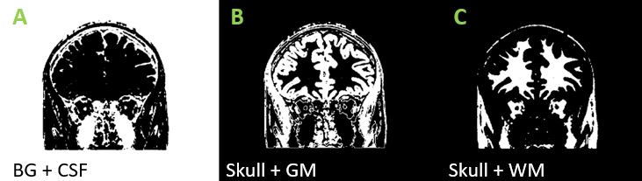
Methods - Initial Segmentation

Slide 6
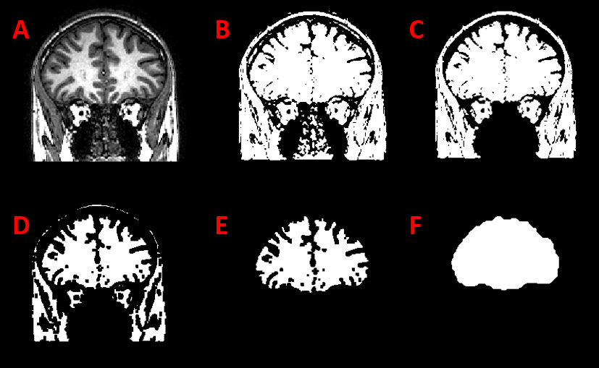
Methods - Brain segmentation
Original image
Otsu-0.09
2 largest regions
Erosion by 10
Largest region
Dilate by 10 + close
disk 40 + dilate by 5

Slide 7
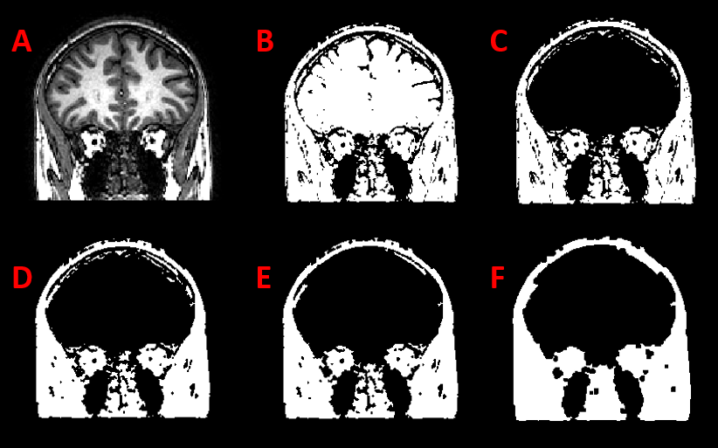
Methods - Skull segmentation
Original image
MT1
Remove brain mask
Close disk 4
Remove small regions
Close disk 7

Slide 8
Methods - WM, GM, CSF
Initial segmentation already separates the brain tissues adequately.

Slide 9
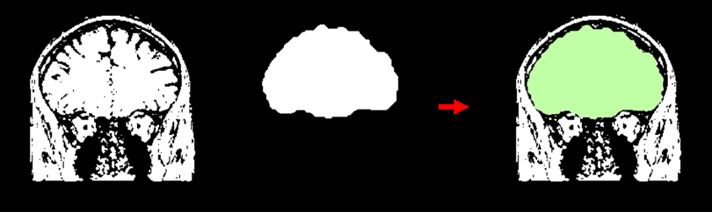
Methods - WM, GM, CSF
However, current brain mask does not include CSF.
Idea → dilate the brain

Slide 10
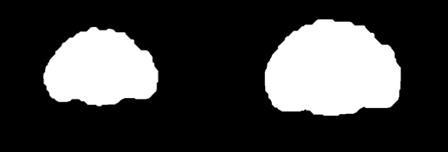
Methods - WM, GM, CSF
Dilate to assure inclusion of GM + CSF in the brain mask.
Notes:
We di

Slide 11
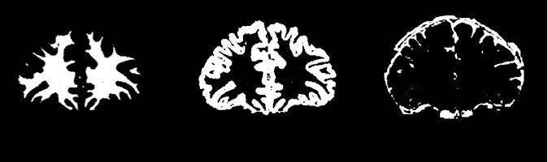
Methods - WM, GM, CSF
WM (Brain Mask) GM (dilated Brain Mask) CSF (dilated Brain Mask)

Slide 12
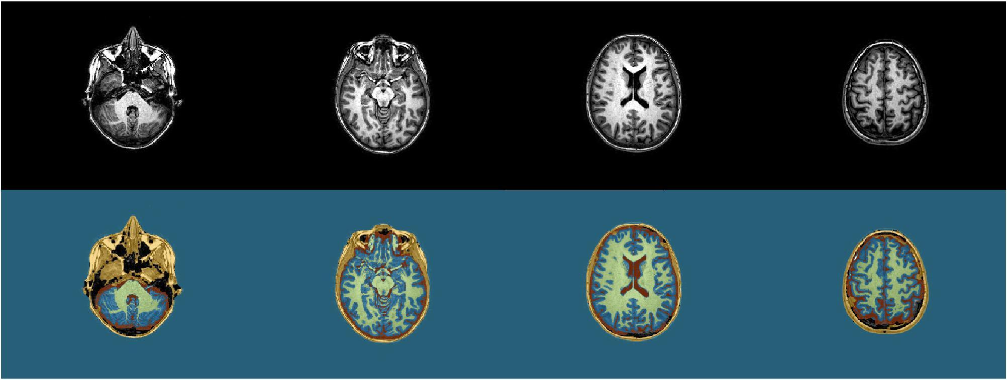
Results - Axial

Slide 13
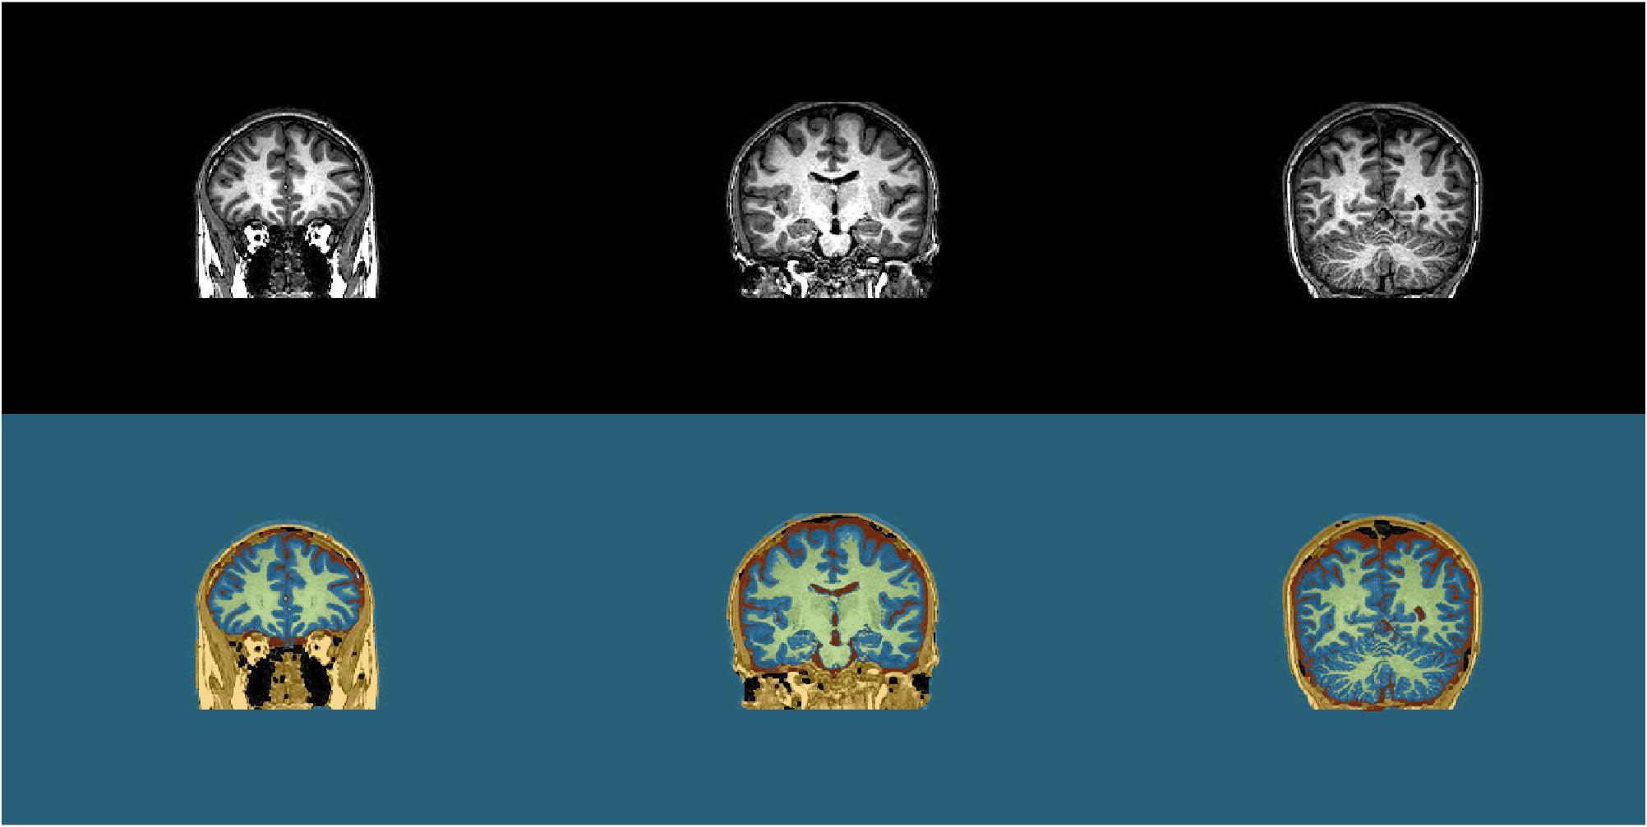
Results - Coronal

Slide 14
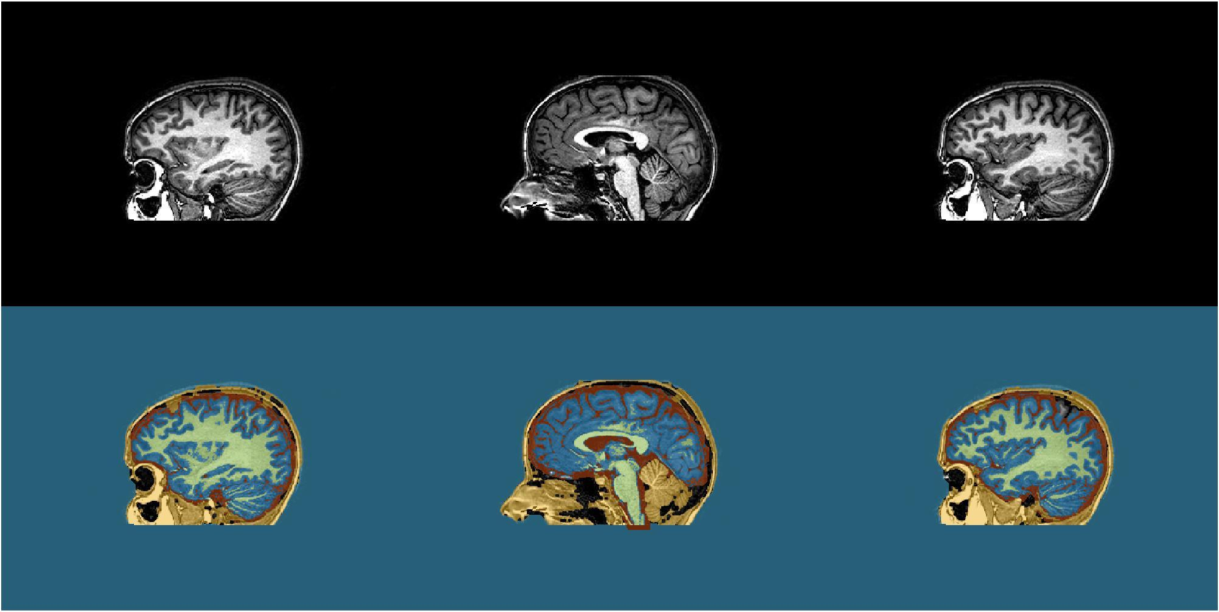
Results - Sagittal

Slide 15
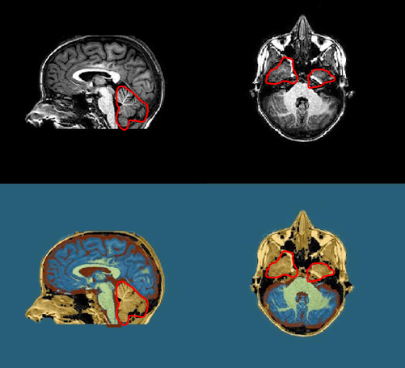
Discussion
Some failures in separating
brain from skull
A better brain extraction is
necessary

Slide 16
Discussion
Thresholding is vulnerable to artefacts → Preprocessing necessary
Many thresholds and morphological operations hardcoded

Slide 17
Thank you for attention!
Contributions
Hilde | Design and initial script of the method, Prior knowledge, Discussion, Figures method section
Frank | Integrating and cleaning up script, Introduction, Results section. Explored other methods of segmentation (levelset, active contour, conditional dilation)
Flavius | Methods, block diagram, bibliography, Formatting the report. Explored other skull segmentation techniques, levelset segmentation.

