Slide 1
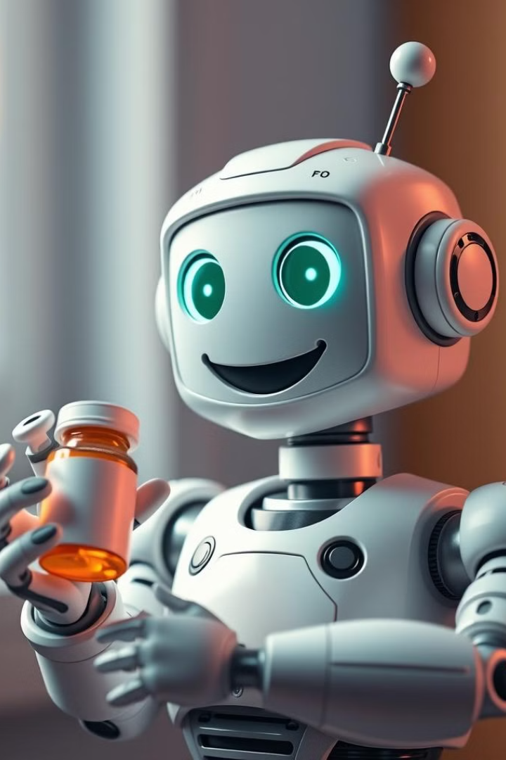
Medicine Reminder App: Your Personalized Healthcare Companion
Medicine Reminder offers a seamless, user-friendly platform that empowers individuals to manage their medication schedules effortlessly. With voice interaction, timely reminders, and AI-powered insights, it caters especially to the elderly and those with mobility challenges. Its unique integration of innovative technologies, such as data visualization and future IoT features, ensures users stay informed and engaged in their health journey. Experience peace of mind with a comprehensive solution designed to enhance medication adherence and overall well-being.

Slide 2
Features, Technologies, and Setup: Empowering Users for Better Wellness
1
Personalized Medication Schedules
2
Visual and Audio Reminders
Effortlessly create and manage your medication schedules, tailoring them to your individual needs. Add multiple medications with customizable frequency, dosage, and reminders. Our smart algorithm ensures you never miss a dose.
Receive timely reminders through clear visual notifications and audible alarms. Customize the reminder settings to your preferences, including vibration patterns and reminder tones, ensuring you're always informed.
3
Technology used
4
Secure Data Storage
Built in Python, the app utilizes Streamlit for a seamless web interface, while LangChain enables effective natural language processing. Google Generative AI powers the chatbot for intuitive user interactions. For voice command processing, we incorporate Speech Recognition & PyTTSx3 for text-to-speech functionality.
Your health information is our priority! Our app uses robust encryption and secure data storage protocols to protect your personal and medical data, ensuring privacy and peace of mind. SQLite manages local database storage for user data..

Slide 3
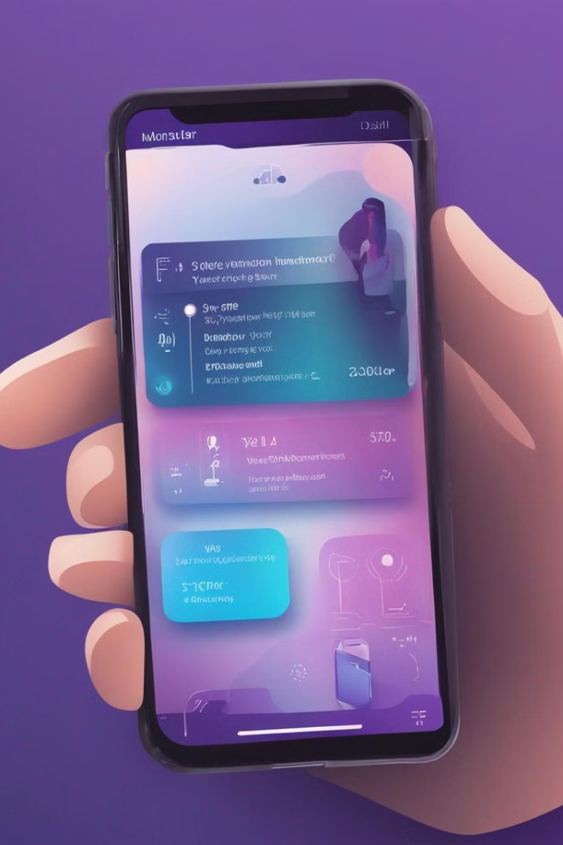
Future Scope: Integrating Voice, IoT, and Enhancing User Authentication
1
Multi-language Support
Voice recognition and interface in multiple languages for diverse elderly populations overcoming issue of huge diversity in dialects and accents across the world
2
IoT Integration
We envision a seamless integration with smart devices like pill dispensers and wearable health trackers. These devices will communicate with our app, providing real-time insights into your medication adherence and overall health status.
3
Augmented Reality (AR) Pill Identification
Use smartphone camera to identify pills and provide information
Clearly capture doctor perception without any error using the OCR
4
Cloud Connection to Family Members
Real-time medication adherence updates for family members
Shared calendar for appointments and medication schedules

