Slide 1

Search with Python and Xapian
Europython 2009
Richard Boulton

Slide 2
Xapian – lightning tour 1
Search engine library.
“Like Lucene”.
Mature (10 years old in September).
C++, with bindings for many languages.
Custom database.
Aims for high quality result ranking.

Slide 3
Xapian - lightning tour 2
Optimised for scalability:
Millions of documents (at least!)
Copes well with databases too big to fully cache
Remote database support
Replication
Search across multiple databases
“Lazy” calculation of results (over 10x faster to get top few results) – highly optimised matcher

Slide 4
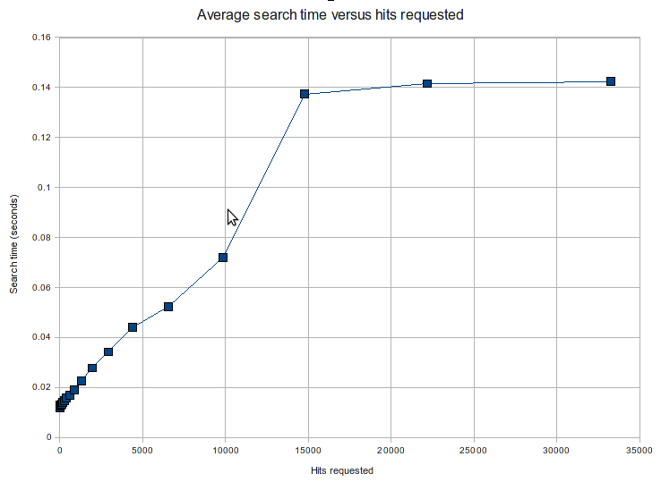

Slide 5
Xapian - lightning tour 3
Full featured:
Structured boolean support
Range search support
Faceted search support (including facet suggestion)
Geographic distance range support
Arbitrary weight bias support

Slide 6
Xapian - lightning tour 4
Full featured:
Spelling correction
Stemming
Support for custom weighting schemes, document sources
Wildcards
Search-as-you-type

Slide 7
Xapian - lightning tour 5
Relevance feedback:
Get relevance judgments from users (“is this result useful?”)
Use to reweight future searches
Use to suggest additional search terms
Used heavily in Enrico Zini's apt-xapian-index to suggest tags for packages & generate tag cloud

Slide 8
What's not so good?
Python bindings
Generated with SWIG, with some tweaks
Not very “pythonic” - awkward to use
Documentation mainly refers to the C++ API

Slide 9
Solution: wrapper wrappers
Two active ones:
Xappy (my one)
ore.xapian
Lots of old discarded ones
mbxap
PyXapian
XapWrap
XAQL

Slide 10
What's not so good? - 2
Database updating is a “single writer, multiple reader” model (with transactional updates)
Large updates should be batched for efficiency
Threading support poor – requires use of “main_interpreter” for mod_wsgi, callbacks to C++ can deadlock with mod_python
To use with a web app, you need to write something to marshal the updates

Slide 11
Solution: Flax Search Service
REST & JSON based web service
Manages indexing and updating
Provides schema layer
Provides rich search API
Customisable with server-side Javascript

Slide 12
Status
Early alpha...
… but already usable.
Developed by the Flax Team, common base for many custom projects.

Slide 13
Implementation
Implemented in Python as a WSGI application, using Xappy and Xapian
Updates queued in-process, but API designed to allow using a message queue & multiple worker architecture in future.
Some compromises to handle transactions, and to work with poor client HTTP libraries.

Slide 14
Flax API
Documentation:
- see docs/api.html

Slide 15
Flax API
Databases:
POST to /dbs/dbname to create
DELETE to /dbs/dbname to delete
GET /dbs/dbname to get status

Slide 16
Flax API
Documents:
Set of fields, each with a list of values.
Order of fields insignificant.
Order of values within fields significant.
Fields are processed when document is added.

Slide 17
Flax API
Document example:
{ u'tags': [u'animals', u'craft',
u'octopus', u'under the sea', u'wool'],
u'tagsyn': [u'Octopodes', u'Octopi'],
u'text': [u'An Octopus made from plaited wool.'],
u'title': [u'Wool Octopus']
}

Slide 18
Flax API
Adding documents:
POST to /dbs/dbname/docs to add
PUT to /dbs/dbname/docs/docid to replace
DELETE to /dbs/dbname/docs/docid to delete

Slide 19
Flax API
Schemas:
Define type of data stored in each field.
Define how data is processed when added.
Define how searches should be built for items in that field.

Slide 20
Flax API
Schemas:
POST some JSON to /dbs/dbname/schema to set the whole schema.
Or POST or DELETE to sub-URIs to modify parts of the schema – eg, to define a new field.
GET to get the current state of the schema.

Slide 21
Flax API
Searches:
Simple search: parse a single string.
Structured search: allow various fields to be added.
Similarity search: find similar documents.
Templated search: do anything – defined by javascript.

Slide 22
Clients
Python
PHP
Perl (thanks to Cognidox)

Slide 23
from flax.searchclient import Client
c = Client('http://127.0.0.1:8080/')
c.create_database('mydb')

Slide 24
schema = c.schema('mydb')
schema.add_field('title', {
'type': 'text',
'freetext': { 'language': 'en' },
})

Slide 25
db = c.db('mydb')
doc = {'title': 'my first document'}
db.add_document(doc, docid='myfirstid')
db.flush()

Slide 26
db = c.db('mydb')
res = db.search_simple('document', 0, 10)
print res.results

Slide 27
Demo
Bamboo – Simple document management system.
ideas4kids – Django powered small site.

Slide 28
Future 1: performance
Some easy fixes:
Add etag support for better caching
Add non-explicit flushing

Slide 29
Future 2: more API design
(for things we've implemented internally)
Multi database searches
Remote database searches

Slide 30
Future 3: features
Geolocation – distance ordering and restriction
Numeric range searches
Faceted searches
All the above are implemented in xappy – just need to expose them.

Slide 31
Future 4: flexibility
Javascript templates for indexing.
Schema changes on the fly.
Webhook notification of document additions/errors.

Slide 32
Digression
Python-spidermonkey
Recently resurrected – see github / pypi
Two-way bridge from python to javascript
Allows javascript resources to be limited
Javascript access to python objects monitored by a callback

Slide 33
Icky detail – WSGI
Database names are arbitrary unicode strings, supplied (UTF encoded and % escaped) in the URI path.
But... WSGI specifies that the PATH_INFO is decoded – so we can't tell a %2f in the URI from a /
Worse – cherrypy WSGI server decodes everything but %2f – so %252f is ambiguous.

Slide 34
Licensing
Xapian is under the GPL
Flax is under the MIT license
Effectively, therefore, Flax is bound by GPL...
... but! Clients may not be (ask a lawyer)
... and Flax could be written to use different backend engine (eg, lucene / whoosh)

Slide 35
Help wanted
Implement persistent connections in the python client.
Write a django-haystack backend.
Help audit our REST API.
Write clients for other languages.
...

Slide 36
Questions? / Comments?
Richard Boulton
richard@flax.co.uk
@rboulton

