Slide 1
EISentiMent
Exploring ways to increase portfolio returns by quantifying market sentiment surrounding releases of economic indicators

Slide 2
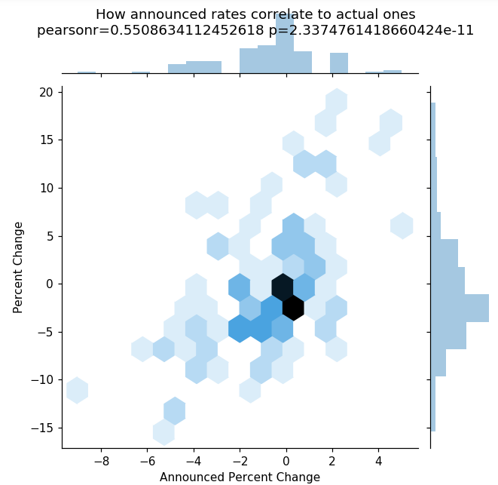
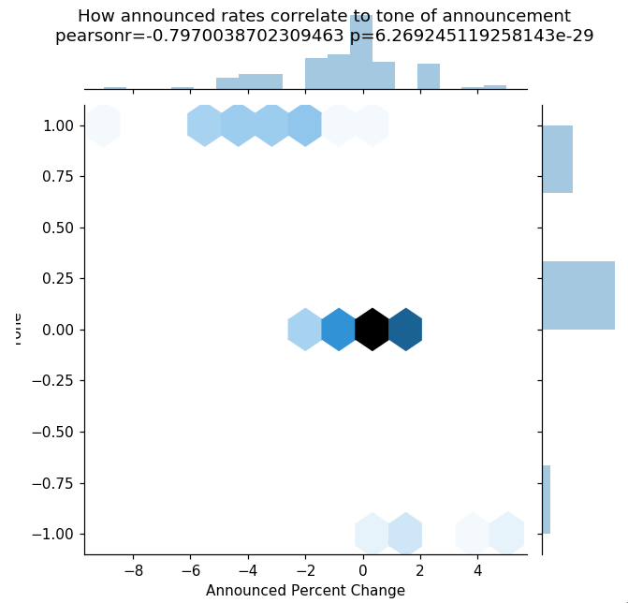
Analysis of Unemployment Rate Announcements

Slide 3
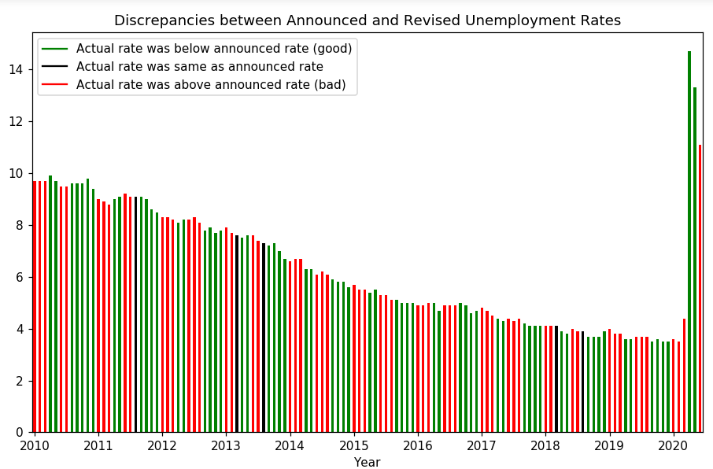
Analysis of Unemployment Rate Announcements

Slide 4
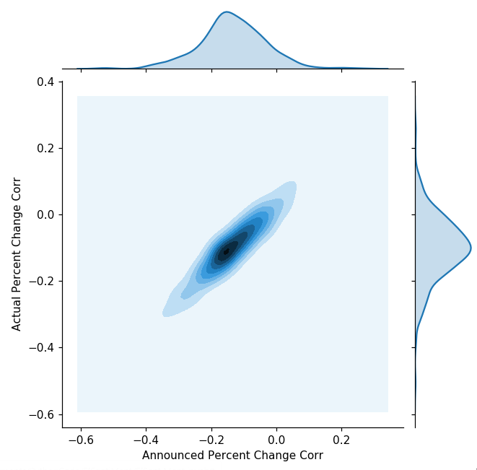
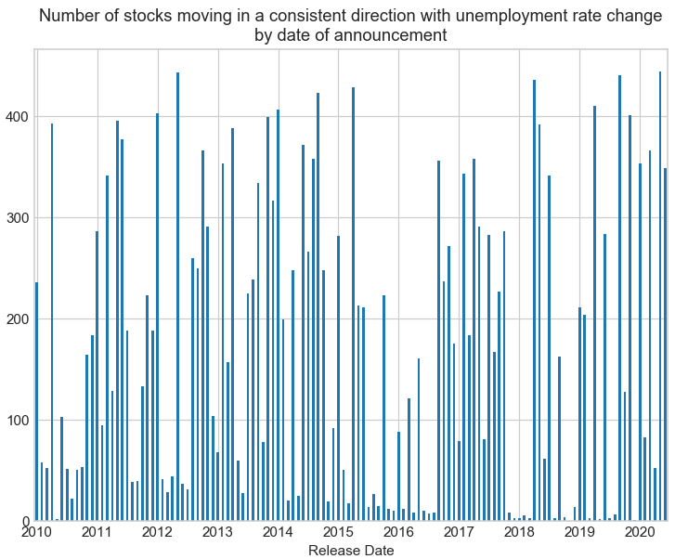
Effects of rate announcements on stock prices

Slide 5
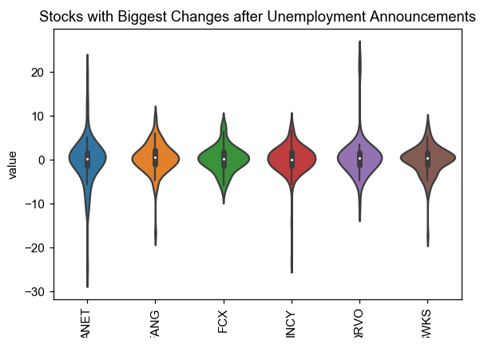
Effects of rate announcements in stock prices

Slide 6
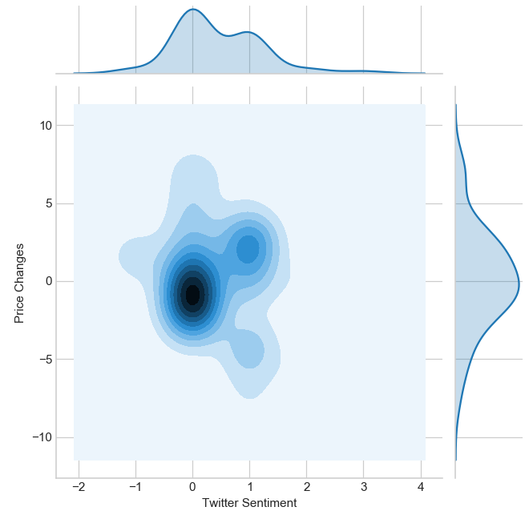
Correlations of price changes to twitter sentiment

Slide 7
Data sources
- Historical data on Employment Situation News Releases from the U.S. Bureau of Labor Statistics website
- Historical data from twitter to extract tweet sentiment around the time of those releases, which we’ll retrieve using their REST API
- Stocks from the S&P 500 Index as our sample, last ten years

