Slide 1
Discrete and Continuous Simulation
Marcio Carvalho
Luis Luna
PAD 824 – Advanced Topics in System Dynamics
Fall 2002

Slide 2
What is it all about?
Numerical simulation approach
Level of Aggregation
  Policies versus Decisions
  Aggregate versus Individuals
  Aggregate Dynamics versus Problem solving
Difficulty of the formulation
Nature of the system/problem
Nature of the question
Nature of preferred lenses

Slide 3
Basic concepts
Static or dynamic models
Stochastic, deterministic or chaotic models
Discrete or continuous change/models
Aggregates or Individuals

Slide 4
1. Static or Dynamic models
Dynamic: State variables change over time (System Dynamics, Discrete Event, Agent-Based, Econometrics?)
Static: Snapshot at a single point in time (Monte Carlo simulation, optimization models, etc.)

Slide 5
2. Deterministic, Stochastic or Chaotic
Deterministic model is one whose behavior is entire predictable. The system is perfectly understood, then it is possible to predict precisely what will happen.
Stochastic model is one whose behavior cannot be entirely predicted.
Chaotic model is a deterministic model with a behavior that cannot be entirely predicted

Slide 6
3. Discrete or Continuous models
Discrete model: the state variables change only at a countable number of points in time. These points in time are the ones at which the event occurs/change in state.
Continuous: the state variables change in a continuous way, and not abruptly from one state to another (infinite number of states).

Slide 7
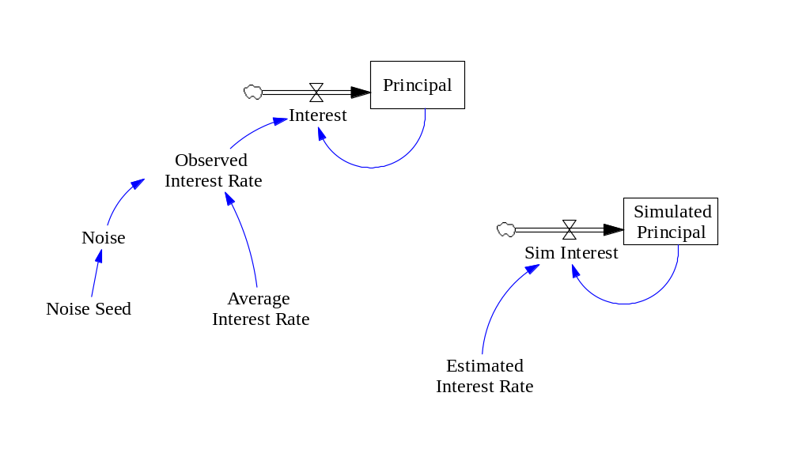
3. Discrete or Continuous models
Continuous model: Bank account
Continuous and Stochastic
Continuous and Deterministic

Slide 8
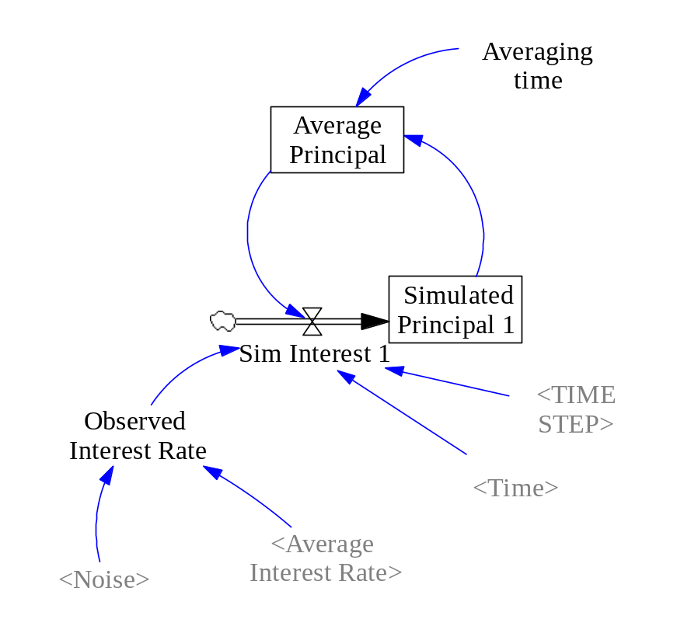
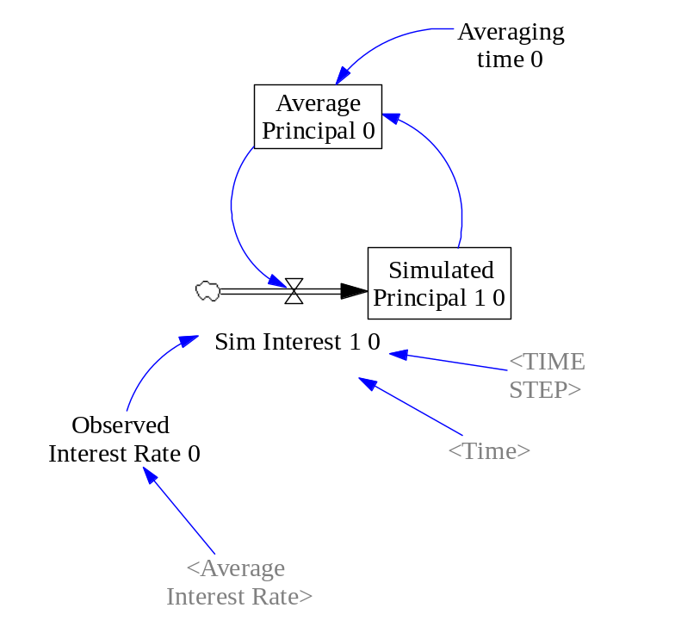
3. Discrete and Continuous models
Discrete model: Bank Account
Discrete and Deterministic
Discrete and Stochastic

Slide 9
4. Aggregate and Individual models
Aggregate model: we look for a more distant position. Modeler is more distant. Policy model. This view tends to be more deterministic.
Individual model: modeler is taking a closer look of the individual decisions. This view tends to be more stochastic.

Slide 10
The “Soup” of models
Waiting in line
Waiting in line 1B
Busy clerk
Waiting in line (Stella version)
Mortgages (ARENA model)

Slide 11
Time handling
2 approaches:
    Time-slicing: move forward in our models in equal time intervals.
    Next-event technique: the model is only examined and updated when it is known that a state (or behavior) changes. Time moves from event to event.

Slide 12
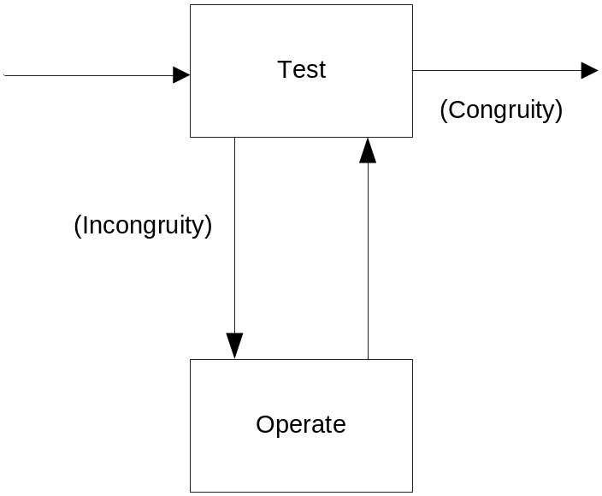
Alternative views of Discreteness
Culberston’s feedback view
TOTE model
(Miller, Galanter and Pribram, 1960)

Slide 13
Peoples thoughts
“The system contains a mixture of discrete events, discrete and different magnitudes, and continuous processes. Such mixed processes have generally been difficult to represent in continuous simulation models, and the common recourse has been a very high level of aggregation which has exposed the model to serious inaccuracy”
(Coyle, 1982)

Slide 14
Peoples thoughts
“Only from a more distant perspective in which events and decisions are deliberately blurred into patterns of behavior and policy structure will the notion that ‘behavior is a consequence of feedback structure’ arise and be perceived to yield powerful insights.”
(Richardson, 1991)

Slide 15
So, is it all about these?
Numerical simulation approach
Level of Aggregation
  Policies versus Decisions
  Aggregate versus Individuals
  Problem solving versus Aggregate Dynamics
Difficulty of the formulation
Nature of the system/problem
Nature of the question
Nature of preferred lenses

