Slide 1
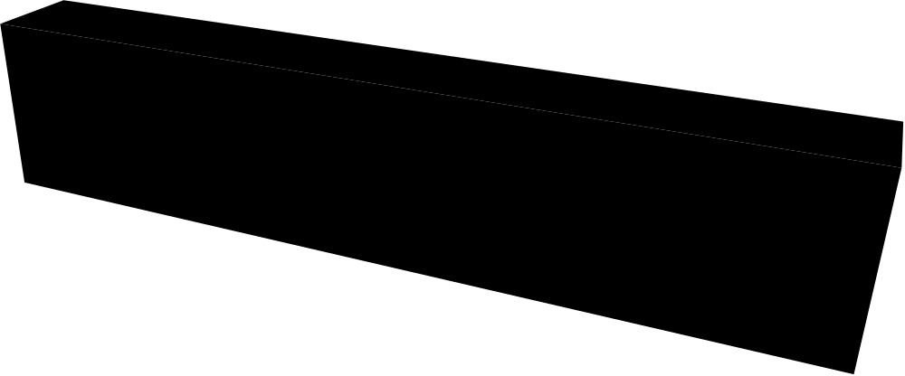
CPS 808
Introduction To Modeling and Simulation
Lecture 1
Notes:
1

Slide 2
Goals Of This Course
Introduce Modeling
Introduce Simulation
Develop an Appreciation for the Need for Simulation
Develop Facility in Simulation Model Building
“Learn by Doing”--Lots of Case Studies
Notes:
2

Slide 3
What Is A Model ?
A Representation of an object, a system, or an idea in some form other than that of the entity itself.
(Shannon)
Notes:
3

Slide 4
Types of Models:
Physical
(Scale models, prototype plants,…)
Mathematical
(Analytical queueing models, linear programs, simulation)
Notes:
4

Slide 5
What is Simulation?
A Simulation of a system is the operation of a model, which is a representation of that system.
The model is amenable to manipulation which would be impossible, too expensive, or too impractical to perform on the system which it portrays.
The operation of the model can be studied, and, from this, properties concerning the behavior of the actual system can be inferred.
Notes:
5

Slide 6
Applications:
Designing and analyzing manufacturing systems
Evaluating H/W and S/W requirements for a computer system
Evaluating a new military weapons system or tactics
Determining ordering policies for an inventory system
Designing communications systems and message protocols for them

Slide 7
Applications:(continued)
Designing and operating transportation facilities such as freeways, airports, subways, or ports
Evaluating designs for service organizations such as hospitals, post offices, or fast-food restaurants
Analyzing financial or economic systems

Slide 8
Steps In Simulation and
Model Building
1. Define an achievable goal
2. Put together a complete mix of skills on the team
3. Involve the end-user
4. Choose the appropriate simulation tools
5. Model the appropriate level(s) of detail
6. Start early to collect the necessary input data
Notes:
8

Slide 9
Steps In Simulation and
Model Building(cont’d)
7. Provide adequate and on-going documentation
8. Develop a plan for adequate model verification
(Did we get the “right answers ?”)
9. Develop a plan for model validation
(Did we ask the “right questions ?”)
10. Develop a plan for statistical output analysis
Notes:
9

Slide 10
Define An Achievable Goal
“To model the…” is NOT a goal!
“To model the…in order to select/determine feasibility/…is a goal.
Goal selection is not cast in concrete
Goals change with increasing insight
Notes:
10

Slide 11
Put together a complete mix of skills on the team
We Need:
-Knowledge of the system under investigation
-System analyst skills (model formulation)
-Model building skills (model Programming)
-Data collection skills
-Statistical skills (input data representation)
Notes:
11

Slide 12
Put together a complete mix of skills on the team(continued)
We Need:
-More statistical skills (output data analysis)
-Even more statistical skills (design of experiments)
-Management skills (to get everyone pulling in the same direction)
Notes:
12

Slide 13
INVOLVE THE END USER
-Modeling is a selling job!
-Does anyone believe the results?
-Will anyone put the results into action?
-The End-user (your customer) can (and must) do all of the above BUT, first he must be convinced!
-He must believe it is HIS Model!
Notes:
13

Slide 14
Choose The Appropriate Simulation Tools
Assuming Simulation is the appropriate means, three alternatives exist:
1. Build Model in a General Purpose Language
2. Build Model in a General Simulation Language
3. Use a Special Purpose Simulation Package
Notes:
14

Slide 15
MODELLING W/ GENERAL PURPOSE LANGUAGES
Advantages:
  Little or no additional software cost
  Universally available (portable)
  No additional training (Everybody knows…(language X) ! )
Disadvantages:
  Every model starts from scratch
  Very little reusable code
  Long development cycle for each model
  Difficult verification phase
Notes:
15

Slide 16
GEN. PURPOSE LANGUAGES USED FOR SIMULATION
FORTRAN
  Probably more models than any other language.
PASCAL
  Not as universal as FORTRAN
MODULA
  Many improvements over PASCAL
ADA
  Department of Defense attempt at standardization
C, C++
  Object-oriented programming language
Notes:
16

Slide 17
MODELING W/ GENERAL
SIMULATION LANGUAGES
Advantages:
  Standardized features often needed in modeling
  Shorter development cycle for each model
  Much assistance in model verification
  Very readable code
Disadvantages:
  Higher software cost (up-front)
  Additional training required
  Limited portability
Notes:
17

Slide 18
GENERAL PURPOSE SIMULATION LANGUAGES
GPSS
  Block-structured Language
  Interpretive Execution
  FORTRAN-based (Help blocks)
  World-view: Transactions/Facilities
SIMSCRIPT II.5
  English-like Problem Description Language
  Compiled Programs
  Complete language (no other underlying language)
  World-view: Processes/ Resources/ Continuous
Notes:
18

Slide 19
GEN. PURPOSE SIMULATION LANGUAGES (continued)
MODSIM III
  Modern Object-Oriented Language
  Modularity Compiled Programs
  Based on Modula2 (but compiles into C)
  World-view: Processes
SIMULA
  ALGOL-based Problem Description Language
  Compiled Programs
  World-view: Processes
Notes:
19

Slide 20
GEN. PURPOSE SIMULATION LANGUAGES (continued)
SLAM
  Block-structured Language
  Interpretive Execution
  FORTRAN-based (and extended)
  World-view: Network / event / continuous
CSIM
  process-oriented language
  C-based (C++ based)
  World-view: Processes
Notes:
20

Slide 21
MODELING W/ SPECIAL-PURPOSE SIMUL. PACKAGES
Advantages
  Very quick development of complex models
  Short learning cycle
  No programming--minimal errors in usage
Disadvantages
  High cost of software
  Limited scope of applicability
  Limited flexibility (may not fit your specific application)
Notes:
21

Slide 22
SPECIAL PURPOSE PACKAGES USED FOR SIMUL.
NETWORK II.5
  Simulator for computer systems
OPNET
  Simulator for communication networks, including wireless networks
COMNET III
  Simulator for communications networks
SIMFACTORY
  Simulator for manufacturing operations
Notes:
22

Slide 23
THE REAL COST OF SIMULATION
Many people think of the cost of a simulation only in terms of the software package price.
There are actually at least three components to the cost of simulation:
1. Purchase price of the software
2. Programmer / Analyst time
3. “Timeliness of Results”
Notes:
23

Slide 24
TERMINOLOGY
System
  A group of objects that are joined together in some regular interaction or interdependence toward the accomplishment of some purpose.
  Entity
  An object of interest in the system.
  E.g., customers at a bank
Notes:
24

Slide 25
TERMINOLOGY (continued)
Attribute
  a property of an entity
  E.g., checking account balance
Activity
  Represents a time period of specified length.
  Collection of operations that transform the state of an entity
  E.g., making bank deposits
Notes:
25

Slide 26
TERMINOLOGY (continued)
Event:
  change in the system state.
  E.g., arrival; beginning of a new execution; departure
State Variables
  Define the state of the system
  Can restart simulation from state variables
  E.g., length of the job queue.
Notes:
26

Slide 27
TERMINOLOGY (continued)
Process
  Sequence of events ordered on time
Note:
  the three concepts(event, process,and activity) give rise to three alternative ways of building discrete simulation models

Slide 28
A GRAPHIC COMPARISON OF DISCRETE SIMUL. METHODOLOGIES
A1
A2
P1
E1
E2 /E3
E4
A1
A2
P2
E1’
E2’
E3’
E4’
Simulation Time
Notes:
28

Slide 29
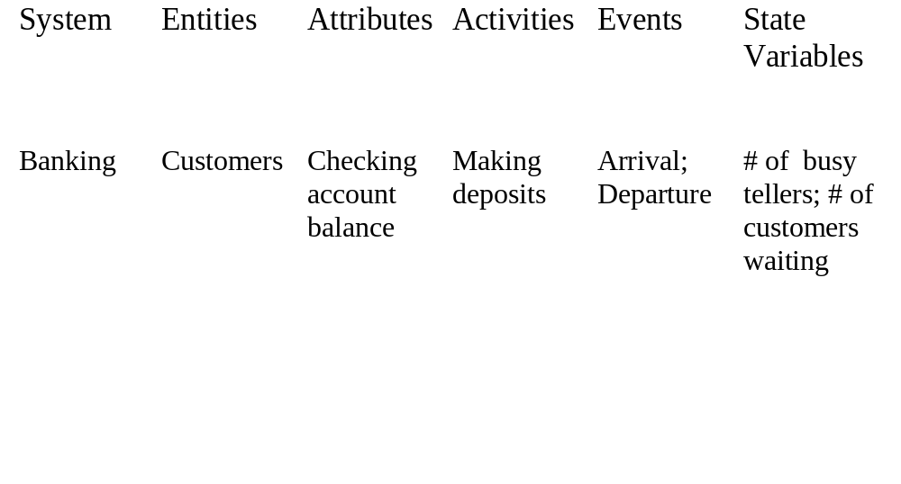
EXAMPLES OF SYSTEMS AND COMPONENTS
Note: State Variables may change continuously (continuous sys.)
over time or they may change only at a discrete set of points
(discrete sys.) in time.
Notes:
29

Slide 30
SIMULATION “WORLD-VIEWS”
Pure Continuous Simulation
Pure Discrete Simulation
  Event-oriented
  Activity-oriented
  Process-oriented
Combined Discrete / Continuous Simulation
Notes:
31

Slide 31
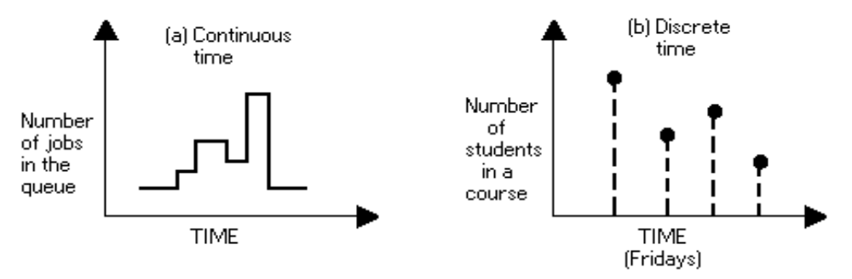
Examples Of Both Type Models
Continuous Time and Discrete Time Models:
CPU scheduling model vs. number of students attending the class.
Notes:
32

Slide 32
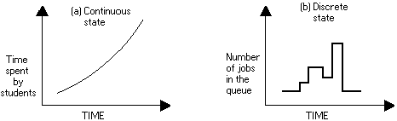
Examples (continued)
Continuous State and Discrete State Models:
Example: Time spent by students in a weekly class vs. Number of jobs in Q.
Notes:
33

Slide 33
Other Type Models
Deterministic and Probabilistic Models:
Output
Output
Input
Input
Static and Dynamic Models:
CPU scheduling model vs. E = mc²
Notes:
34

Slide 34
Stochastic vs. Deterministic
System
Model
1
Deterministic
Deterministic
3
2
Stochastic
Stochastic
4

Slide 35
MODEL THE APPROPRIATE LEVEL(S) OF DETAIL
Define the boundaries of the system to be modeled.
Some characteristics of “the environment” (outside the boundaries) may need to be included in the model.
Not all subsystems will require the same level of detail.
Control the tendency to model in great detail those elements of the system which are well understood, while skimming over other, less well - understood sections.
Notes:
36

Slide 36
START EARLY TO COLLECT THE NECESSARY INPUT DATA
Data comes in two quantities:
TOO MUCH!!
TOO LITTLE!!
With too much data, we need techniques for reducing it to a form usable in our model.
With too little data, we need information which can be represented by statistical distributions.
Notes:
37

Slide 37
PROVIDE ADEQUATE AND ON-GOING DOCUMENTATION
In general, programmers hate to document. (They love to program!)
Documentation is always their lowest priority item. (Usually scheduled for just after the budget runs out!)
They believe that “only wimps read manuals.”
What can we do?
  Use self-documenting languages
  Insist on built-in user instructions(help screens)
  Set (or insist on) standards for coding style
Notes:
38

Slide 38
DEVELOP PLAN FOR ADEQUATE MODEL VERIFICATION
Did we get the “right answers?”
(No such thing!!)
Simulation provides something that no other technique does:
Step by step tracing of the model execution.
This provides a very natural way of checking the internal consistency of the model.
Notes:
39

Slide 39
DEVELOP A PLAN FOR MODEL VALIDATION
VALIDATION: “Doing the right thing”
Or “Asking the right questions”
How do we know our model represents the
system under investigation?
  Compare to existing system?
  Deterministic Case?
Notes:
40

Slide 40
DEVELOP A PLAN FOR STATISTICAL OUTPUT ANALYSIS
How much is enough?
Long runs versus Replications
Techniques for Analysis
Notes:
41

