Slide 1

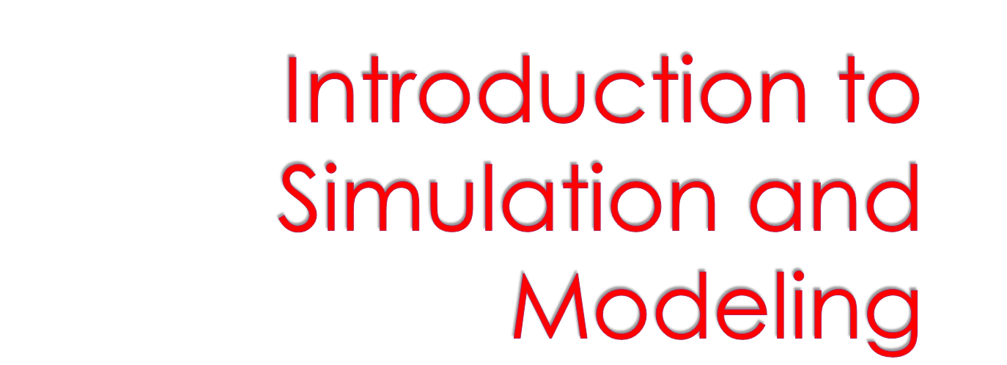


Slide 2

Definitions
  System, Model, Simulation
Computer Simulation
  why? how?
Example Applications

Slide 3

A system is a part of some potential reality where we are concerned with space-time effects and casual relationships among parts of the system
Defining a system requires setting boundaries
  separates system from rest of the universe
  makes the system a closed world

Slide 4
Examples:
  the energy flow among biological components in a pond
  the physical motion of balls rebounding
  inside a closed space
  customer service at a fast-food restaurant
  Federal Express

Slide 5

A model is something that we use in lieu of the real system in order to understand something about that system
A model of a system
is an abstraction of that system
Models give us comprehensible representations of systems
  something to think about
  something to communicate about

Slide 6
Models can have many forms
  mathematical equations
  diagrams
  physical mock-ups
Choice of form depends on the
purpose of the model
A model is a static representation
of the system

Slide 7

A simulation uses a model to emulate the dynamic characteristics of a system
A simulation is an execution of a model
The quality of a simulation is (obviously) only as good as the quality of the model

Slide 8

System: a cannonball in flight
Model: a tennis ball
Simulation: throw the tennis ball across the parking lot

Slide 9

Simulations are used instead of real systems for many reasons:
  cheaper
  more configurable and controllable
  safer
  faster (or slower)
  more accessible – easier to collect data

Slide 10

Computer simulation is ideal when a model can be expressed in terms of mathematics and logic (that’s what computers do)
Computer simulations can easily store information about all attributes of the model, throughout the simulation run

Slide 11

design
model
analyze and
validate
model
implement
simulation
execute
simulation

Slide 12


Slide 13

December 26, 2004
  tsunami-v.wmv
  tsunami-sphere.wmv
Source:
  http://www.wldelft.nl/gen/news/tsunami/

Slide 14

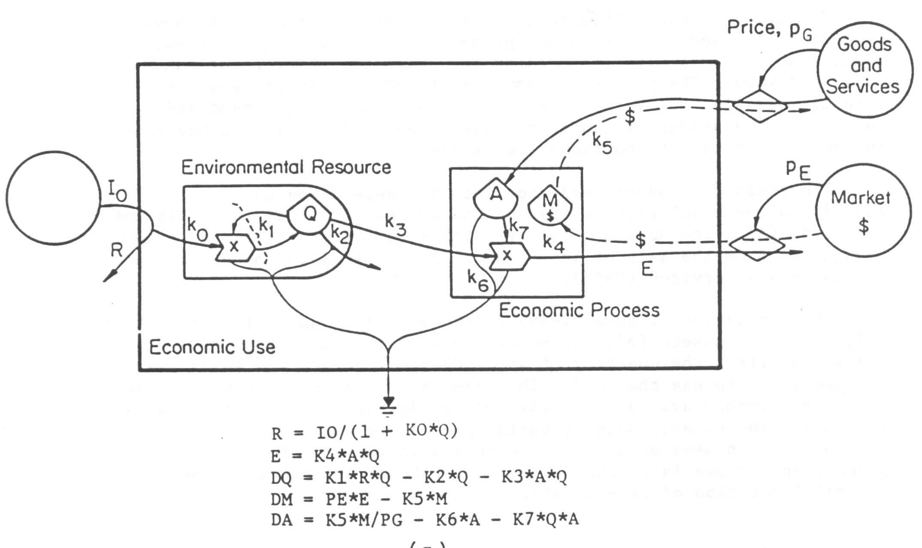
Howard Odum, Univ of Florida

Slide 15

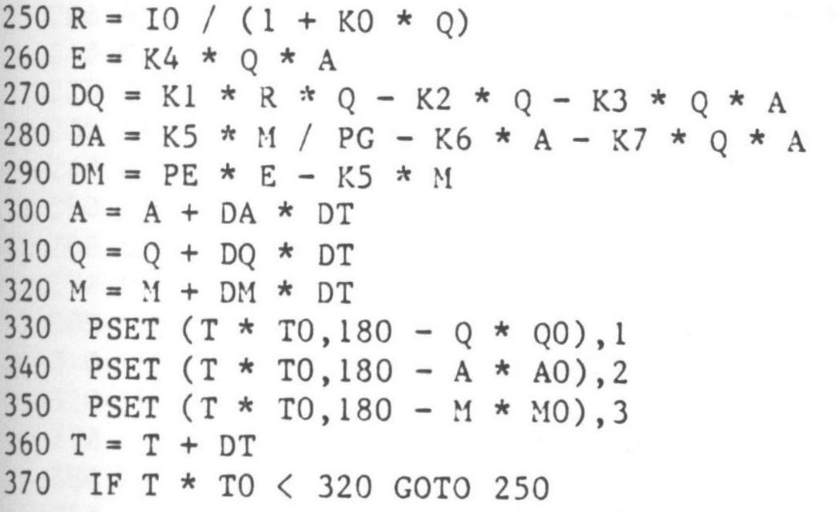
Howard Odum, Univ of Florida

Slide 16

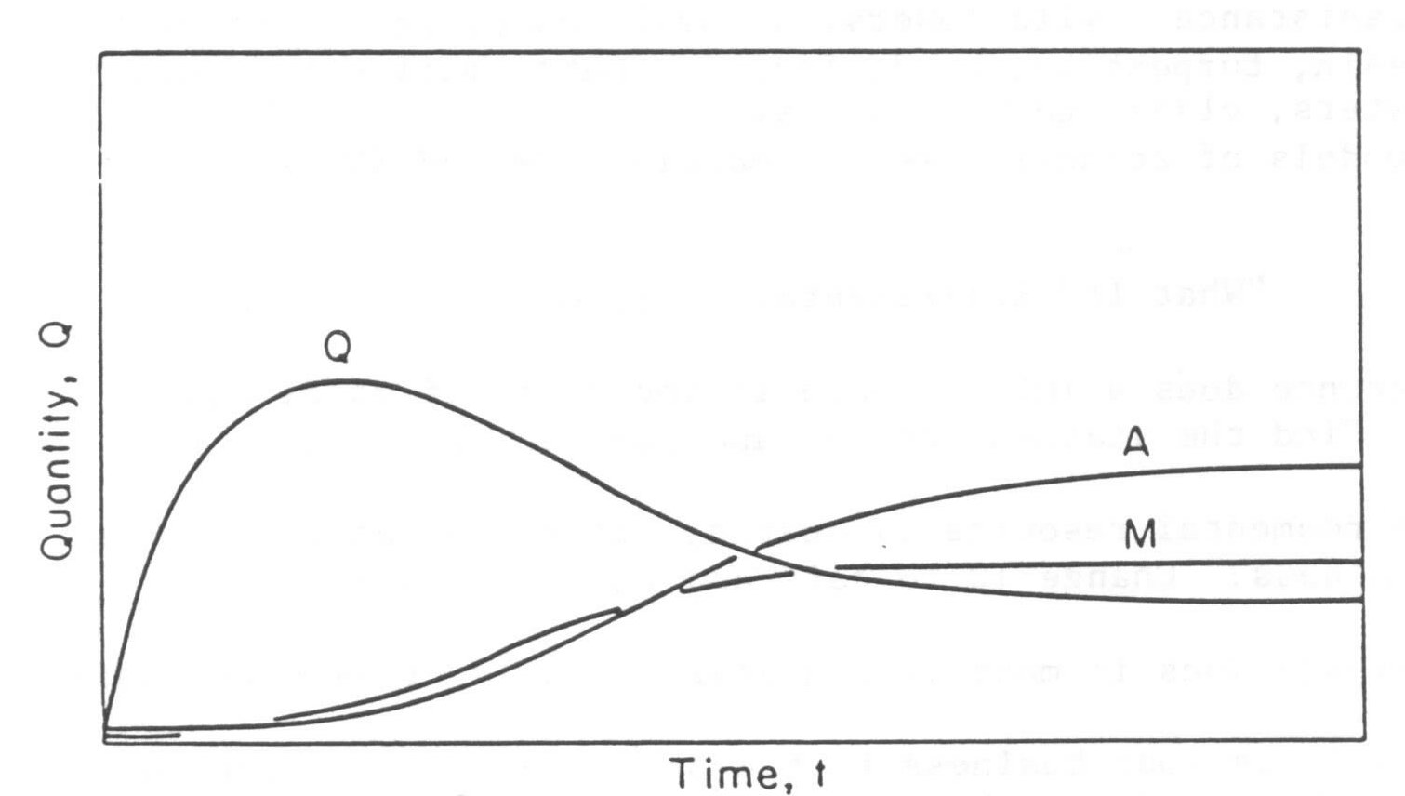
Howard Odum, Univ of Florida

Slide 17

We continued with a group discussion, comparing and contrasting Conway’s Game of Life with SimCity, in terms of underlying models and execution methods.

