Slide 1
Exponential Smoothing Models
Francy Camacho
Basado en Udacity
Notes:
https://classroom.udacity.com/courses/ud980/lessons/df9861e4-d359-4662-855f-97b81007efff/concepts/23592b4f-bd5f-45d2-ae3f-f9b44df17746

Slide 2

ETS = Error Trend Seasonality

Slide 3
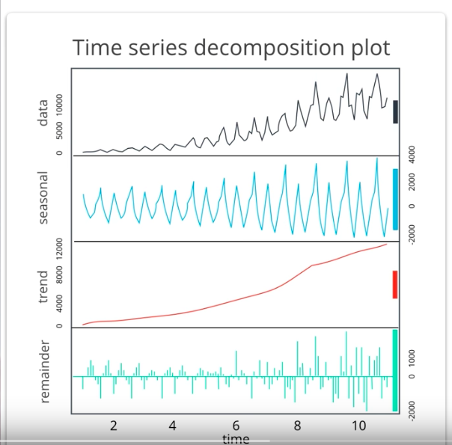
Decomposition plot

Slide 4
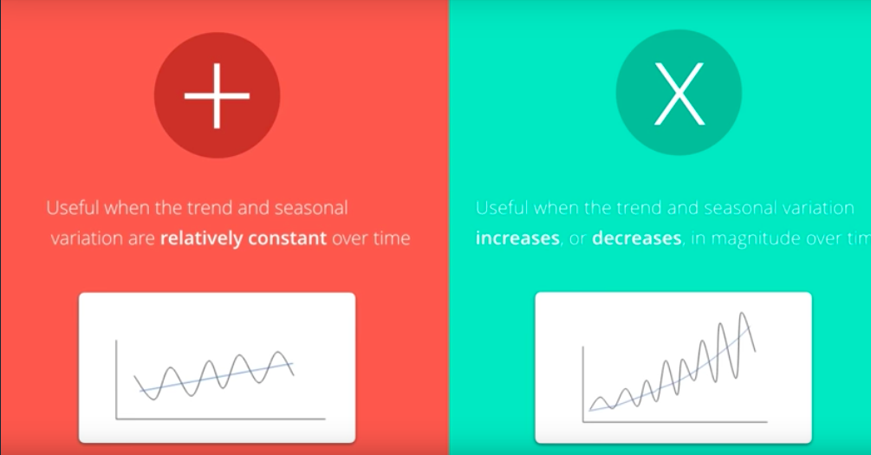
Additive or Multiplicative

Slide 5
Scenarios
No-Trend, No-Seasonal
No-Trend, Seasonal-Constant
No-Trend, Seasonal-Increasing
Trend-Linear, No-Seasonal
Trend-Linear, Seasonal-Constant
Trend-Linear,Seasonal-Increasing
Trend-Exponential,No-Seasonal
Trend-Exponential,Seasonal-Constant
Trend-Exponential,Seasonal-Increasing
Notes:
TS has a trend?If yes, is the trend increasing linearly or exponentially?
TS has seasonality?If yes, do the seasonal components increase in magnitude over time?

Slide 6
Scenario 1

Slide 7
Simple Exponential Smoothing
The formula looks like this:
Forecast = Weight_{t} Y_{t} + Weight_{t-1} Y_{t-1} + Weight_{t-2} Y_{t-2} + ... + (1-α)^{n} Y_{n}
where
t is the number of time periods before the most recent period (e.g. t = 0 for the most recent time period, t = 1 for the time period before that).
Y_{t} = actual value of the time series in period t
Weight_{t} = α(1-α)^{t}
n = the total number of time periods
Notes:
For simple exponential smoothing methods, the forecast is calculated by multiplying past values by relative weights, which are calculated based upon what is termed a smoothing parameter. You’ll also hear this called the alpha or α. This is the magnitude of the weight applied to the previous values, with the weights decreasing exponentially as the observations get older.

Slide 8
Simple Exponential Smoothing
Here are a few key points to help understand the smoothing parameter:
The smoothing parameter can be set for any value between 0 and 1.
If the smoothing parameter is close to one, more recent observations carry more weight or influence over the forecast (if α = 0.8, weights are 0.8, 0.16, 0.03, 0.01, etc.).
If the smoothing parameter is close to zero, the influence or weight of recent and older observations is more balanced (if α = 0.2, weights are 0.2, 0.16, 0.13, 0.10, etc.).
Notes:
This model basically gives us a smooth line or LEVEL in our forecast that we can use to forecast the next period.

Slide 9
Choosing the Smoothing Parameter α
Choosing the correct smoothing parameter is often an iterative process. Luckily, advanced statistical tools, will select the best smoothing parameter based upon minimizing forecasting error. Otherwise, you will need to test many smoothing parameters against each other to see which model best fits the data.
This makes the method suitable only for time series without trend and seasonality

Slide 10
Exercise
Use Single Family Home Sales.xlsx
Create a notebook
what is the forecast for December 1995
α = 0.8
α = 0.6
α = 0.2

Slide 11
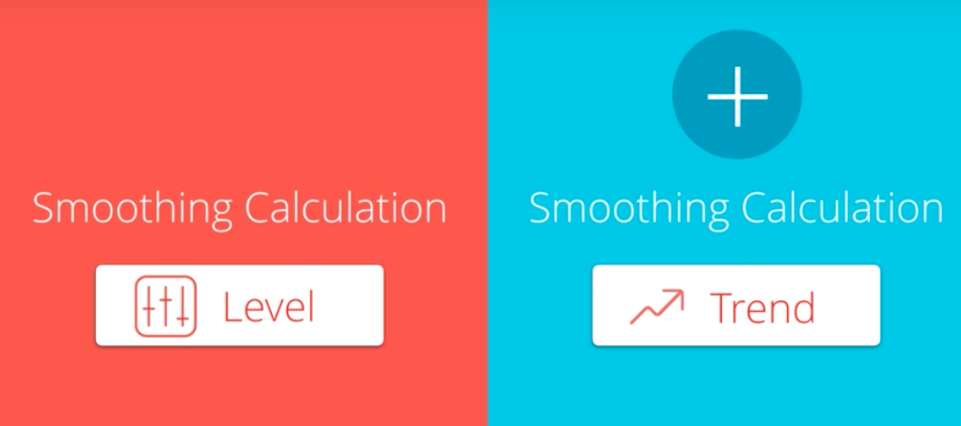
Holt's Linear Trend Method
Notes:
It’s a great model to apply to any non seasonal data set

Slide 12
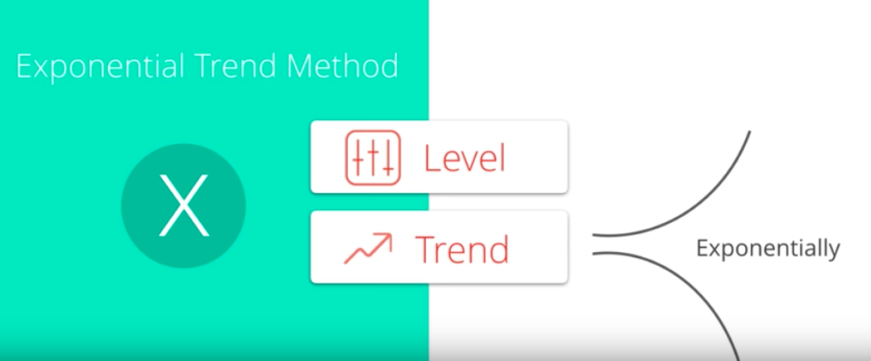
Exponential Trend Method

Slide 13

Damped Trend Methods
Implement a parameter that dampens the trend line in to a flat line
Phi parameter (small values assume the trend line change only very slowly over time)

Slide 14

Holt Winter Seasonal Method
Notes:
Damped parameter

Slide 15
Methods
Simple Exponential Smoothing
Finds the level of the time series
Holt's Linear Trend
Finds the level of the time series
Additive model for linear trend
Exponential Trend
Finds the level of the time series
Multiplicative model for exponential trend
Holt-Winters Seasonal
Finds the level of the time series
Additive for trend
Multiplicative and Additive for seasonal components

Slide 16
Summary
An ETS model has three main components: error, trend, and seasonality. Each can be applied either additively, multiplicatively, or not at all.
Trend - If the trend plot is linear then we apply it additively (A). If the trend line grows or shrinks exponentially, we apply it multiplicatively (M). If there is no clear trend, no trend component is included (N).

Slide 17
Summary
Seasonal - If the peaks and valleys for seasonality are constant over time, we apply it additively (A). If the size of the seasonal fluctuations tends to increase or decrease with the level of time series, we apply it multiplicatively (M). If there is no seasonality, it is not applied (N).
Error - If the error plot has constant variance over time (peaks and valleys are about the same size), we apply it additively (A). If the error plot is fluctuating between large and small errors over time, we apply it multiplicatively (M).

Slide 18
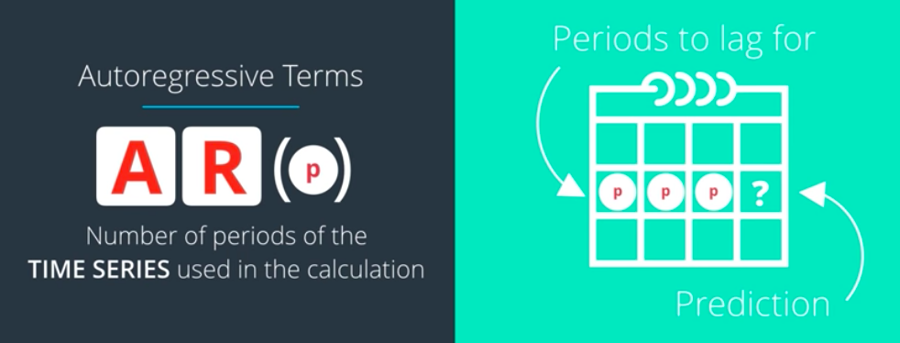
ARIMA (p, d, q)
AR = Autoregressive I = differencing MA = Moving Average
Notes:
Non seasonal

Slide 19
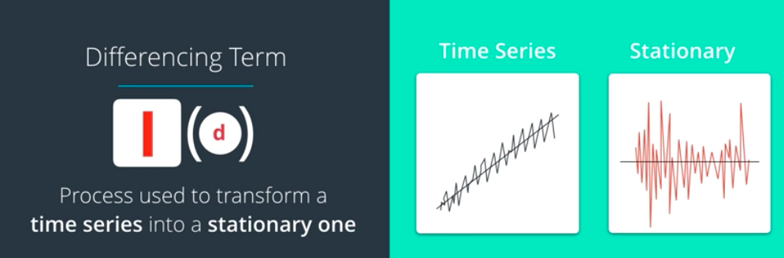
Differencing Term

Slide 20
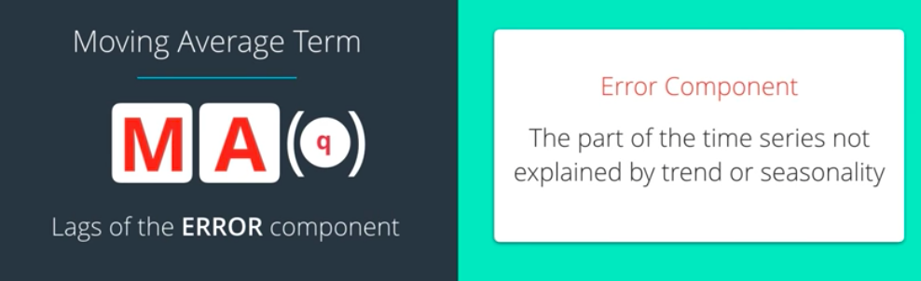
Moving Average Term

Slide 21
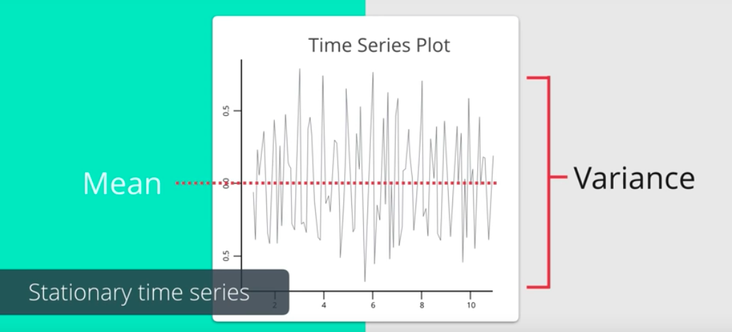
Stationary time series
Notes:
Understimate

Slide 22
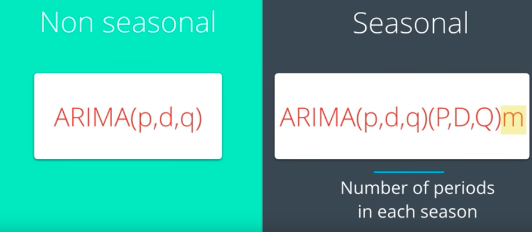
Seasonal ARIMA

