Slide 1
SIMULATION AND MONTE CARLO
Some General Principles
James C. Spall
Johns Hopkins University
Applied Physics Laboratory
August 2011

Slide 2
Overview
Basic principles
Advantages/disadvantages
Classification of simulation models
Role of sponsor and management in simulation study
Verification, validation, and accreditation
Pseudo random numbers and danger of replacing random variables by their means
Parallel and distributed computing
Example of Monte Carlo in computing integral
What course will/will not cover
Homework exercises
Selected references

Slide 3
Basics
System: The physical process of interest
Model: Mathematical representation of the system
  Models are a fundamental tool of science, engineering, business, etc.
  Abstraction of reality
  Models always have limits of credibility
Simulation: A type of model where the computer is used to imitate the behavior of the system
Monte Carlo simulation: Simulation that makes use of internally generated (pseudo) random numbers

Slide 4
Ways to Study System
System
Experiment w/ actual system
Experiment w/ model of system
Physical
Model
Mathematical
Model
Analytical
Model
Simulation
Model
Reference: Adapted from
Law (2007), Fig. 1.1
Focus of course

Slide 5
Some Advantages of Simulation
Often the only type of model possible for complex systems
  Analytical models frequently infeasible
Process of building simulation can clarify understanding of real system
  Sometimes more useful than actual application of final simulation
Allows for sensitivity analysis and optimization of real system without need to operate real system
Can maintain better control over experimental conditions than real system
Time compression/expansion: Can evaluate system on slower or faster time scale than real system

Slide 6
Some Disadvantages of Simulation
May be very expensive and time consuming to build simulation
Easy to misuse simulation by “stretching” it beyond the limits of credibility
  Problem especially apparent when using commercial simulation packages due to ease of use and lack of familiarity with underlying assumptions and restrictions
  Slick graphics, animation, tables, etc. may tempt user to assign unwarranted credibility to output
Monte Carlo simulation usually requires several (perhaps many) runs at given input values
  Contrast: analytical solution provides exact values

Slide 7
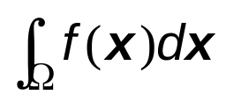
Classification of Simulation Models
Static vs. dynamic
  Static: E.g., Simulation solution to integral
  Dynamic: Systems that evolve over time; simulation of traffic system over morning or evening rush period
Deterministic vs. stochastic
  Deterministic: No randomness; solution of complex differential equation in aerodynamics
  Stochastic (Monte Carlo): Operations of grocery store with randomly modeled arrivals (customers) and purchases
Continuous vs. discrete
  Continuous: Differential equations; “smooth” motion of object
  Discrete: Events occur at discrete times; queuing networks (discrete-event dynamic systems is core subject of books such as Cassandras and Lafortune, 2008, Law, 2007, and Rubinstein and Melamed, 1998)

Slide 8
Practical Side: Role of Sponsor and Management in Designing/Executing Simulation Study
Project sponsor (and management) play critical role
  Simulation model and/or results of simulation study much more likely to be accepted if sponsor closely involved
Sponsor may reformulate objectives as study proceeds
  A great model for the wrong problem is not useful
Sponsor’s knowledge may contribute to validity of model
Important to have sponsor “sign off” on key assumptions
  Sponsor: “It’s a good model—I helped develop it.”

Slide 9
Verification, Validation, and Accreditation
Verification and validation are critical parts of practical implementation
Verification pertains to whether software correctly implements specified model
Validation pertains to whether the simulation model (perfectly coded) is acceptable representation
  Are the assumptions reasonable?
Accreditation is an official determination (U.S. DoD) that a simulation is acceptable for particular purpose(s)

Slide 10


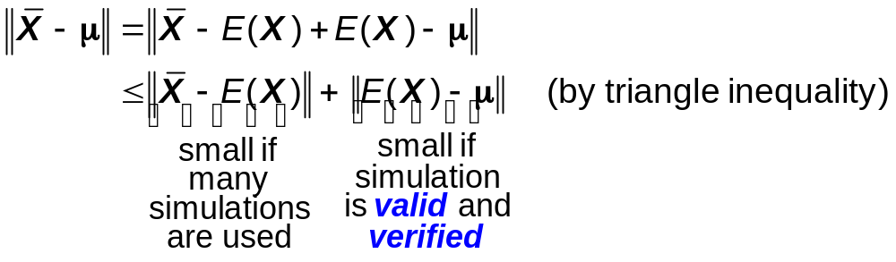
Relationship of Validation and Verification Error to Overall Estimation Error
Suppose analyst is using simulation to estimate (unknown) mean vector of some process, say μ
Simulation output is (say) X; X may be a vector
Let sample mean of several simulation runs be
  Value is an estimate of μ
Let be an appropriate norm (“size”) of a vector
Error in estimate of μ given by:

Slide 11
Pseudo Random Number Generators
Monte Carlo simulations usually based on computer generation of pseudo random numbers
Starting point is generation of sequence of independent, identically distributed uniform (U(0, 1)) random variables
  U(0, 1) random numbers of direct interest in some applications
  More commonly, U(0, 1) numbers transformed to random numbers having other distributions (e.g., Poisson distribution for arrivals in a network)
Computer-based random pseudo number generators produce deterministic and periodic sequence of numbers
  Discussed in Appendix D and Chapter 16 of Spall (2003)
Want pseudo random numbers that “look” random
  Able to pass all relevant statistical tests for randomness

Slide 12
Danger of Replacing Random Variables by Their Means
Suppose Monte Carlo simulation involves random process X
Common simplification is to replace X by its mean
  Makes simulation easier to implement and interpret
  Can work with constants instead of probability distributions
  No need to specify forms of distributions
  No need to generate random outcomes X (may be difficult for non-standard distributions; see, e.g, Appendix D and Chap. 16 of Spall, 2003)
  Easier output analysis as removes source of randomness
However, simplification can lead to seriously incorrect results
Example: Queuing system with random arrival/service times
  Replacing randomness with mean arrival rate and service times may lead to very different (wrong) estimates of average wait time and/or number of customers in queue

Slide 13
Parallel and Distributed Simulation
Simulation may be of little practical value if each run requires days or weeks
  Practical simulations may easily require processing of 10⁹ to 10¹² events, each event requiring many computations
Parallel and distributed (PAD) computation based on:
Execution of large simulation on multiple
processors connected through a network
PAD simulation is large activity for researchers and practitioners in parallel computation (e.g., Chap. 12 by Fujimoto in Banks, 1998; Law, 2007, pp. 61–66)
Distributed interactive simulation is closely related area; very popular in defense applications

Slide 14
Parallel and Distributed Simulation (cont’d)
Parallel computation sometimes allows for much faster execution
Two general roles for parallelization:
  Split supporting roles (random number generation, event coordination, statistical analysis, etc.)
  Decompose model into submodels (e.g., overall network into individual queues)
Need to be able to decouple computing tasks
Synchronization important—cause must precede effect!
  Decoupling of airports in interconnected air traffic network difficult; may be inappropriate for parallel processing
  Certain transaction processing systems (e.g., supermarket checkout, toll booths) easier for parallel processing

Slide 15
Parallel and Distributed Simulation (cont’d)
Hardware platforms for implementation vary
  Shared vs. distributed memory (all processors can directly access key variables vs. information is exchanged indirectly via “messages”)
  Local area network (LAN) or wide area network (WAN)
  Speed of light is limitation to rapid processing in WAN
Distributed interactive simulation (DIS) is one common implementation of PAD simulation
DIS very popular in defense applications
  Geographically disbursed analysts can interact as in combat situations (LAN or WAN is standard platform)
  Sufficiently important that training courses exist for DIS alone (e.g., www.simulation.com/Training)

Slide 16
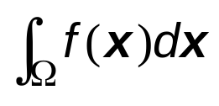
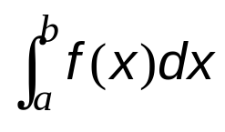
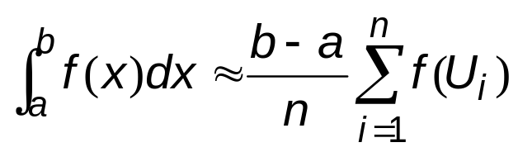
Example Use of Simulation:
Monte Carlo Integration
Common problem is estimation of where f is a function, x is vector and Ω is domain of integration
  Monte Carlo integration popular for complex f and/or Ω
Special case: Estimate for scalar x, and limits of integration a, b
One approach:
  Let p(u) denote uniform density function over [a, b]
  Let U_{i} denote i ^{th} uniform random variable generated by Monte Carlo according to the density p(u)
  Then, for “large” n:

Slide 17
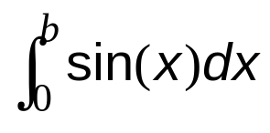
Numerical Example of Monte Carlo Integration
Suppose interested in
  Simple problem with known solution
Considerable variability in quality of solution for varying b
  Accuracy of numerical integration sensitive to integrand and domain of integration
Integral estimates for varying n
n = 20
n = 200
n = 2000
b = π
(ans.=2)
2.296
2.069
2.000
b = 2π
(ans.=0)
0.847
0.091
−0.0054

Slide 18
What Course Will and Will Not Cover
Emphasis is on general principles relevant to simulation
  At course end, students will have rich “toolbox,” but will need to bridge gap to specific application
Course will cover
  Fundamental mathematical techniques relevant to simulation
  Principles of stochastic (Monte Carlo) simulation
  Algorithms for model selection, random number generation, simulation-based optimization, sensitivity analysis, estimation, experimental design, etc.
Course will not cover
  Particular applications in detail
  Computer languages/packages relevant to simulation (GPSS, Flexsim, SLAM, SIMSCRIPT, Arena, Simulink, etc.)
  Software design; user interfaces; spreadsheet techniques; details of PAD computing; object-oriented simulation
  Architecture/interface issues (HLA, virtual reality, etc.)

Slide 19
Overall Simulation Study
Top line: building model; bottom line: using model
(Most relevant chapters/appendices from Spall, 2003, shown for selected blocks)
Appendix D;
Chaps. 16 & 17
Chaps. 13 & 17
Construct program;
verify
Collect data; define model
Yes
Model
valid?
Yes
Assumptions
OK?
No
No
Appendices B & C, etc.
Chaps. 14, 15, & 17
Data analysis
& reporting
Production runs
Design simulation experiments
Reference: Figure adapted from Law (2007, Fig. 1.46)

Slide 20
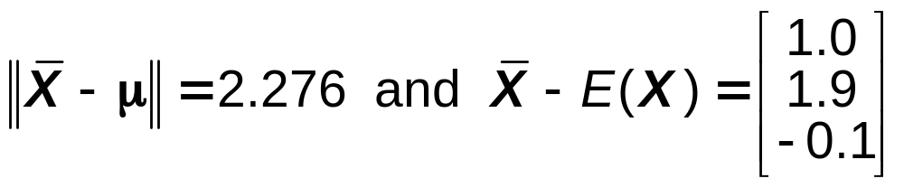


Homework Exercise 1
Suppose a simulation output vector X has 3 components. Suppose that
(a) Using the information above and the standard Euclidean (distance) norm, what is a (strictly positive) lower bound to the validation/verification error ?
(b) In addition, suppose μ = [1 0 1]^{T} and = [2.3 1.8 1.5]^{T} (superscript T denotes transpose). What is ? How does this compare with the lower bound in part (a)? (c) Comment on whether the simulation appears to be a “good” model.

Slide 21
Homework Exercise 2
A frequent (possibly misguided) simplification in modeling and simulation is to replace a random process by its mean value (see previous slide “Danger of Replacing Random Variables by Their Means”). To that end:
  Give an example where this simplification may lead to dramatically flawed results. Keep the description to less than one page (i.e., keep to one or two paragraphs). Show specific formulas and/or numbers to support your conclusions. This should be a different example than any shown in the course lecture.

Slide 22
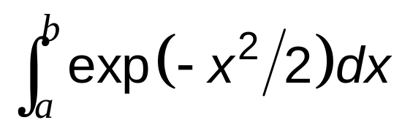
Homework Exercise 3
This problem uses the Monte Carlo integration technique (see previous slide “Example Use of Simulation: Monte Carlo Integration ”) to estimate
for varying a, b, and n. Specifically:
(a) To at least 3 post-decimal digits of accuracy, what is the true integral value when a = 0, b = 1? a = 0, b = 4?
(b) Using n = 20, 200, and 2000, estimate (via Monte Carlo) the integral for the two combinations of a and b in part (a).
(c) Comment on the relative accuracy of the two settings. Explain any significant differences.

Slide 23
Selected General References in
Simulation and Monte Carlo
Arsham, H. (1998), “Techniques for Monte Carlo Optimizing,” Monte Carlo Methods and Applications, vol. 4, pp. 181−229.
Banks, J. (ed.) (1998), Handbook of Simulation: Principles, Methodology, Advances, Applications, and Practice, Wiley, New York.
Cassandras, C. G. and Lafortune, S. (2008), Introduction to Discrete Event Systems (2nd ed.), Springer, New York.
Fu, M. C. (2002), “Optimization for Simulation: Theory vs. Practice” (with discussion by S. Andradóttir, P. Glynn, and J. P. Kelly), INFORMS Journal on Computing, vol. 14, pp. 192−227.
Fu, M. C. and Hu, J.-Q. (1997), Conditional Monte Carlo: Gradient Estimation and Optimization Applications, Kluwer, Boston.
Gosavi, A. (2003), Simulation-Based Optimization: Parametric Optimization Techniques and Reinforcement Learning, Kluwer, Boston.
Law, A. M. (2007), Simulation Modeling and Analysis (4th ed.), McGraw-Hill, New York.
Liu, J. S. (2001), Monte Carlo Strategies in Scientific Computing, Springer-Verlag, New York.
Robert, C. P. and Casella, G. (2004), Monte Carlo Statistical Methods (2nd ed.), Springer-Verlag, New York.
Rubinstein, R. Y. and Melamed, B. (1998), Modern Simulation and Modeling, Wiley, New York.
Rubinstein, R. Y. and Kroese, D. P. (2007), Simulation and the Monte Carlo Method (2nd ed.), Wiley, New York.
Spall, J. C. (2003), Introduction to Stochastic Search and Optimization, Wiley, Hoboken, NJ.

