Slide 1
Agile Software Development Methodologies
Gruppe 8
Bernhard Fleck
Rafael Konik
Stephan Matiasch
Harald Watzke

Slide 2
Topic Motivation, Problem statement
Agile Software Development
Light-weight Software Development Methodologies
  Not Heavy-Weight like e.g. Waterfall
Agile Manifesto
  Individuals and interactions over processes and tools
  Working software over comprehensive documentation
  Customer collaboration over contract negotiation
  Responding to change over following a plan
„Agile is an idea supported by a set of values and beliefs“

Slide 3
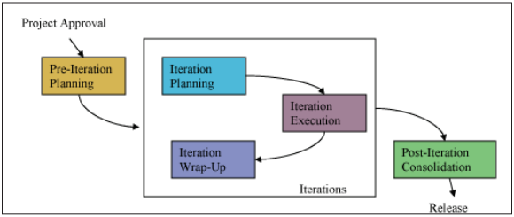
Technical Details
Quick definition of prototypes & requirements, code development, testing and verification per iteration
Iterative, incremental development
  One to three months increments
User Stories, Co-Location, Pair Programming, Unit testing, Test-Driven Development, …
  Two to eight people in one room
  Onsite usage experts offer continuous feedback
  Fully automated regression tests

Slide 4
Important Works/Systems/Researchers
Agile Manifesto
  Adjunct: Declaration of Interdependence
Important Systems, e.g.
  Scrum
  eXtreme Programming
  Crystal Methods
Manifesto Signatories
  Kent Beck, Mike Beedle, Arie van Bennekum, Alistair Cockburn, Ward Cunningham, Martin Fowler, James Grenning, Jim Highsmith, Andrew Hunt, Ron Jeffries, Jon Kern, Brian Marick, Robert C. Martin, Steve Mellor, Ken Schwaber, Jeff Sutherland, Dave Thomas,

Slide 5
Scrum Scrum Team
Product Owner
  Maximizes value of the product & work of the development team
  Manages the Product Backlog
Development Team
  Self-organizing, cross-functional
  Fewer than 3, more than 9 members problematic
Scrum Master
  Servant-leader
  Ensures Scrum Team adheres to Scrum theory, pratice, rules
  Supports interaction between Scrum Team and „Outside“

Slide 6
Scrum Scrum Events
Sprint – 1 Month or less
  Container for other events
  Ends with a releasable increment of „Done“
Sprint Planning Meeting – 8 hours/1 month Sprint
  Planning the work to be performed in a Sprint
Daily Scrum – 15 Minutes Daily
  Plan for the next 24 hours
Sprint Review – 4 hours/ 1 month Sprint
  Review work done this Sprint
  Inspect Increment, Adapt Product Backlog
Sprint Retrospective
  Sprint Team inspects itself
  Creates plan for improvements

Slide 7
Scrum Scrum Artifacts
Product Backlog
  List of all all features, functions, requirements, enhancements, fixes
  Attributes: Description, Order, Estimate
  Never complete, evolves
Sprint Backlog
  Set of Product Backlog items to be accomplished in a Sprint
  Plan for delivering product Increment and realizing Sprint Goal
Increment
  Sum of all Product Backlog items completed during a Sprint and all previous Sprints
  Must be „Done“ at the end of a Sprint

Slide 8
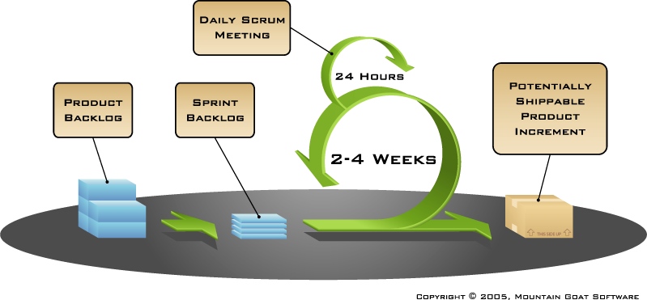
Scrum Lifecycle

Slide 9
Conclusion & Current research questions
Traditional Software Development Methodologies often not used in practice, too mechanistic to be used in detail
Agile is more light-weight, is …
  Incremental
  Cooperative
  Straightforward
  adaptive
Still relatively young, require more empirical studies to achieve higher acceptance, mostly case studies, anecdotic evidence currently
Possibly inefficient in larger organizations, but e.g. Microsoft has started using Agile methods

Slide 10
Q&A

Slide 11
References
http://www.serena.com/docs/repository/solutions/intro-to-agile-devel.pdf
http://agilemanifesto.org/
http://www.forbes.com/sites/stevedenning/2012/09/25/what-exactly-is-agile-is-kanban-agile/
http://infolific.com/technology/methodologies
http://alistair.cockburn.us/The+declaration+of+interdependence+for+modern+management+or+DOI
http://www.vtt.fi/inf/pdf/publications/2002/P478.pdf
Cockburn, A. (2002). Agile Software Development. Boston, Addison-Wesley
http://www.scrum.org/Portals/0/Documents/Scrum%20Guides/Scrum_Guide.pdf
http://steconomice.uoradea.ro/anale/volume/2009/v4-management-and-marketing/66.pdf

