Slide 1


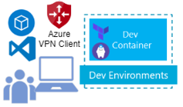


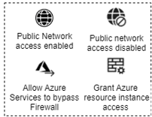

Public deployment
Azure Subscription
public azure ai resource group
Microsoft Entra ID Siemens Tenant
Acr Pull
Storage Blob Data Contributor Storage File Data Privileged Contributor
Container Registry
Storage
Key Vault Secrets Officer
Key Vault
Azure Machine Learning
Azure AI User
Open AI
Microsoft Foundry
Roles assigned
Legend
Azure DevOps
DevOps Pipeline
Artifacts
Git Repo
Resource Group
OpenAI
Virtual Network
Public IP Address
Azure DevOps
github
Machine Learning
EventHub
NIC Card
Foundry
DNS Forwarder
Private
endpoint
Databricks Cluster
Private DNS Zone
Azure Storage Account
App Services
Data Lake Store
Container Registry
Virtual Machine
Key Vault
Key Vault

Slide 2

Private deployment
Azure Subscription
public Azure AI resource group
Microsoft Entra ID Siemens Tenant
10.0.0.0/16
default
Subnet
Acr Pull
agent
Subnet
Container Registry 10.0.0.8
Container Registry
10.0.3.0/24
Storage Blob Data Contributor Storage File Data Privileged Contributor
DNS Delegation
Subnet
10.0.2.0/24
Blob 10.0.0.9
Storage
VPN Gateway
Key Vault Secrets Officer
10.0.1.0/24
Key Vault 10.0.0.7
Key Vault
VPN Gateway IP address
Azure Machine Learning 10.0.0.12
Azure Machine Learning
Azure AI User
Foundry 10.0.0.4
10.0.0.0/24
Microsoft Foundry
Open AI
Roles assigned
Legend
Azure DevOps
DevOps Pipeline
Artifacts
Git Repo
Resource Group
OpenAI
Virtual Network
Public IP Address
Azure DevOps
github
Machine Learning
EventHub
NIC Card
Foundry
DNS Forwarder
Private
endpoint
Databricks Cluster
Private DNS Zone
Azure Storage Account
App Services
Data Lake Store
Container Registry
Virtual Machine
Key Vault
Key Vault

