Slide 1
Automating Data Transformation with Python REST API using Azure Data Factory

Slide 2



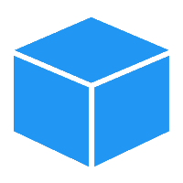




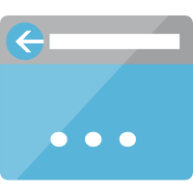




Azure Architecture
Azure Subscription
Azure Active Directory Tenant
Factory Resource group
factory-rest-api
Container
Registry
Storage Account
Web App
Data Factory
Service Plan
Azure
Legend
Container Image
Container Registry
App Service Plan
App Service
Storage Account
Data Factory

Slide 3
Subcription
LIST OF KEYS
LIST OF COLUMNS
COL
Last Name
City
KEY
123
652
545
Data Factory
Last Name | City | KEY
Lewis | London | 123
Carter | Rome | 652
Howard | Madrid | 545
First Name | Last Name | City | KEY
John | Lewis | London | 123
Jim | Baldwin | Lisbon | 234
Barbara | Carter | Rome | 652
Helen | Curtis | Berlin | 523
Matthew | Howard | Madrid | 545

Slide 4




Software Architecture
POST /pipelines/{pipeline_name}/run Body: RunRequest
Response: RunResponse
Azure Function
Azure App Service
Azure Container Instance
Azure Kubernetes Service
factory-rest-api
Data Factory
Library
POST /pipelines Body: PipelineRequest
Response: pipeline_name
GET /pipelines/{pipeline_name} Response: PipelineResponse
REFRESH_PERIOD
GET /pipelines/{pipeline_name}/run/{run_id} Response: RunResponse

