Slide 1
mini-services Architectures Authentication/Authorization Storage/Database File format/Data models REST API Dubcredit import Experience Dubcard export Experience

Slide 2













Architecture for mini-services Frontend web pages on Azure Storage + Files on Azure Storage
Azure Subscription
Resource group
Internet
Azure Active Directory Tenant
fe-ts-web-app (HTML, Javascripts, CSS files)
Public
IP
Address
Storage Account
todo files
Azure
Legend
todo files
Container Registry
App Service Plan
Azure
Function
Storage
Account
Container Image
App Service

Slide 3

Minimal Architecture for the Web UI Azure App Service + Azure Function + Azure Storage (Tables + Files)+ Container Registry
Azure Subscription
Resource group
Internet
Azure Active Directory Tenant
be-dotnet-rest-api
Container
Registry
Service Plan
fe-ts-web-app
Public
IP
Address
fe-ts-web-app
be-dotnet-rest-api
todo Tables
Web App
Azure Function
Storage Account
todo files
Azure
Legend
todo files
Container Registry
App Service Plan
Azure
Function
Storage
Account
Container Image
App Service

Slide 4

Minimal Architecture for the Web UI Azure App Service + Azure Function + Azure Storage + Container Registry + CosmosDB
Azure Subscription
Resource group
Internet
Azure Active Directory Tenant
be-dotnet-rest-api
Container
Registry
Service Plan
fe-ts-web-app
todo Tables
Cosmos DB
Public
IP
Address
fe-ts-web-app
be-dotnet-rest-api
Web App
Azure Function
Storage Account
todo files
Azure
Legend
todo files
Container Registry
App Service Plan
Azure
Function
Storage
Account
Container Image
App Service

Slide 5

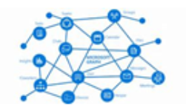
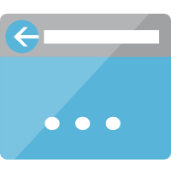
Authentication Architecture
Azure Subscription
1
1
2
Frontend Resource group
Azure Active Directory Tenant
User
4
Azure Active Directory
5
1
User signing in, the web application receives an authorization code
Azure App Service
Hosting Web UI
2
Acquire token for Storage Account access
3
Upload/download file from Storage Account
3
Azure Function
4
Acquire token for Azure Function Web API access
Storage Account
5
Call Web API
Microsoft Graph
Azure
Legend
Container Image
Container Registry
App Service Plan
App Service
Storage Account
Azure Function

Slide 6
Files Storage + Tables
Files on Storage Account
Tables on Storage Account
Those tables can be either stored on Azure Storage Account (Dev, Test) or Cosmos DB (Prod).
todo files container
A container is created for - todo files
For each container a specific RBAC defines the access rules
todo table
Tables on CosmosDB
todo table

