Slide 1
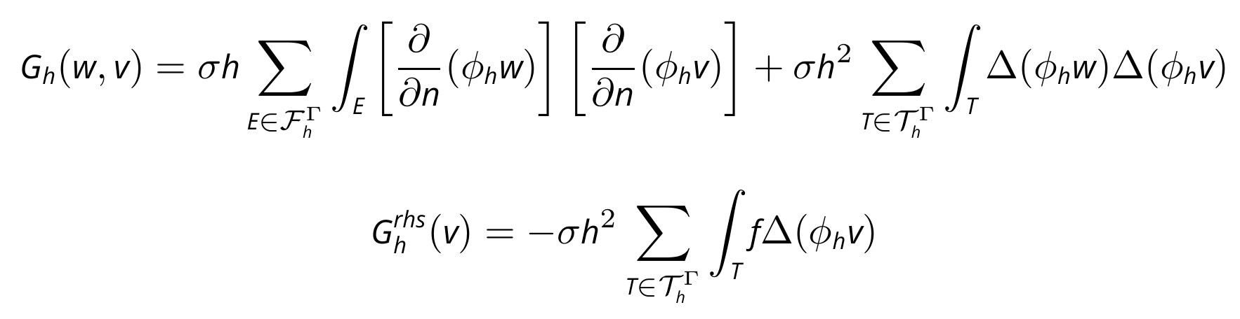
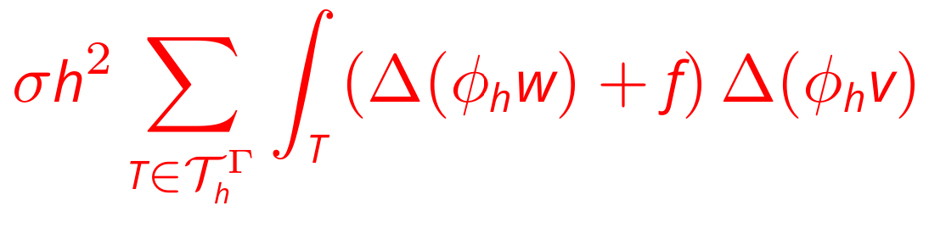
Independent parameter of h
Jump on the interface E
-
1st order term
2nd order term

