Slide 1
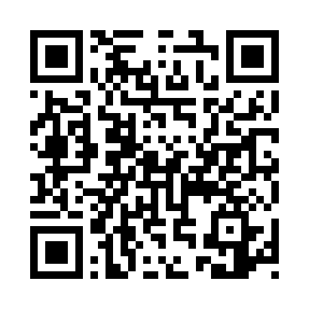
Pause Before the Next Patient
A prototype post-call wellbeing and reflection intervention for ambulance clinicians
The concept
A brief, optional check-in after a challenging or emotionally significant call.
Accessed at the point where the EPR is completed and submitted.
Designed to help clinicians recognise their own response, reset, reflect and identify support before the next patient.
Prototype QR code
(temporary link)

Slide 2
Mock EPR prompt
Illustrative only — not an actual Trust EPR interface
EPR SUBMITTED
Before your next patient…
Was this job difficult, stressful or emotionally challenging for you?
I'm okay
I need a moment
I need support

Slide 3
1. Check in
A 30-second self-awareness check
How are you feeling following that job?
🙂 I'm okay
😐 A little unsettled
😟 Quite affected
😣 Very distressed
You don't need to explain or record anything. This is a private moment to notice how you are.

Slide 4
2. Reset
Take 60–90 seconds before moving on
STOP
Give yourself a moment.
BREATHE
Take 3 slow breaths. Let your shoulders drop.
NOTICE
What am I feeling? Where am I holding tension?
RESET
Unclench your jaw. Ground your feet. Take a drink if available.

Slide 5
3. Reflect
A brief reflection informed by the consultation/self-reflection process
What went well?
What did I find difficult?
Is there anything I would do differently?
Is there anything I need to discuss with my crewmate or colleague?
What do I need to take forward — and what can I leave with this job?

Slide 6
4. Prepare
What do I need before the next patient?
A drink of water
A toilet break
A minute of quiet
A conversation with my crewmate
A quick team/clinical discussion
Nothing — I'm ready

Slide 7
5. Ready for the next patient?
The aim is awareness, not a pass/fail test.
🟢 YES — I'm ready to continue
🟠 I'M ABLE TO CONTINUE — but I'll monitor how I'm feeling
🔴 NO — I need to speak to someone before continuing

Slide 8
If you need support
The resource should connect clinicians to the support routes available within their own service.
Talk to your crewmate or another trusted colleague.
Speak to your team leader / clinical supervisor where appropriate.
Use your Trust's wellbeing, occupational health or employee support services.
If you are concerned about your ability to continue safely, raise this through the appropriate operational/clinical pathway.
Prototype note: replace this slide with the approved local support pathways before any real-world use.

Slide 9
How this could become a QI project
Initial PDSA concept
PLAN
Identify whether clinicians feel they have sufficient opportunity to reflect and reset after challenging jobs. Co-design a brief resource.
DO
Pilot with a small group. Embed access at EPR completion / provide QR access.
STUDY
Measure confidence in recognising stress, ability to transition to the next patient, awareness of support and perceived usefulness.
ACT
Refine the resource based on staff feedback and consider whether/how it could be incorporated into practice.

Slide 10
Next steps
What to do once your mentor confirms the project
1. Agree the scope and QI question.
2. Check local Trust policies, governance and information/data requirements.
3. Find the appropriate evidence base for staff wellbeing, reflection and transition after challenging clinical encounters.
4. Identify approved local support pathways.
5. Co-design the wording with ambulance clinicians.
6. Pilot, collect feedback, and refine.

