Slide 1
The Effect of Perceived Quality and
Satisfaction on Hospital Rating
Jae Yong (Francisco) Lee
Notes:
Good afternoon!
My name is Francisco and I am pleased to present to you my analysis on the effect of perceived quality and satisfaction on Hospital Rating.

Slide 2

Hospital Quality?
Notes:
There is complexity in evaluating the efficacy of a health care system due to a combination of scientific, technological, economic, and epidemiological imperatives. As such, the common proxy for quality of hospital care is the patients’ ratings of their hospital [2]. The perceived quality and satisfaction of patients is of particular importance as it can be a salient indicator used to draw detailed contextual descriptions of hospital’s different components to identify patterns that may have an impact on other outcomes of a health care system
metric : recall on True instances, accuracy

Slide 3
Data Preparation

Slide 4
Attributes | Type
Hospital Overall Rating | Nominal
Provider ID | Quantitative
Hospital Name | Nominal
Address | Nominal
City | Nominal
State | Nominal
ZIP Code | Nominal
County Name | Nominal
Phone Number | Quantitative
Hospital Type | Nominal
Hospital Ownership | Nominal
Attributes | Type
Emergency Services | Nominal
Meets EHR criteria | Nominal
Mortality | Nominal
Safety of care | Nominal
Readmission | Nominal
Patient experience | Nominal
Effectiveness of care | Nominal
Timeliness of care | Nominal
Efficient use of imaging | Nominal

Slide 5
Eliminate attributes
Provider ID
Hospital Name
…
Footnote attributes
Attributes | Kruskal-Wallis chi-squared | df | P-value
h_mortality | 136.15 | 2 | < 2.2e-16
h_soc | 453.12 | 2 | < 2.2e-16
h_ra | 673.62 | 2 | < 2.2e-16
h_pex | 719.14 | 2 | < 2.2e-16
h_eoc | 79.619 | 2 | < 2.2e-16
h_toc | 173.25 | 2 | < 2.2e-16
h_imaging | 11.624 | 2 | 0.002992
h_ownership | 69.485 | 8 | 6.222e-12
h_es | 0.053771 | 1 | 0.8166
Chi-squared Test
Emergency Services

Slide 6
Imbalanced Class
Class balancing
Notes:
ClassBalancing
SMOTE or ROSE could have been chosen; however, the low true instances required that the weighting be changed.

Slide 7
No missing values
Remove outliers

Slide 8
Predictive Modeling/Classification

Slide 9
Patient Experience
< National Average
>= National Average
Safety of Care
HHQ
Decision Tree
< National Average
>= National Average
Readmission
HHQ
< National Average
>= National Average
LHQ
HHQ
Notes:
Patient Experience
Safety of Care
Readmission
BinarySplit was used

Slide 10
Naive Bayes
Not suitable
Limitations
Treatment
Discretize numeric variables
Probability Density Function
Loss of Information
Notes:
Naïve Bayes was not suitable because of the absence of numerical attributes of the dataset.

Slide 11
Final Model Summary
Odds Ratios...
Class
Variable HHQ
===================================================
h_mortality=Same as the national average 0.7994
h_mortality=Above the national average 12.4041
h_mortality=Below the national average 0.0362
h_soc=Above the national average 7.7909
h_soc=Same as the national average 0.7639
h_soc=Below the national average 0.08
h_ra=Above the national average 9.052
h_ra=Below the national average 0.0626
h_ra=Same as the national average 0.9357
h_pex=Above the national average 7.7946
h_pex=Same as the national average 0.6781
h_pex=Below the national average 0.1414
h_toc=Below the national average 0.7872
h_toc=Same as the national average 0.9767
h_toc=Above the national average 1.3474
Logistic Regression
Mortality
↑ probability of HHQ
More Satisfaction, Readmission, and Patient Experience
↑ probability of HHQ
Notes:
Having mortality rate above the national average increases the probability of HHQ
This indicates that the hospital is capable of treating terminal patients.
More satisfaction, readmission and patient experience increases probability of HHQ
log(prob of churn)
Positively related

Slide 12
Post-Prediction Analysis

Slide 13
K = 3
K-Means Clustering
2 3 4 5 6 7
Number of Clusters
Notes:
The number of cluster at 3 offered the highest information gain.
Although the within cluster sum of squared errors decreased at the 7th cluster, the explanation of cluster suffers and does not translate to actionable items.

Slide 14
Hospitals with Tertiary Care Capacity
↑ Mortality
Hospitals with Patient Relations
↑ Satisfaction of Care
Hospitals with Patient Management
↑ Readmission
Notes:
Based on post-predictive analysis, I’ve identified three segments.

Slide 15
Conclusions and Recommendations

Slide 16
 | Accuracy | Precision (True) | Recall (True) | ROC Area
Decision Tree | 87.49% | 84.4% | 91.8% | 0.911
Logistic Regression (on full dataset with classification threshold = 0.5) | 86.89% | 85.6% | 88.5% | 0.943
Logistic Regression (on further eliminated dataset) | 87.85% | 85.3% | 91.5% | 0.944
Logistic Regression (on further eliminated dataset)
Notes:
Further eliminated Dataset based on the previous
Prediction = attributes of hospitals that will be high quality
Post prediction = attributes of hospitals that are high quality.

Slide 17
Tertiary Care Capacity | Patient Relations | Patient Management
● Problems on pooling | ● Satisfaction | ● Communication
→ Technical Analysis
→ Surveys
→ Loyalty Plans
→ Audit current
patient plan
Notes:
Tertiary Care Capacity
All the patients are pooling

Slide 18
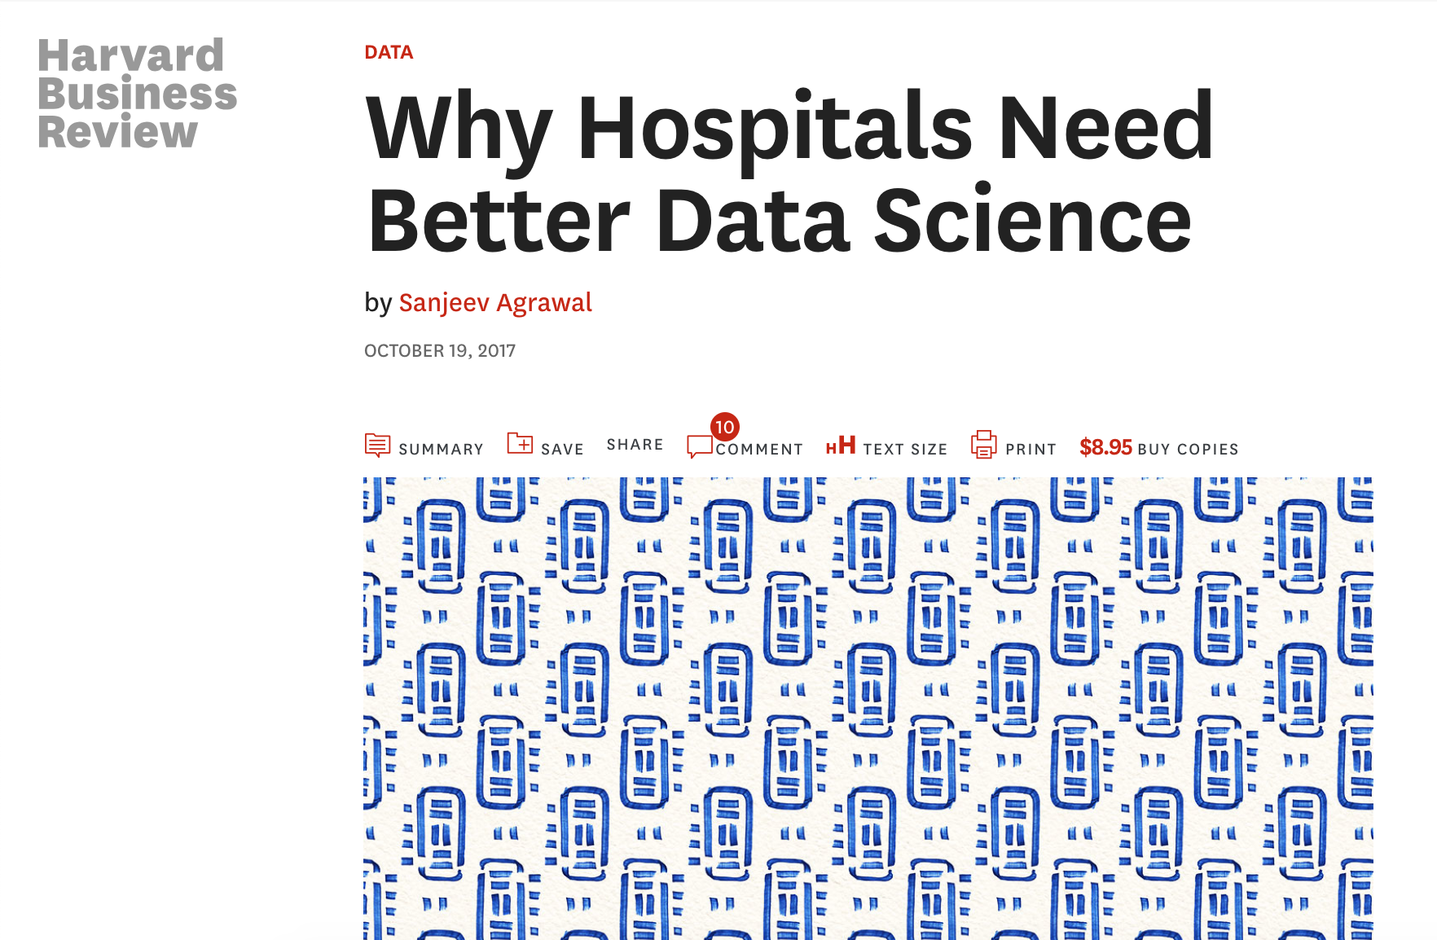
Importance of Hospital Overall Quality Prediction Model
Notes:
But ultimately, when used correctly, analytics tools can lower health care costs, reduce wait times, increase patient access, and unlock capacity with the infrastructure that’s already in place.
- Increasing OR utilization
- Slashing infusion center wait times
- Streamlining ED operations
- ED to inpatient-bed transfer
Accelerated discharge planning

Slide 19
Questions?

